Slide 1



Practical and Reliable Retrieval Evaluation
Through Online Experimentation
WSDM Workshop on Web Search Click Data
February 12th, 2012
Yisong Yue
Carnegie Mellon University

Slide 2
Offline Post-hoc Analysis
Launch some ranking function on live traffic
  Collect usage data (clicks)
  Often beyond our control

Slide 3
Offline Post-hoc Analysis
Launch some ranking function on live traffic
  Collect usage data (clicks)
  Often beyond our control
Do something with the data
  User modeling, learning to rank, etc

Slide 4
Offline Post-hoc Analysis
Launch some ranking function on live traffic
  Collect usage data (clicks)
  Often beyond our control
Do something with the data
  User modeling, learning to rank, etc
Did we improve anything?
  Often only evaluated on pre-collected data

Slide 5
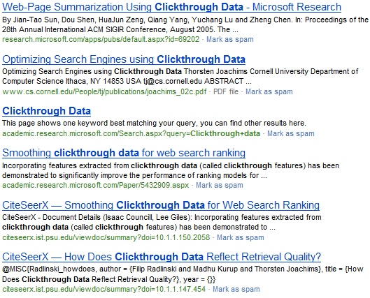
Evaluating via Click Logs
Suppose our model
swaps results 1 and 6
Did retrieval quality
improve?
Click

Slide 6
What Results do Users View/Click?
[Joachims et al. 2005, 2007]

Slide 7
Online Evaluation
Try out new ranking function on real users
Collect usage data
Interpret usage data
Conclude whether or not quality has improved

Slide 8
Challenges
Establishing live system
Getting real users
Needs to be practical
  Evaluation shouldn’t take too long
  I.e., a sensitive experiment
Needs to be reliable
  Feedback needs to be properly interpretable
  Not too systematically biased

Slide 9
Challenges
Establishing live system
Getting real users
Needs to be practical
  Evaluation shouldn’t take too long
  I.e., a sensitive experiment
Needs to be reliable
  Feedback needs to be properly interpretable
  Not too systematically biased
Interleaving Experiments!

Slide 10
Team Draft Interleaving
Ranking A
Napa Valley – The authority for lodging...
www.napavalley.com
Napa Valley Wineries - Plan your wine...
www.napavalley.com/wineries
Napa Valley College
www.napavalley.edu/homex.asp
4. Been There | Tips | Napa Valley
www.ivebeenthere.co.uk/tips/16681
5. Napa Valley Wineries and Wine
www.napavintners.com
6. Napa Country, California – Wikipedia
en.wikipedia.org/wiki/Napa_Valley
Ranking B
1. Napa Country, California – Wikipedia
en.wikipedia.org/wiki/Napa_Valley
2. Napa Valley – The authority for lodging...
www.napavalley.com
3. Napa: The Story of an American Eden...
books.google.co.uk/books?isbn=...
4. Napa Valley Hotels – Bed and Breakfast...
www.napalinks.com
5. NapaValley.org
www.napavalley.org
6. The Napa Valley Marathon
www.napavalleymarathon.org
Presented Ranking
Napa Valley – The authority for lodging...
www.napavalley.com
2. Napa Country, California – Wikipedia
en.wikipedia.org/wiki/Napa_Valley
3. Napa: The Story of an American Eden...
books.google.co.uk/books?isbn=...
Napa Valley Wineries – Plan your wine...
www.napavalley.com/wineries
5. Napa Valley Hotels – Bed and Breakfast...
www.napalinks.com
Napa Balley College
www.napavalley.edu/homex.asp
7 NapaValley.org
www.napavalley.org
A
B
[Radlinski et al., 2008]

Slide 11
Team Draft Interleaving
Ranking A
Napa Valley – The authority for lodging...
www.napavalley.com
Napa Valley Wineries - Plan your wine...
www.napavalley.com/wineries
Napa Valley College
www.napavalley.edu/homex.asp
4. Been There | Tips | Napa Valley
www.ivebeenthere.co.uk/tips/16681
5. Napa Valley Wineries and Wine
www.napavintners.com
6. Napa Country, California – Wikipedia
en.wikipedia.org/wiki/Napa_Valley
Ranking B
1. Napa Country, California – Wikipedia
en.wikipedia.org/wiki/Napa_Valley
2. Napa Valley – The authority for lodging...
www.napavalley.com
3. Napa: The Story of an American Eden...
books.google.co.uk/books?isbn=...
4. Napa Valley Hotels – Bed and Breakfast...
www.napalinks.com
5. NapaValley.org
www.napavalley.org
6. The Napa Valley Marathon
www.napavalleymarathon.org
Presented Ranking
Napa Valley – The authority for lodging...
www.napavalley.com
2. Napa Country, California – Wikipedia
en.wikipedia.org/wiki/Napa_Valley
3. Napa: The Story of an American Eden...
books.google.co.uk/books?isbn=...
Napa Valley Wineries – Plan your wine...
www.napavalley.com/wineries
5. Napa Valley Hotels – Bed and Breakfast...
www.napalinks.com
Napa Balley College
www.napavalley.edu/homex.asp
7 NapaValley.org
www.napavalley.org
Click
Tie!
Click
[Radlinski et al., 2008]

Slide 12
Simple Example
Two users, Alice & Bob
  Alice clicks a lot,
  Bob clicks very little,
Two retrieval functions, r₁ & r₂
  r₁ > r₂
Two ways of evaluating:
  Run r₁ & r₂ independently, measure absolute metrics
  Interleave r₁ & r₂, measure pairwise preference

Slide 13
Simple Example
Two users, Alice & Bob
  Alice clicks a lot,
  Bob clicks very little,
Two retrieval functions, r₁ & r₂
  r₁ > r₂
Two ways of evaluating:
  Run r₁ & r₂ independently, measure absolute metrics
  Interleave r₁ & r₂, measure pairwise preference
Absolute metrics:
  Higher chance of falsely
  concluding that r₂ > r₁
Interleaving:
User | Ret Func | #clicks
Alice | r₂ | 5
Bob | r₁ | 1
User | #clicks on r₁ | #clicks on r₂
Alice | 4 | 1
Bob | 1 | 0

Slide 14
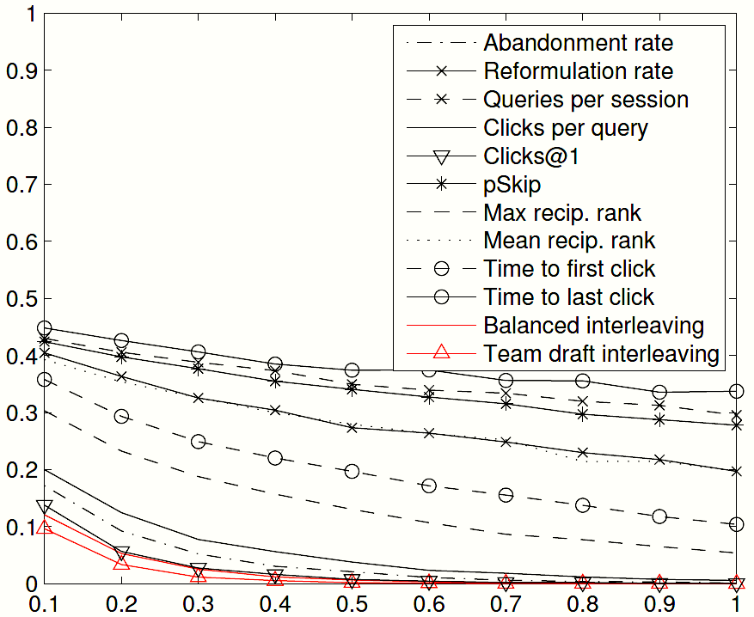
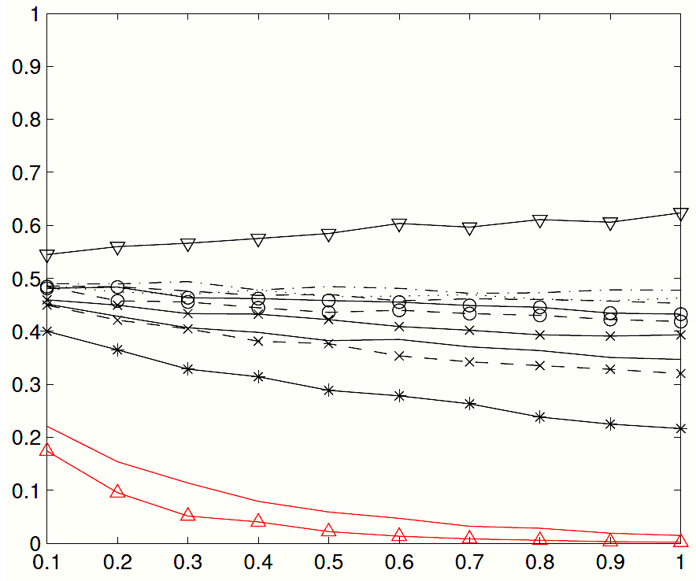
Comparison with Absolute Metrics (Online)
ArXiv.org Pair 1
ArXiv.org Pair 2
p-value
Disagreement Probability
Query set size
Clicks@1 diverges in
preference estimate
Experiments on arXiv.org
About 1000 queries per experiment
Interleaving is more sensitive and more reliable
Interleaving achieves
significance faster
  [Radlinski et al. 2008; Chapelle et al., 2012]

Slide 15
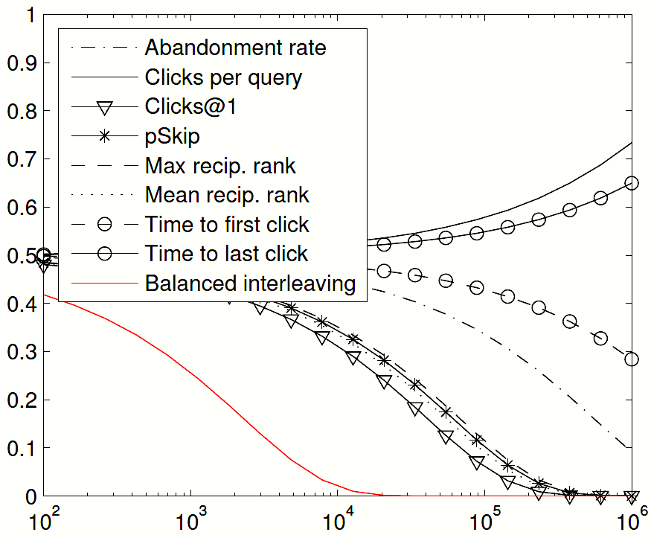
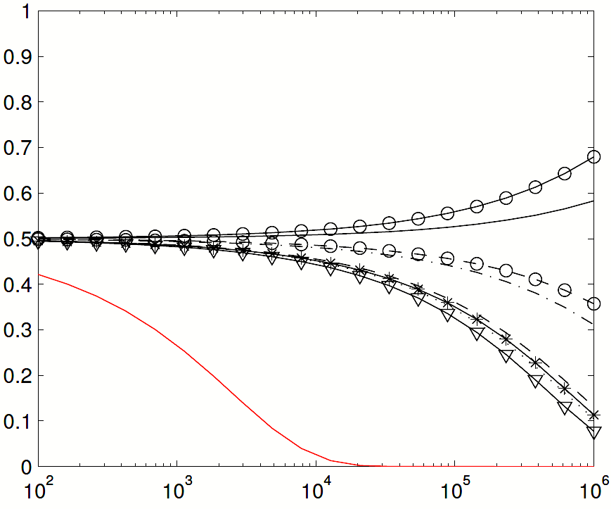
Comparison with Absolute Metrics (Online)
Yahoo! Pair 1
Yahoo! Pair 2
p-value
Disagreement Probability
Query set size
Experiments on Yahoo! (smaller differences in quality)
Large scale experiment
Interleaving is sensitive and more reliable (~7K queries for significance)
  [Radlinski et al. 2008; Chapelle et al., 2012]

Slide 16
Benefits & Drawbacks of Interleaving
Benefits
  A more direct way to elicit user preferences
  A more direct way to perform retrieval evaluation
  Deals with issues of position bias and calibration
Drawbacks
  Can only elicit pairwise ranking-level preferences
  Unclear how to interpret at document-level
  Unclear how to derive user model

Slide 17
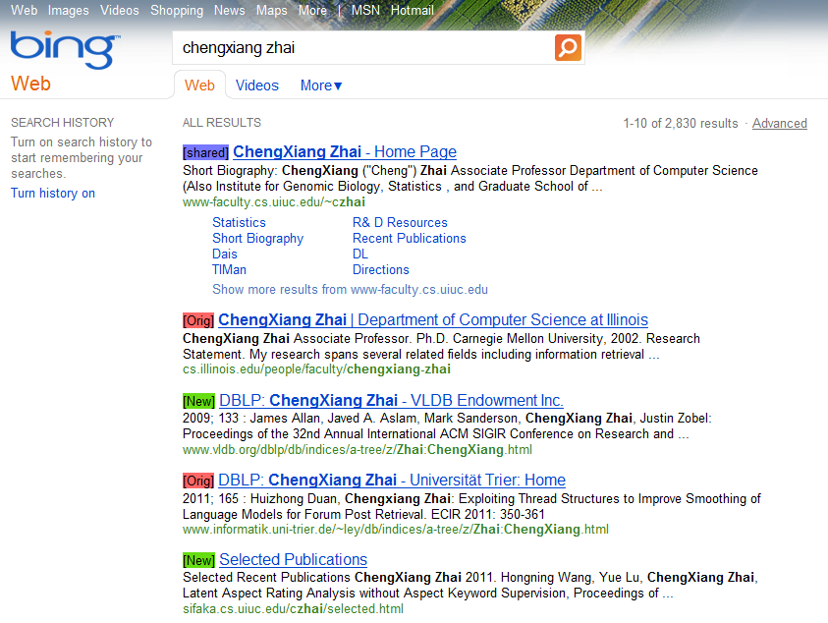
Demo!
http://www.yisongyue.com/downloads/sigir_tutorial_demo_scripts.tar.gz

Slide 18
Story So Far
Interleaving is an efficient and consistent online experiment framework.
How can we improve interleaving experiments?
How do we efficiently schedule multiple interleaving experiments?

Slide 19
Not All Clicks Created Equal
Interleaving constructs a paired test
  Controls for position bias
  Calibrates clicks
But not all clicks are equally informative
  Attractive summaries
  Last click vs first click
  Clicks at rank 1

Slide 20
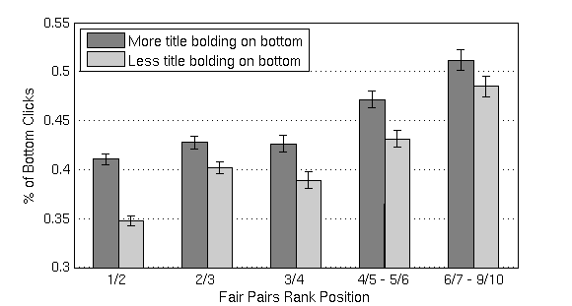
Title Bias Effect
Bars should be equal if no title bias
Click Percentage on Bottom
Adjacent Rank Positions
[Yue et al., 2010]

Slide 21
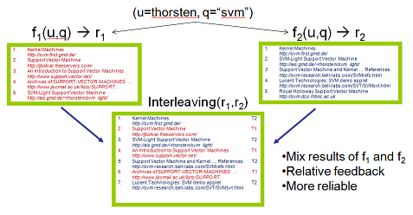
Not All Clicks Created Equal
Example: query session with 2 clicks
  One click at rank 1 (from A)
  Later click at rank 4 (from B)
  Normally would count this query session as a tie

Slide 22
Not All Clicks Created Equal
Example: query session with 2 clicks
  One click at rank 1 (from A)
  Later click at rank 4 (from B)
  Normally would count this query session as a tie
  But second click is probably more informative…
  …so B should get more credit for this query

Slide 23
Linear Model for Weighting Clicks
Feature vector φ(q,c):
Weight of click is w^{T}φ(q,c)
[Yue et al., 2010; Chapelle et al., 2012]

Slide 24
Example
w^{T}φ(q,c) differentiates last clicks and other clicks
[Yue et al., 2010; Chapelle et al., 2012]

Slide 25
Example
w^{T}φ(q,c) differentiates last clicks and other clicks
Interleave A vs B
  3 clicks per session
  Last click 60% on result from A
  Other 2 clicks random
[Yue et al., 2010; Chapelle et al., 2012]

Slide 26
Example
w^{T}φ(q,c) differentiates last clicks and other clicks
Interleave A vs B
  3 clicks per session
  Last click 60% on result from A
  Other 2 clicks random
Conventional w = (1,1) – has significant variance
Only count last click w = (1,0) – minimizes variance
[Yue et al., 2010; Chapelle et al., 2012]

Slide 27
Learning Parameters
Training set: interleaved click data on pairs of retrieval functions (A,B)
  We know A > B
[Yue et al., 2010; Chapelle et al., 2012]

Slide 28
Learning Parameters
Training set: interleaved click data on pairs of retrieval functions (A,B)
  We know A > B
Learning: train parameters w to maximize sensitivity of interleaving experiments
[Yue et al., 2010; Chapelle et al., 2012]

Slide 29
Learning Parameters
Training set: interleaved click data on pairs of retrieval functions (A,B)
  We know A > B
Learning: train parameters w to maximize sensitivity of interleaving experiments
Example: z-test depends on z-score = mean / std
  The larger the z-score, the more confident the test
[Yue et al., 2010; Chapelle et al., 2012]

Slide 30
Learning Parameters
Training set: interleaved click data on pairs of retrieval functions (A,B)
  We know A > B
Learning: train parameters w to maximize sensitivity of interleaving experiments
Example: z-test depends on z-score = mean / std
  The larger the z-score, the more confident the test
  Inverse z-test learns w to maximize z-score on training set
[Yue et al., 2010; Chapelle et al., 2012]

Slide 31
Inverse z-Test
Aggregate features of
all clicks in a query
[Yue et al., 2010; Chapelle et al., 2012]

Slide 32
Inverse z-Test
Aggregate features of
all clicks in a query
Choose w* to maximize
the resulting z-score
[Yue et al., 2010; Chapelle et al., 2012]

Slide 33
ArXiv.org Experiments
Learned
Baseline
Trained on 6 interleaving experiments
Tested on 12 interleaving experiments
[Yue et al., 2010; Chapelle et al., 2012]

Slide 34
ArXiv.org Experiments
Ratio Learned / Baseline
Baseline
Trained on 6 interleaving experiments
Tested on 12 interleaving experiments
Median relative score of 1.37
Baseline requires 1.88 times more data
[Yue et al., 2010; Chapelle et al., 2012]

Slide 35
Yahoo! Experiments
Learned
Baseline
16 Markets, 4-6 interleaving experiments
Leave-one-market-out validation
[Yue et al., 2010; Chapelle et al., 2012]

Slide 36
Yahoo! Experiments
Ratio Learned / Baseline
Baseline
16 Markets, 4-6 interleaving experiments
Leave-one-market-out validation
Median relative score of 1.25
Baseline requires 1.56 times more data
[Yue et al., 2010; Chapelle et al., 2012]

Slide 37
Improving Interleaving Experiments
Can re-weight clicks based on importance
  Reduces noise
  Parameters correlated so hard to interpret
  Largest weight on “single click at rank > 1”
Can alter the interleaving mechanism
  Probabilistic interleaving [Hofmann et al., 2011]
Reusing interleaving usage data

Slide 38
Story So Far
Interleaving is an efficient and consistent online experiment framework.
How can we improve interleaving experiments?
How do we efficiently schedule multiple interleaving experiments?

Slide 39















Information
Systems

Slide 40


Interleave A vs B
…
 | Left wins | Right wins
A vs B | 1 | 0
A vs C | 0 | 0
B vs C | 0 | 0

Slide 41
Interleave A vs C
…
 | Left wins | Right wins
A vs B | 1 | 0
A vs C | 0 | 1
B vs C | 0 | 0

Slide 42
Interleave B vs C
…
 | Left wins | Right wins
A vs B | 1 | 0
A vs C | 0 | 1
B vs C | 1 | 0

Slide 43
Interleave A vs B
…
 | Left wins | Right wins
A vs B | 1 | 1
A vs C | 0 | 1
B vs C | 1 | 0

Slide 44
Interleave A vs B
Exploration / Exploitation Tradeoff!
…
 | Left wins | Right wins
A vs B | 1 | 1
A vs C | 0 | 1
B vs C | 1 | 0

Slide 45
Identifying Best Retrieval Function
Tournament
  E.g., tennis
  Eliminated by an arbitrary player
Champion
  E.g., boxing
  Eliminated by champion
Swiss
  E.g., group rounds
  Eliminated based on overall record

Slide 46
Tournaments are Bad
Two bad retrieval functions are dueling
They are similar to each other
  Takes a long time to decide winner
  Can’t make progress in tournament until deciding
Suffer very high regret for each comparison
  Could have been using better retrieval functions

Slide 47
Champion is Good
The champion gets better fast
  If starts out bad, quickly gets replaced
  Duel against each competitor in round robin
Treat sequence of champions as a random walk
  Log number of rounds to arrive at best retrieval function
One of these will become next champion
[Yue et al., 2009]

Slide 48
Champion is Good
The champion gets better fast
  If starts out bad, quickly gets replaced
  Duel against each competitor in round robin
Treat sequence of champions as a random walk
  Log number of rounds to arrive at best retrieval function
One of these will become next champion
[Yue et al., 2009]

Slide 49
Champion is Good
The champion gets better fast
  If starts out bad, quickly gets replaced
  Duel against each competitor in round robin
Treat sequence of champions as a random walk
  Log number of rounds to arrive at best retrieval function
One of these will become next champion
[Yue et al., 2009]

Slide 50
Champion is Good
The champion gets better fast
  If starts out bad, quickly gets replaced
  Duel against each competitor in round robin
Treat sequence of champions as a random walk
  Log number of rounds to arrive at best retrieval function
[Yue et al., 2009]

Slide 51
Swiss is Even Better
Champion has a lot of variance
  Depends on initial champion
Swiss offers low-variance alternative
  Successively eliminate retrieval function with worst record
Analysis & intuition more complicated
[Yue & Joachims, 2011]

Slide 52
Interleaving for Online Evaluation
Interleaving is practical for online evaluation
  High sensitivity
  Low bias (preemptively controls for position bias)
Interleaving can be improved
  Dealing with secondary sources of noise/bias
  New interleaving mechanisms
Exploration/exploitation tradeoff
  Need to balance evaluation with servicing users

Slide 53
References:
Large Scale Validation and Analysis of Interleaved Search Evaluation (TOIS 2012)
Olivier Chapelle, Thorsten Joachims, Filip Radlinski, Yisong Yue
A Probabilistic Method for Inferring Preferences from Clicks (CIKM 2012)
Katja Hofmann, Shimon Whiteson, Maarten de Rijke
Evaluating the Accuracy of Implicit Feedback from Clicks and Query Reformulations (TOIS 2007)
Thorsten Joachims, Laura Granka, Bing Pan, Helen Hembrooke, Filip Radlinski, Geri Gay
How Does Clickthrough Data Reflect Retrieval Quality? (CIKM 2008)
Filip Radlinski, Madhu Kurup, Thorsten Joachims
The K-armed Dueling Bandits Problem (COLT 2009)
Yisong Yue, Josef Broder, Robert Kleinberg, Thorsten Joachims
Learning More Powerful Test Statistics for Click-Based Retrieval Evaluation (SIGIR 2010)
Yisong Yue, Yue Gao, Olivier Chapelle, Ya Zhang, Thorsten Joachims
Beat the Mean Bandit (ICML 2011)
Yisong Yue, Thorsten Joachims
Beyond Position Bias: Examining Result Attractiveness as a Source of Presentation Bias in Clickthrough Data (WWW 2010)
Yisong Yue, Rajan Patel, Hein Roehrig
Papers and demo scripts available at www.yisongyue.com

