Slide 1



Optimizing Recommender Systems as a Submodular Bandits Problem
Yisong Yue
Carnegie Mellon University
Joint work with Carlos Guestrin & Sue Ann Hong

Slide 2
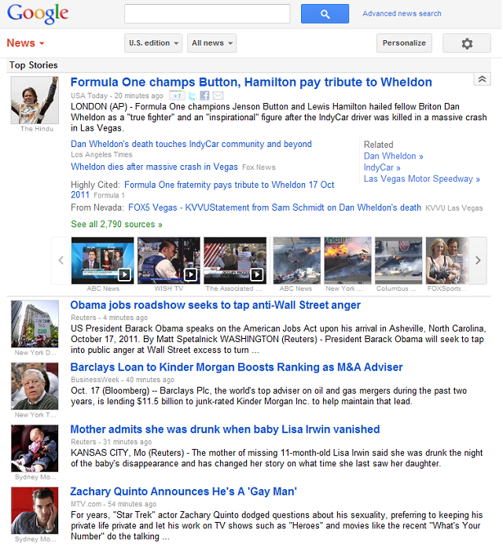


Slide 3

Optimizing Recommender Systems
Must Personalize!
10K articles per day
Must predict what the user finds interesting
Receive feedback (training data) “on the fly”

Slide 4
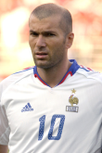

Day 1
Like!
Sports
Topic | # Likes | # Displayed | Average
Sports | 1 | 1 | 1
Politics | 0 | 0 | N/A
Economy | 0 | 0 | N/A
Celebrity | 0 | 0 | N/A

Slide 5
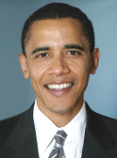
Day 2
Boo!
Politics
Topic | # Likes | # Displayed | Average
Sports | 1 | 1 | 1
Politics | 0 | 1 | 0
Economy | 0 | 0 | N/A
Celebrity | 0 | 0 | N/A

Slide 6

Day 3
Like!
Economy
Topic | # Likes | # Displayed | Average
Sports | 1 | 1 | 1
Politics | 0 | 1 | 0
Economy | 1 | 1 | 1
Celebrity | 0 | 0 | N/A

Slide 7
Day 4
Boo!
Sports
Topic | # Likes | # Displayed | Average
Sports | 1 | 2 | 0.5
Politics | 0 | 1 | 0
Economy | 1 | 1 | 1
Celebrity | 0 | 0 | N/A

Slide 8
Day 5
Boo!
Politics
Topic | # Likes | # Displayed | Average
Sports | 1 | 2 | 0.5
Politics | 0 | 2 | 0
Economy | 1 | 1 | 1
Celebrity | 0 | 0 | N/A

Slide 9
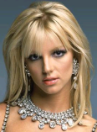
Goal: Maximize total user utility
(total # likes)
Exploit:
Economy
Explore:
Celebrity
Best:
Sports
How to behave optimally at each round?
Topic | # Likes | # Displayed | Average
Sports | 1 | 2 | 0.5
Politics | 0 | 2 | 0
Economy | 1 | 1 | 1
Celebrity | 0 | 0 | N/A

Slide 10
Often want to recommend multiple articles at a time!

Slide 11
Making Diversified Recommendations
☹
☺
“Israel implements unilateral Gaza cease-fire :: WRAL.com”
“Israel unilaterally halts fire, rockets persist”
“Gaza truce, Israeli pullout begin | Latest News”
“Hamas announces ceasefire after Israel declares truce - …”
“Hamas fighters seek to restore order in Gaza Strip - World - Wire …”
“Israel implements unilateral Gaza cease-fire :: WRAL.com”
“Obama vows to fight for middle class”
“Citigroup plans to cut 4500 jobs”
“Google Android market tops 10 billion downloads”
“UC astronomers discover two largest black holes ever found”

Slide 12
Outline
Optimally diversified recommendations
  Minimize redundancy
  Maximize information coverage
Exploration / exploitation tradeoff
  Don’t know user preferences a priori
  Only receives feedback for recommendations
Incorporating prior knowledge
  Reduce the cost of exploration

Slide 13
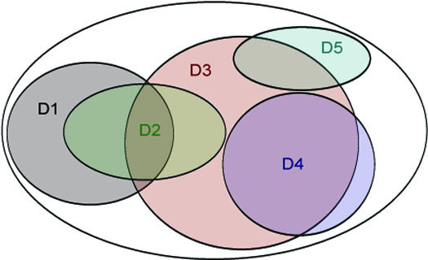
Choose top 3 documents
  Individual Relevance: D3 D4 D1
  Greedy Coverage Solution: D3 D1 D5

Slide 14

Choose top 3 documents
  Individual Relevance: D3 D4 D1
  Greedy Coverage Solution: D3 D1 D5

Slide 15
Choose top 3 documents
  Individual Relevance: D3 D4 D1
  Greedy Coverage Solution: D3 D1 D5

Slide 16
Choose top 3 documents
  Individual Relevance: D3 D4 D1
  Greedy Coverage Solution: D3 D1 D5

Slide 17
Choose top 3 documents
  Individual Relevance: D3 D4 D1
  Greedy Coverage Solution: D3 D1 D5

Slide 18
Choose top 3 documents
  Individual Relevance: D3 D4 D1
  Greedy Coverage Solution: D3 D1 D5

Slide 19
This diminishing returns
property is called
submodularity
Choose top 3 documents
  Individual Relevance: D3 D4 D1
  Greedy Coverage Solution: D3 D1 D5

Slide 20

Submodular
Coverage Model
F_{c}(A) = how well A
“covers” c
F (A)
Diminishing returns: Submodularity
Set of articles: A
User preferences: w
NP-hard in general
Greedy: (1-1/e) guarantee
[Nemhauser et al., 1978]
Goal:

Slide 21
Submodular Coverage Model
a1 = “China's Economy Is on the Mend, but Concerns Remain”
a2 = “US economy poised to pick up, Geithner says”
a3 = “Who's Going To The Super Bowl?”
w = [0.6, 0.4]
A = Ø

Slide 22
Submodular Coverage Model
a1 = “China's Economy Is on the Mend, but Concerns Remain”
a2 = “US economy poised to pick up, Geithner says”
a3 = “Who's Going To The Super Bowl?”
w = [0.6, 0.4]
A = Ø
Incremental Coverage
Incremental Benefit
 | F₁(A+a)-F₁(A) | F₂(A+a)-F₂(A)
a1 | 0.9 | 0
a2 | 0.8 | 0
a3 | 0 | 0.5
 | a1 | a2 | a3 | Best
Iter 1 | 0.54 | 0.48 | 0.2 | a1
Iter 2

Slide 23
Submodular Coverage Model
a1 = “China's Economy Is on the Mend, but Concerns Remain”
a2 = “US economy poised to pick up, Geithner says”
a3 = “Who's Going To The Super Bowl?”
w = [0.6, 0.4]
A = {a1}
Incremental Coverage
Incremental Benefit
 | F₁(A+a)-F₁(A) | F₂(A+a)-F₂(A)
a1 | -- | --
a2 | 0.1 (0.8) | 0 (0)
a3 | 0 (0) | 0.5 (0.5)
 | a1 | a2 | a3 | Best
Iter 1 | 0.54 | 0.48 | 0.2 | a1
Iter 2 | -- | 0.06 | 0.2 | a3

Slide 24
Example: Probabilistic Coverage
Each article a has independent prob. Pr(i|a) of covering topic i.
Define F_{i}(A) = 1-Pr(topic i not covered by A)
Then F_{i}(A) = 1 – Π(1-P(i|a))
“noisy or”
[El-Arini et al., KDD 2009]

Slide 25
Outline
Optimally diversified recommendations
  Minimize redundancy
  Maximize information coverage
Exploration / exploitation tradeoff
  Don’t know user preferences a priori
  Only receives feedback for recommendations
Incorporating prior knowledge
  Reduce the cost of exploration

Slide 26
Outline
Optimally diversified recommendations
  Minimize redundancy
  Maximize information coverage
Exploration / exploitation tradeoff
  Don’t know user preferences a priori
  Only receives feedback for recommendations
Incorporating prior knowledge
  Reduce the cost of exploration
Submodular information coverage model
Diminishing returns property, encourages diversity
Parameterized, can fit to user’s preferences
Locally linear (will be useful later)

Slide 27
Learning Submodular Coverage Models
Submodular functions well-studied
  [Nemhauser et al., 1978]
Applied to recommender systems
  Parameterized submodular functions
  [Leskovec et al., 2007; Swaminathan et al., 2009; El-Arini et al., 2009]
Learning submodular functions:
  [Yue & Joachims, ICML 2008]
  [Yue & Guestrin, NIPS 2011]
We want to
personalize!
Interactively from user feedback

Slide 28
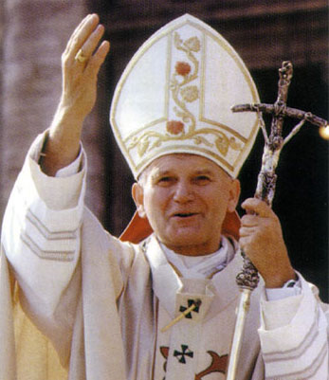

Interactive Personalization
Sports
Politics
World
-- | -- | -- | -- | --
0 | 0 | 1 | 1 | 1
: 0
Average Likes
# Shown

Slide 29


Interactive Personalization
Sports
Politics
World
-- | -- | 1.0 | 0.0 | 0.0
0 | 0 | 1 | 1 | 1
: 1
Average Likes
# Shown

Slide 30
Interactive Personalization
Sports
Politics
Politics
Economy
World
Sports
-- | -- | 1.0 | 0.0 | 0.0
0 | 1 | 2 | 2 | 1
: 1
Average Likes
# Shown

Slide 31
Interactive Personalization
Sports
Politics
Politics
Economy
World
Sports
-- | 1.0 | 1.0 | 0.0 | 0.0
0 | 1 | 2 | 2 | 1
: 3
Average Likes
# Shown

Slide 32
Interactive Personalization
Sports
Politics
Politics
Politics
Economy
Economy
World
Sports
Politics
-- | 1.0 | 1.0 | 0.0 | 0.0
0 | 2 | 4 | 2 | 1
: 3
Average Likes
# Shown

Slide 33
Interactive Personalization
Sports
Politics
Politics
Politics
Economy
Economy
…
World
Sports
Politics
-- | 0.5 | 0.75 | 0.0 | 0.0
0 | 2 | 4 | 2 | 1
: 4
Average Likes
# Shown

Slide 34
Exploration vs Exploitation
Goal: Maximize total user utility
Exploit:
Politics
Explore:
Celebrity
Best:
World
Economy
World
Politics
Politics
Celebrity
World
-- | 0.5 | 0.75 | 0.0 | 0.0
0 | 2 | 4 | 2 | 1
: 4
Average Likes
# Shown

Slide 35
Linear Submodular Bandits Problem
For time t = 1…T
  Algorithm recommends articles A_{t}
  User scans articles in order and rates them
    E.g., like or dislike each article (reward)
    Expected reward is F(A_{t}|w*) (discussed later)
  Algorithm incorporates feedback
Regret:
Best possible
recommendations
[Yue & Guestrin, NIPS 2011]

Slide 36
Linear Submodular Bandits Problem
Time Horizon
Regret:
Best possible
recommendations
Opportunity cost of not knowing preferences
“no-regret” if R(T)/T ➔ 0
  Efficiency measured by convergence rate
[Yue & Guestrin, NIPS 2011]

Slide 37
Local Linearity
Current article
User’s preferences
Utility
Previous articles
Incremental
Coverage

Slide 38
User Model
User scans articles in order
Generates feedback y
Obeys:
Independent of other feedback
Politics
a
A
A
Celebrity
a
Economy
a
“Conditional Submodular Independence”
[Yue & Guestrin, NIPS 2011]

Slide 39
Estimating User Preferences
Observed
Feedback
Submodular Coverage
Features of Recommendations
User
Y
Δ
w
=
Linear regression to estimate w!
[Yue & Guestrin, NIPS 2011]

Slide 40


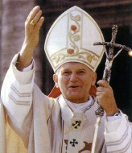
Balancing Exploration vs Exploitation
For each slot:
Example below: select article on economy
Estimated gain
Uncertainty
Estimated Gain by Topic
+
Uncertainty of Estimate

Slide 41
Balancing Exploration vs Exploitation
Sports
Politics
World
C(a|A) shrinks as roughly:
#times topic was shown
[Yue & Guestrin, NIPS 2011]

Slide 42
Balancing Exploration vs Exploitation
Sports
Politics
World
C(a|A) shrinks as roughly:
#times topic was shown
[Yue & Guestrin, NIPS 2011]

Slide 43
Balancing Exploration vs Exploitation
Sports
Politics
Politics
Economy
World
Celebrity
C(a|A) shrinks as roughly:
#times topic was shown
[Yue & Guestrin, NIPS 2011]

Slide 44
Balancing Exploration vs Exploitation
Sports
Politics
Politics
Economy
World
Celebrity
C(a|A) shrinks as roughly:
#times topic was shown
[Yue & Guestrin, NIPS 2011]

Slide 45
Balancing Exploration vs Exploitation
Sports
Politics
Politics
Politics
Economy
Economy
…
World
Celebrity
Sports
C(a|A) shrinks as roughly:
#times topic was shown
[Yue & Guestrin, NIPS 2011]

Slide 46
LSBGreedy
Loop:
  Compute least squares estimate
  Start with A_{t} empty
  For i=1,…,L
    Recommend article a that maximizes
  Receive feedback y_{t,1},…,y_{t,L}
Least Squares Regression
Estimated gain
Uncertainty

Slide 47
Regret Guarantee
Time Horizon
  Builds upon linear bandits to submodular setting
    [Dani et al., 2008; Li et al., 2010; Abbasi-Yadkori et al., 2011]
  Leverages conditional submodular independence
No-regret algorithm! (regret sub-linear in T)
  Regret convergence rate: d/(LT)^{1/2}
  Optimally balances explore/exploit trade-off
# Topics
# Articles per Day
[Yue & Guestrin, NIPS 2011]

Slide 48
Other Approaches
Multiplicative Weighting [El-Arini et al. 2009]
  Does not employ exploration
  No guarantees (can show doesn’t converge)
Ranked bandits [Radlinski et al. 2008; Streeter & Golovin 2008]
  Reduction, treats each slot as a separate bandit
  Use LinUCB [Dani et al. 2008; Li et al. 2010; Abbasi-Yadkori et al 2011]
  Regret guarantee O(dLT^{1/2}) (factor L^{1/2} worse)
ε-Greedy
  Explore with probability ε
  Regret guarantee O(d(LT)^{2/3}) (factor (LT)^{1/3} worse)

Slide 49
Simulations
LSBGreedy
RankLinUCB
e-Greedy
MW

Slide 50
Simulations
MW
RankLinUCB
e-Greedy
LSBGreedy

Slide 51
User Study
Tens of thousands of
real news articles
T=10 days
L=10 articles per day
d=18 topics
Users rate articles
Count #likes
Users heterogeneous
Requires personalization

Slide 52
User Study
Submodular
Bandits Wins
Submodular
Bandits Wins
Submodular
Bandits Wins
~27 users in study
Ties
Ties
Losses
Losses
Static
Weights
Multiplicative
Updates
(no exploration)
RankLinUCB
(doesn’t directly
model diversity)

Slide 53
Comparing Learned Weights vs MW
MW overfits to
“world” topic
Few liked articles.
MW did not learn
anything

Slide 54
Outline
Optimally diversified recommendations
  Minimize redundancy
  Maximize information coverage
Exploration / exploitation tradeoff
  Don’t know user preferences a priori
  Only receives feedback for recommendations
Incorporating prior knowledge
  Reduce the cost of exploration
Submodular information coverage model
Diminishing returns property, encourages diversity
Parameterized, can fit to user’s preferences
Locally linear (will be useful later)
Linear Submodular Bandits Problem
Characterizes exploration/exploitation
Provably near-optimal algorithm
User study

Slide 55
The Price of Exploration
Time Horizon
User’s
Preferences
# Topics
# Articles per day
This is the price of exploration
  Region of uncertainty depends linearly on |w*|
  Region of uncertainty depends linearly on d
  Unavoidable without further assumptions

Slide 56

Observation: Systems do not serve users in a vacuum
Previous Users
  Have: preferences of previous users
  Goal: learn faster for new users?
[Yue, Hong & Guestrin, ICML 2012]

Slide 57
Assumption:
Users are similar to “stereotypes”
Stereotypes described by low
dimensional subspace
Use SVD-style approach to
estimate stereotype subspace
E.g., [Argyriou et al., 2007]
  Have: preferences of previous users
  Goal: learn faster for new users?
[Yue, Hong & Guestrin, ICML 2012]

Slide 58
Coarse-to-Fine Bandit Learning
Suppose w* mostly in subspace
  Dimension k << d
  “Stereotypical preferences”
Two tiered exploration
  First in subspace
  Then in full space
Suppose:
w*
16x Lower
Regret!
Original Guarantee:
[Yue, Hong & Guestrin, ICML 2012]

Slide 59
Coarse-to-Fine Hierarchical Exploration
Loop:
  Least squares in subspace
  Least squares in full space
  Start with A_{t} empty
  For i=1,…,L
    Recommend article a that maximizes
  Receive feedback y_{t,1},…,y_{t,L}
regularized to
Uncertainty in
Full Space
Uncertainty in
Subspace

Slide 60
Simulation Comparison
Naïve (LSBGreedy from before)
Reshaped Prior in Full Space (LSBGreedy w/ prior)
  Estimated using pre-collected user profiles
Subspace (LSBGreedy on the subspace)
  Often what people resort to in practice
Coarse-to-Fine Approach
  Our approach
  Combines full space and subspace approaches

Slide 61
Naïve Baselines
Reshaped Prior on Full space
“Atypical Users”
Coarse-to-Fine Approach
Subspace
[Yue, Hong, Guestrin, ICML 2012]

Slide 62
User Study
Similar setup as before
T=10 days
L=10 articles per day
d=100 topics
k=5 (5-dim subspace)
(estimated from real users)
Tens of thousands of
real news articles
Users rate articles
Count #likes

Slide 63
User Study
Coarse-to-Fine
Wins
Coarse-to-Fine
Wins
~27 users in study
Ties
Losses
Naïve LSBGreedy
LSBGreedy with
Optimal Prior in
Full Space

Slide 64
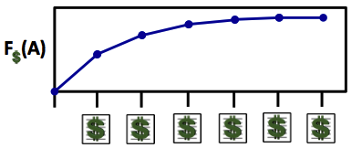
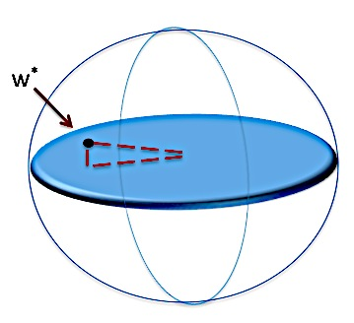


Learning Submodular Functions
  Parameterized submodular functions
  Diminishing returns
  Flexible
Linear Submodular Bandit Problem
  Balance Explore/Exploit
  Provably optimal algorithms
  Faster convergence using prior knowlege
Practical bandit learning approaches
Research supported by ONR (PECASE) N000141010672 and ONR YIP N00014-08-1-0752

