Slide 1
Practical Online Retrieval Evaluation
SIGIR 2011 Tutorial
Filip Radlinski (Microsoft)
Yisong Yue (CMU)

Slide 2
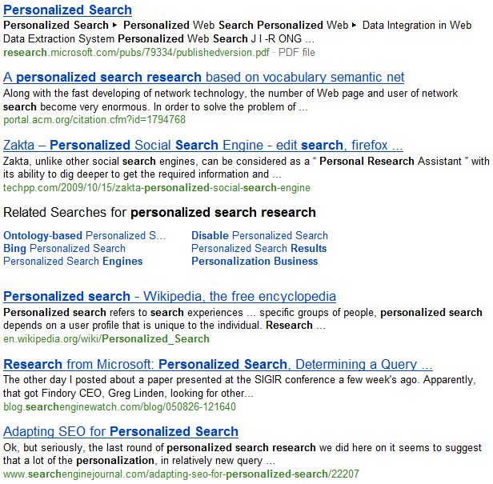
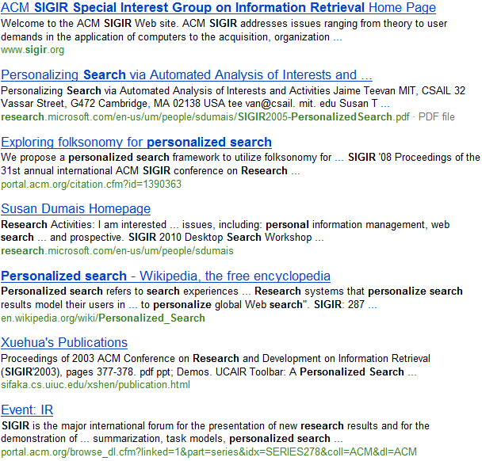
Retrieval Evaluation Goals
Baseline Ranking Algorithm
My Research Project
Which is better?
Goals: Practicality, Correctness, Efficiency

Slide 3
Retrieval Evaluation Goals
Practicality
  If I’m a researcher with a small group, can I really use this evaluation method in practice?
Correctness
  If my evaluation says that my ranking method is better than a baseline, would users really agree?
  If my evaluation says that my ranking method isn’t better than the baseline, is that true?
Efficiency
  I want to make the best use of my resources: How do I best trade off time/cost and sensitivity to changes?

Slide 4
Evaluation
Two types of retrieval evaluation:
“Offline evaluation”
  Ask experts or users to explicitly evaluate your retrieval system. This dominates evaluation today.
“Online evaluation”
  See how normal users interact with your retrieval system when just using it.

Slide 5
Do we need online evaluation?
Traditional offline evaluation: The Cranfield approach
  Sample some real representative queries
  Run them against a number of systems
  Judge the relevance of (top) documents versus (inferred) information needs
More often: Assume that somebody else has done this
  Many groups have: TREC, OHSUMED, CLEF, LETOR, …
Basic evaluation method:
  For my new approach, rank a collection & combine the judgments into a summary number. Hope it goes up

Slide 6
Do we need online evaluation?
The Cranfield approach is a good idea when
  Query set is representative of cases that my research tries to address
  Judges can give accurate judgments in my setting
  I trust a particular summary value (e.g., MAP, NDCG, ERR) to accurately reflects my users’ perceptions
If these aren’t the case: Even if my approach is valid, the number might not go up
  Or worse: The number might go up despite my approach producing worse rankings in practice

Slide 7
Challenges with Offline Evaluation
Do users and judges agree on relevance?
  Particularly difficult for personalized search
  Particularly difficult for specialized documents
It’s expensive and slow to collect new data
  Cheaper crowdsourcing (this morning) is sometimes an alternative
Ambiguous queries are particularly hard to judge realistically
  Which intent is most popular? Which others are important?
Judges need to correctly appreciate uncertainty
  If you want to diversify web results to satisfy multiple intents, how do judges know what is most likely to be relevant?
How do you identify when relevance changes?
  Temporal changes: Document changes; Query intent changes
Summary aggregate score must agree with users
  Do real users agree with MAP@1000? NDCG@5? ERR?

Slide 8
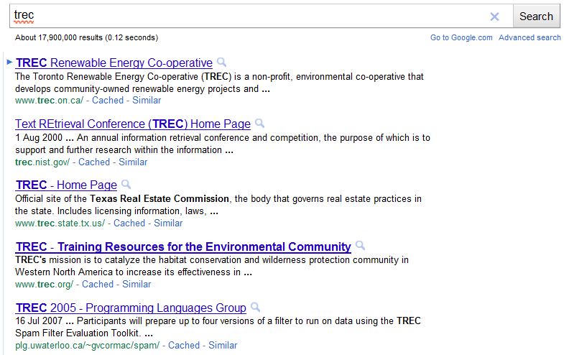
Challenges with Offline Evaluation

Slide 9
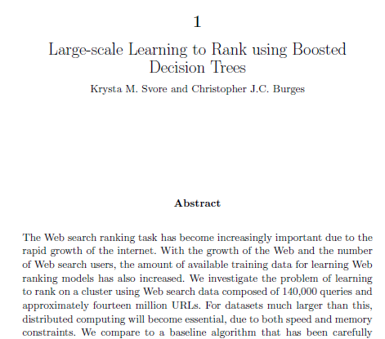
Challenges with Offline Evaluation
Query: “introduction to ranking boosted decision trees”
Document:
…

Slide 10

Challenges with Offline Evaluation
Query: “ski jump world record”
Document:

Slide 11
Tutorial Goals
Provide an overview of online evaluation
  Online metrics: What works when (especially if you’re an academic)
  Interpreting user actions at the Document or Ranking level
  Experiment Design: Opportunities, biases and challenges
Get you started in obtaining your own online data
  How to realistically “be the search engine”
  End-to-End: Design, Implementation, Recruitment and Analysis
  Overview of alternative approaches
Present interleaving for retrieval evaluation
  Describe one particular online evaluation approach in depth
  How it works, why it works and what to watch out for
  Provide a reference implementation
  Describe a number of open challenges
Quick overview of using your online data for learning

Slide 12
Outline
Part 1: Overview of Online Evaluation
  Things to measure (e.g. clicks, mouse movements)
  How to interpret feedback (absolute vs. relative)
  What works well in a small-scale setting?
Part 2: End-to-End, From Design to Analysis
(Break during Part 2)
Part 3: Open Problems in Click Evaluation
Part 4: Connection to Optimization & Learning

Slide 13
Online Evaluation
Key Assumption: Observable user behavior reflects relevance
Implicit in this: Users behave rationally
  Real users have a goal when they use an IR system
    They aren’t just bored, typing and clicking pseudo-randomly
  They consistently work towards that goal
    An irrelevant result doesn’t draw most users away from their goal
  They aren’t trying to confuse you
    Most users are not trying to provide malicious data to the system

Slide 14
Online Evaluation
Key Assumption: Observable user behavior reflects relevance
This assumption gives us “high fidelity”
  Real users replace the judges: No ambiguity in information need; Users actually want results; Measure performance on real queries
But introduces a major challenge
  We can’t train the users: How do we know when they are happy? Real user behavior requires careful design and evaluation
And a noticeable drawback
  Data isn’t trivially reusable later (more on that later)

Slide 15
What is Online Data?
A variety of data can describe online behavior:
  Urls, Queries and Clicks
    Browsing Stream: Sequence of URLs users visit
    In IR: Queries, Results and Clicks
  Mouse movement
    Clicks, selections, hover
The line between online and offline is fuzzy
  Purchase decisions: Ad clicks to online purchases
  Eye tracking
  Offline evaluation using historical online data
Notes:
Mention that this tutorial focuses on click data.

Slide 16
Online Evaluation Designs
We have some key choices to make:
  Document Level or Ranking Level?
  Absolute or Relative?
Document Level | Ranking Level
I want to know about the documents Similar to the Cranfield approach, I’d like to find out the quality of each document. | I am mostly interested in the rankings I’m trying to evaluate retrieval functions. I don’t need to be able to drill down to individual documents.
Absolute Judgments | Relative Judgments
I want a score on an absolute scale Similar to the Cranfield approach, I’d like a number that I can compare to many methods, over time. | I am mostly interested in a comparison It’s enough if I know which document, or which ranking, is better. Its not necessary to know the absolute value.

Slide 17
Online Evaluation Designs
Click
Document-Level feedback
  E.g., click indicates document is relevant
  Document-level feedback often used to define retrieval evaluation metrics.
Ranking-level feedback
  E.g., click indicates result-set is good
  Directly define evaluation metric for a result-set.

Slide 18
Experiment Design
Lab Study
Ask users to come to the lab, where they perform a specific task while you record online behavior. | Controlled Task Controlled Environment
Example: Users sit in front of an eye tracker while finding the answers to questions using a specific search engine [Granka et al, SIGIR ’04]
Controlled Task Field Study
Ask volunteers to complete a specific task using your system but on their computer. | Controlled Task Uncontrolled Environment
Example: Crowdsourcing tasks (tutorial this morning)
General Usage Field Study
Ask volunteers to use your system for whatever they find it useful for over a longer period of time | Uncontrolled Task Uncontrolled Environment
Example: Track cursor position on web search results page [Huang et al, CHI ‘11]

Slide 19
Concerns for Evaluation
Key Concerns:
  Practicality
  Correctness
  Efficiency (cost)
Practical for academic scale studies
  Keep it blind: Small studies are the norm
  Must measure something that real users do often
  Can’t hurt relevance too much (but that’s soft)
  Cannot take too long (too many queries)

Slide 20
Interpretation Choices
 | Absolute | Relative
Document Level | Click Rate, Cascade Models, … | Click-Skip, FairPairs
Ranking Level | Abandonment, Reciprocal Rank, Time to Click, PSkip, … | Side by Side, Interleaving

Slide 21
Absolute Document Judgments
Can we simply interpret clicked results as relevant?
  This would provide a relevance dataset, after which we run a Cranfield style evaluation
A variety of biases make this difficult
  Position Bias:
    Users are more inclined to examine and click on higher-ranked results
  Contextual Bias:
    Whether users click on a result depends on other nearby results
  Attention Bias:
    Users click more on results which draw attention to themselves

Slide 22
Position Bias
Hypothesis: Order of presentation influences where users look, but not where they click!
More relevant
1
2
1
2
→ Users appear to have trust in Google’s ability to
rank the most relevant result first.
Normal: Google’s order of results
Swapped:
Order of top 2 results swapped
[Joachims et al. 2005, 2007]
Notes:
This is for pairs of top-2 results rated by human judges. A proxy is used to randomly swap the order of results without changing the Google layout.

Slide 23
What Results do Users View/Click?
[Joachims et al. 2005, 2007]
Notes:
Eye tracking study.

Slide 24
Which Results are Viewed Before Click?
Clicked Link
→ Users typically do not look at lower results before they click (except maybe the next result)
[Joachims et al. 2005, 2007]
Notes:
Eye tracking study.

Slide 25
Quality-of-Context Bias
Hypothesis: Clicking depends only on the result itself, but not on other results.
 | Rank of clicked link as sorted by relevance judges
Normal + Swapped | 2.67
Reversed | 3.27
→ Users click on less relevant results, if they are embedded between irrelevant results.
Reversed:
Top 10 results in reversed order.
[Joachims et al. 2005, 2007]

Slide 26
Correcting for Position
(Absolute / Document-Level)
How to model position bias?
What is the primary modeling goal?
Position Models | Cascade Models
Clicks depend on relevance and position Each rank position has some independent probability of being examined. | Users examine ranking sequentially Users scan down the ranking until finding a relevant document to click on.
Insight into User Behavior | Estimating Relevance
Model parameters can be used to interpret how users behave “Position bias generally affects users X amount at rank 1”. Indirectly enables relevance estimation of documents. | Directly estimate the relevance of documents (or quality of rankings) “A clicked document corresponds to X% probability of being relevant”. Does not directly give insight on user behavior.
Also: Some joint models do both!

Slide 27
Examination Hypothesis
(Position Model)
Users can only click on documents they examine
  Independent probability of examining each rank
  Choose parameters to maximize probability of observing click log
  Straightforward to recover prob. of relevance
  Extensions possible (e.g. Dupret & Piwowarski 2008)
  Requires multiple clicks on the same document/query pair (at different rank positions is helpful)
Click
A
C
Click
B
A
C
B
[Richardson et al. 2007; Craswell et al. 2008; Dupret & Piwowarski 2008]

Slide 28
Logistic Position Model
(Position Model)
  Choose parameters to maximize probability of observing click log
  Removes independence assumption
  Straightforward to recover relevance (α)
    (Interpret as increase in log odds)
  Requires multiple clicks on the same document/query pair (at different rank positions helpful)
[Craswell et al. 2008; Chapelle & Zhang 2009]

Slide 29
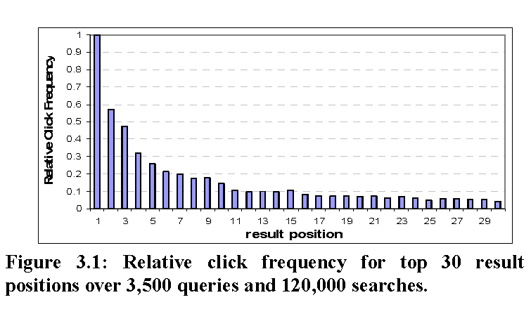
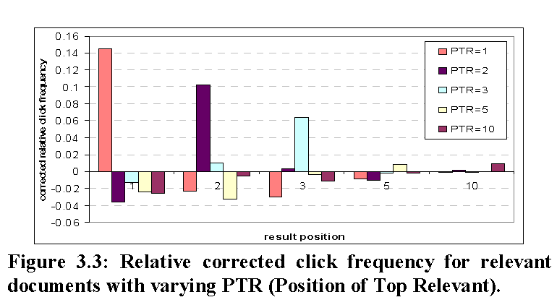
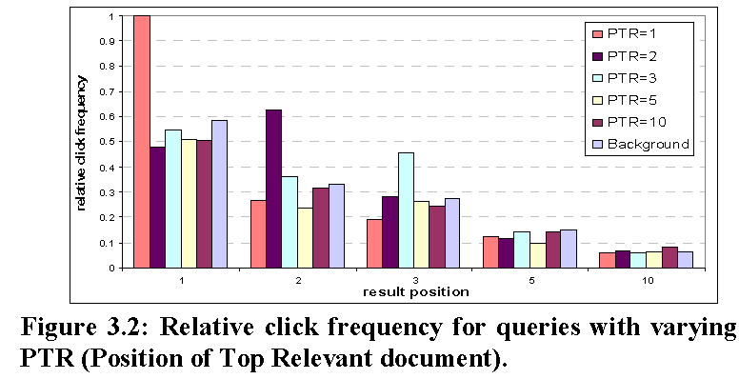
Relative Click Frequency
(Position Model)
Can also use ratio of click frequencies
called Clicks Over Expected Clicks (COEC) [Zhang & Jones 2007]
[Agichtein et al 2006a; Zhang & Jones 2007; Chapelle & Zhang 2009]

Slide 30
Cascade Model
Assumes users examines results top-down
  Examines result
  If relevant: click, end session
  Else: go to next result, return to step 1
  Probability of click depends on relevance of documents ranked above.
  Also requires multiple query/doc impressions
[Craswell et al. 2008]

Slide 31
Cascade Model Example
500 users typed a query
0 click on result A in rank 1
100 click on result B in rank 2
100 click on result C in rank 3
Cascade Model says:
0 of 500 clicked A ➔ rel_{A} = 0
100 of 500 clicked B ➔ rel_{B} = 0.2
100 of remaining 400 clicked C ➔ rel_{C} = 0.25
Notes:
Slide credit: Nick Craswell

Slide 32
Dynamic Bayesian Network
(Extended Cascade Model)
Like cascade model, but with added steps
  Examines result at rank j
  If attracted to result at rank j:
    Clicks on result
    If user is satisfied, ends session
  Otherwise, decide whether to abandon session
  If not, j ← j + 1, go to step 1
  Can model multiple clicks per session
  Distinguishes clicks from relevance
  Requires multiple query/doc impressions
[Chapelle & Zhang 2009]

Slide 33
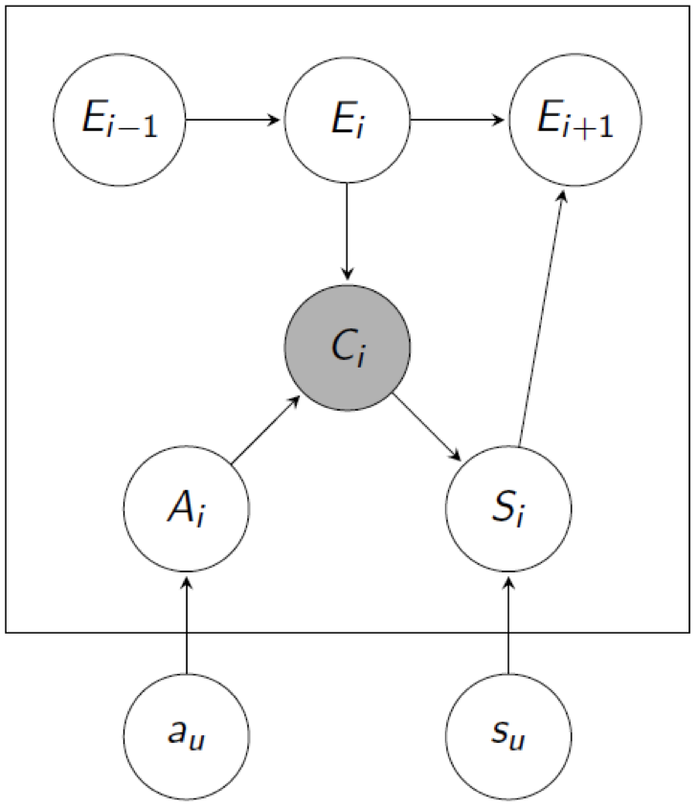
Dynamic Bayesian Network
(Extended Cascade Model)
[Chapelle & Zhang 2009]
Notes:
E nodes are hidden variables representing whether the user examined the result.
A nodes are hidden variables representing whether the user was attracted to the result.
C nodes are observed variables representing whether the user clicked on the result.
S nodes are hidden variables representing whether the user was satisfied with the result.

Slide 34
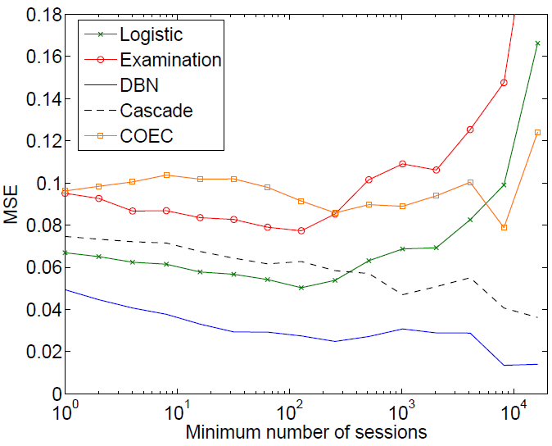
Performance Comparison
Predicting clickthrough rate (CTR) on top result
Models trained on query logs of large-scale search engine
[Chapelle & Zhang 2009]

Slide 35
Estimating DCG Change Using Clicks
Model the relevance of each doc as random variable
  I.e., multinomial distribution of relevance levels
  X = random variable
  a_{j} = relevance level (e.g., 1-5)
  c = click log for query q
  Can be used to measure P(ΔDCG < 0)
  Requires expert labeled judgments
[Carterette & Jones 2007]
Notes:
Note that previously presented models are used to estimate document relevance, from which we can estimate measures such as MAP or NDCG. This approach directly estimates changes in NDCG based on click data (and human judgments).

Slide 36
Estimating DCG Change Using Clicks
Plotting accuracy of predicting better ranking vs model confidence, i.e. P(ΔDCG < 0)
Trained using Yahoo! sponsored search logs with relevance judgments from experts
About 28,000 expert judgments on over 2,000 queries
[Carterette & Jones 2007]

Slide 37
Absolute Document Judgments (Summary)
Joint model of user behavior and relevance
  E.g., how often a user examines results at rank 3
Straightforward to infer relevance of documents
  Need to convert document relevance to evaluation metric
Requires additional assumptions
  E.g., cascading user examination assumption
Requires multiple impressions of doc/query pair
  A special case of “Enhancing Web Search by Mining Search and Browse Logs” tutorial this morning
  Often impractical at small scales

Slide 38
Absolute Ranking-Level Judgments
Document-level feedback requires converting judgments to evaluation metric (of a ranking)
Ranking-level judgments directly define such a metric
Some Absolute Metrics
Abandonment Rate | Reformulation Rate
Queries per Session | Clicks per Query
Click rate on first result | Max Reciprocal Rank
Time to first click | Time to last click
% of viewed documents skipped (pSkip)
[Radlinski et al. 2008; Wang et al. 2009]

Slide 39
Absolute Ranking-Level Judgments
Benefits
  Often much simpler than document click models
  Directly measure ranking quality: Simpler task requires less data, hopefully
Downsides
  Can’t really explain the outcome:
    Never get examples of inferred ranking quality
    Different queries may naturally differ on metrics: counting on the average being informative
  Evaluations over time need not necessarily be comparable. Need to ensure:
    Done over the same user population
    Performed with the same query distribution
    Performed with the same document distribution

Slide 40
Monotonicity Assumption
Consider two sets of results: A & B
  A is high quality
  B is medium quality
Which will get more clicks from users, A or B?
  A has more good results: Users may be more likely to click when presented results from A.
  B has fewer good results: Users may need to click on more results from ranking B to be satisfied.
Need to test with real data
  If either direction happens consistently, with a reasonable amount of data, we can use this to evaluate online

Slide 41
Testing Monotonicity on ArXiv.org
  This is an academic search engine, similar to ACM digital library but mostly for physics.
  Real users looking for real documents.
  Relevance direction known by construction
  Orig > Swap2 > Swap4
    Orig: Hand-tuned ranking function
    Swap2: Orig with 2 pairs swapped
    Swap4: Orig with 4 pairs swapped
  Orig > Flat > Rand
    Orig: Hand-tuned ranking function, over many fields
    Flat: No field weights
    Rand : Top 10 of Flat randomly reordered shuffled
Evaluation on 3500 x 6 queries
Do all pairwise tests: Each retrieval function used half the time.
[Radlinski et al. 2008]

Slide 42
Absolute Metrics
Name | Description | Hypothesized Change as Quality Falls
Abandonment Rate | % of queries with no click | Increase
Reformulation Rate | % of queries that are followed by reformulation | Increase
Queries per Session | Session = no interruption of more than 30 minutes | Increase
Clicks per Query | Number of clicks | Decrease
Clicks @ 1 | Clicks on top results | Decrease
pSkip [Wang et al ’09] | Probability of skipping | Increase
Max Reciprocal Rank* | 1/rank for highest click | Decrease
Mean Reciprocal Rank* | Mean of 1/rank for all clicks | Decrease
Time to First Click* | Seconds before first click | Increase
Time to Last Click* | Seconds before final click | Decrease
(*) only queries with at least one click count

Slide 43
Evaluation of Absolute Metrics on ArXiv.org
[Radlinski et al. 2008]

Slide 44
Evaluation of Absolute Metrics on ArXiv.org
How well do statistics reflect the known quality order?
Evaluation Metric | Consistent (weak) | Inconsistent (weak) | Consistent (strong) | Inconsistent (strong)
Abandonment Rate | 4 | 2 | 2 | 0
Clicks per Query | 4 | 2 | 2 | 0
Clicks @ 1 | 4 | 2 | 4 | 0
pSkip | 5 | 1 | 2 | 0
Max Reciprocal Rank | 5 | 1 | 3 | 0
Mean Reciprocal Rank | 5 | 1 | 2 | 0
Time to First Click | 4 | 1 | 0 | 0
Time to Last Click | 3 | 3 | 1 | 0
[Radlinski et al. 2008; Chapelle et al. under review]

Slide 45
Evaluation of Absolute Metrics on ArXiv.org
How well do statistics reflect the known quality order?
Evaluation Metric | Consistent (weak) | Inconsistent (weak) | Consistent (strong) | Inconsistent (strong)
Abandonment Rate | 4 | 2 | 2 | 0
Clicks per Query | 4 | 2 | 2 | 0
Clicks @ 1 | 4 | 2 | 4 | 0
pSkip | 5 | 1 | 2 | 0
Max Reciprocal Rank | 5 | 1 | 3 | 0
Mean Reciprocal Rank | 5 | 1 | 2 | 0
Time to First Click | 4 | 1 | 0 | 0
Time to Last Click | 3 | 3 | 1 | 0
Absolute Metric Summary
None of the absolute metrics reliably reflect expected order.
Most differences not significant with thousands of queries.
(These) absolute metrics not suitable for ArXiv-sized search engines with these retrieval quality differences.
[Radlinski et al. 2008; Chapelle et al. under review]

Slide 46
Relative Comparisons
What if we ask the simpler question directly:
  Which of two retrieval methods is better?
Interpret clicks as preference judgments
  between two (or more) alternatives
U(f₁) > U(f₂) ⬄ pairedComparisonTest(f₁, f₂) > 0
Can we control for variations in particular user/query?
Can we control for presentation bias?
Need to embed comparison in a ranking

Slide 47
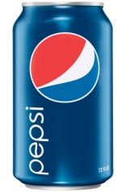
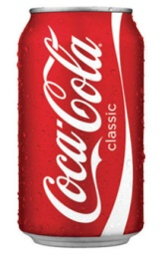
Analogy to Sensory Testing
Suppose we conduct taste experiment: vs
  Want to maintain a natural usage context
Experiment 1: absolute metrics
  Each participant’s refrigerator randomly stocked
    Either Pepsi or Coke (anonymized)
  Measure how much participant drinks
Issues:
  Calibration (person’s thirst, other confounding variables…)
  Higher variance

Slide 48
Analogy to Sensory Testing
Suppose we conduct taste experiment: vs
  Want to maintain natural usage context
Experiment 2: relative metrics
  Each participant’s refrigerator randomly stocked
    Some Pepsi (A) and some Coke (B)
  Measure how much participant drinks of each
    (Assumes people drink rationally!)
Issues solved:
  Controls for each individual participant
  Lower variance
A
B

Slide 49
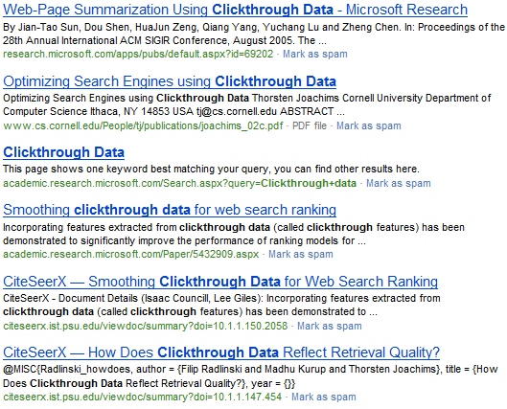
A Taste Test in Retrieval:
Document Level Comparisons
Is probably
better than that
This
Click
[Joachims, 2002]

Slide 50
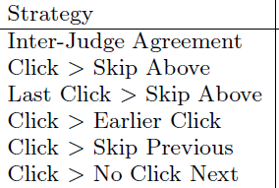
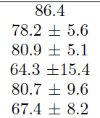
A Taste Test in Retrieval:
Document Level Comparisons
There are other alternatives
  Click > Earlier Click
  Last Click > Skip Above
  …
How accurate are they?
[Joachims et al, 2005]

Slide 51
A Taste Test in Retrieval:
Document Level Comparisons
We can only observe that lower > higher
So randomly reorder pairs of documents
Half the time, show:
The other half, show:
Document 1
Document 2
What happens more often?
Document 2
Click
Document 1
Click
[Radlinski & Joachims ‘07]

Slide 52
A Taste Test in Retrieval:
Document Level Comparisons
We can only observe that lower > higher
So randomly reorder pairs of documents
Hybrid approach: Convert pairs to absolute
Half the time, show:
The other half, show:
Document 1
Document 2
What happens more often?
Document 2
Click
Document 1
Click
[Radlinski & Joachims ‘07]
[Agrawal et al ‘09]

Slide 53
Document-Level Comparisons(Summary)
Derive pairwise judgments between documents
Often more reliable than absolute judgments
  Also supported by experiments on collecting expert judgments [Carterette et al. 2008]
Benefits: reliable & easily reusable
  Gives “correct” (in expectation) feedback
  Easy to convert into training data for standard ML algorithms
Limitations: still a biased sample
  Distribution of feedback slanted towards top of rankings
  Need to turn document-level feedback into evaluation metric

Slide 54
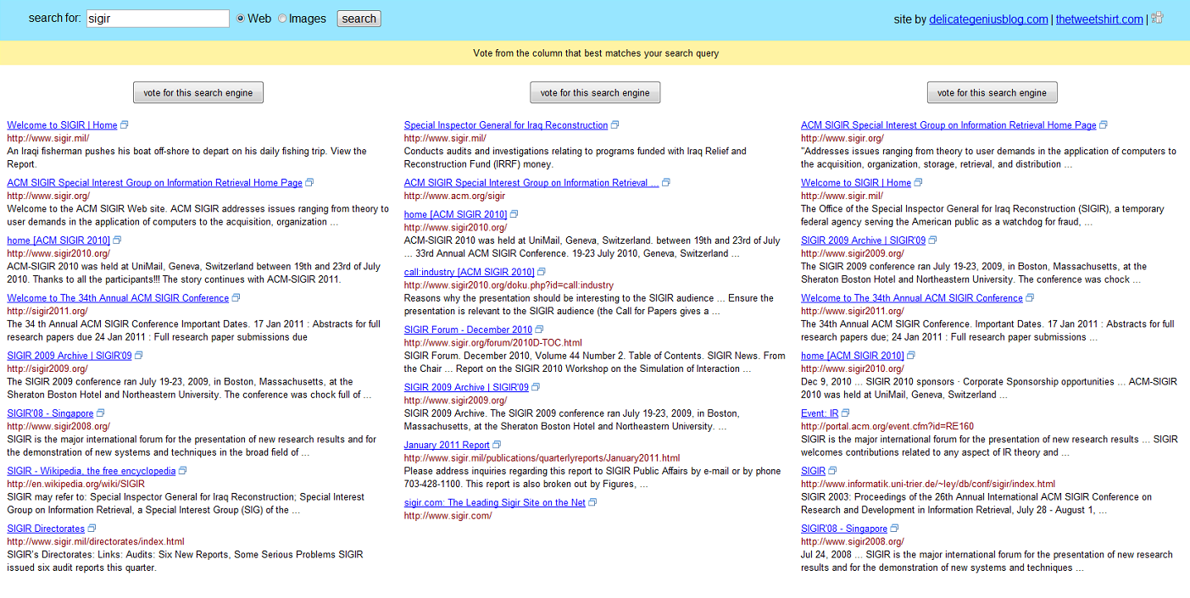
A Taste Test in Retrieval:
Ranking Level Comparisons
What about getting a preference between rankings?
Not natural (even getting rid of the “vote” button)
If you’re an expert, maybe you can guess which is which
e.g. [Thomas & Hawking, 2008]

Slide 55
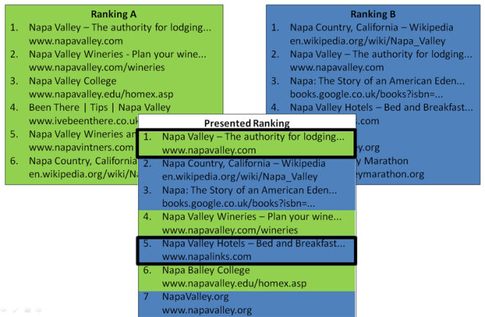
Paired Comparisons
How to create a natural (and blind) paired test?
  Side by side disrupts natural usage context
  Need to embed comparison test inside a single ranking

Slide 56
Team Draft Interleaving
Ranking A
Napa Valley – The authority for lodging...
www.napavalley.com
Napa Valley Wineries - Plan your wine...
www.napavalley.com/wineries
Napa Valley College
www.napavalley.edu/homex.asp
4. Been There | Tips | Napa Valley
www.ivebeenthere.co.uk/tips/16681
5. Napa Valley Wineries and Wine
www.napavintners.com
6. Napa Country, California – Wikipedia
en.wikipedia.org/wiki/Napa_Valley
Ranking B
1. Napa Country, California – Wikipedia
en.wikipedia.org/wiki/Napa_Valley
2. Napa Valley – The authority for lodging...
www.napavalley.com
3. Napa: The Story of an American Eden...
books.google.co.uk/books?isbn=...
4. Napa Valley Hotels – Bed and Breakfast...
www.napalinks.com
5. NapaValley.org
www.napavalley.org
6. The Napa Valley Marathon
www.napavalleymarathon.org
Presented Ranking
Napa Valley – The authority for lodging...
www.napavalley.com
2. Napa Country, California – Wikipedia
en.wikipedia.org/wiki/Napa_Valley
3. Napa: The Story of an American Eden...
books.google.co.uk/books?isbn=...
Napa Valley Wineries – Plan your wine...
www.napavalley.com/wineries
5. Napa Valley Hotels – Bed and Breakfast...
www.napalinks.com
Napa Valley College
www.napavalley.edu/homex.asp
7 NapaValley.org
www.napavalley.org
A
B
  [Radlinski et al. 2008]

Slide 57
Team Draft Interleaving
Ranking A
Napa Valley – The authority for lodging...
www.napavalley.com
Napa Valley Wineries - Plan your wine...
www.napavalley.com/wineries
Napa Valley College
www.napavalley.edu/homex.asp
4. Been There | Tips | Napa Valley
www.ivebeenthere.co.uk/tips/16681
5. Napa Valley Wineries and Wine
www.napavintners.com
6. Napa Country, California – Wikipedia
en.wikipedia.org/wiki/Napa_Valley
Ranking B
1. Napa Country, California – Wikipedia
en.wikipedia.org/wiki/Napa_Valley
2. Napa Valley – The authority for lodging...
www.napavalley.com
3. Napa: The Story of an American Eden...
books.google.co.uk/books?isbn=...
4. Napa Valley Hotels – Bed and Breakfast...
www.napalinks.com
5. NapaValley.org
www.napavalley.org
6. The Napa Valley Marathon
www.napavalleymarathon.org
Presented Ranking
Napa Valley – The authority for lodging...
www.napavalley.com
2. Napa Country, California – Wikipedia
en.wikipedia.org/wiki/Napa_Valley
3. Napa: The Story of an American Eden...
books.google.co.uk/books?isbn=...
Napa Valley Wineries – Plan your wine...
www.napavalley.com/wineries
5. Napa Valley Hotels – Bed and Breakfast...
www.napalinks.com
Napa Balley College
www.napavalley.edu/homex.asp
7 NapaValley.org
www.napavalley.org
Click
Tie!
Click
  [Radlinski et al. 2008]

Slide 58
Scoring Interleaved Evaluations
Clicks credited to “owner” of result
  Ranking r₁
  Ranking r₂
  Shared
  A & B share top K results when they have identical results at each rank 1…K
  Ranking with more credits wins
r₁
r₂
A
A
B
A
B
C
B
E
D
C
F
F

Slide 59
Simple Example
Two users, Alice & Bob
  Alice clicks a lot,
  Bob clicks very little.
Two retrieval functions, r₁ & r₂
  r₁ > r₂
Two ways of evaluating:
  Run r₁ & r₂ independently, measure absolute metrics
  Interleave r₁ & r₂, measure pairwise preference

Slide 60
Simple Example
Two users, Alice & Bob
  Alice clicks a lot,
  Bob clicks very little.
Two retrieval functions, r₁ & r₂
  r₁ > r₂
Two ways of evaluating:
  Run r₁ & r₂ independently, measure absolute metrics
  Interleave r₁ & r₂, measure pairwise preference
Absolute metrics:
  Higher chance of falsely
  concluding that r₂ > r₁
Interleaving:
User | Ret Func | #clicks
Alice | r₂ | 5
Bob | r₁ | 1
User | #clicks on r₁ | #clicks on r₂
Alice | 4 | 1
Bob | 1 | 0

Slide 61
Challenges (Calibration)
No longer need to calibrate clickthrough rate
  across users or across queries
More sensitive
  Fewer queries to achieve statistical significance
Will see empirical evaluations later.

Slide 62
Challenges (Presentation Bias)
Interleaved ranking preserves rank fairness
  Random clicker clicks on both rankings equally
  Biased clicker clicks on both rankings equally
More reliable
  More consistently identifies better ranking
Will see empirical evaluations later.

Slide 63
Benefits & Drawbacks of Interleaving
Benefits
  A more direct way to elicit user preferences
  A more direct way to perform retrieval evaluation
  Deals with issues of position bias and calibration
Drawbacks
  Reusability: Can only elicit pairwise preferences for specific pairs of ranking functions
    Similar to some offline settings [Carterette & Smucker, 2007]
  Benchmark: No absolute number for benchmarking
  Interpretation: Unable to interpret much at the document-level, or about user behavior

Slide 64
Quantitative Analysis
Can we quantify how well Interleaving performs?
  Compared with Absolute Ranking-level Metrics
  Compared with Offline Judgments
How reliable is it?
  Does Interleaving identify the better retrieval function?
How sensitive is it?
  How much data is required to achieve a target p-value?
  [Radlinski et al. 2008; Chapelle et al. (under review)]

Slide 65
Experimental Setup
Selected 4-6 pairs of ranking functions to compare
  Known retrieval quality, by construction or by judged evaluation
Collected click logs in two experimental conditions
  Each ranking function by itself to measure absolute metrics
  Interleaving of the two ranking functions
Three search platforms used
  arXiv.org
  Yahoo!
  Bing
  [Radlinski et al. 2008; Chapelle et al. (under review)]

Slide 66
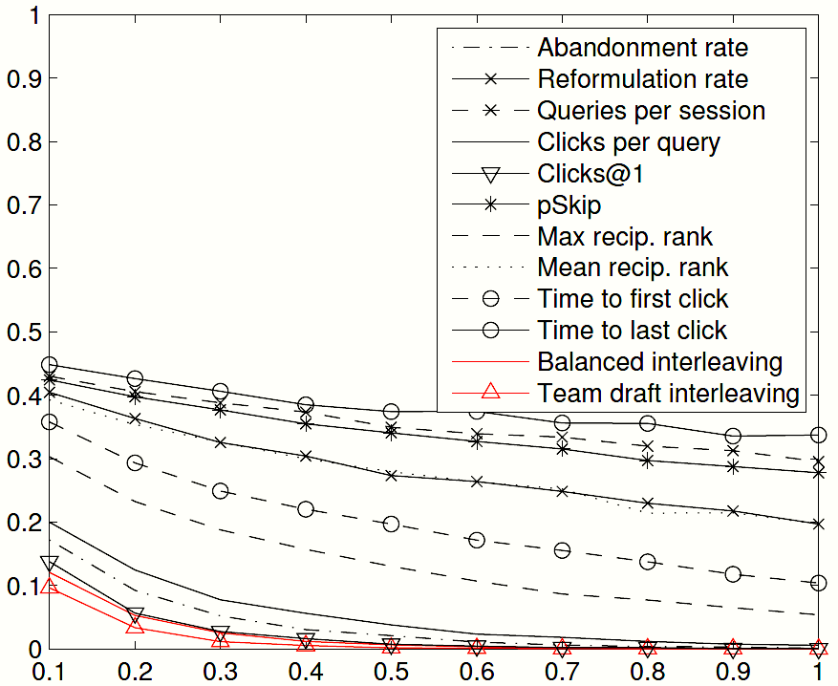
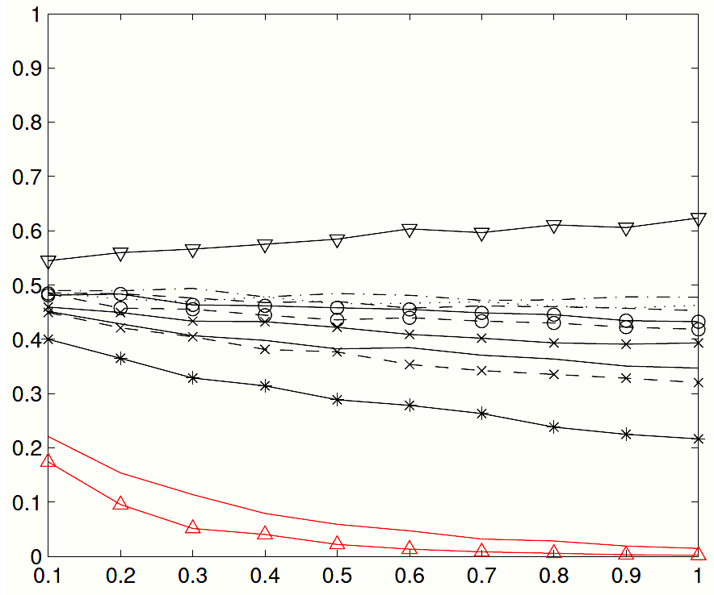
Comparison with Absolute Metrics (Online)
ArXiv.org Pair 1
ArXiv.org Pair 2
p-value
Agreement Probability
Query set size
Clicks@1 diverges in
preference estimate
Experiments on arXiv.org
About 1000 queries per experiment
Interleaving is more sensitive and more reliable
Interleaving achieves
significance faster
  [Radlinski et al. 2008; Chapelle et al. (under review)]

Slide 67
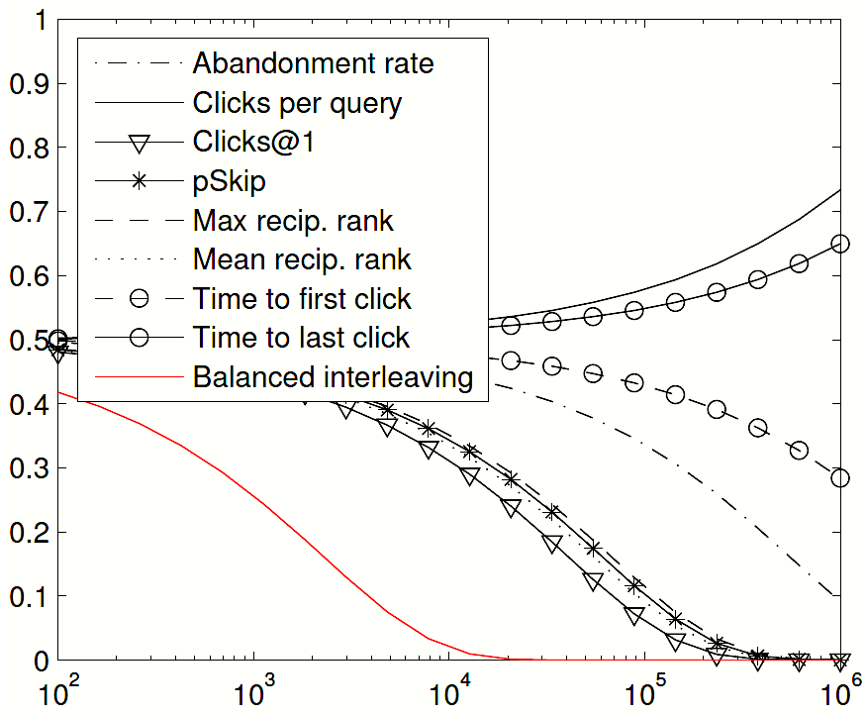
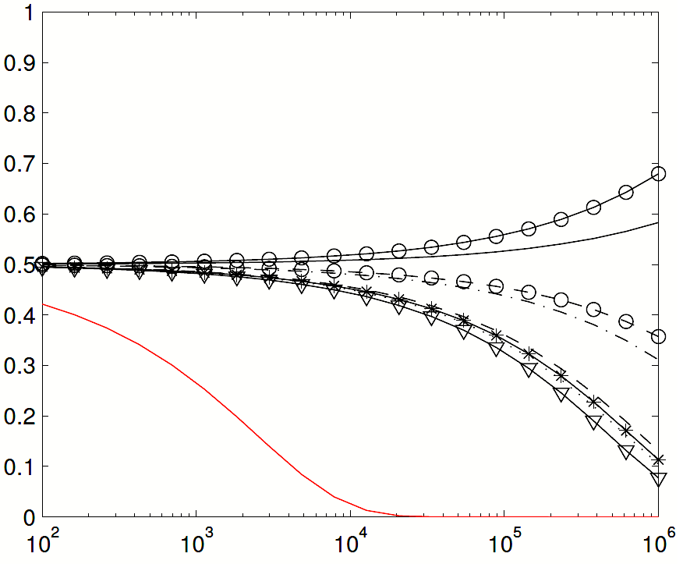
Comparison with Absolute Metrics (Online)
Yahoo! Pair 1
Yahoo! Pair 2
p-value
Agreement Probability
Query set size
Experiments on Yahoo! (much smaller differences in relevance)
Large scale experiment
Interleaving is sensitive and more reliable (~7K queries for significance)
  [Radlinski et al. 2008; Chapelle et al. (under review)]

Slide 68
Comparative Summary
p-value
Comparison of arXiv.org experiments with~150 queries
Results on Yahoo! qualitatively similar
  [Radlinski et al. 2008; Chapelle et al. (under review)]

Slide 69
Comparative Summary
Method | Consistent (weak) | Inconsistent (weak) | Consistent (strong) | Inconsistent (strong)
Abandonment Rate | 4 | 2 | 2 | 0
Clicks per Query | 4 | 2 | 2 | 0
Clicks @ 1 | 4 | 2 | 4 | 0
pSkip | 5 | 1 | 2 | 0
Max Reciprocal Rank | 5 | 1 | 3 | 0
Mean Reciprocal Rank | 5 | 1 | 2 | 0
Time to First Click | 4 | 1 | 0 | 0
Time to Last Click | 3 | 3 | 1 | 0
Interleaving | 6 | 0 | 6 | 0
Comparison of arXiv.org experiments
Results on Yahoo! qualitatively similar
  [Radlinski et al. 2008; Chapelle et al. (under review)]

Slide 70
Interpretation Choices
Often more reliable & sensitive
 | Absolute | Relative
Document Level | Click Rate, Cascade Model, … | Click/Skip, FairPairs
Ranking Level | Abandonment, Reciprocal Rank, Time to Click, PSkip, … | Side by Side, Interleaving
Often more reusable
Best understood & most reusable
Often what you actually want

Slide 71
Returning to Interleaving
Quantitatively compared Interleaving to a number of absolute online metrics
  Interleaving appears more reliable
  Interleaving appears more sensitive
What about relative to offline (expert) judgments?
  Does Interleaving agree with experts?
  How many clicks need to be observed relative to judged queries?

Slide 72
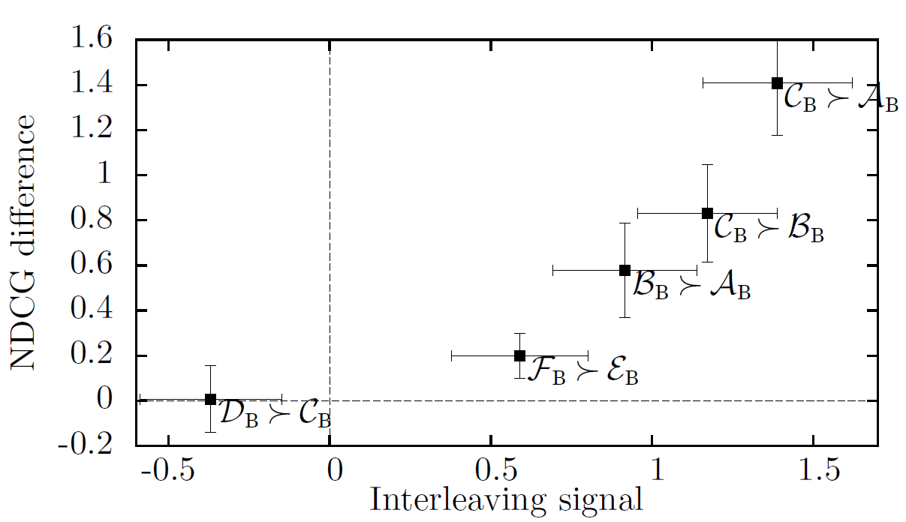
Calibration with Offline Judgments
Experiments on Bing (large scale experiment)
Plotted interleaving preference vs NDCG difference
Good calibration between expert judgments and interleaving
I.e., magnitude preserving
  [Radlinski & Craswell 2010; Chapelle et al. (under review)]

Slide 73
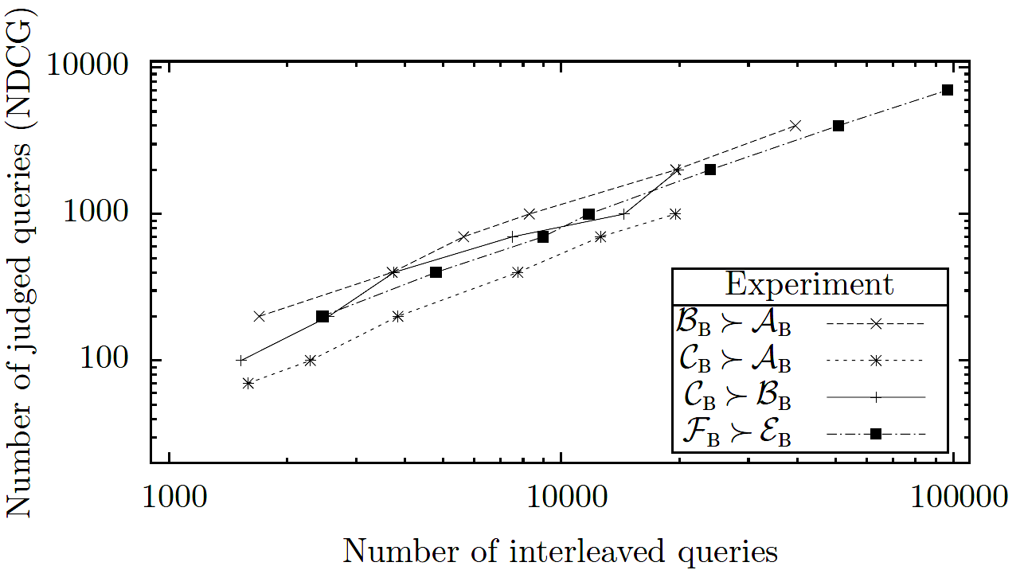
Comparison with Offline Judgments
Experiments on Bing (large-scale experiment)
Plotted queries required vs expert judgments required (for different p-values)
Linear relationship between queries and expert judgments required
One expert judgment is worth ~10 queries
  [Radlinski & Craswell 2010; Chapelle et al. (under review)]

Slide 74
Summary of Ranking-Level Quantitative Analysis
Interleaving is reliable
  Consistent & calibrated expert judgments
Interleaving is sensitive
  Requires fewer queries to achieve significance
  For Bing: 1 judgment = ~10 queries
Not easily reusable or interpretable
  Each evaluation requires new online experiment
    Similar limitation to methods for efficient offline evaluation, e.g., [Carterette et al. 2006; Carterette & Smucker 2007]
  Hard to say more than Ranking A > Ranking B

Slide 75
More In-Depth Analysis
Other usage patterns reflect more than relevance
  Click entropy for personalization [Teevan et al. 2008]
  Revisitations to detect “bookmarking” and long-term interests [Adar et al. 2008]
  Spikes in queries and clicks [Kulkarni et al. 2011]
This enables more detailed understanding of users
  Can design specific changes to better service such specific types of information needs
  Typically requires larger scale usage data
  Requires more careful experimental design
Related tutorial: “Design of Large Scale Log Analysis Studies” by Dumais et al, at HCIC 2010
Notes:
See related tutorial: http://research.microsoft.com/en-us/um/people/sdumais/Logs-talk-HCIC-2010.pdf

Slide 76
Summary of Part 1
Considered online versus offline evaluation
  Under which conditions is each better
With online data
  Compared absolute & relative interpretations
  Compared document level & ranking level interpretations
Part 2 will show you how to collect data and apply these methods yourself

Slide 77
Practical Online Retrieval Evaluation
Part 2
Filip Radlinski (Microsoft)
Yisong Yue (CMU)

Slide 78
Outline
Part 1 : Overview of Online Evaluation
Part 2: End-to-End, From Design to Analysis
  Setting up a search service
  Getting your own data
  Running online experiments
(Break during Part 2)
Part 3: Open Problems in Click Evaluation
Part 4: Connection to Optimization & Learning

Slide 79

















Your System!
Information
Systems

Slide 80
A Recipe
0. Come up with a new retrieval algorithm
Create logging infrastructure
Create reranking infrastructure
Recruit some users
Wait for data
Analyze Results
Write a paper

Slide 81
User behavior we can record
Queries & results
  Context as well: Which computer & when
Clicks on results
  Metadata: What order, dwell time
The same methods can be used to observe
  Query reformulations
  Browsing of result site
With some more work
  Mouse movements, text selection, tabs, etc …

Slide 82
Being the Search Engine
To get real data, we need real users
  Need to implement an IR system that people want to use …
  … without having to break their normal routine
  Then convince some people to actually do it
Benefits
  Real users & data!
Challenges
  Make the system usable (hint: start by using it yourself)
  Effective data collection
  Make it easy to run evaluation experiments
  Important consideration: Privacy & Human Subjects

Slide 83
A spectrum of possible approaches
Web proxy
  Intercept, record & modify results before they get to the client
Browser toolbar
  Intercept and modify the page the browser gets
Search engine on top of a public search API
  Fetch results from a search API, build your own results page
  Or fetch results page like a proxy, but serve it yourself
Your own search engine
  Many tools exist to get you most of the way there
  Direct access to index, generate any rankings
  Usually for a special collection: arXiv.org, CiteSeer, PubMed, …

Slide 84
A spectrum of possible approaches
Method | Easy to get users | Easy on/off? | Easy to observe | Robust | Runs on … | Amount of work | Changes are easy
Proxy | ✓ |  | All web traffic |  | server | ✶ | ✓
Toolbar | ✓ | ✓ | Everything |  | client | 
Search API |  | ✓ | Our queries & clicks | ✓ | server |  | ✓
Write an engine |  | ✓ | Our queries & clicks | ✓ | server |  | ✓
How likely are you to need to actively keep tweaking it?
What happens when you find a bug just after setting up the 20th user?
Do you need to set up a special server?
Can you get some volunteers to spend 5 minutes to be set up, then regularly use it without thinking?
Is this something you can do before lunch?
How easy is it for a user to remember that you’re logging things? Can they just turn it off for a minute?
What data can you (the researcher) easily record?

Slide 85
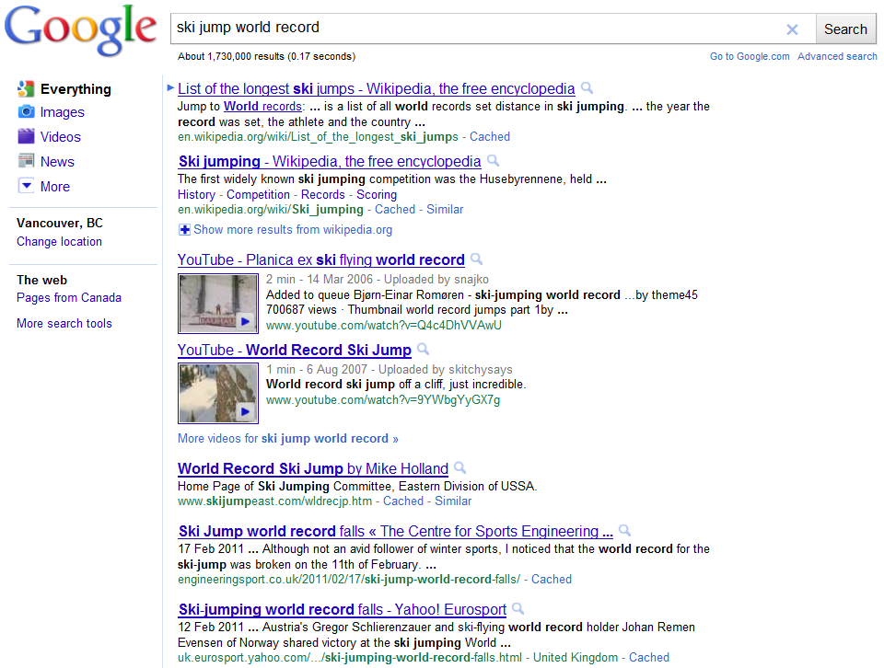
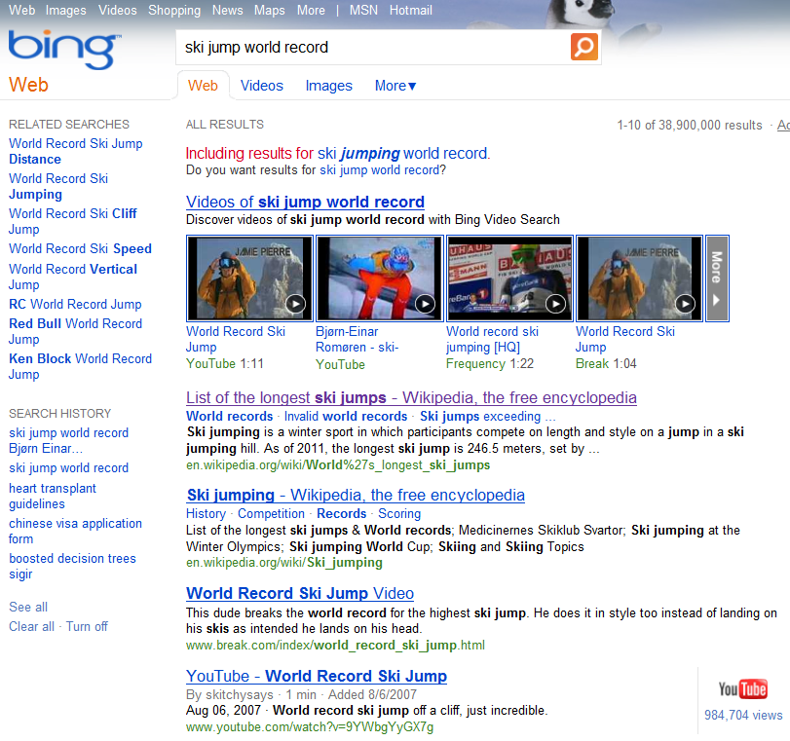

Demo Application
Some easy to use academic research systems

Slide 86
Building a Proxy
Intercepting traffic is easy
  All you need are representative users
  … who don’t mind sharing their traffic with you
Four parts to a proxy:
  Intercepting search engine requests
  Logging queries & results
  Logging clicks on results
  Substituting in your own search engine results

Slide 87
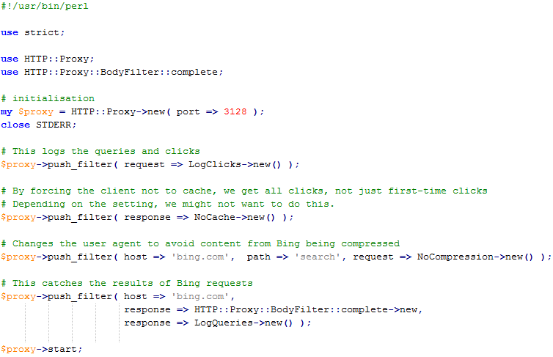
Intercepting search engine requests
Write a proxy, e.g. in Perl. Its REALLY EASY!
Set volunteers’ browsers to use this proxy
Data Logging
& Experimentation

Slide 88
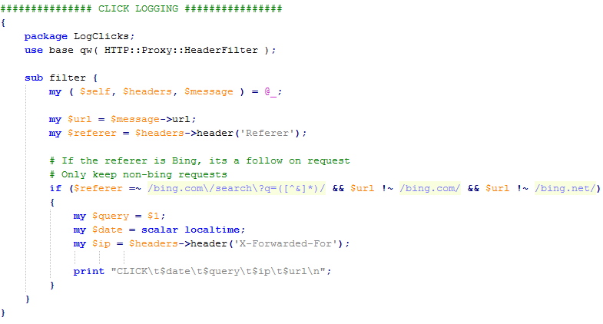
Logging clicks
Get request metadata
we want to log this request
Then log it

Slide 89
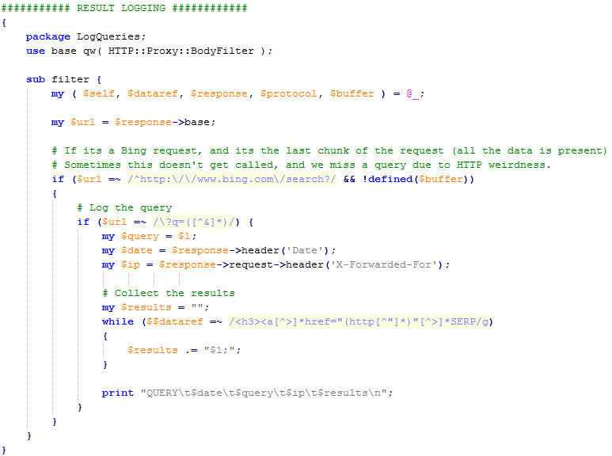
Logging queries & results
we want to log this request
Get the metadata
Parse the results

Slide 90
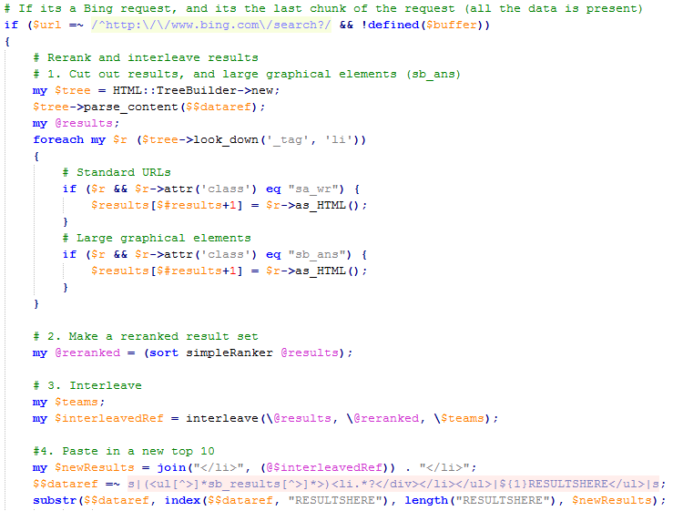
Modifying results
Get the original results
Rerank them
Set up the evaluation
Replace the old results with your new set
Notes:
Mention: Another way to log clicks is to add an “onclick” event to html

Slide 91
Demo!

Slide 92
Other approaches
Browser toolbar
  All modern browsers support custom toolbars
  They are relatively straightforward to write
  Lemur toolkit [lemurproject.org] has open source toolbars to start with. Another starting point is AlterEgo [Matthijs & Radlinski ’10]
  GreaseMonkey is another way to do limited logging & rewriting
Use a search API
  Bing, Google, Yahoo! all offer search APIs
  Many non-web-search engines (twitter, Facebook, etc) also offer APIs
  You can treat a regular search page as an API of sorts, parsing the results
  ViewSer [Lagun & Agichtein ‘11] is one example of a fetch-and-serve implementation (also shows an example of how to do mouse position tracking)
Build your own search engine
  Easy to use libraries: Lucene (java), Lucene.Net (C#)
  Easy to run-on engines: Indri, Lucene, Terrier, Zettair, and many more
Notes:
http://www.slideshare.net/7mary4/open-source-search-tools-for-www2010-conferencesourcesearchtoolswww20100426dapplications-of-open-search-tools-www2010-tutorial

Slide 93
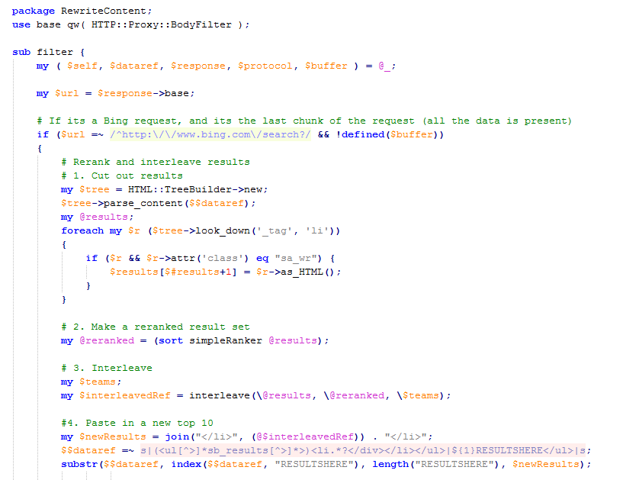
Designing interleaving experiment
Get the original results
Rerank them
Replace the old results with your new set

Slide 94
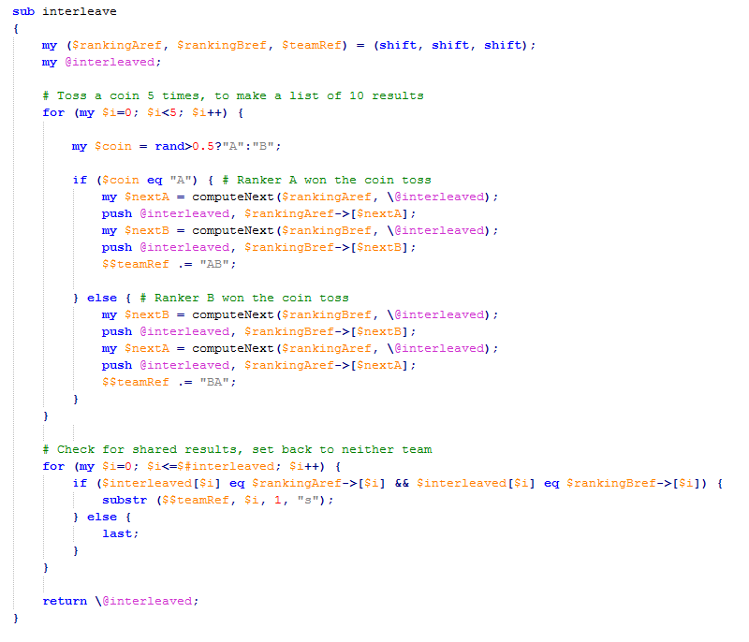
Repeat until 10
results chosen
Randomly choose which Ranker picks next
Case 1: Ranker A chooses, then Ranker B chooses
Case 2: Ranker B chooses, then Ranker A chooses
Check for shared results

Slide 95

Demo!

Slide 96
So far in our recipe
0. Come up with a reranking system
Create logging infrastructure
Create reranking infrastructure
Recruit some users
Wait for data
Analyze Results

Slide 97
Recruiting Users
Questions to ask when recruiting
  Are you using the system yourself?
    If not, why not?
  Will your users find the system usable?
    A little worse than the default is ok
    A little slower than the default is ok
    A little less reliable than the default is ok
    … but never by too much
  Are you collecting private data?
    Do you really need to?
    What will you do with it?
  Is your user base representative?

Slide 98
What to ask of your users
Recall the three study setup alternatives
  Controlled task lab study
  Controlled task, uncontrolled environment
  General uncontrolled retrieval tasks
The right setup depends on the research question
  Will users naturally enter a sufficient number of queries that you want to improve?
    For example, for long question queries
  Do you need additional metadata about users?
    For example, for personalization
  Is there a natural place this system should be deployed?
    For example, on a computer in your building lobby?

Slide 99
Analyzing the Results
We have collected data of the form:
  <query> <results> <metadata>
  and <clicks> <associated query>
We want to group those into
<query> <metadata> <clicks>
And evaluate how often each retrieval function wins
<query 1> <which ranking won>
<query 2> <which ranking won>
…
Finally, we can see if the retrieval functions are different, statistically significantly.

Slide 100

Significance Testing
The simplest test: Sign Test
Suppose:
  The baseline won interleaving on 120 queries
  Your ranking won interleaving on 140 queries
  Is your ranking significantly better? [here: no]
Statistical tests:
  Run a sign test in your favorite software
  Use a Binomial confidence interval
$$p=\hat{p}±z_{α}\sqrt{\frac{\hat{p}(1−\hat{p})}{n}}$$

Slide 101
Significance Testing
We can also test the power (or consistency) of the evaluation methodology
  (Bootstrap Sampling)
Given set of logged queries Q = {q₁,…,q_{n}}
  Sample k queries Q’ from Q with replacement
    k ≤ n
    A “bag”
  Compute whether r₁ wins in Q’
  Repeat m times
Power (consistency) is fraction of bags that agree
[Efron & Tibshirani 1993]

Slide 102
Significance Testing
Example: log 4 queries Q = { }
q₁
q₂
q₃
q₄
[Efron & Tibshirani 1993]

Slide 103
Significance Testing
Example: log 4 queries Q = { }
Generate m bootstrap samples
  Sample w/ replacement
  Record who wins each sample
q₁
q₂
q₃
q₄
q₁
q₁
q₃
q₄
q₄
q₁
q₄
q₂
q₃
q₁
q₃
q₃
…
q₂
q₄
q₃
q₂
[Efron & Tibshirani 1993]

Slide 104
Significance Testing
Example: log 4 queries Q = { }
Generate m bootstrap samples
  Sample w/ replacement
  Record who wins each sample
E.g., r₁ wins in 74% of samples
  Suppose we know r₁ > r₂
  We’d make the wrong conclusion 26% of the time
  More queries = higher confidence (more consistent)
q₁
q₂
q₃
q₄
q₁
q₁
q₃
q₄
q₄
q₁
q₄
q₂
q₃
q₁
q₃
q₃
…
q₂
q₄
q₃
q₂
[Efron & Tibshirani 1993]

Slide 105
Significance Testing
Many other statistical tests exist
  Assumes a dataset sample from a population
    Query logs with clicks
  Tests on a measured quantity
    Each query has signed score indicating preference
    Is the aggregate score noticeably different from 0?
  More sensitive binomial tests
  t-Test
  Also see [Smucker et al., 2009] for another comparison of various statistical tests

Slide 106
Evaluation Demo

Slide 107
Summary of Part 2
Provided a recipe for evaluation
  Blind test, minimally disruptive of natural usage context
  A number of implementation alternatives reviewed
  Proxy implementation presented
  Demonstration of logging, interleaving, and analysis
Interleaving reference implementation
  Combining document rankings
  Credit assignment
Overview of significance testing

Slide 108
Practical Online Retrieval Evaluation
Part 3
Filip Radlinski (Microsoft)
Yisong Yue (CMU)

Slide 109
Outline
Part 1 : Overview of Online Evaluation
Part 2: End-to-End, From Design to Analysis
(Break during Part 2)
Part 3: Open Problems in Click Evaluation
  Alternative interleaving algorithms
  Challenges in click interpretation
  Other sources of presentation bias
  Learning better click weighting
Part 4: Connection to Optimization & Learning

Slide 110
Alternative Interleaving Algorithms
Goals of interleaving
  Paired test to maximize sensitivity
  Fair comparison to maximize reliability
There are multiple ways to interleave rankings
  We saw Team-Draft Interleaving in Part 2.
  Another way is Balanced Interleaving
  Other methods exist, e.g., [He et al. 2009; Hofmann et al. 2011b]
There are multiple ways to assign credit for clicks
  We’ll see what the parameters are

Slide 111
Balanced Interleaving
Ranking A
Napa Valley – The authority for lodging...
www.napavalley.com
Napa Valley Wineries - Plan your wine...
www.napavalley.com/wineries
Napa Valley College
www.napavalley.edu/homex.asp
4. Been There | Tips | Napa Valley
www.ivebeenthere.co.uk/tips/16681
5. Napa Valley Wineries and Wine
www.napavintners.com
6. Napa Country, California – Wikipedia
en.wikipedia.org/wiki/Napa_Valley
Ranking B
1. Napa Country, California – Wikipedia
en.wikipedia.org/wiki/Napa_Valley
2. Napa Valley – The authority for lodging...
www.napavalley.com
3. Napa: The Story of an American Eden...
books.google.co.uk/books?isbn=...
4. Napa Valley Hotels – Bed and Breakfast...
www.napalinks.com
5. NapaValley.org
www.napavalley.org
6. The Napa Valley Marathon
www.napavalleymarathon.org
Presented Ranking
Napa Valley – The authority for lodging...
www.napavalley.com
2. Napa Country, California – Wikipedia
en.wikipedia.org/wiki/Napa_Valley
Napa Valley Wineries – Plan your wine...
www.napavalley.com/wineries
Napa Valley College
www.napavalley.edu/homex.asp
Napa: The Story of an American Eden...
books.google.co.uk/books?isbn=...
Been There | Tips | Napa Valley
www.ivebeenthere.co.uk/tips/16681
Napa Valley Hotels – Bed and Breakfast...
www.napalinks.com
[Joachims ‘02]

Slide 112
Balanced Interleaving
Winner!
Ranking A
Napa Valley – The authority for lodging...
www.napavalley.com
Napa Valley Wineries - Plan your wine...
www.napavalley.com/wineries
Napa Valley College
www.napavalley.edu/homex.asp
4. Been There | Tips | Napa Valley
www.ivebeenthere.co.uk/tips/16681
5. Napa Valley Wineries and Wine
www.napavintners.com
6. Napa Country, California – Wikipedia
en.wikipedia.org/wiki/Napa_Valley
Ranking B
1. Napa Country, California – Wikipedia
en.wikipedia.org/wiki/Napa_Valley
2. Napa Valley – The authority for lodging...
www.napavalley.com
3. Napa: The Story of an American Eden...
books.google.co.uk/books?isbn=...
4. Napa Valley Hotels – Bed and Breakfast...
www.napalinks.com
5. NapaValley.org
www.napavalley.org
6. The Napa Valley Marathon
www.napavalleymarathon.org
[
Presented Ranking
Napa Valley – The authority for lodging...
www.napavalley.com
2. Napa Country, California – Wikipedia
en.wikipedia.org/wiki/Napa_Valley
Napa Valley Wineries – Plan your wine...
www.napavalley.com/wineries
Napa Valley College
www.napavalley.edu/homex.asp
Napa: The Story of an American Eden...
books.google.co.uk/books?isbn=...
Been There | Tips | Napa Valley
www.ivebeenthere.co.uk/tips/16681
Napa Valley Hotels – Bed and Breakfast...
www.napalinks.com
Click
Click
[Joachims ‘02]

Slide 113
Biases in Interleaving
Different interleaving approaches exhibit different properties in various corner cases
Would random clicking consistently prefer one ranking over another?
Would rational clicking consistently prefer one ranking over another equally good one?

Slide 114
Random Clicking is subtle
Ranking A
Ranking B
Balanced Interleaving
Click
Ranking A wins
Click
Ranking B wins
Click
Ranking A wins
Random clicks A wins 2/3 of the time

Slide 115
Random Clicking is subtle
Ranking A
Ranking B
Balanced Interleaving
Click
Ranking B wins
Click
Ranking A wins
Click
Ranking A wins
Random clicks A wins 2/3 of the time, again
This affects Balanced, but not Team Draft interleaving

Slide 116
Rational Clicking is subtle
One Query, Three Intents
Ranking A
Ranking B
49 %
49 %
98% happy
51% happy
2 %
Team Draft Interleaving
Coin Tosses:
A
A
A
B
B
A
B
B
A
A
B
B
B
B
A
A
A
B
A
B
A gets 50%
A gets 49%
A gets 50%
A gets 49%
Ranking B is better?

Slide 117
Biases in Interleaving
Both interleaving algorithms can be broken
  These are contrived edge cases
  If each edge case prefers for each ranker equally often, it doesn’t affect the outcome
These cases seem to have low impact across many real experiments
Open problem: Does there exist an interleaving algorithm not subject to such edge cases?

Slide 118
Clicks versus Relevance
Presentation bias affects clicks
  Interleaving addresses position bias
  Are there other important biasing effects?
Sometimes clicks ≠ relevance
  Sometimes the answer is in the snippet
  Otherwise, a click is the expectation of relevance
    Some snippets are misleading
  How do we define relevance?
    What people click on, or what the query means?
Result attractiveness also plays a role

Slide 119

Attractiveness Bias
Click
Click
Does the third result look more relevant?
  i.e., judging a book by its cover
Maybe 3rd result attracted more attention
  It contains more words, more bolded query terms
  [Yue et al. 2010a]

Slide 120
Recall: Document Level Comparisons
Randomly reorder pairs of documents
Measure which is clicked more frequently when shown at lower rank
Half the time, show:
The other half, show:
Document 1
Document 2
What happens more often?
Document 2
Click
Document 1
Click
[Radlinski & Joachims ‘07]

Slide 121
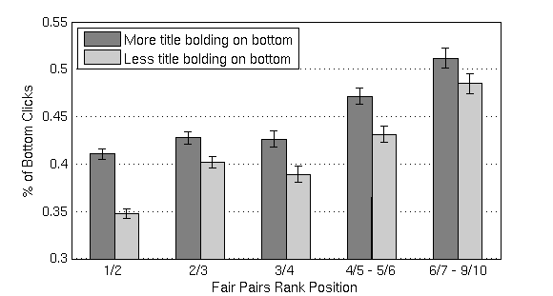
Bias due to Bolding in Title
Click frequency on adjacent results (randomly swapped)
Click data collected from Google web search
Bars should be equal if not biased
Suggests a method to correct for attractiveness bias
Rank Pair
  [Yue et al. 2010a]

Slide 122
Credit Assignment
Not all clicks are created equal
  Most click evaluation usually just counts clicks as binary events
  Clicks can be weighted based on order, time spent, position…
Example: Interleaved query session with 2 clicks
  One click at rank 1 (from ranking A)
  Later click at rank 4 (from ranking B)
  Normally would count this query session as a tie

Slide 123
Credit Assignment
Clicks need not be weighted equally in Interleaving evaluation
Take this Team Draft interleaving:
(this click was very likely)
(yet the user clicked again)
Is this a tie, or should Ranking B actually win here?
  Rather than making something up, lets look at some data
A
Click
B
A
B
Click

Slide 124
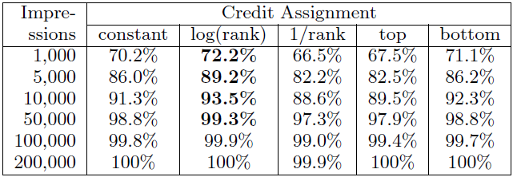
Credit Assignment
A simple test:
  Suppose you saw many queries
  How often does a small subsample agree on the experiment outcome?
  More sensitive assignment should agree more often
A
Click
B
A
Amount of data
B
Click
Get the “right” outcome sooner
  [Radlinski & Craswell, 2010]

Slide 125
Learning a Better Credit Assignment
Represent each click as a feature vector
The score of a click is
  How do we learn the optimal ?
  [Yue et al. 2010b; Chapelle et al. (under review)]

Slide 126
Learning a Better Credit Assignment
differentiates last clicks and other clicks
  [Yue et al. 2010b; Chapelle et al. (under review)]

Slide 127
Learning a Better Credit Assignment
differentiates last clicks and other clicks
Suppose we interleave A vs B
Lets suppose that:
  On average there are 3 clicks per session
  The last click is on A 60% of the time
  The other 2 clicks split 50/50 random
  [Yue et al. 2010b; Chapelle et al. (under review)]

Slide 128
Learning a Better Credit Assignment
differentiates last clicks and other clicks
Suppose we interleave A vs B
Lets suppose that:
  On average there are 3 clicks per session
  The last click is on A 60% of the time
  The other 2 clicks split 50/50 random
Normal weighting corresponds to w = [1 1]
A weighting vector w = [1 0] has much lower variance
  [Yue et al. 2010b; Chapelle et al. (under review)]

Slide 129
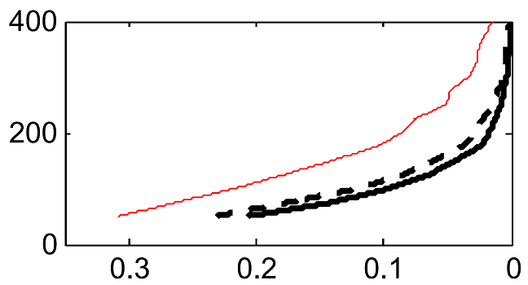
Experimental Test
Uniform click weighting
Data Required
Learning approaches
Target p-value
Click data collected from ArXiv.org with two known rankers
Learned weights let you obtain the same significance level with fewer queries
However, the calibration results from Part 2 no longer hold
  [Yue et al. 2010b; Chapelle et al. (under review)]

Slide 130
Other Click Evaluation Challenges
Clicks on different documents are only equally meaningful if they get the same attention
  E.g. documents with different length snippets
  E.g. a mix of text, images and video
Evaluating for diversity
  Suppose the goal is to diversify search results
  Some types of intents might be preferentially not clicked
  Two differently diverse lists, if interleaved, may end up less diverse
Beyond rankings
  Evaluating results in a grid (e.g. images)
  Evaluating faceted search rankings (e.g. shopping)
Beyond evaluation: How to optimize the system?

Slide 131
Summary of Part 3
Subtleties/imperfections in interleaving
  Different interleaving methods exhibit different behavior
  Interpretation can be improved by weighting clicks
Part 1 focused on position bias
  Should be aware of other sources of bias (e.g., title bias)
Alternative click weighting was explored
  Provide more sensitive evaluation for interleaving
  But you lose the calibration results shown in Part 1
  Not limited to interleaving: Any online evaluation could do something similar

Slide 132
Practical Online Retrieval Evaluation
Part 4
Filip Radlinski (Microsoft)
Yisong Yue (CMU)

Slide 133
Outline
Part 1 : Overview of Online Evaluation
Part 2: End-to-End, From Design to Analysis
(Break during Part 2)
Part 3: Open Problems in Click Evaluation
Part 4: Connection to Optimization & Learning
  Deriving training data from pairwise preferences
  Document-level vs ranking-level feedback
  Machine learning approaches that use pairwise prefs.

Slide 134
From Evaluation to Optimization
Evaluation is only half the battle
We want better information retrieval systems!
Conclude with brief overview of machine learning approaches that leverage implicit feedback

Slide 135
Optimization
Two general ways of optimizing
1. Start with collection of retrieval functions
  Pick best one based on user feedback
2. Start with parameterized retrieval function
  Pick best parameters based on user feedback

Slide 136
Optimization Criterion
We need to an optimization goal
Our goal is simple: maximize an evaluation metric!
Leverage techniques we’ve seen for deriving judgments from usage data
  Convert into deriving training data for machine learning algorithms

Slide 137
Absolute Judgments
Trivial conversion to Cranfield style training
  Covered in Machine Learning for IR tutorial this morning
Derived judgments
  Rel(D1) = 1
  Rel(D2) = 0
  Rel(D3) = 0
  …
Presented Ranking
Napa Valley – The authority for lodging...
www.napavalley.com
2. Napa Country, California – Wikipedia
en.wikipedia.org/wiki/Napa_Valley
3. Napa: The Story of an American Eden...
books.google.co.uk/books?isbn=...
Napa Valley Wineries – Plan your wine...
www.napavalley.com/wineries
5. Napa Valley Hotels – Bed and Breakfast...
www.napalinks.com
Napa Balley College
www.napavalley.edu/homex.asp
7 NapaValley.org
www.napavalley.org
Click
Click
Agichtein et al. 2006b
Carterette & Jones 2007
Chapelle & Zhang 2009
Bennett et al. 2011

Slide 138
Reliable Training Data
We’ll mainly focus on pairwise online data
  If pairwise evaluation is more sensitive, can we derive training data using pairwise approaches?
Two approaches:
  Document-level feedback
  Ranking-level feedback (interleaving two rankings)

Slide 139
Outline of Approaches
 | Document-level Judgments | Ranking-level Judgments
Select the Best Retrieval Function from a Collection | 1 | 3
Optimize a Parameterized Retrieval Function | 2 | 4

Slide 140
Document-level Training Data
Recall from Part 1:
  Users tend to look at results above clicked result
  Users sometimes look at one below clicked result
Derived judgments
  D5 > D2
  D5 > D3
  D5 > D4
  D1 > D2
  D5 > D6
Presented Ranking
Napa Valley – The authority for lodging...
www.napavalley.com
2. Napa Country, California – Wikipedia
en.wikipedia.org/wiki/Napa_Valley
3. Napa: The Story of an American Eden...
books.google.co.uk/books?isbn=...
Napa Valley Wineries – Plan your wine...
www.napavalley.com/wineries
5. Napa Valley Hotels – Bed and Breakfast...
www.napalinks.com
Napa Balley College
www.napavalley.edu/homex.asp
7 NapaValley.org
www.napavalley.org
Click
Click
  [Joachims et al. 2007]

Slide 141
Derived Judgments as Optimization Criterion
Measure utility of ranking function r:
  U(r) = # of pairwise judgments ranked correctly
  Summed over all derived (q, d+, d-) tuples
Derived judgments
  D1 > D2
  D5 > D2
  D5 > D3
  D5 > D4
  D5 > D6

Slide 142
Derived Judgments as Optimization Criterion
Measure utility of ranking function r:
  U(r) = # of pairwise judgments ranked correctly
  Summed over all derived (q, d+, d-) tuples
Derived judgments
  D1 > D2
  D5 > D2
  D5 > D3
  D5 > D4
  D5 > D6
U(r) = 1[ r(q,D1) > r(q,D2) ]
+ 1[ r(q,D5) > r(q,D2) ]
+ 1[ r(q,D5) > r(q,D3) ]
+ 1[ r(q,D5) > r(q,D4) ]
+ 1[ r(q,D5) > r(q,D6) ]
I.e., classification accuracy on pairwise judgments!
Similar to pSkip objective [Wang et al. 2009]

Slide 143
Derived Judgments as Optimization Criterion
Case 1. Collection of retrieval functions {r₁,…,r_{k}}
  Choose r_{i} with highest U(r_{i})
Example:
  Three retrieval functions r₁, r₂, r₃
  U(r₁) = 100
  U(r₂) = 250
  U(r₃) = 175
  Conclusion: r₂ is best

Slide 144
Derived Judgments as Optimization Criterion
Case 2. Parameterized retrieval function r(q,d;w)
  Choose w with highest U(r)
  Often optimize w over a smooth approximation of U(r)
    Recall U(r) is just classification accuracy on pairwise judgments
  Can use SVM, Logistic Regression, etc.
    E.g., Joachims 2002; Freund et al. 2003; Radlinski & Joachims 2005; Burges et al. 2005
Example: logistic regression

Slide 145
Document-level Judgments (Extensions)
Relative preferences across query reformulations
Clicked doc more relevant than earlier unclicked doc
  “Query Chains”
Requires mechanism for segment query sessions
    Simple 30 minute timeout worked well on Cornell Library
q1
q2
Derived document-
level judgments:
Click
A
D
B > A
B > C
D > A
D > C
D > E
Click
B
E
C
F
[Radlinski & Joachims 2005]

Slide 146
Document-level Judgments (Extensions)
Recall from Part 1: Most pairwise judgments go against current ranking
  E.g., cannot derive judgment that higher ranked result is better than lower ranked result
Solution: swap 2 adjacent results w/ prob. 50%
  E.g., interleave two results
  “FairPairs”
  Only store judgment between
  paired results (e.g., D1 > D2)
50%
50%
Click
D1
D2
Click
D2
D1
D3
D3
[Radlinski & Joachims 2006; 2007; Craswell et al. 2008]

Slide 147
Document-level Judgments (Summary)
Derive pairwise judgments between documents
Often more reliable than absolute judgments
  Also supported by experiments on collecting expert judgments [Carterette et al. 2008]
Benefits: reliable & easily reusable
  Often gives “correct” (in expectation) feedback
  Easy to convert into training data for standard ML algorithms
Limitations: still a biased sample
  Distribution of feedback slanted towards top of rankings

Slide 148
Ranking-level Training Data
In Part 2, we evaluated pairs of retrieval functions by interleaving rankings
Use directly as derived judgments for optimization
  Interleave r₁ and r₂
  Derive U(r₁) > U(r₂) or vice versa

Slide 149
Derived Judgments as Optimization Criterion
Case 1. Collection of retrieval functions {r₁,…,r_{k}}
  Choose r_{i} that wins interleaving comparisons vs rest
Example:
  Three retrieval functions r₁, r₂, r₃
  U(r₁) > U(r₂)
  U(r₁) > U(r₃)
  U(r₂) > U(r₃)
  r₁ is best retrieval func.
Interleaving | Winner (% clicks)
r₁ vs r₂ | r₁ (60%)
r₁ vs r₃ | r₁ (75%)
r₂ vs r₃ | r₂ (65%)
[Feige et al. 1997; Yue et al. 2009; 2011]

Slide 150
Derived Judgments as Optimization Criterion
Case 1. Collection of retrieval functions {r₁,…,r_{k}}
  Choose r_{i} that wins interleaving comparisons vs rest
Example:
  Three retrieval functions r₁, r₂, r₃
  U(r₁) > U(r₂)
  U(r₁) > U(r₃)
  U(r₂) > U(r₃)
  r₁ is best retrieval func.
Only need r₁ vs r₂ and r₁ vs r₃!
What is cost of comparing r₂ vs r₃?
Interleaving | Winner (% clicks)
r₁ vs r₂ | r₁ (60%)
r₁ vs r₃ | r₁ (75%)
r₂ vs r₃ | r₂ (65%)
[Feige et al. 1997; Yue et al. 2009; 2011]

Slide 151
Derived Judgments as Optimization Criterion
Case 2. Parameterized retrieval function r(w)
  Choose w with highest U(r(w))
  Interleaving reveals relative values of U(r(w)) vs U(r(w’))
Approach: gradient descent via interleaving
  Make a perturbation w’ from w
  Interleave r(w) vs r(w’)
  If r(w’) wins, replace w = w’
[Yue & Joachims 2009; Hofmann et al. 2011a]

Slide 152

Current point
Losing candidate
Winning candidate
Dueling Bandit Gradient Descent

Slide 153
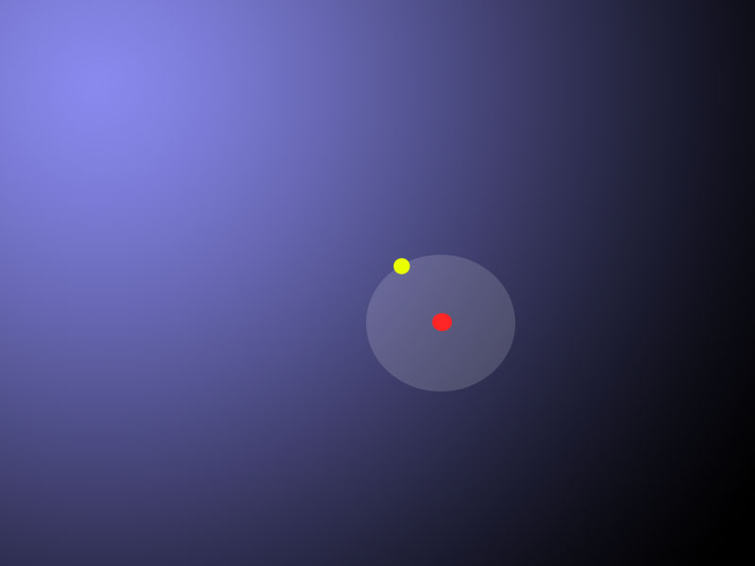
Current point
Losing candidate
Winning candidate
Dueling Bandit Gradient Descent

Slide 154
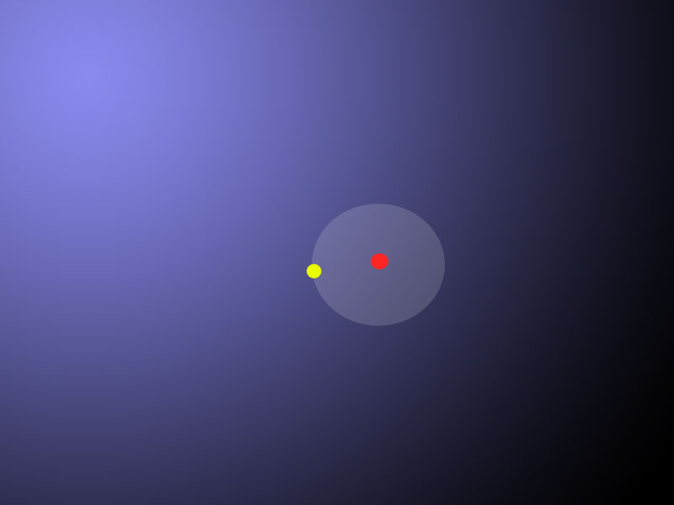
Current point
Losing candidate
Winning candidate
Dueling Bandit Gradient Descent

Slide 155

Current point
Losing candidate
Winning candidate
Dueling Bandit Gradient Descent

Slide 156
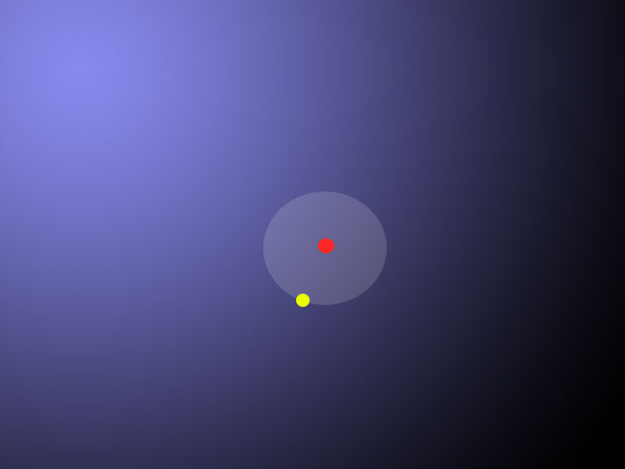
Current point
Losing candidate
Winning candidate
Dueling Bandit Gradient Descent

Slide 157

Current point
Losing candidate
Winning candidate
Dueling Bandit Gradient Descent

Slide 158

Current point
Losing candidate
Winning candidate
Dueling Bandit Gradient Descent

Slide 159
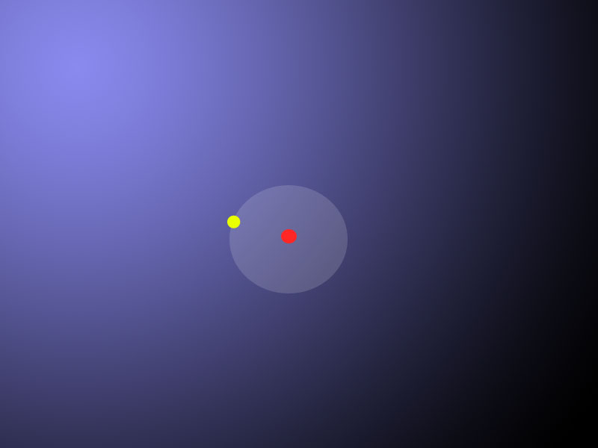
Current point
Losing candidate
Winning candidate
Dueling Bandit Gradient Descent

Slide 160
Ranking-level Judgments (Summary)
Derive pairwise judgments between rankings
  Directly measures relative quality between two rankings
  I.e., U(r) > U(r’) ??
  Fewer assumptions about the form of U(r)
Benefits: reliable & unbiased feedback
  Interleaving samples from the distribution of queries and users
Drawbacks: not easily reusable
  Evaluating each pair requires new interleaving experiment
  Should model cost of running an interleaving experiment

Slide 161
Summary of Approaches
 | Document-level Judgments | Ranking-level Judgments
Select the Best Retrieval Function from a Collection | Define utility based on pairs ranked correctly Select retrieval function with highest utility | Treat interleaving as comparison oracle Similar to running a tournament
Optimize a Parameterized Retrieval Function | Treat as classification Judgments are training labels between pairs Train w/ standard methods | Treat interleaving as comparison oracle Can be used to estimate a gradient in parameter space

Slide 162
Summary of Approaches
 | Document-level Judgments | Ranking-level Judgments
Select the Best Retrieval Function from a Collection | Define utility based on pairs ranked correctly Select retrieval function with highest utility | Treat interleaving as comparison oracle Similar to running a tournament
Optimize a Parameterized Retrieval Function | Treat as classification Judgments are training labels between pairs Train w/ standard methods | Treat interleaving as comparison oracle Can be used to estimate a gradient in parameter space
*More popular
Notes:
Continuous parameter optimization is more popular when using document-level judgments because of the straightforward reduction to conventional learning algorithms. This has been an area of intense study within the machine learning community called Learning to Rank.
When collecting ranking-level judgments such as via interleaving, because of limited re-usability and quality penalty of running poor rankers online, evaluation is typically only done on a set of “good” candidate ranking functions. This is often restricted to a small pool of ranking functions (very frequently just 2 at a time – the incumbent ranker and a proposed candidate).

Slide 163
Other Approaches
Usage data as features
  E.g., clickthrough rate as feature of a result
  Use expert judgments as training data (Cranfield-style)
  E.g., [Agichtein et al. 2006a; Chapelle & Zhang 2009; Wang et al. 2009]

Slide 164
Other Approaches
Other forms of usage data
Browsing data
  “The documents users browse to after issuing a query are relevant documents for that query.”
  Teevan et al. 2005; Liu et al. 2008; Bilenko & White 2008
Mouse movements
  “The search results that users mouse over often are relevant documents for that query”
  Guo et al. 2006a; 2006b; Huang et al. 2011

Slide 165
Summary of Part 4
Ultimate goal: Find the best retrieval system
  Evaluation is only half the battle
ML approach to optimization
Reviewed methods for deriving training data
  Focused on pairwise/relative feedback

Slide 166
Tutorial Summary
Provided an overview of online evaluation
  Online metrics: What works when (especially if you’re an academic)
  Interpreting user actions at the Document or Ranking level
  Experiment Design: Opportunities, biases and challenges
Showed how to get started obtaining your own online data
  How to realistically “be the search engine”
  End-to-End: Design, Implementation, Recruitment and Analysis
  Overview of alternative approaches
Presented interleaving for retrieval evaluation
  Described one particular online evaluation approach in depth
  How it works, why it works and what to watch out for
  Provide a reference implementation
  Describe a number of open challenges
Quick overview of using your online data for learning

Slide 167
Questions?

Slide 168
Acknowledgments
We thank Thorsten Joachims, Nick Craswell, Matt Lease, Yi Zhang, and the anonymous reviewers for providing valuable feedback.
We thank Eugene Agichtein, Ben Carterette, Olivier Chapelle, Nick Craswell, and Thorsten Joachims for providing slide material.
Yisong Yue was funded in part by ONR (PECASE) N000141010672.

Slide 169
Bibliography
1 Interleaving Algorithms & Evaluation
  1.1 Producing interleaved rankings
    JOACHIMS, T. 2002. Optimizing Search Engines Using Clickthrough Data. In Proceedings of the ACM International Conference on Knowledge Discovery and Data Mining (KDD).pp 132–142.
    JOACHIMS, T. 2003. Evaluating Retrieval Performance using Clickthrough Data. In Text Mining, J. Franke, G. Nakhaeizadeh, and I. Renz, Eds. Physica/Springer Verlag, 7996.
    RADLINSKI, F., KURUP, M., AND JOACHIMS, T. 2008. How Does Clickthrough Data Reflect Retrieval Quality. In Proceedings of the ACM Conference on Information and Knowledge Management (CIKM).
    RADLINSKI, F., KURUP, M., AND JOACHIMS, T. 2010. Evaluating search engine relevance with click-based metrics. In Preference Learning, J. Fuernkranz and E. Huellermeier, Eds. Springer, pp 337–362.
    CHAPELLE, O., JOACHIMS, T., RADLINSKI, F., YUE, Y. (under review) Large Scale Validation and Analysis of Interleaved Search Evaluation.
  1.2 Alternative scoring approaches & Statistical tests
    CHAPELLE, O., JOACHIMS, T., RADLINSKI, F., YUE, Y. (under review) Large Scale Validation and Analysis of Interleaved Search Evaluation.
    EFRON, B., TIBSHIRANI, R. 1993. An Introduction to the Bootstrap. Chapman & Hall, CRC Monographs on Statistics & Applied Probability.
    RADLINSKI, F. AND CRASWELL, N. 2010. Comparing the sensitivity of information retrieval metrics. In Proceedings of the ACM International Conference on Research and Development in Information Retrieval (SIGIR).pp 667–674.
    SMUCKER, M. AND ALLAN, J. AND CARTERETTE, B. 2009. Agreement Among Statistical Significance Tests for Information Retrieval Evaluation at Varying Sample Sizes. In Proceedings of the ACM International Conference on Research and Development in Information Retrieval (SIGIR).
    YUE, Y. AND GAO, Y. AND CHAPELLE, O., ZHANG, Y., AND JOACHIMS, T. 2010. Click-Based Retrieval Evaluation. In Proceedings of the ACM International Conference on Research and Development in Information Retrieval (SIGIR).

Slide 170
  1.3 Examples of other work that uses interleaving to evaluate rankings
    RADLINSKI, F. AND JOACHIMS, T. 2005. Query chains: Learning to rank from implicit feedback. In Proceedings of the ACM International Conference on Knowledge Discovery and Data Mining (KDD).
    MATTHIJS, N. AND RADLINSKI, F. 2011. Personalizing Web Search using Long Term Browsing History. In Proceedings of the ACM International Conference on Web Search and Data Mining (WSDM).
    HE, J. AND ZHAI, C. AND LI, X. 2009. Evaluation of methods for relative comparison of retrieval systems based on clickthroughs. In Proceedings of the ACM Conference on Information and Knowledge Management (CIKM).
    HOFMANN, K. AND WHITESON, S. AND DE RIJKE, M. 2011. A Probabilistic Method for Inferring Preferences from Clicks. In Proceedings of the ACM Conference on Information and Knowledge Management (CIKM).
2 Clicks in General
  2.1 Click based evaluation
    AGICHTEIN, E., BRILL, E., DUMAIS, S., AND RAGNO, R. 2006. Learning user inter- action models for prediction web search results preferences. In Proceedings of the ACM International Conference on Research and Development in Information Retrieval (SIGIR).
    BENNETT, P., RADLINSKI, F., WHITE, R., YILMAZ, E. 2011. Inferring and Using Location Metadata to Personalize Web Search. In Proceedings of the ACM International Conference on Research and Development in Information Retrieval (SIGIR).
    CARTERETTE, B. AND JONES, R. 2007. Evaluating search engines by modeling the relationship between relevance and clicks. In Proceedings of the International Conference on Advances in Neural Information Processing Systems (NIPS).
    CHAPELLE, O., ZHANG, Y., METZLER, D., AND GRINSPAN, P. 2009. Expected Reciprocal Rank for Graded Relevance. In Proceedings of the ACM Conference on Information and Knowledge Management (CIKM).
    CHAPELLE, O. AND ZHANG, Y. 2009. A dynamic bayesian network click model for web search ranking. In Proceedings of the International Conference on the World Wide Web (WWW).pp 1–10.
    CRASWELL, N., ZOETER, O., TAYLOR, M., AND RAMSEY, B. 2008. An experimental comparison of click position-bias models. In Proceedings of the ACM International Conference on Web Search and Data Mining (WSDM).

Slide 171
    DUPRET, G., AND LIAO, C., 2010. A model to estimate intrinsic document relevance from the clickthrough logs of a web search engine. In Proceedings of the ACM International Conference on Web Search and Data Mining (WSDM).
    DUPRET, G., AND PIWOWARSKI, B. 2008. A User Browsing Model to Predict Search Engine Click Data from Past Observations. In Proceedings of the ACM International Conference on Research and Development in Information Retrieval (SIGIR).
    JOACHIMS, T., GRANKA, L., PAN, B., HEMBROOKE, H., RADLINSKI, F., AND GAY, G. 2007. Evaluating the accuracy of implicit feedback from clicks and query reformulations in web search. ACM Transactions on Information Science (TOIS) 25 (2). Article 7.
    JOACHIMS, T., GRANKA, L., PAN, B., HEMBROOKE, H., GAY, G. 2005. Accurately Interpreting Clickthrough Data as Implicit Feedback. In Proceedings of the ACM International Conference on Research and Development in Information Retrieval (SIGIR).
    RADLINSKI, F., BENNETT, P., AND YILMAZ, E. 2011. Detecting Duplicate Web Documents using Clickthrough Data. In Proceedings of the ACM International Conference on Web Search and Data Mining (WSDM).
    RADLINSKI, F., JOACHIMS, T. 2007. Active Exploration for Learning Rankings from Clickthrough Data. In Proceedings of the ACM International Conference on Knowledge Discovery and Data Mining (KDD).
    THOMAS, P., HAWKING, D. 2008. Experiences evaluating personal metasearch. In Proceedings of the Information Interaction in Context Conference (IIiX).
    WANG, K., WALKER, T., AND ZHENG, Z. 2009. PSkip: estimating relevance ranking quality from web search clickthrough data. In Proceedings of the ACM International Conference on Knowledge Discovery and Data Mining (KDD).pp 1355–1364.
    YUE, Y., PATEL, R., AND ROEHRIG, H. 2010a. Beyond Position Bias: Examining Result Attractiveness as a Source of Presentation Bias in Clickthrough Data. In Proceedings of the International Conference on the World Wide Web (WWW).
    ZHANG, W., JONES, R. 2007. Comparing Click Logs and Editorial Labels for Training Query Rewriting. In Proceedings of the International Conference on the World Wide Web (WWW).
    ZHONG, F., WANG, D., WANG, G., WEIZHU, C., ZHANG, Y., CHEN, Z., WANG, H. 2010. Incorporating Post-Click Behaviors into a Click Model. In Proceedings of the ACM International Conference on Research and Development in Information Retrieval (SIGIR).

Slide 172
  2.2 Limitations of clicks
    YUE, Y., PATEL, R., AND ROEHRIG, H. 2010a. Beyond Position Bias: Examining Result Attractiveness as a Source of Presentation Bias in Clickthrough Data. In Proceedings of the International Conference on the World Wide Web (WWW).
    LI, J., HUFFMAN, S., TOKUDA, A. 2009. Good Abandonment in Mobile and PC Internet Search. In Proceedings of the ACM International Conference on Research and Development in Information Retrieval (SIGIR).
  2.3 Clicks as features
    AGICHTEIN, E., BRILL, E., DUMAIS, S., AND RAGNO, R. 2006a. Learning user interaction models for prediction web search results preferences. In Proceedings of the ACM International Conference on Research and Development in Information Retrieval (SIGIR).
    AGICHTEIN, E., BRILL, E., AND DUMAIS, S. 2006b. Improving Web Search Ranking by Incorporating User Behavior Information. In Proceedings of the ACM International Conference on Research and Development in Information Retrieval (SIGIR).
    CHAPELLE, O. AND ZHANG, Y. 2009. A dynamic bayesian network click model for web search ranking. In Proceedings of the International Conference on the World Wide Web (WWW).pp 1–10.
    GAO, J., YUAN, W., LI, X., DENG, K., AND NIE, J. 2009. Smoothing clickthrough data for web search ranking. In Proceedings of the ACM International Conference on Research and Development in Information Retrieval (SIGIR).
    JI, S., ZHOU, K., LIAO, C., ZHENG, Z., XUE, G., CHAPELLE, O., SUN, G., AND ZHA, H. 2009. Global Ranking by Exploiting User Clicks. In Proceedings of the ACM International Conference on Research and Development in Information Retrieval (SIGIR).
    TEEVAN, J., DUMAIS, S., LIEBLING, D. 2008. To Personalize or Not to Personalize: Modeling Queries with Variation in User Intent. In Proceedings of the ACM International Conference on Research and Development in Information Retrieval (SIGIR).
    WANG, K., WALKER, T., AND ZHENG, Z. 2009. PSkip: estimating relevance rank- ing quality from web search clickthrough data. In Proceedings of the ACM International Conference on Knowledge Discovery and Data Mining (KDD).pp 1355–1364.

Slide 173
  2.4 Learning from Clicks
    AGRAWAL, R., HALVERSON, A., KENTHAPADI, K., MISHRA, N., AND TSAPARAS, P. 2009. Generating labels from clicks. In Proceedings of the ACM International Conference on Web Search and Data Mining (WSDM).pp 172–181.
    BOYAN, J., FREITAG, D., AND JOACHIMS, T. 1996. A Machine Learning Architecture for Optimizing Web Search Engines. Proceedings of the AAAI Workshop on Internet Based Information Systems.
    EL-ARINI, K., VEDA, G., SHAHAF, D., GUESTRIN, C. 2009. Turning down the noise in the blogosphere. In Proceedings of the ACM International Conference on Knowledge Discovery and Data Mining (KDD).
    FEIGE, U., RAGHAVAN, P., PELEG, D., UPFAL. E. 1994. Computing with Noisy Information. SIAM Journal on Computing 23(5):1001-1018.
    HOFMANN, K. AND WHITESON, S. AND DE RIJKE, M. 2011. Balancing Exploration and Exploitation in Learning to Rank Online. In Proceedings of the European Conference on Information Retrieval (ECIR).
    JOACHIMS, T. 2002. Optimizing Search Engines Using Clickthrough Data. In Proceedings of the ACM International Conference on Knowledge Discovery and Data Mining (KDD).pp 132–142.
    LI, L., CHU, W., LANGFORD, J., SCHAPIRE, R. 2010. A contextual-bandit approach to personalized news article recommendation. In Proceedings of the International Conference on the World Wide Web (WWW).
    RADLINSKI, F. AND JOACHIMS, T. 2005. Query chains: Learning to rank from implicit feedback. In Proceedings of the ACM International Conference on Knowledge Discovery and Data Mining (KDD).
    RADLINSKI, F., JOACHIMS, J. 2007. Active Exploration for Learning Rankings from Clickthrough Data. In Proceedings of the ACM International Conference on Knowledge Discovery and Data Mining (KDD).
    RADLINSKI, F., KLEINBERG, R., AND JOACHIMS, T. 2008. Learning Diverse Rankings with Multi-Armed Bandits. In Proceedings of the International Conference on Machine Learning (ICML).
    SLIVKINS, A., RADLINSKI, F., GOLLAPUDI, S. 2010. Learning optimally diverse rankings over large document collections. In Proceedings of the International Conference on Machine Learning (ICML).
    YUE, Y., JOACHIMS, T. 2009. Interactively Optimizing Information Retrieval Systems as a Dueling Bandits Problem. In Proceedings of the International Conference on Machine Learning (ICML).
    YUE, Y., BRODER, J., KLEINBERG, R., JOACHIMS, T.. 2009. The K-Armed Dueling Bandits Problem. In Proceedings of the International Conference on Learning Theory (COLT).
    YUE, Y., JOACHIMS, T. 2011. Beat the Mean Bandit. In Proceedings of the International Conference on Machine Learning (ICML).

Slide 174
3 Online Usage Data Beyond Search Clicks
  3.1 Non-click based metrics
    BUSCHER, G., DENGEL, A., AND VAN ELST, L. 2008. Eye movements as implicit relevance feedback. In Proceedings of the ACM Conference on Human Factors in Computing Systems (CHI).pp 2991–2996.
    GRANKA, L., JOACHIMS, T. AND GAY, G. 2004. Eye-Tracking Analysis of User Behavior in WWW-Search, Poster Abstract, In Proceedings of the ACM International Conference on Research and Development in Information Retrieval (SIGIR).
    HUANG, J., WHITE, R., DUMAIS, S. 2011. No Clicks, No Problem: Using Cursor Movements to Understand and Improve Search. In Proceedings of the ACM Conference on Human Factors in Computing Systems (CHI).
    KELLY, D. AND TEEVAN, J. 2003. Implicit feedback for inferring user preference: A bibliography. ACM SIGIR Forum 37, 2, pp 18–28.
    GUO, Q., AGICHTEIN, E., 2010. Ready to Buy or Just Browsing? Detecting Web Searcher Goals from Interaction Data. In Proceedings of the ACM International Conference on Research and Development in Information Retrieval (SIGIR).
    GUO, Q., AGICHTEIN, E., 2010. Towards Predicting Web Searcher Gaze Position from Mouse Movements. In Proceedings of the ACM Conference on Human Factors in Computing Systems (CHI).

Slide 175
  3.2 Clicks outside of search
    BILENKO, M., WHITE, R., RICHARDSON, M., AND Murray, C. 2008. Talking the talk vs. walking the walk: salience of information needs in querying vs. browsing. In Proceedings of the ACM International Conference on Research and Development in Information Retrieval (SIGIR).
    BILENKO, M., WHITE, R. 2008. Mining the Search Trails of Surfing Crowds: Identifying Relevant Websites From User Activity. In Proceedings of the ACM International Conference on Research and Development in Information Retrieval (SIGIR).
    LIU, Y., GAO, B., LIU, T., ZHANG, Y., Ma, Z., HE, S., AND LI, H. 2008. BrowseRank: letting web users vote for page importance. In Proceedings of the ACM International Conference on Research and Development in Information Retrieval (SIGIR).
    MATTHIJS, N. AND RADLINSKI, F. 2011. Personalizing Web Search using Long Term Browsing History. In Proceedings of the ACM International Conference on Web Search and Data Mining (WSDM).
    TEEVAN, J., DUMAIS, S., HORVITZ, E., 1995. Personalizing Search via Automated Analysis of Interests and Activities. In Proceedings of the ACM International Conference on Research and Development in Information Retrieval (SIGIR).

Slide 176
4 Learning from Pairwise Feedback
    BURGES, C., SHAKED, T., RENSHAW, E., LAZIER, A., DEEDS, M., HAMILTON, N., HULLENDER, G. 2005. Learning to Rank using Gradient Descent. In Proceedings of the International Conference on Machine Learning (ICML).
    FREUND, Y., IYER, R., SCHAPIRE, R., SINGER, Y. 2003. An Efficient Boosting Algorithm for Combining Preferences. Journal of Machine Learning Research (JMLR), Vol 4, pp 933–969
    HOFMANN, K. AND WHITESON, S. AND DE RIJKE, M. 2011. Balancing Exploration and Exploitation in Learning to Rank Online. In Proceedings of the European Conference on Information Retrieval (ECIR).
    JOACHIMS, T. 2005. A Support Vector Method for Multivariate Performance Measures. In Proceedings of the International Conference on Machine Learning (ICML).
    RADLINSKI, F., JOACHIMS, J. 2007. Active Exploration for Learning Rankings from Clickthrough Data. In Proceedings of the ACM International Conference on Knowledge
    Discovery and Data Mining (KDD).
5 Efficient Offline Evaluation
    CARTERETTE, B., ALLAN, J., SITARAMA, R. 2006. Minimal Test Collections for Retrieval Evaluation. In Proceedings of the ACM International Conference on Research and Development in Information Retrieval (SIGIR)
    CARTERETTE, B., BENNETT, P. N., CHICKERING, D. M., AND DUMAIS, S. T. 2008. Here or there: Preference judgments for relevance. In Proceedings of the European Conference on Information Retrieval (ECIR).
    CARTERETTE, B., SMUCKER, M. 2007. Hypothesis Testing with Incomplete Relevance Judgments. In Proceedings of the ACM Conference on Information and Knowledge Management (CIKM).

