Slide 1



Learning with
Humans in the Loop
Yisong Yue
Carnegie Mellon University
Research supported by:
Microsoft Fellowship, Yahoo! Key Scientific Challenges Award,
NSF IIS-0412894, NSF IIS-0713483, NSF CAREER 0237381,
ONR (PECASE) N000141010672, ONR YIP N00014-08-1-0752

Slide 2
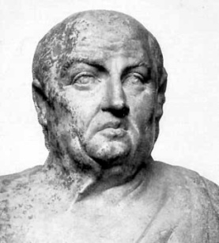
The abundance of
books is a distraction
‘‘
,,
Lucius Annaeus Seneca
4 BC – 65 AD
Today: 129,864,880 Books
(Google estimate, 2012)

Slide 3


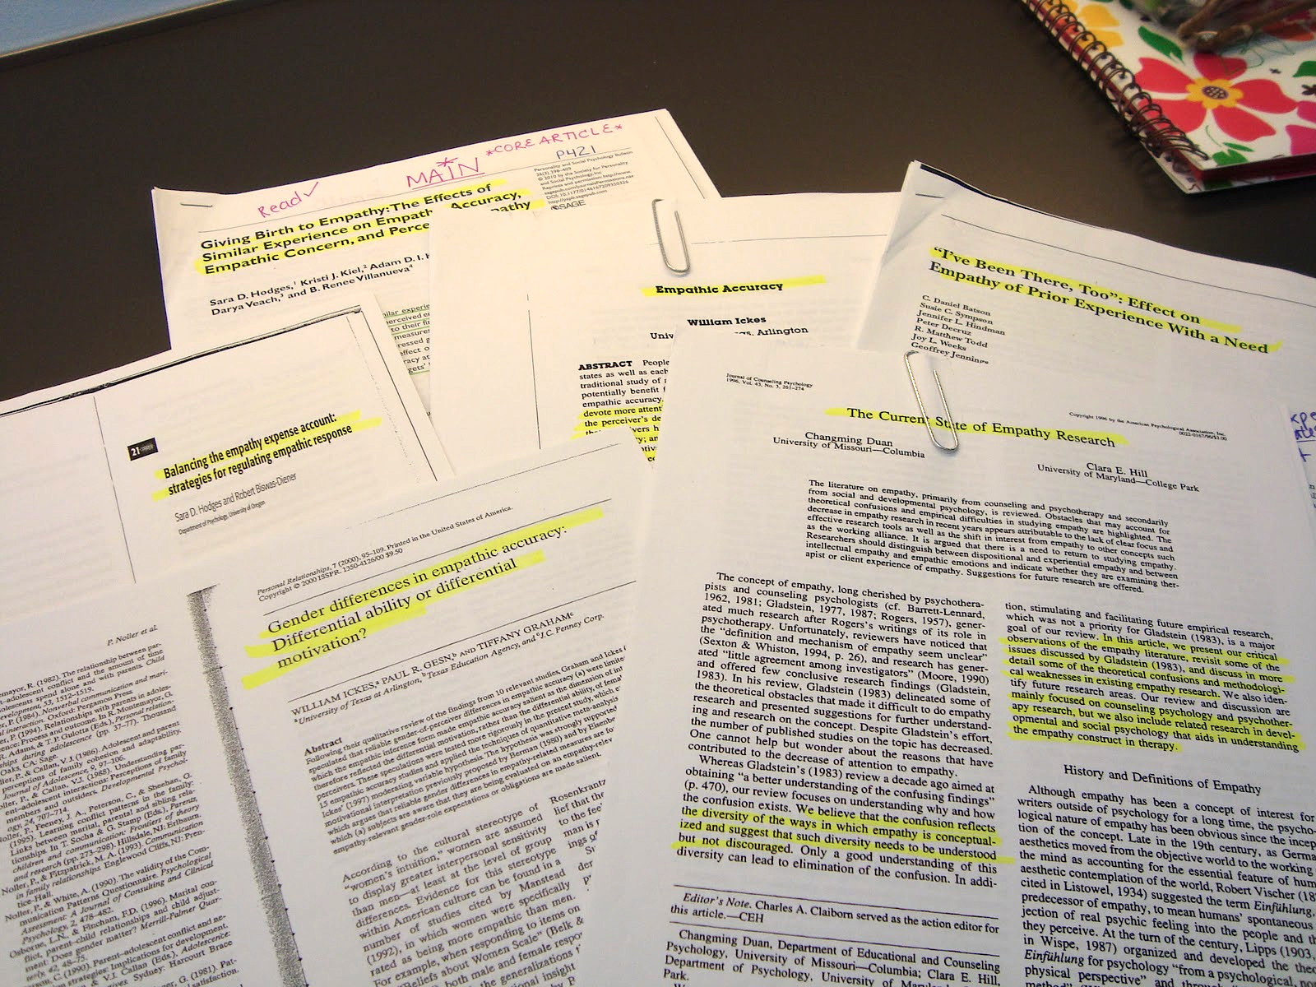
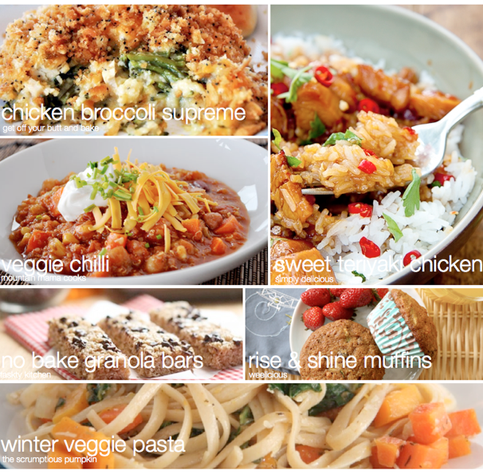
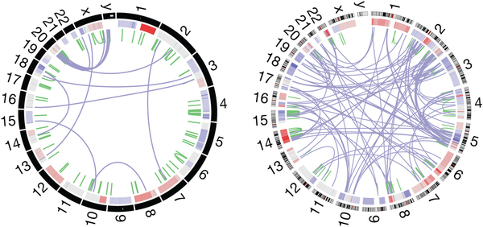


10K articles per day
815K papers on arXiv.org
58K movies on Amazon Instant Video
36K MicroArray experiments on PUMAdb
Thousands of attractions
450K recipes on food.com
Ratings
Reviews
Ratings of Reviews
“Big Data”
Notes:
Get rid of retarded animation

Slide 4












Goal:
Maximize total user utility
Tasks
Multiple Rounds
Browse, Search,
Review, Rate, etc.
Recommend Content
Applications

Slide 5
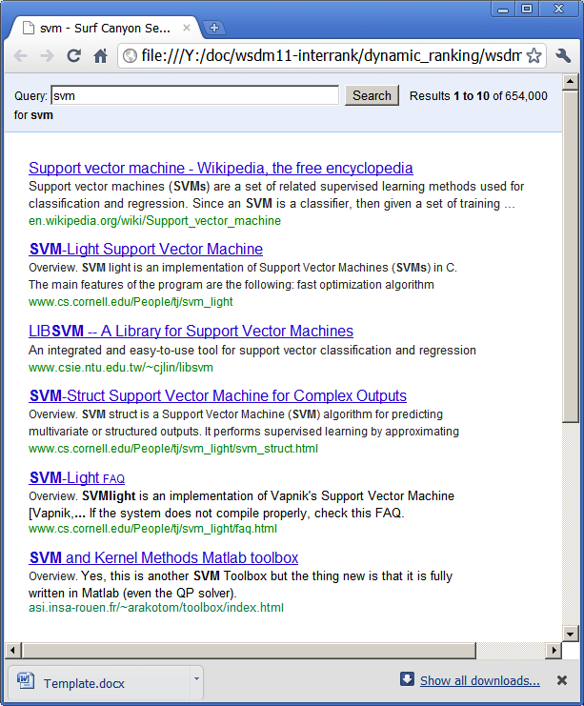


Goal: Maximize total user utility
Model
Information Need
Close Loop Interaction
Multiple Rounds
Click
Interpret Human Interaction
Principled
-- Theoretically justified
Practical
-- Big Data
-- Works in practice

Slide 6



Personalized
News Recommendation
Model
Information Need
Close Loop Interaction
Multiple Rounds

Slide 7

Obama goes big on gun control, but can he deliver?
Modeling
Information Utility
Lance Armstrong admits doping to Oprah
Several State Legislators Say No to Federal Gun Control Laws
Algeria hostage crisis ends; death toll unclear
In Newtown, calls for more gun control
Redundant!
Diverse and Novel!
Redundancy leads to bad user experience
Users often interested in multiple things
Should “cover all bases” by diversifying
Structured optimization problem

Slide 8
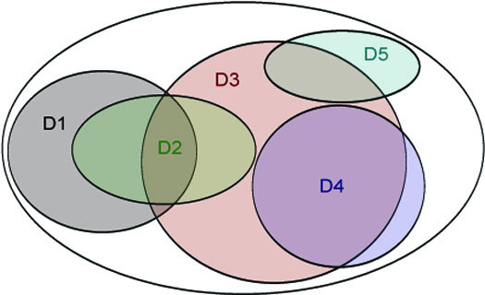
Choose top 3 documents
  Individual Relevance: D3 D4 D1
  Greedy Coverage Solution: D3 D1 D5

Slide 9

Choose top 3 documents
  Individual Relevance: D3 D4 D1
  Greedy Coverage Solution: D3 D1 D5

Slide 10
Choose top 3 documents
  Individual Relevance: D3 D4 D1
  Greedy Coverage Solution: D3 D1 D5

Slide 11
Choose top 3 documents
  Individual Relevance: D3 D4 D1
  Greedy Coverage Solution: D3 D1 D5

Slide 12
Choose top 3 documents
  Individual Relevance: D3 D4 D1
  Greedy Coverage Solution: D3 D1 D5

Slide 13
Choose top 3 documents
  Individual Relevance: D3 D4 D1
  Greedy Coverage Solution: D3 D1 D5

Slide 14
This diminishing returns
property is called
submodularity
Choose top 3 documents
  Individual Relevance: D3 D4 D1
  Greedy Coverage Solution: D3 D1 D5

Slide 15

F_{c}(A) = how well A
“covers” c
Submodular
Coverage Functions
F (A)
Diminishing returns: Submodularity
Set of articles: A
User preferences: w
NP-hard in general
Greedy: (1-1/e) guarantee
[Nemhauser et al., 1978]
Goal:

Slide 16

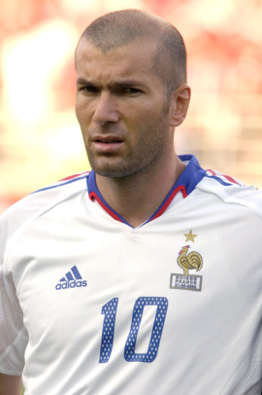
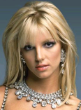
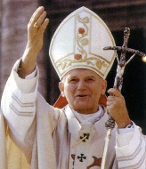
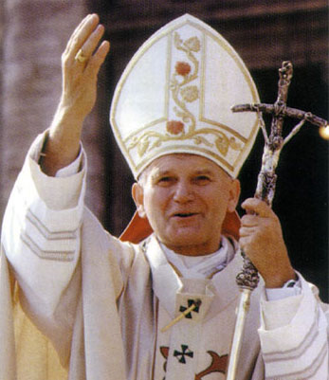
Likes Politics and Sports
Likes Celebrity and Economy
Obama goes big on gun control, but can he deliver?
Jodie Foster's Golden Globes Speech: Surprisingly Personal
Who's Going To The Super Bowl?
China's Economy Is on the Mend, but Concerns Remain
Obama Renews Oath for 2nd Term
Les Misérables: a revolutionary musical

Slide 17
Personalized
News Recommendation
Model
Information Need
Close Loop Interaction
Multiple Rounds
Structured Information Utility Model
-- Submodular Coverage
-- Models Redundancy
-- Flexible, personalizable

Slide 18

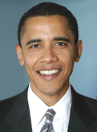

Interactive Personalization
Sports
Politics
World
-- | -- | -- | -- | --
0 | 0 | 1 | 1 | 1
: 0
Average Likes
# Shown

Slide 19


Interactive Personalization
Sports
Politics
World
-- | -- | 1.0 | 0.0 | 0.0
0 | 0 | 1 | 1 | 1
: 1
Average Likes
# Shown

Slide 20
Interactive Personalization
Sports
Politics
Politics
Economy
World
Sports
-- | -- | 1.0 | 0.0 | 0.0
0 | 1 | 2 | 2 | 1
: 1
Average Likes
# Shown

Slide 21
Interactive Personalization
Sports
Politics
Politics
Economy
World
Sports
-- | 1.0 | 1.0 | 0.0 | 0.0
0 | 1 | 2 | 2 | 1
: 3
Average Likes
# Shown

Slide 22
Interactive Personalization
Sports
Politics
Politics
Politics
Economy
Economy
World
Sports
Politics
-- | 1.0 | 1.0 | 0.0 | 0.0
0 | 2 | 4 | 2 | 1
: 3
Average Likes
# Shown

Slide 23
Interactive Personalization
Sports
Politics
Politics
Politics
Economy
Economy
…
World
Sports
Politics
-- | 0.5 | 0.75 | 0.0 | 0.0
0 | 2 | 4 | 2 | 1
: 4
Average Likes
# Shown

Slide 24
Linear Submodular Bandits Problem
Exploration vs Exploitation
Goal: Maximize total user utility
Exploit:
Politics
Explore:
Celebrity
Best:
World
Economy
World
Politics
How to optimally balance explore/exploit?
Politics
Celebrity
World
-- | 0.5 | 0.75 | 0.0 | 0.0
0 | 2 | 4 | 2 | 1
: 4
Average Likes
# Shown

Slide 25
( )
( )
( )
…
( )
( )
( )
…
Time Horizon
Regret:
Opportunity cost of not knowing preferences
“no-regret” if R(T)/T ➔ 0
  Efficiency measured by convergence rate
[Yue & Guestrin, NIPS 2011]

Slide 26
Learning Submodular Coverage Models
Submodular functions well-studied
  [Nemhauser et al., 1978; Hochbaum, 1996; Khuller et al., 1997]
Submodular recommender systems
  Parameterized submodular functions
  [Leskovec et al., 2007; Swaminathan et al., 2009; El-Arini et al., 2009]
Learning submodular functions:
  [Yue & Joachims, ICML 2008]
  [Yue & Guestrin, NIPS 2011]
Interactively from user feedback

Slide 27
Local Linearity
Current article
User’s preferences
Utility
Previous articles
Incremental Gain
Incremental
Coverage

Slide 28
User Model
User scans articles in order
Generates feedback y
Obeys:
Independent of other feedback
Politics
a
A
A
Celebrity
a
Economy
a
“Conditional Submodular Independence”
[Yue & Guestrin, NIPS 2011]

Slide 29
Estimating User Preferences
Observed
Feedback
Submodular Coverage
Features of Recommendations
User
Y
Δ
w
=
Linear regression to estimate w!
[Yue & Guestrin, NIPS 2011]

Slide 30
Balancing Exploration vs Exploitation
For each slot:
Example below: select article on economy
Estimated gain
Uncertainty
Estimated Gain by Topic
+
Uncertainty of Estimate
[Yue & Guestrin, NIPS 2011]

Slide 31
Balancing Explore/Exploit
Sports
Politics
World
C(a|A) shrinks as roughly:
#times topic was shown
[Yue & Guestrin, NIPS 2011]

Slide 32
Balancing Explore/Exploit
Sports
Politics
World
C(a|A) shrinks as roughly:
#times topic was shown
[Yue & Guestrin, NIPS 2011]

Slide 33
Balancing Explore/Exploit
Sports
Politics
Politics
Economy
World
Celebrity
C(a|A) shrinks as roughly:
#times topic was shown
[Yue & Guestrin, NIPS 2011]

Slide 34
Balancing Explore/Exploit
Sports
Politics
Politics
Economy
World
Celebrity
C(a|A) shrinks as roughly:
#times topic was shown
[Yue & Guestrin, NIPS 2011]

Slide 35
Balancing Explore/Exploit
Sports
Politics
Economy
Politics
Economy
Sports
World
Celebrity
World
C(a|A) shrinks as roughly:
#times topic was shown
[Yue & Guestrin, NIPS 2011]

Slide 36
Balancing Explore/Exploit
Sports
Politics
Economy
Politics
Economy
Sports
…
World
Celebrity
World
C(a|A) shrinks as roughly:
#times topic was shown
[Yue & Guestrin, NIPS 2011]

Slide 37
Regret Guarantee
Time Horizon
  Builds upon linear bandits to submodular setting
    [Dani et al., 2008; Li et al., 2010; Abbasi-Yadkori et al., 2011]
  Leverages conditional submodular independence
No-regret algorithm! (regret sub-linear in T)
  Effective at long-term personalization
  Optimal convergence rate: d/(LT)^{1/2}
# Topics
# Articles per Day
[Yue & Guestrin, NIPS 2011]

Slide 38
User Study
Tens of thousands of
real news articles
T=10 days
L=10 articles per day
d=18 topics
Blind paired
comparison
Users rate articles
Count #likes

Slide 39
User Study
Submodular
Bandits Wins
Submodular
Bandits Wins
Submodular
Bandits Wins
~27 users in study
Ties
Ties
Losses
Losses
Static
Weights
Multiplicative
Updates (MW)
(no exploration)
[El-Arini et al., 2009]
LinUCB
(doesn’t directly
model diversity)
[Li et al., 2010]
T=10
L=10
d=18

Slide 40
Inspecting Learned Weights
Submodular Bandits (dark) vs. MW (light)
User liked few articles (8 out of 100)
MW did not learn anything meaningful
Submodular Bandits found 2 interesting topics
(won comparison 7-1)

Slide 41
The Price of Exploration
Time Horizon
User’s
Preferences
# Topics
# Articles per day
This is the price of exploration
  Region of uncertainty depends linearly on |w*|
  Region of uncertainty depends linearly on d
  Unavoidable without further assumptions

Slide 42
Multiple Rounds
Previous Users
  Have: preferences of previous users
  Goal: learn faster for new users?
[Yue, Hong & Guestrin, ICML 2012]

Slide 43
Assumption:
Users are similar to “stereotypes”
Stereotypes described by low
dimensional subspace
Use SVD-style approach to
estimate stereotype subspace
E.g., [Argyriou et al., 2007]
  Have: preferences of previous users
  Goal: learn faster for new users?
[Yue, Hong & Guestrin, ICML 2012]

Slide 44
Coarse-to-Fine Bandit Learning
Suppose w* mostly in subspace
  Dimension k << d
  “Stereotypical preferences”
Two tiered exploration
  First in subspace
  Then in full space
w*
Suppose:
16x Lower
Regret!
Original Guarantee:
[Yue, Hong & Guestrin, ICML 2012]

Slide 45
User Study
Coarse-to-Fine
Wins
Coarse-to-Fine
Wins
~27 users in study
Ties
Losses
Naïve
Submodular Bandits
Submodular Bandits
With Reshaped
Full Space
T=10
L=10
d=100, k=5

Slide 46
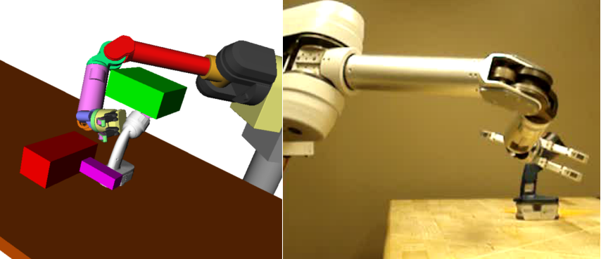
Brief Detour
Grasp Trajectory Prediction
Quickly identify successful trajectory
Requires high-fidelity simulator (slow)

Slide 47
High-fidelity Simulator
First trajectory fails
Failure Rate
(After 4 simulations)
Second trajectory diverse
[Ross, Zhou, Yue, Dey, Bagnell, ICML 2013]

Slide 48
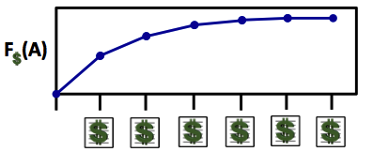
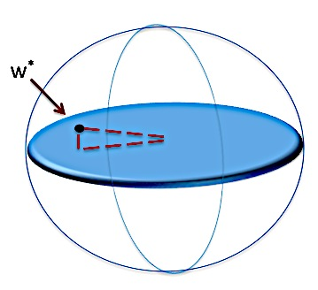
Model
Information Need
Close Loop Interaction
Multiple Rounds
Wisdom of Crowds
First principled approach to jointly model
  Structured information models
    Submodular coverage models
  Optimize explore/exploit trade-off
  Faster personalization
    Learning from wisdom of crowd
Personalized
News Recommendation

Slide 49
Online Experiment Design in Search
Model
Information Need
Close Loop Interaction
Multiple Rounds
Click
Wisdom of Crowds
Interpret Human Interaction
First principled approach to jointly model
  Structured information models
    Submodular coverage models
  Optimize explore/exploit trade-off
  Faster personalization
    Learning from wisdom of crowd

Slide 50

Learning from Click Data
Interpretation 1:
Result #2 is good.
(Absolute)
Click
Interpretation 2:
Result #2 is better
than Result #1.
(Relative / Preference)

Slide 51
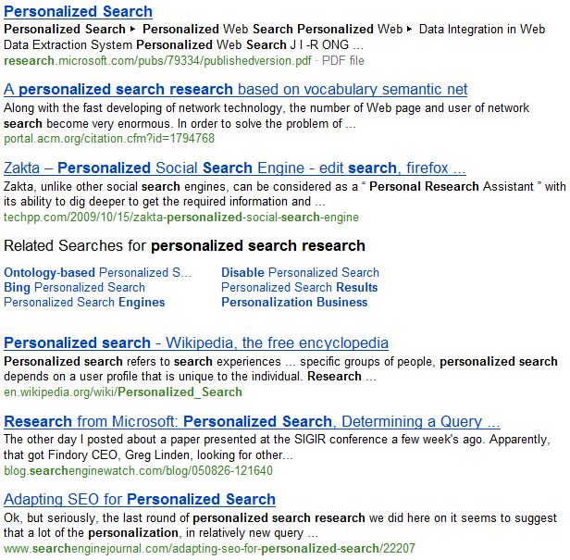
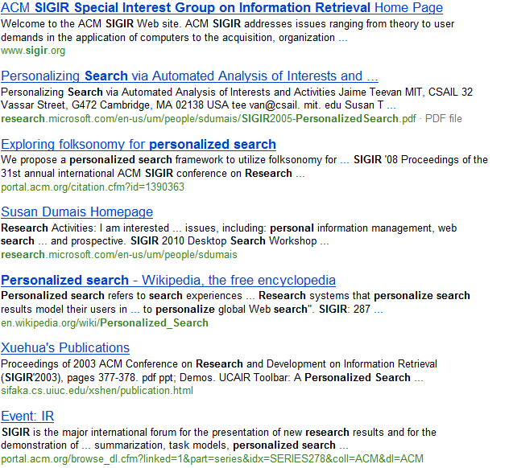
Learning from Click Data
Retrieval Function A
Retrieval Function B
Click
Which is better?
Click
Click

Slide 52

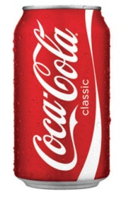
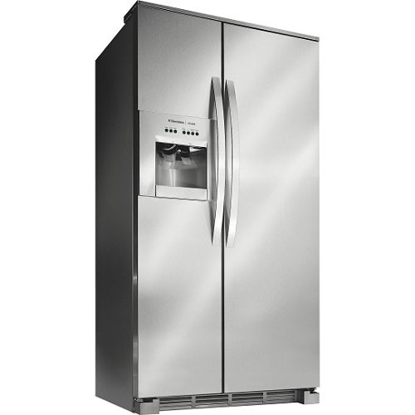


Analogy to Sensory Testing
(Hypothetical) taste experiment: vs
  Natural usage context
Experiment 1: Absolute Metrics
Very Thirsty!
3 cans
3 cans
2 cans
1 can
5 cans
3 cans
Total: 8 cans
Total: 9 cans

Slide 53
Analogy to Sensory Testing
(Hypothetical) taste experiment: vs
  Natural usage context
Experiment 1: Relative Metrics
2 - 1
3 - 0
2 - 0
1 - 0
4 - 1
2 - 1
All 6 prefer Pepsi

Slide 54
Interleaving (Taste Test in Search)
Ranking A
Napa Valley – The authority for lodging...
www.napavalley.com
Napa Valley Wineries - Plan your wine...
www.napavalley.com/wineries
Napa Valley College
www.napavalley.edu/homex.asp
4. Been There | Tips | Napa Valley
www.ivebeenthere.co.uk/tips/16681
5. Napa Valley Wineries and Wine
www.napavintners.com
6. Napa Country, California – Wikipedia
en.wikipedia.org/wiki/Napa_Valley
Ranking B
1. Napa Country, California – Wikipedia
en.wikipedia.org/wiki/Napa_Valley
2. Napa Valley – The authority for lodging...
www.napavalley.com
3. Napa: The Story of an American Eden...
books.google.co.uk/books?isbn=...
4. Napa Valley Hotels – Bed and Breakfast...
www.napalinks.com
5. NapaValley.org
www.napavalley.org
6. The Napa Valley Marathon
www.napavalleymarathon.org
Presented Ranking
Napa Valley – The authority for lodging...
www.napavalley.com
2. Napa Country, California – Wikipedia
en.wikipedia.org/wiki/Napa_Valley
3. Napa: The Story of an American Eden...
books.google.co.uk/books?isbn=...
Napa Valley Wineries – Plan your wine...
www.napavalley.com/wineries
5. Napa Valley Hotels – Bed and Breakfast...
www.napalinks.com
Napa Balley College
www.napavalley.edu/homex.asp
7 NapaValley.org
www.napavalley.org
A
B
[Radlinski et al. 2008]
Notes:
Slide credit Filip Radlinski

Slide 55
Interleaving (Taste Test in Search)
Ranking A
Napa Valley – The authority for lodging...
www.napavalley.com
Napa Valley Wineries - Plan your wine...
www.napavalley.com/wineries
Napa Valley College
www.napavalley.edu/homex.asp
4. Been There | Tips | Napa Valley
www.ivebeenthere.co.uk/tips/16681
5. Napa Valley Wineries and Wine
www.napavintners.com
6. Napa Country, California – Wikipedia
en.wikipedia.org/wiki/Napa_Valley
Ranking B
1. Napa Country, California – Wikipedia
en.wikipedia.org/wiki/Napa_Valley
2. Napa Valley – The authority for lodging...
www.napavalley.com
3. Napa: The Story of an American Eden...
books.google.co.uk/books?isbn=...
4. Napa Valley Hotels – Bed and Breakfast...
www.napalinks.com
5. NapaValley.org
www.napavalley.org
6. The Napa Valley Marathon
www.napavalleymarathon.org
Presented Ranking
Napa Valley – The authority for lodging...
www.napavalley.com
2. Napa Country, California – Wikipedia
en.wikipedia.org/wiki/Napa_Valley
3. Napa: The Story of an American Eden...
books.google.co.uk/books?isbn=...
Napa Valley Wineries – Plan your wine...
www.napavalley.com/wineries
5. Napa Valley Hotels – Bed and Breakfast...
www.napalinks.com
Napa Valley College
www.napavalley.edu/homex.asp
7 NapaValley.org
www.napavalley.org
Click
B wins!
Extension for
Comparing Greedy
Submodular Policies
[Yue & Guestrin, 2011]
Click
[Radlinski et al. 2008]
Notes:
Slide credit Filip Radlinski

Slide 56
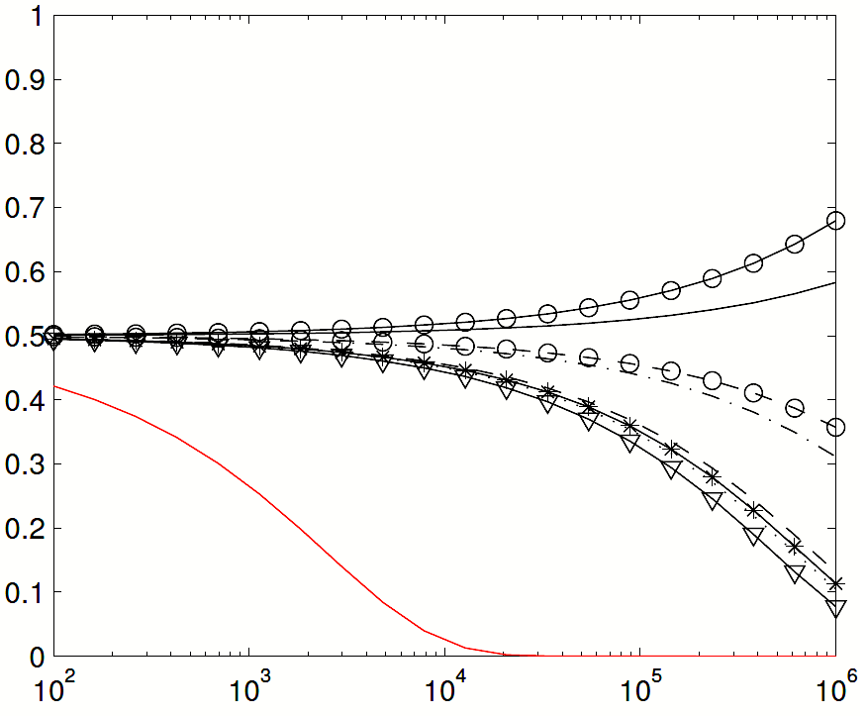
Deployment on Yahoo! Search Engine
Comparing Two Ranking Functions
B E T T E R
Disagreement Probability
Absolute Metrics
E.g., #Clicks@1,
Total #Clicks, etc.
100x
Each ranking function
receives 50% traffic
Interleaving
# Queries
Interleaving is more sensitive and more reliable
  [Chapelle, Joachims, Radlinski & Yue, TOIS 2012]

Slide 57
Online Experiment Design in Search
Close Loop Interaction
Multiple Rounds
Click
Interpret Human Interaction

Slide 58

Interactive Learning Setting
Search engine for corporate network
  No prior training data
  500 candidate retrieval functions
Optimize using interleaving
  (Find best retrieval function)

Slide 59
Interleave A vs B
…
 | Left wins | Right wins
A vs B | 0 | 1
A vs C | 0 | 0
B vs C | 0 | 0

Slide 60
Interleave A vs C
…
 | Left wins | Right wins
A vs B | 0 | 1
A vs C | 0 | 1
B vs C | 0 | 0

Slide 61
Interleave B vs C
…
 | Left wins | Right wins
A vs B | 0 | 1
A vs C | 0 | 1
B vs C | 0 | 1

Slide 62
Dueling Bandits Problem
Goal: Maximize total user utility
Exploit: run C
(interleave C with itself)
Explore: interleave A vs B
Best: A
(interleave A with itself)
How to interact optimally?
Interleave A vs C
…
 | Left wins | Right wins
A vs B | 0 | 1
A vs C | 1 | 1
B vs C | 0 | 1

Slide 63


Dueling Bandits Problem
 | A | B | C | D | E | F
A | 0 | 0.05 | 0.05 | 0.04 | 0.11 | 0.11
B | -0.05 | 0 | 0.05 | 0.06 | 0.08 | 0.10
C | -0.05 | -0.05 | 0 | 0.04 | 0.01 | 0.06
D | -0.04 | -0.04 | -0.04 | 0 | 0.04 | 0.00
E | -0.11 | -0.08 | -0.01 | -0.04 | 0 | 0.01
F | -0.11 | -0.10 | -0.06 | -0.00 | -0.01 | 0
Values are Pr(row > col) – 0.5
Derived from interleaving experiments on http://arXiv.org

Slide 64
Dueling Bandits Problem
 | A | B | C | D | E | F
A | 0 | 0.05 | 0.05 | 0.04 | 0.11 | 0.11
B | -0.05 | 0 | 0.05 | 0.06 | 0.08 | 0.10
C | -0.05 | -0.05 | 0 | 0.04 | 0.01 | 0.06
D | -0.04 | -0.04 | -0.04 | 0 | 0.04 | 0.00
E | -0.11 | -0.08 | -0.01 | -0.04 | 0 | 0.01
F | -0.11 | -0.10 | -0.06 | -0.00 | -0.01 | 0
P(B>F) = 0.6
Values are Pr(row > col) – 0.5
Derived from interleaving experiments on http://arXiv.org

Slide 65
Dueling Bandits Problem
 | A | B | C | D | E | F
A | 0 | 0.05 | 0.05 | 0.04 | 0.11 | 0.11
B | -0.05 | 0 | 0.05 | 0.06 | 0.08 | 0.10
C | -0.05 | -0.05 | 0 | 0.04 | 0.01 | 0.06
D | -0.04 | -0.04 | -0.04 | 0 | 0.04 | 0.00
E | -0.11 | -0.08 | -0.01 | -0.04 | 0 | 0.01
F | -0.11 | -0.10 | -0.06 | -0.00 | -0.01 | 0
P(A > E) = 0.61
P(A > F) = 0.61
Incurred Regret = 0.22
Compare E & F:
Values are Pr(row > col) – 0.5
Derived from interleaving experiments on http://arXiv.org

Slide 66
Dueling Bandits Problem
 | A | B | C | D | E | F
A | 0 | 0.05 | 0.05 | 0.04 | 0.11 | 0.11
B | -0.05 | 0 | 0.05 | 0.06 | 0.08 | 0.10
C | -0.05 | -0.05 | 0 | 0.04 | 0.01 | 0.06
D | -0.04 | -0.04 | -0.04 | 0 | 0.04 | 0.00
E | -0.11 | -0.08 | -0.01 | -0.04 | 0 | 0.01
F | -0.11 | -0.10 | -0.06 | -0.00 | -0.01 | 0
P(A > B) = 0.55
P(A > C) = 0.55
Incurred Regret = 0.10
Compare B & C:
Values are Pr(row > col) – 0.5
Derived from interleaving experiments on http://arXiv.org

Slide 67
Dueling Bandits Problem
 | A | B | C | D | E | F
A | 0 | 0.05 | 0.05 | 0.04 | 0.11 | 0.11
B | -0.05 | 0 | 0.05 | 0.06 | 0.08 | 0.10
C | -0.05 | -0.05 | 0 | 0.04 | 0.01 | 0.06
D | -0.04 | -0.04 | -0.04 | 0 | 0.04 | 0.00
E | -0.11 | -0.08 | -0.01 | -0.04 | 0 | 0.01
F | -0.11 | -0.10 | -0.06 | -0.00 | -0.01 | 0
Interleaving
shows ranking
produced by A.
P(A > A) = 0.50
P(A > A) = 0.50
Incurred Regret = 0.0
Compare A & A:
Values are Pr(row > col) – 0.5
Derived from interleaving experiments on http://arXiv.org

Slide 68
Dueling Bandits Problem
Best Overall
Regret:
Chosen by Algorithm
(% users who prefer best over chosen ones)
Opportunity cost of not knowing b*
Also considered continuous case [Yue & Joachims, 2009]
[Yue, Broder, Kleinberg & Joachims, COLT 2009]

Slide 69
Identifying Best Retrieval Function
(Dueling Bandits Problem)
Tournament
  E.g., tennis
  [Feige et al., 1994]
Champion
  E.g., boxing
  [Yue, Broder, Kleinberg & Joachims, 2009]
Swiss
  E.g., group rounds in World Cup
  [Yue & Joachims, 2011]

Slide 70

Tournament
Each pair “duels” until statistical significance
[Feige et al., 1994]
Best!

Slide 71

Tournament is Bad
Each pair “duels” until statistical significance
[Feige et al., 1994]
Problem: two equally
bad retrieval functions
Analogy: Hypothetical Soccer Tournament
  A team wins when it has a 3-goal lead
  Audience prefers good teams play (regret)
  Two equally bad teams will play for a long time

Slide 72
Champion
Champion duels each challenger (round robin)
  Until statistical significance
Challengers
Best!
Champion
[Yue, Broder, Kleinberg & Joachims, COLT 2009]

Slide 73
Champion is Good
The champion gets better fast
  Quickly replaced if bad
Sequence of champions as a random walk
  Log #rounds to arrive at best
One of these will become next champion
Better
[Yue, Broder, Kleinberg & Joachims, COLT 2009]

Slide 74
Champion is Good
The champion gets better fast
  Quickly replaced if bad
Sequence of champions as a random walk
  Log #rounds to arrive at best
One of these will become next champion
Better
[Yue, Broder, Kleinberg & Joachims, COLT 2009]

Slide 75
Champion is Good
The champion gets better fast
  Quickly replaced if bad
Sequence of champions as a random walk
  Log #rounds to arrive at best
One of these will become next champion
Better
[Yue, Broder, Kleinberg & Joachims, COLT 2009]

Slide 76
Champion is Good
The champion gets better fast
  Quickly replaced if bad
Sequence of champions as a random walk
  Log #rounds to arrive at best
# Retrieval Functions
Regret:
Time Horizon
Optimal Regret
Guarantee!
Better
Margin between best retrieval function and others
[Yue, Broder, Kleinberg & Joachims, COLT 2009]

Slide 77
Swiss
Each iteration: Duel random pair
  Eliminate retrieval function w/ worst record
Best!
[Yue & Joachims, ICML 2011]

Slide 78
Swiss is Best
Champion has high variance
  Depends on initial champion
Swiss offers low-variance alternative
  Eliminate worst retrieval functions first
Optimal Regret
w/ High Probability!
Regret:
[Yue & Joachims, ICML 2011]

Slide 79
Tournament
Regret
B E T T E R
Champion
# Retrieval Functions
Tournament performs poorly (>10x worse)
(In some experiments >10000x worse)
Swiss has lower variance than Champion
Swiss
[Yue & Joachims, ICML 2011]

Slide 80
Online Experiment Design in Search
Close Loop Interaction
Multiple Rounds
Click
Interpret Human Interaction
First framework for modeling interactive preference elicitation
  Dueling Bandits Problem
Provably optimal algorithms

Slide 81
Goal: Maximize total user utility
Close Loop Interaction
Model
Information Need
Close Loop Interaction
Multiple Rounds
Click
Multiple Rounds
Click
Interpret Human Interaction
First framework for modeling interactive preference elicitation
  Dueling Bandits Problem
Provably optimal algorithms
Wisdom of crowds
Interpret Human Interaction
Principled
-- Theoretically justified
Practical
-- Big Data
-- Works in practice

Slide 82
Richer Interactions
Click
We can only learn as much as interface permits
(We can only help user as much as interface permits)

Slide 83
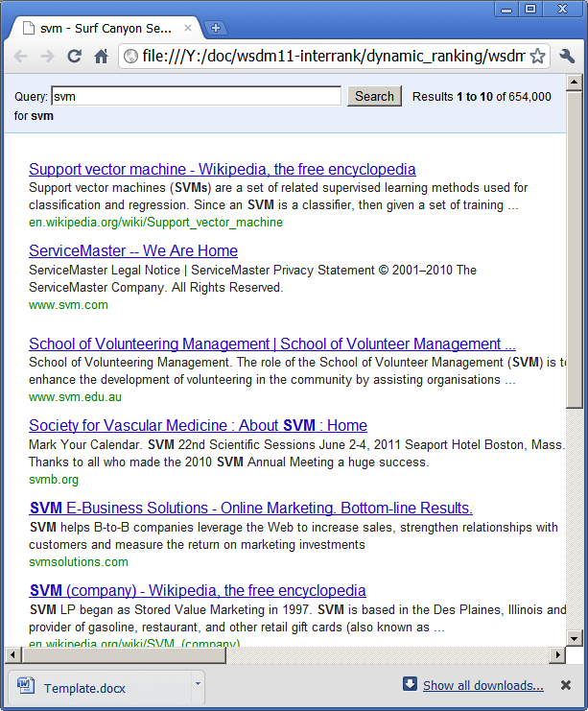
Handling Query Ambiguity
Most Likely Intent
Diversified

Slide 84
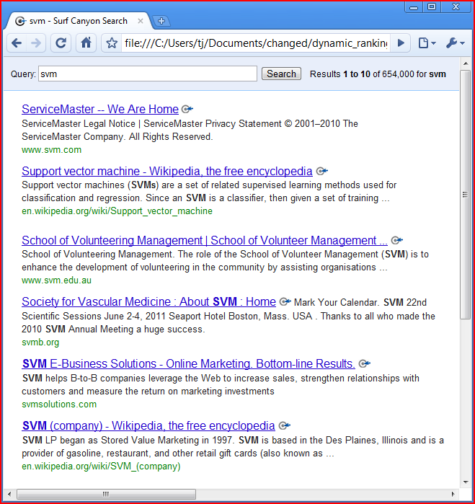
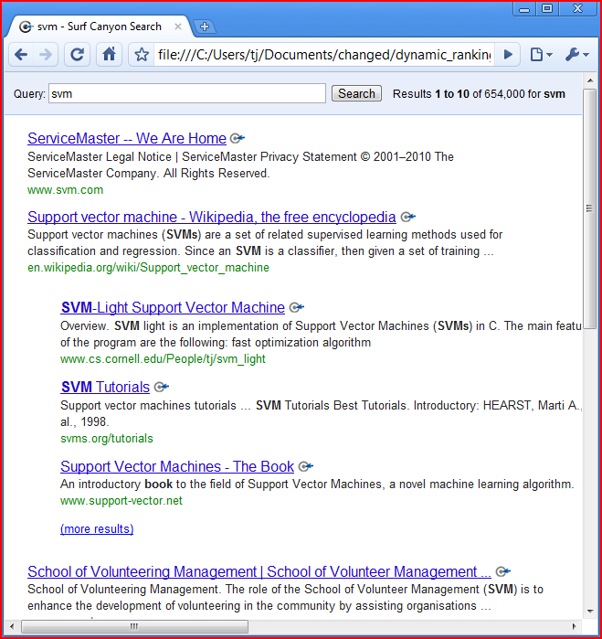
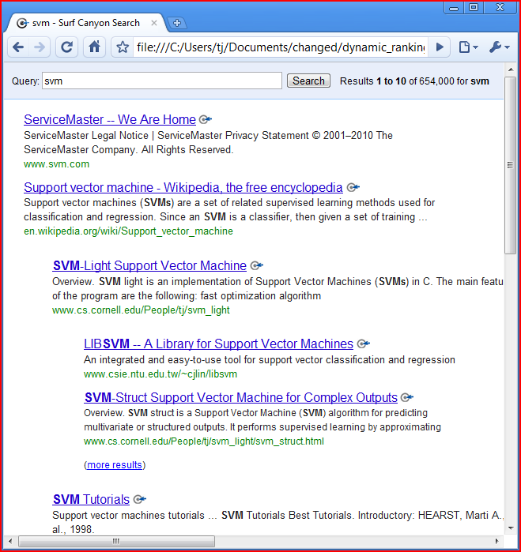
Dynamic Ranking
skip
d₁
expand
d₂

d₁
skip
expand

d₂
skip
d₃
expand
d₄
d₃
skip
expand
d₄
d₅


d₅
d₆

[Brandt, Joachims, Yue & Bank, WSDM 2011]

Slide 85
Dynamic Ranking
d₁
d₂
d₃
d₄
d₅
[Brandt, Joachims, Yue & Bank, WSDM 2011]

Slide 86
Dynamic rankings offer
both diversity and depth
Fundamentally not possible with flat rankings
Dynamic rankings offer expanded action space
B E T T E R
Flat
Ranking
Dynamic
Ranking
Simulated users browsing results
Based on web-search dataset
Substantial query ambiguity
[Brandt, Joachims, Yue & Bank, WSDM 2011]

Slide 87
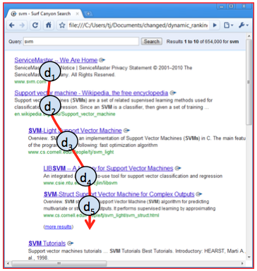
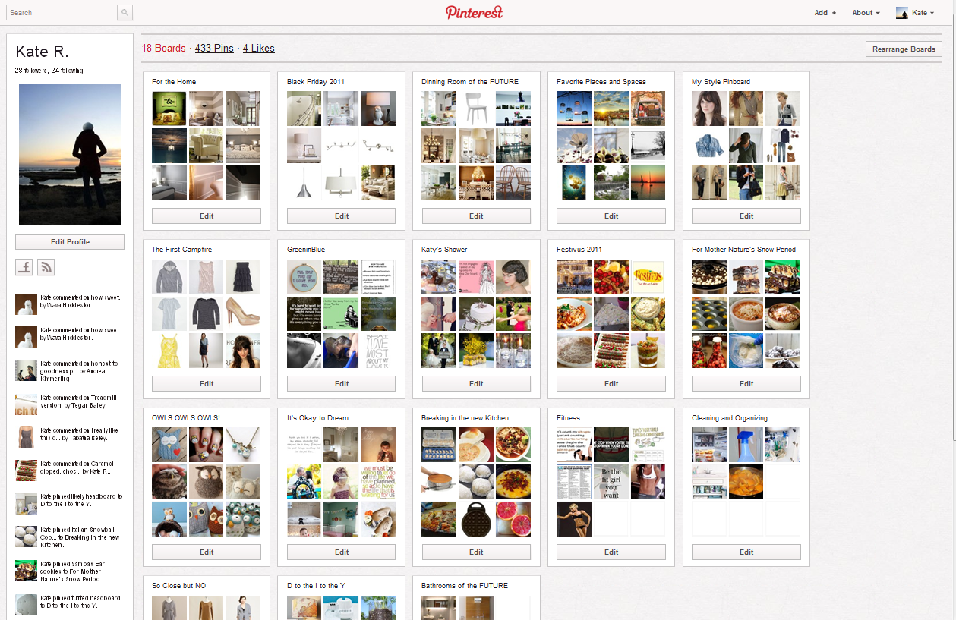
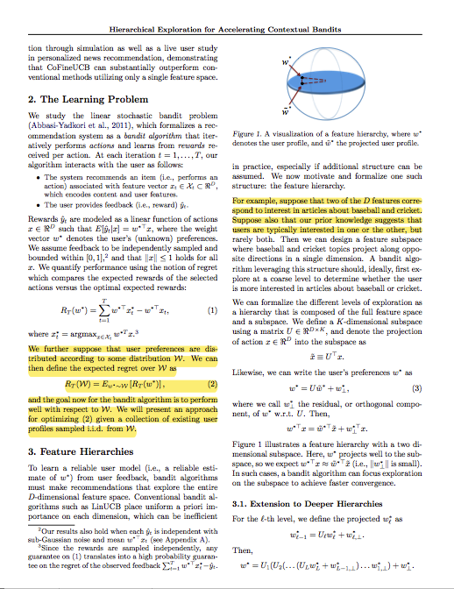
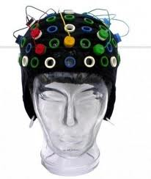
Multiple Rounds
?
Dynamic Rankings
Clustering
Highlighting
Etc…
Future Work: model new interaction primitives
-- Learning (richer training data)
-- Recommending (expanded action space)

Slide 88
Ongoing Work:
Goal-Oriented Data Browsing
Literature review for grant proposal
Planning a meals for the week
Planning a vacation
Clustering Interaction!

Slide 89

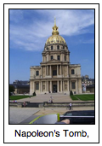
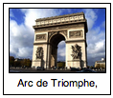
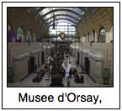
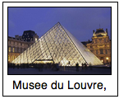
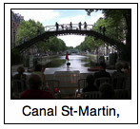
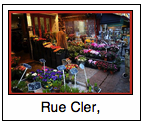
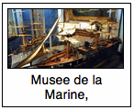
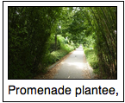
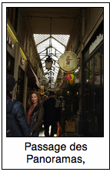
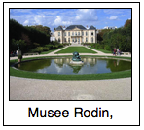
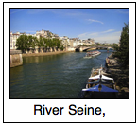
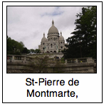
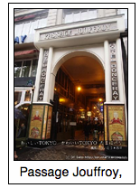
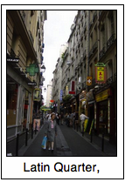
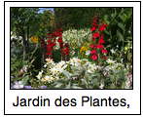
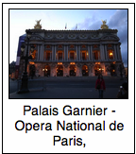
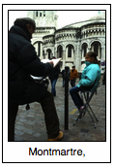
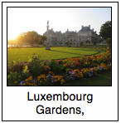

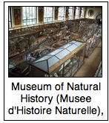

Monuments
Museums
Strolling / Shopping
Out-of-cluster accuracy:
Prior work: 20%
Our work: 37%
“Generic”
“Photography Enthusiast”
Architecture
People
Nature
[Yue, Wang, El-Arini, Guestrin, WWW 2014]

Slide 90
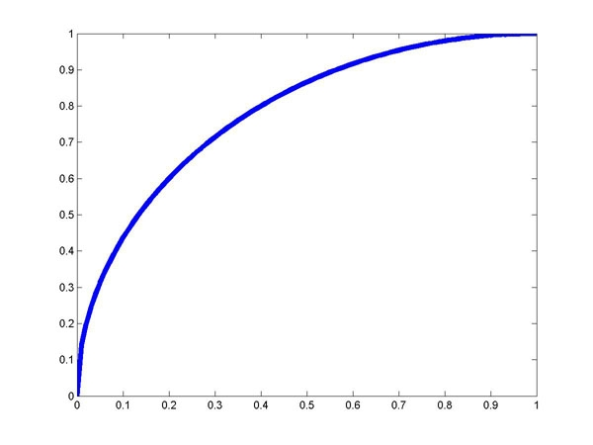

Interactive Algorithms
Structured Prediction
Submodular Bandits
[Yue & Guestrin, 2011]
[Yue, Hong & Guestrin, 2012]
Dueling Bandits
[Yue & Joachims, 2009]
[Yue, Broder, Kleinberg & Joachims, 2009]
[Yue & Joachims, 2011]
Adaptive Urban Systems
[Yue, Marla & Krishnan, 2012]
[Liu, Yue & Krishnan, 2013]
Robot Trajectory Planning
[Ross, Zhou, Yue, Dey, Bagnell, 2013]
Learning to Diversify
[Yue & Joachims, 2008]
[Joachims, Hoffman, Yue & Yu, 2009]
[Yue & Guestrin, 2011]
Optimizing Ranking Measures
[Yue, Finley, Radlinksi & Joachims, 2007]
[Yue & Burges, 2007]
Models that Justify Predictions
[Yessenalina, Yue & Cardie, 2010]
Interpreting Feedback
Improving Interleaving
[Yue, Gao, Chapelle, Zhang & Joachims, 2010]
[Chapelle, Joachims, Radlinski & Yue, 2012]
Attractiveness Bias
[Yue, Patel, Roehrig, 2010]
Richer Interactions
Dynamic Rankings
[Brandt, Joachims, Yue & Bank, 2011]
Clustered Feedback
[Yue, Wang, El-Arini, Guestrin, 2014]
Dynamic Rankings
Click
www.yisongyue.com

Slide 91
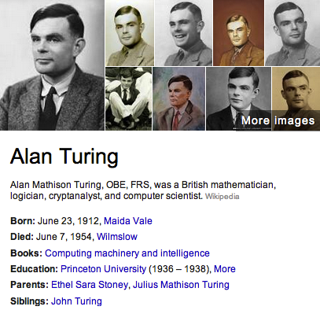
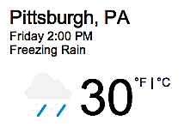
Information Systems
…
Data Exploration & Summarization
Abstractive Retrieval
Extractive Retrieval

Slide 92
Collaborative Learning
Learn from wisdom of crowd
Multiple users, joint task
Interactive Machine Learning
Balance Explore/Exploit Trade-off
Multiple Rounds
Information Bottleneck
Richer Interaction Primitives
Clustering, dynamic ranking, etc.
Structured Information Model
Model Redundancy, Optimal Diversity
Interpreting Feedback
Reliable Preference Elicitation
Understanding human biases
Richer Information Models
New Learning Challenges
Expanded Action Space
Interpretable

Slide 93
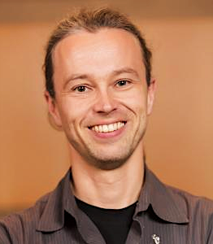





















Thank You!
Thorsten
Joachims
(Cornell)
Bobby
Kleinberg
(Cornell)
Claire
Cardie
(Cornell)
Carlos
Guestrin
(U.Washington)
Khalid
El-Arini
(Facebook)
Chong
Wang
(CMU)
Sue Ann
Hong
(Facebook)
Jacob
Bank
(Stanford)
Christie
Brandt
(Stanford)
Filip
Radlinski
(Microsoft)
Tom
Finley
(Microsoft)
Lavanya
Marla
(UIUC)
Siyuan
Liu
(CMU)
Robin
Zhou
(CMU)
Ramayya
Krishnan
(CMU)
Chris
Burges
(Microsoft)
Olivier
Chapelle
(Criteo)
Rajan
Patel
(Google)
Ainur
Yessenalina
(Amazon)
Drew
Bagnell
(CMU)
Stephane
Ross
(CMU)
Debadeepta
Dey
(CMU)

Slide 94
Extra Slides

Slide 95
a₁ = “US economy poised to pick up, Geithner says”
a₂ = “China's Economy Is on the Mend, but Concerns Remain”
a₃ = “Who's Going To The Super Bowl?”
A = Ø
w =
,
Incremental Coverage
 | F (A+a) - F (A) | F (A+a) - F (A)
a₁
a₂
a₃

Slide 96
a₁ = “US economy poised to pick up, Geithner says”
a₂ = “China's Economy Is on the Mend, but Concerns Remain”
a₃ = “Who's Going To The Super Bowl?”
A = {a₁}
w =
,
Incremental Coverage
Incremental Benefit
 | F (A+a) - F (A) | F (A+a) - F (A)
a₁
a₂
a₃
 | a₁ | a₂ | a₃ | Best
Iter 1 |  |  |  | a₁
Iter 2

Slide 97
a₁ = “US economy poised to pick up, Geithner says”
a₂ = “China's Economy Is on the Mend, but Concerns Remain”
a₃ = “Who's Going To The Super Bowl?”
A = {a₁}
w =
,
Incremental Coverage
Incremental Benefit
 | F (A+a) - F (A) | F (A+a) - F (A)
a₁
a₂
a₃
 | a₁ | a₂ | a₃ | Best
Iter 1 |  |  |  | a₁
Iter 2

Slide 98
a₁ = “US economy poised to pick up, Geithner says”
a₂ = “China's Economy Is on the Mend, but Concerns Remain”
a₃ = “Who's Going To The Super Bowl?”
A = {a₁,a₃}
w =
,
Incremental Coverage
Incremental Benefit
 | F (A+a) - F (A) | F (A+a) - F (A)
a₁
a₂
a₃
 | a₁ | a₂ | a₃ | Best
Iter 1 |  |  |  | a₁
Iter 2 |  |  |  | a₃

Slide 99
Example: Probabilistic Coverage
Each article a has independent probability Pr(i|a) of covering topic c.
F_{c}(A) = 1-Pr(topic c not covered by A)
Then F_{c}(A) = 1 – Π(1-P(c|a))
“noisy or”
[El-Arini et al., KDD 2009]

Slide 100
LSBGreedy
Loop:
  Compute least squares estimate
  A_{t} initially empty
  For i=1,…,L
    Recommend article a that maximizes
  Receive feedback y_{t,1},…,y_{t,L}
Least Squares Regression
Estimated gain
Uncertainty

Slide 101
Other Approaches
Multiplicative Weighting [El-Arini et al. 2009]
  Does not employ exploration
  No guarantees (can show doesn’t converge)
Ranked bandits [Radlinski et al. 2008; Streeter & Golovin 2008]
  Reduction, treats each slot as a separate bandit
  Use LinUCB [Dani et al. 2008; Li et al. 2010; Abbasi-Yadkori et al 2011]
  Regret guarantee O(dLT^{1/2}) (factor L^{1/2} worse)
ε-Greedy
  Explore with probability ε
  Regret guarantee O(d(LT)^{2/3}) (factor (LT)^{1/3} worse)

Slide 102
Simulations
LSBGreedy
RankLinUCB
e-Greedy
MW

Slide 103
Simulations
MW
RankLinUCB
e-Greedy
LSBGreedy

Slide 104
Coarse-to-Fine Hierarchical Exploration
Loop:
  Least squares in subspace
  Least squares in full space
  Start with A_{t} empty
  For i=1,…,L
    Recommend article a that maximizes
  Receive feedback y_{t,1},…,y_{t,L}
regularized to
Uncertainty in
Full Space
Uncertainty in
Subspace

Slide 105
Simulation Comparison
Naïve (LSBGreedy from before)
Reshaped Prior in Full Space (LSBGreedy w/ prior)
  Estimated using pre-collected user profiles
Subspace (LSBGreedy on the subspace)
  Often what people resort to in practice
Coarse-to-Fine Approach
  Our approach
  Combines full space and subspace approaches

Slide 106
Naïve Baselines
Reshaped Prior on Full space
“Atypical Users”
Coarse-to-Fine Approach
Subspace
[Yue, Hong & Guestrin, ICML 2012]

Slide 107
Dynamic Ranking Model
skip
d₁
expand
skip
d₂
d₃
expand
skip
expand
d₄
expand
d₅
d₆
d₇
skip
skip
expand
expand
expand
skip
skip
d₈
d₉
d₁₀
d₁₁
d₁₂
d₁₃
d₁₄
d₁₅
















Users: u ~ P(u)
User behavior = path in tree
Goal: optimize expected utility
Proposed dynamic ranking algorithms
[Brandt, Joachims, Yue & Bank, WSDM 2011]

Slide 108

Ambulance Deployment
25 min
(20 min)
18 min
(12 minutes saved)
25 min
30 min
(15 min)
25 min
(no vehicle assigned previously)
(25 min)
15 min
(30 minutes saved)
45 min
[Yue, Marla, Krishnan, AAAI 2012]

