Slide 1

Personalized Collaborative Clustering
Yisong Yue
Joint work with:
Chong Wang
Khalid El-Arini
Carlos Guestrin

Slide 2
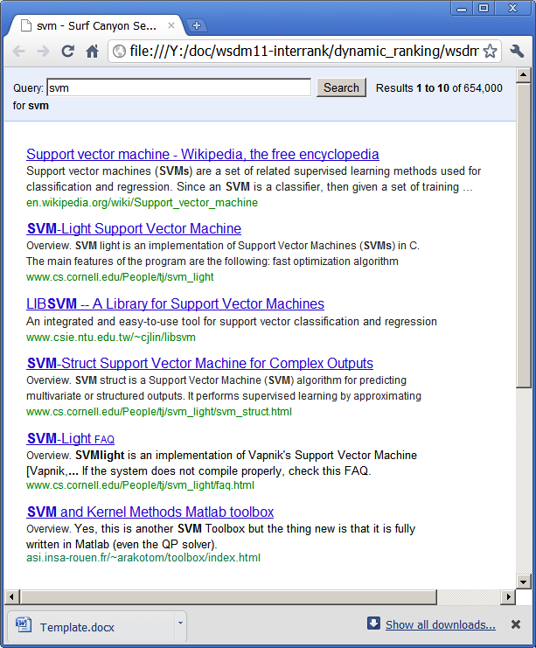


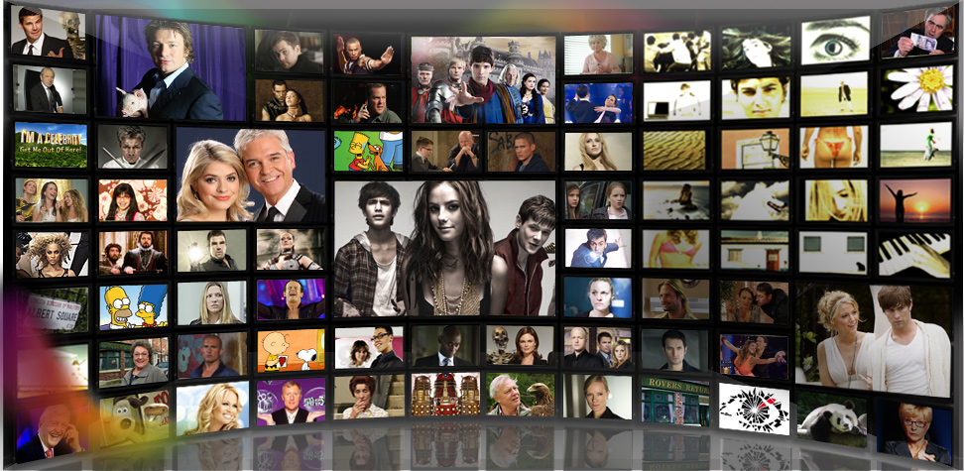









User Feedback
Click
Learning preferences from user feedback
Typically based on simple interactions
E.g., star rating, “like”, “retweet”
Fundamentally limiting

Slide 3
Richer Interactions
?
Click
Information Bottleneck
We can only learn as much as interface permits
(We can only help user as much as interface permits)

Slide 4
“ReGroup: Interactive Machine Learning for On-Demand Group Creation in Social Networks”
[Amershi et al., CHI 2012]

Slide 5
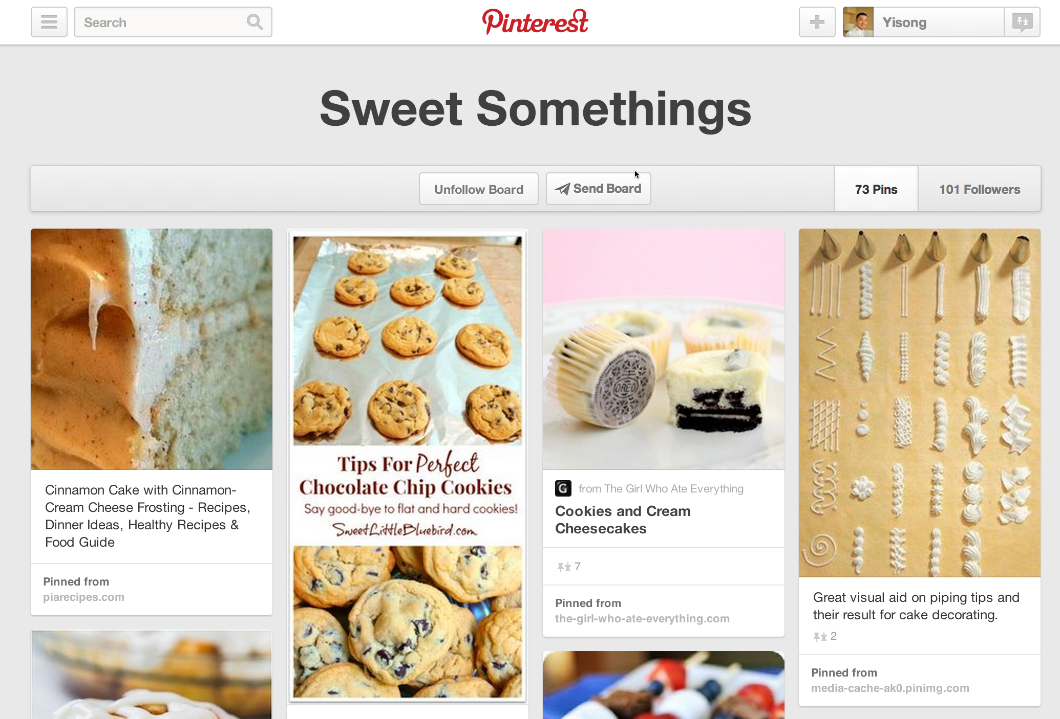
http://www.pinterest.com

Slide 6
“Apolo: Making Sense of Large Network Data by Combining Rich User Interaction and Machine Learning”
[Chau et al., CHI 2011]

Slide 7
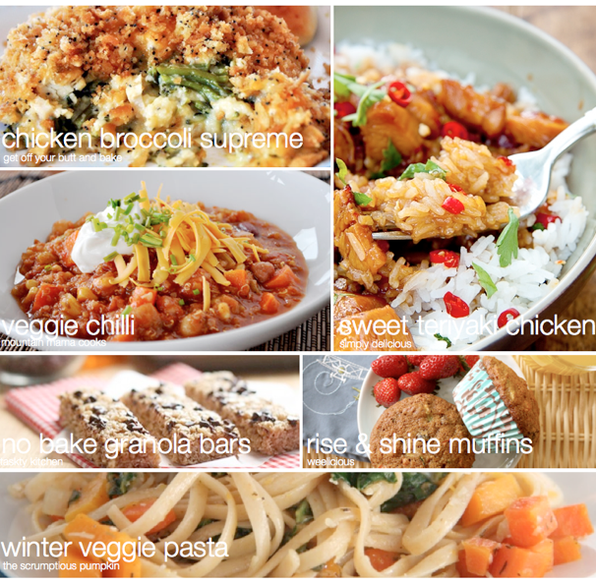
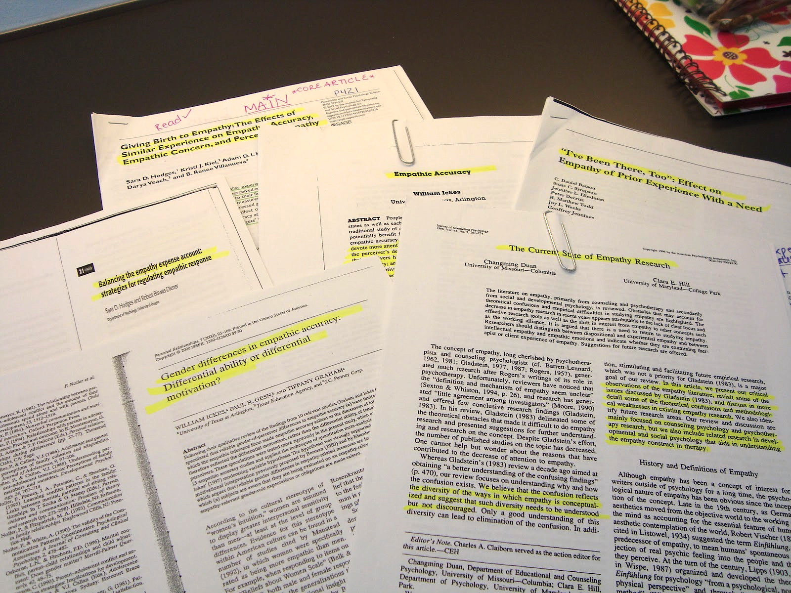
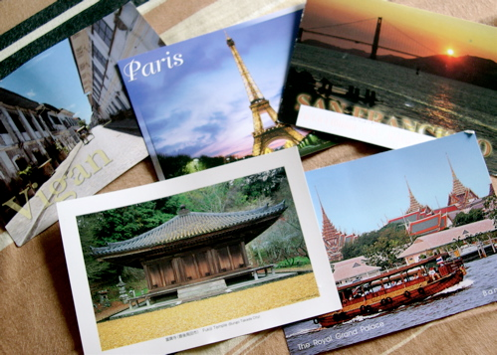
Demo
(Goal Oriented Data Browsing)
Planning a vacation
Planning meals for the week
Literature review for grant proposal

Slide 8
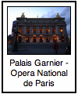

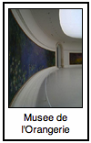






Clustering Interaction
Architecture
Art Museums
Outdoors
“Collaborative Clustering”
  Problem definition
Latent Collaborative Clustering
  Learning algorithm
Data Collection User Study
Evaluation

Slide 9
Clustering Interaction
Architecture
Art Museums
Outdoors
“Collaborative Clustering”
  Problem definition
Latent Collaborative Clustering
  Learning algorithm
Data Collection User Study
Evaluation

Slide 10
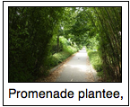
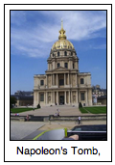
Collaborative Filtering
Training Data: N items, M users
Y = {Y₁ … Y_{M}}
Y_{m} =
Y_{k} =
( , ), ( , ),
( , ), …
Each user rates a
a subset of items
( , ), ( , ),
( , ), …

Slide 11
Collaborative Clustering
Training Data: N items, M users
Y = {Y₁ … Y_{M}}
Y_{m} =
Y_{k} =
Each user clusters
a subset of items
(partial clustering)

Slide 12
Collaborative Clustering
Learning goal: F(m,i,j) ≈ y_{mij} (+1 or -1)
Y_{m} =
F(m, , ) ≈ +1
F(m, , ) ≈ -1
Prediction goal: F(m,i,j) for new items
Clustering analogue to
Collaborative Filtering

Slide 13
Clustering Interaction
Architecture
Art Museums
Outdoors
“Collaborative Clustering”
  Formal Learning Framework
Latent Collaborative Clustering
  Learning algorithm
Data Collection User Study
Evaluation

Slide 14
Latent Factor Models
Collaborative Filtering: N items, M users
Users rate items (y_{mi})
Prediction: F(m,i) = <u_{m}, x_{i}>
N
K
N
Y
U
X
K
=
M
M
Users and items modeled
as K-dimensional factors.
(matrix factorization)
(Missing Values)

Slide 15
Latent Collaborative Clustering
K
N
X
N
Y
N
=
×
X
K
M
N
U
(Missing Values)
Users and items modeled
as K-dimensional factors.
(tensor factorization)
M
K
Hadamard Product
Prediction: F(m,i,j) = x_{i} u_{m} x_{j}
Actual model slightly
more complicated

Slide 16
Latent Collaborative Clustering
F(m,i,j) = x_{i} u_{m} x_{j}
F(m,i,j) =
Diag(u_{m}) = user-specific transform
  Metric learning (i.e., Mahanalobis)
  Diag(u_{m}) positive semi-definite
    u_{m} ≥ 0
Diag(u_{m})
Actual model slightly
more complicated

Slide 17
Learning
User Transform
Item Factor
Regularization
Reconstruction Error
Enforces Metric
also tried
hinge loss
(optimization details in paper)

Slide 18
Learning
User Transform
Item Factor
Alternating least squares optimization
  (convex in U and each x, but not jointly)
Iterative closed form solutions
  (use ADMM to solve U≥0)
(optimization details in paper)

Slide 19
Everyone Loves Anecdotes
(I know I do)

Slide 20
Input Clustering
Input Clustering
F(m, , ?)
F(m, , ?)
F(m, , ?)

Slide 21
Clustering Interaction
Architecture
Art Museums
Outdoors
“Collaborative Clustering”
  Problem definition
Latent Collaborative Clustering
  Learning algorithm
Data Collection User Study
Evaluation

Slide 22
Data Collection
New User Study: Hypothetical trip to Paris
Mechanical Turk
Cluster interesting attractions
250 attractions
(from TripAdvisor)
218 users
18.7 items per user
4.5 clusters per user
“Very interesting - I feel like I learned a bit about Paris!”
“I have never been to Paris but now I want to go even more.”
“We would just about sell our souls to get there! Thank you for letting me travel there vicariously through this HIT!!!”
(HIT refers to “Human Intelligence Task”)
“Great format. Have been to Paris several times but still learned about many great new places to visit”

Slide 23
Features for Attractions
2 sets of features
Wikipedia tf-idf
(~3.5K features)
Mechanical Turk
Tagging (right)
(~40 features)
Used for baselines

Slide 24
Evaluation
For each test user:
  Hold out some attractions
  Predict cluster membership (or new cluster)
Feature-based baselines:
  Diagonal metric (per user)
  [Wagstaff & Cardie, 2000] [Xing et al., 2002] [Schultz & Joachims, 2003]
  [Davis et al., 2007] [Parameswaran & Weinberger, 2010]
  Latent feature transform (significantly slower)
  [Blitzer & Weston, 2012]

Slide 25
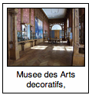
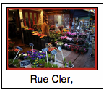
Prediction Tasks
Predict cluster membership
  Existing cluster:
  New cluster:
Cluster with highest average F(m,i,j).
(conventional classification)
All clusters have negative F(m,i,j).
(predicting novelty)

Slide 26
Conventional Prediction Setting
B E T T E R
Random
Largest
Cluster
Feature-Based
Transformed
Feature-Based
LCC
Hold 25% from each cluster (no empty clusters)
Predict cluster membership (conventional classification)

Slide 27
Predicting Novelty
Only method to
beat random!
B E T T E R
Random
Largest
Cluster
Feature-Based
Transformed
Feature-Based
LCC
Hold one entire cluster
Predict new cluster (predict novelty)

Slide 28
Overall
B E T T E R
Random
Largest
Cluster
Feature-Based
Transformed
Feature-Based
LCC
Hold 50% of attractions at random (some clusters empty)
Predict cluster membership (or new cluster)

Slide 29
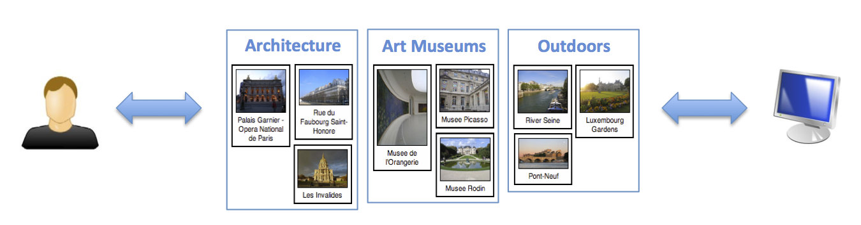
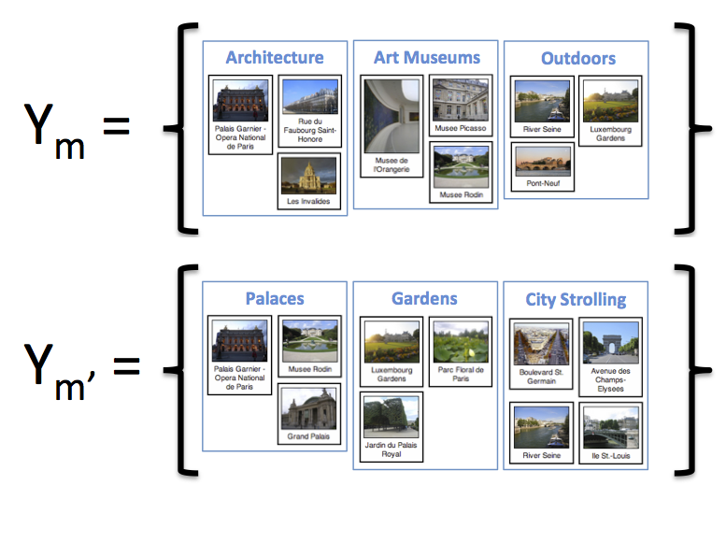
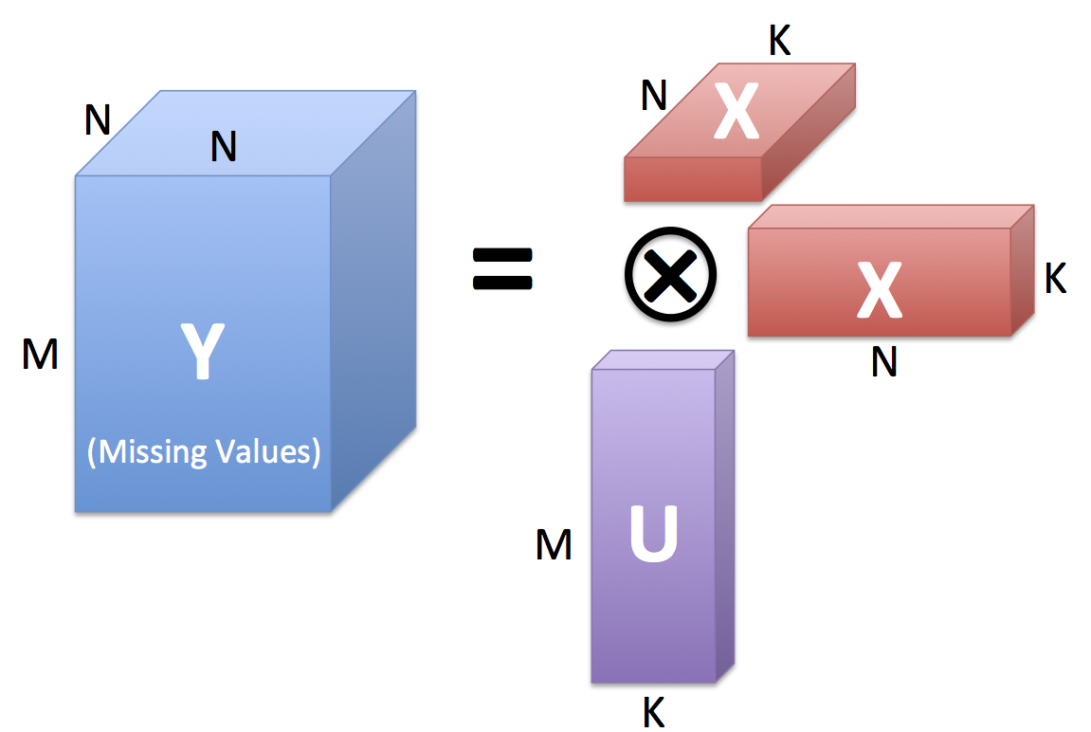
Collaborative Clustering
Rich User Feedback
Learning Problem
Latent Factor Model
User Study Data
Evaluation
http://projects.yisongyue.com/collab_cluster/

Slide 30
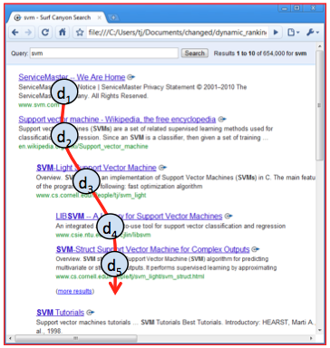
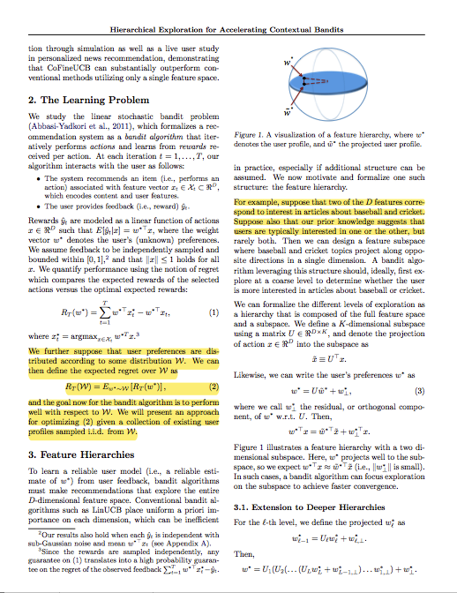
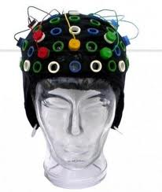
Future Work
Context, scalability, transfer learning, etc.
How to model interactive setting?
  Exploration vs Exploitation
  User goals?
How to model other rich interactions?
Dynamic Rankings
Zooming
Highlighting
Etc…
[Brandt et al., 2011]
[Shahaf et al., 2013]
Research supported by: ONR (PECASE) N000141010672 and ONR YIP N00014-08-1-0752

Slide 31
Extra Slides

Slide 32
(Also efficient methods for
speeding up computation.)

Slide 33
Sequential Prediction Experiment
Architecture
Art Museums
Outdoors
Ground Truth:
Goal: Maximize
Clusters Created
(Predict item with
lowest F(m,i,j) scores)
Recommend item
Simulate user response
Repeat
# Clusters Created:
2
1
0
3

Slide 34
Sequential Prediction Experiment
B E T T E R
LCC outperforms competing methods

