Slide 1



Hierarchical Exploration for Accelerating Contextual Bandits
Yisong Yue
Carnegie Mellon University
Joint work with
Sue Ann Hong (CMU) & Carlos Guestrin (CMU)

Slide 2
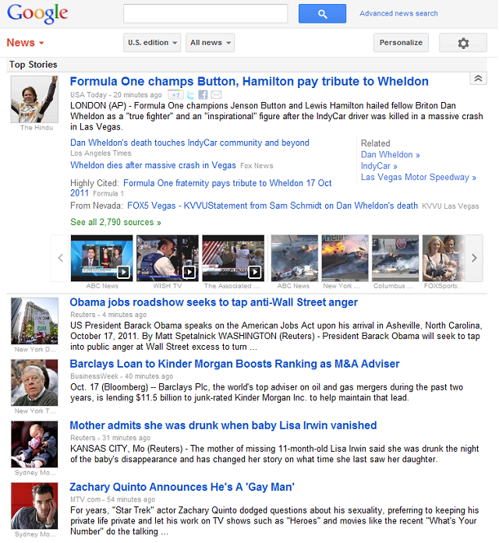


Slide 3



Sports
…
Like!
Topic | # Likes | # Displayed | Average
Sports | 1 | 1 | 1
Politics | 0 | 0 | N/A
Economy | 0 | 0 | N/A

Slide 4

Politics
…
Boo!
Topic | # Likes | # Displayed | Average
Sports | 1 | 1 | 1
Politics | 0 | 1 | 0
Economy | 0 | 0 | N/A

Slide 5

Economy
…
Like!
Topic | # Likes | # Displayed | Average
Sports | 1 | 1 | 1
Politics | 0 | 1 | 0
Economy | 1 | 1 | 1

Slide 6
Sports
…
Boo!
Topic | # Likes | # Displayed | Average
Sports | 1 | 2 | 0.5
Politics | 0 | 1 | 0
Economy | 1 | 1 | 1

Slide 7
Politics
…
Boo!
Topic | # Likes | # Displayed | Average
Sports | 1 | 2 | 0.5
Politics | 0 | 2 | 0
Economy | 1 | 1 | 1

Slide 8
Politics
Exploration / Exploitation Tradeoff!
Learning “on-the-fly”
Modeled as a contextual bandit problem
Exploration is expensive
Our Goal: use prior knowledge to reduce exploration
…
Boo!
Topic | # Likes | # Displayed | Average
Sports | 1 | 2 | 0.5
Politics | 0 | 2 | 0
Economy | 1 | 1 | 1

Slide 9
Linear Stochastic Bandit Problem
At time t
  Set of available actions A_{t} = {a_{t,1}, …, a_{t,n}}
    (articles to recommend)
  Algorithm chooses action â_{t} from A_{t}
    (recommends an article)
  User provides stochastic feedback ŷ_{t}
    (user clicks on or “likes” the article)
    E[ŷ_{t}] = w^{*T}â_{t} (w* is unknown)
  Algorithm incorporates feedback
  t=t+1
Regret:

Slide 10

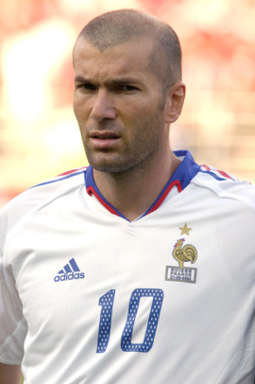

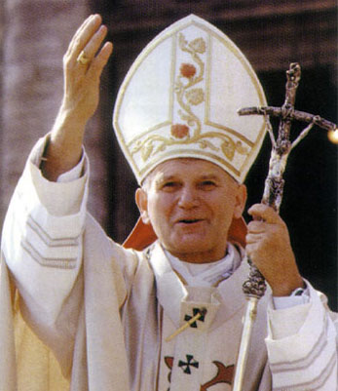

Balancing Exploration vs. Exploitation
“Upper Confidence Bound”
At each iteration:
Example below: select article on economy
Estimated Gain
Uncertainty
Estimated Gain by Topic
+
Uncertainty of Estimate

Slide 11
Conventional Bandit Approach
LinUCB algorithm
[Dani et al. 2008; Rusmevichientong & Tsitsiklis 2008; Abbasi-Yadkori et al. 2011]
  Uses particular way of defining uncertainty
  Achieves regret:
    Linear in dimensionality D
    Linear in norm of w*
How can we do better?

Slide 12
More Efficient Bandit Learning
LinUCB naively explores D-dimensional space
  S = |w*|
Assume w* mostly in subspace
  Dimensionality K << D
  E.g., “European vs Asia News”
  Estimated using prior knowledge
    E.g., existing user profiles
Two tiered exploration
  First in subspace
  Then in full space
Significantly less exploration
w*
w*
Feature
Hierarchy
LinUCB Guarantee:

Slide 13
CoFineUCB: Coarse-to-Fine Hierarchical Exploration
At time t:
  Least squares in subspace
  Least squares in full space
  (regularized to )
  Recommend article a that maximizes
  Receive feedback ŷ_{t}
Uncertainty in
Full Space
Uncertainty in
Subspace
(Projection onto subspace)

Slide 14
Theoretical Intuition
Regret analysis of UCB algorithms requires 2 things
  Rigorous confidence region of the true w*
  Shrinkage rate of confidence region size
CoFineUCB uses tighter confidence regions
  Can prove lies mostly in K-dim subspace
  Convolution of K-dim ellipse with small D-dim ellipse

Slide 15
Constructing Feature Hierarchies
(One Simple Approach)
Empirical sample learned user preferences
  W = [w₁,…,w_{N}]
Approximately minimizes norms in regret bound
Similar to approaches for multi-task structure learning
  [Argyriou et al. 2007; Zhang & Yeung 2010]
LearnU(W,K):
  [A,Σ,B] = SVD(W)
    (I.e., W = AΣB^{T})
  Return U = (AΣ^{1/2})_{(1:K)} / C
“Normalizing
Constant”

Slide 16
Simulation Comparison
Leave-one-out validation using existing user profiles
      From previous personalization study [Yue & Guestrin 2011]
Methods
  Naïve (LinUCB) (regularize to mean of existing users)
  Reshaped Full Space (LinUCB using LearnU(W,D))
  Subspace (LinUCB using LearnU(W,K))
    Often what people resort to in practice
  CoFineUCB
    Combines full space and subspace approaches
(D=100, K = 5)

Slide 17
Naïve Baselines
Reshaped Full space
“Atypical Users”
Coarse-to-Fine Approach
Subspace

Slide 18
User Study
10 days
10 articles per day
  From thousands of
  articles for that day
  (from Spinn3r – Jan/Feb 2012)
  Submodular bandit
  extension to model
  utility of multiple articles
  [Yue & Guestrin 2011]
100 topics
  5 dimensional subspace
Users rate articles
Count #likes

Slide 19
User Study
Coarse-to-Fine
Wins
Coarse-to-Fine
Wins
~27 users per study
Ties
Losses
Losses
Naïve LinUCB
LinUCB with
Reshaped Full Space
*Short time horizon (T=10) made comparison with Subspace LinUCB not meaningful

Slide 20
Conclusions
Coarse-to-Fine approach for saving exploration
  Principled approach for transferring prior knowledge
  Theoretical guarantees
    Depend on the quality of the constructed feature hierarchy
  Validated via simulations & live user study
Future directions
  Multi-level feature hierarchies
  Learning feature hierarchy online
    Requires learning simultaneously from multiple users
  Knowledge transfer for sparse models in bandit setting
Research supported by ONR (PECASE) N000141010672, ONR YIP N00014-08-1-0752,
and by the Intel Science and Technology Center for Embedded Computing.

Slide 21
Extra Slides

Slide 22
Submodular Bandit Extension
Algorithm recommends set of articles
Features depend on articles above
  “Submodular basis features”
User provides stochastic feedback

Slide 23
CoFine LSBGreedy
At time t:
  Least squares in subspace
  Least squares in full space
  (regularized to )
  Start with A_{t} empty
  For i=1,…,L
    Recommend article a that maximizes
  Receive feedback y_{t,1},…,y_{t,L}

Slide 24
Comparison with Sparse Linear Bandits
Another possible assumption: is sparse
  At most B parameters are non-zero
  Sparse bandit algorithms achieve regret that depend on B:
    E.g., Carpentier & Munos 2011
Limitations:
  No transfer of prior knowledge
    E.g., don’t know WHICH parameters are non-zero.
  Typically K < B ➔ CoFineUCB achieves lower regret
    E.g., fast singular value decay
    S ≈ S_{P}

