Slide 1
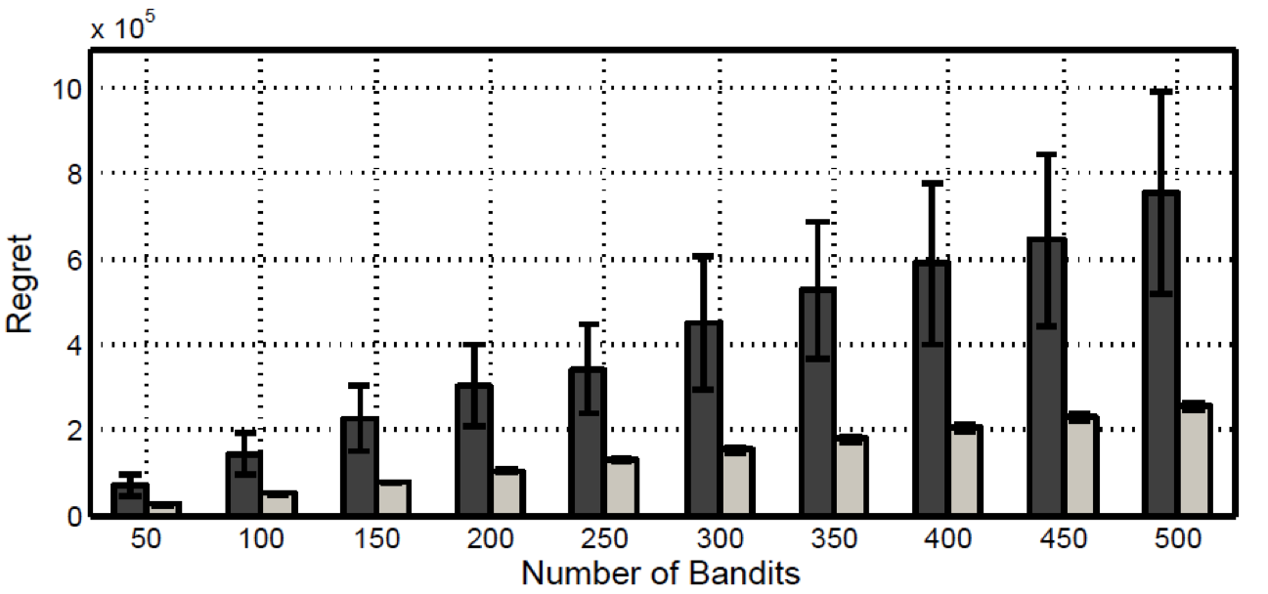
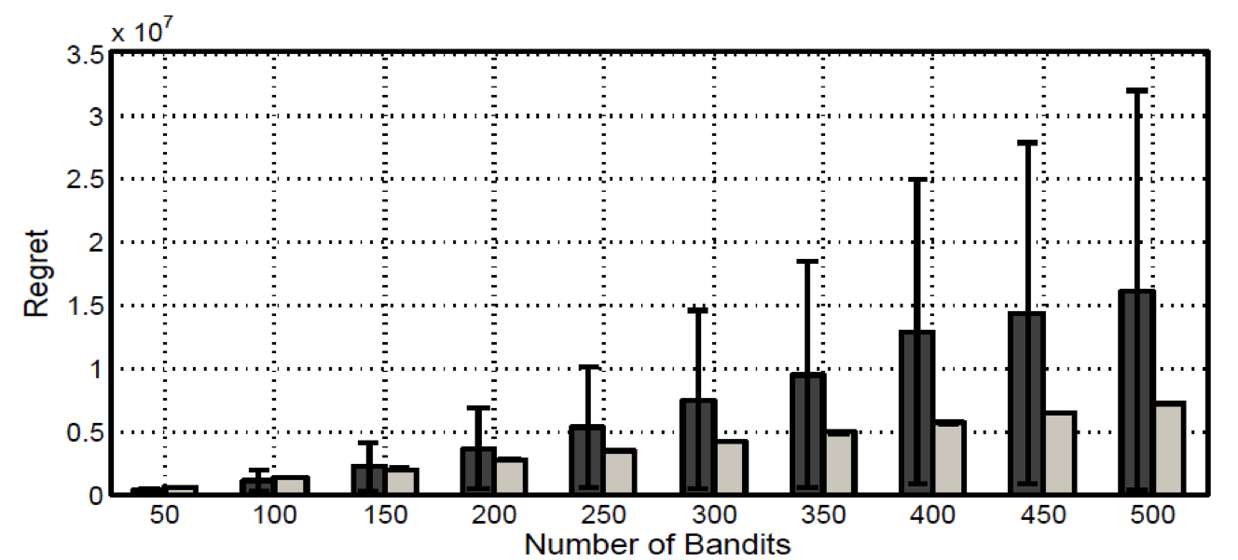
Beat the Mean Bandit
Yisong Yue (CMU) & Thorsten Joachims (Cornell)
Optimizing Information Retrieval Systems
Assumptions
Regret Guarantee
Increasingly reliant on user feedback
(E.g., clicks on search results)
Online learning is a popular modeling tool
(Especially partial-information (bandit) settings)
Our focus: learning from relative preferences
Motivated by recent work on interleaved retrieval evaluation
Assumptions of preference behavior (required for theoretical analysis)
P(b_{i} > b_{j}) = ½ + ε_{ij} (distinguishability)
Playing against mean bandit calibrates preference scores
-- Estimates of (active) bandits directly comparable
-- One estimate per active bandit = linear number of estimates
We can bound comparisons needed to remove worst bandit
-- Varies smoothly with transitivity parameter γ
-- High probability bound
We can bound the regret incurred by each comparison
-- Varies smoothly with transitivity parameter γ
Can bound the total regret with high probability:
-- γ is typically close to 1
Relaxed Stochastic Transitivity
For three bandits b* > b_{j} > b_{k} :
Internal consistency property
Stochastic Triangle Inequality
For three bandits b* > b_{j} > b_{k} :
Diminishing returns property
← This is not possible
with previous work!
Team Draft Interleaving
(Comparison Oracle for Search)
B wins!
γ = 1 required in previous work, and required to apply for all bandit triplets
γ = 1.5 in Example Pairwise Preferences shown in left column
Ranking A
Napa Valley – The authority for lodging...
www.napavalley.com
Napa Valley Wineries - Plan your wine...
www.napavalley.com/wineries
Napa Valley College
www.napavalley.edu/homex.asp
4. Been There | Tips | Napa Valley
www.ivebeenthere.co.uk/tips/16681
5. Napa Valley Wineries and Wine
www.napavintners.com
6. Napa Country, California – Wikipedia
en.wikipedia.org/wiki/Napa_Valley
Presented Ranking
Napa Valley – The authority for lodging...
www.napavalley.com
2. Napa Country, California – Wikipedia
en.wikipedia.org/wiki/Napa_Valley
3. Napa: The Story of an American Eden...
books.google.co.uk/books?isbn=...
Napa Valley Wineries – Plan your wine...
www.napavalley.com/wineries
5. Napa Valley Hotels – Bed and Breakfast...
www.napalinks.com
Napa Balley College
www.napavalley.edu/homex.asp
7 NapaValley.org
www.napavalley.org
Ranking B
1. Napa Country, California – Wikipedia
en.wikipedia.org/wiki/Napa_Valley
2. Napa Valley – The authority for lodging...
www.napavalley.com
3. Napa: The Story of an American Eden...
books.google.co.uk/books?isbn=...
4. Napa Valley Hotels – Bed and Breakfast...
www.napalinks.com
5. NapaValley.org
www.napavalley.org
6. The Napa Valley Marathon
www.napavalleymarathon.org
We also have a similar PAC guarantee.
Click
 | A | B | C | D | E | F | Mean | Lower Bound | Upper Bound
A wins Total | 13 25 | 16 24 | 11 22 | 16 28 | 20 30 | 13 21 | 0.59 150 | 0.49 | 0.69
B wins Total | 14 30 | 15 30 | 13 19 | 15 20 | 17 26 | 20 25 | 0.63 150 | 0.53 | 0.73
C wins Total | 12 28 | 10 22 | 13 23 | 15 28 | 20 24 | 13 25 | 0.55 150 | 0.45 | 0.65
D wins Total | 9 20 | 15 28 | 10 21 | 11 23 | 15 28 | 15 30 | 0.50 150 | 0.40 | 0.60
E wins Total | 8 24 | 11 25 | 6 22 | 14 29 | 14 31 | 10 19 | 0.42 150 | 0.32 | 0.52
F wins Total | 11 29 | 4 25 | 10 18 | 12 25 | 14 30 | 13 23 | 0.43 150 | 0.33 | 0.53
 | A | B | C | D | E | F | Mean | Lower Bound | Upper Bound
A wins Total | 15 30 | 19 29 | 14 28 | 18 33 | 23 30 | 15 25 | 0.55 120 | 0.43 | 0.67
B wins Total | 15 33 | 17 34 | 15 24 | 20 27 | 15 26 | 23 27 | 0.56 118 | 0.44 | 0.68
C wins Total | 13 31 | 11 28 | 14 29 | 15 30 | 20 24 | 16 27 | 0.45 118 | 0.33 | 0.57
D wins Total | 11 26 | 17 31 | 12 26 | 14 29 | 15 28 | 17 33 | 0.48 112 | 0.36 | 0.60
E wins Total | 8 24 | 11 25 | 6 22 | 14 29 | 14 31 | 10 19 | 0.42 150 | 0.32 | 0.52
F wins Total | 12 32 | 7 30 | 13 26 | 13 28 | 14 30 | 15 29 | 0.41 145 | 0.31 | 0.51
Beat-the-Mean
Click
-- Each bandit (row) maintains score against mean bandit
-- Mean bandit is average against all active bandits (averaging over columns A-F)
-- Maintains upper/lower bound confidence intervals (last two columns)
-- When one bandit dominates another (lower bound > upper bound), remove bandit (grey out)
-- Remove comparisons from estimate of score against mean bandit (don’t count greyed out columns)
-- Remaining scores form estimate of versus new mean bandit (of remaining active bandits)
-- Continue until one bandit remains
[Radlinski et al. 2008]
Dueling Bandits Problem
Given K bandits b₁, …, b_{K}
Each iteration: compare (duel) two bandits
(E.g., interleaving two retrieval functions)
Cost function (regret):
(b_{t}, b_{t}’) are the two bandits chosen
b* is the overall best one
(% users who prefer best bandit over chosen ones)
 | A | B | C | D | E | F | Mean | Lower Bound | Upper Bound
A wins Total | 13 25 | 16 24 | 11 22 | 16 28 | 20 30 | 13 21 | 0.58 120 | 0.49 | 0.67
B wins Total | 14 30 | 15 30 | 13 19 | 15 20 | 15 26 | 20 25 | 0.62 124 | 0.51 | 0.73
C wins Total | 12 28 | 10 22 | 13 23 | 15 28 | 20 24 | 13 25 | 0.50 126 | 0.39 | 0.61
D wins Total | 9 20 | 15 28 | 10 21 | 11 23 | 15 28 | 15 30 | 0.49 122 | 0.38 | 0.60
E wins Total | 8 24 | 11 25 | 6 22 | 14 29 | 14 31 | 10 19 | 0.42 150 | 0.32 | 0.52
F wins Total | 11 29 | 4 25 | 10 18 | 12 25 | 14 30 | 13 23 | 0.42 120 | 0.31 | 0.53
 | A | B | C | D | E | F | Mean | Lower Bound | Upper Bound
A wins Total | 41 80 | 44 75 | 38 70 | 42 75 | 23 30 | 15 25 | 0.51 80 | 0.38 | 0.64
B wins Total | 31 69 | 38 78 | 47 78 | 51 75 | 15 26 | 23 27 | 0.52 147 | 0.45 | 0.49
C wins Total | 33 77 | 31 77 | 35 70 | 39 76 | 20 24 | 16 27 | 0.33 225 | 0.24 | 0.42
D wins Total | 30 76 | 27 77 | 35 74 | 35 73 | 15 28 | 17 33 | 0.42 300 | 0.35 | 0.49
E wins Total | 8 24 | 11 25 | 6 22 | 14 29 | 14 31 | 10 19 | 0.42 150 | 0.32 | 0.52
F wins Total | 12 32 | 7 30 | 13 26 | 13 28 | 14 30 | 15 29 | 0.41 145 | 0.31 | 0.51
[Yue et al. 2009]
Example Pairwise Preferences
 | A | B | C | D | E | F
A | 0 | 0.05 | 0.05 | 0.04 | 0.11 | 0.11
B | -0.05 | 0 | 0.05 | 0.06 | 0.08 | 0.10
C | -0.05 | -0.05 | 0 | 0.04 | 0.01 | 0.06
D | -0.04 | -0.04 | -0.04 | 0 | 0.04 | 0.00
E | -0.11 | -0.08 | -0.01 | -0.04 | 0 | 0.01
F | -0.11 | -0.10 | -0.06 | -0.00 | -0.01 | 0
Compare E & F:
P(A > E) = 0.61
P(A > F) = 0.61
Incurred Regret = 0.22
Empirical Results
Conclusions
Online learning approach using pairwise feedback
-- Well-suited for optimizing information retrieval systems from user feedback
-- Models exploration/exploitation tradeoff
-- Models violations in preference transitivity
Algorithm: Beat-the-Mean
-- Regret linear in #bandits and logarithmic in #iterations
-- Degrades smoothly with transitivity violation
-- Stronger guarantees than previous work
-- Also has PAC guarantees
-- Empirically supported
Compare D & F:
P(A > D) = 0.54
P(A > F) = 0.61
Incurred Regret = 0.15
Values are Pr(row > col) – 0.5
Derived from interleaving experiments on http://arXiv.org
Violation in internal consistency!
For strong stochastic transitivity:
A > D should be at least 0.06
C > E should be at least 0.04
Compare A & B:
P(A > A) = 0.50
P(A > B) = 0.55
Incurred Regret = 0.05
Simulation experiment where γ = 1
Light (Beat-the-Mean)
Dark (Interleaved Filter [Yue et al. 2009])
Beat-the-Mean exhibits lower variance.
Simulation experiment where γ = 1.3
Light (Beat-the-Mean)
Dark (Interleaved Filter [Yue et al. 2009])
Interleaved Filter has quad. regret in worst case

