Slide 1


Learning Spatial Models of Basketball Gameplay
Yisong Yue
Joint work with:
Patrick Lucey, Peter Carr, Alina Bialkowski, Iain Matthews, Stephan Zheng

Slide 2
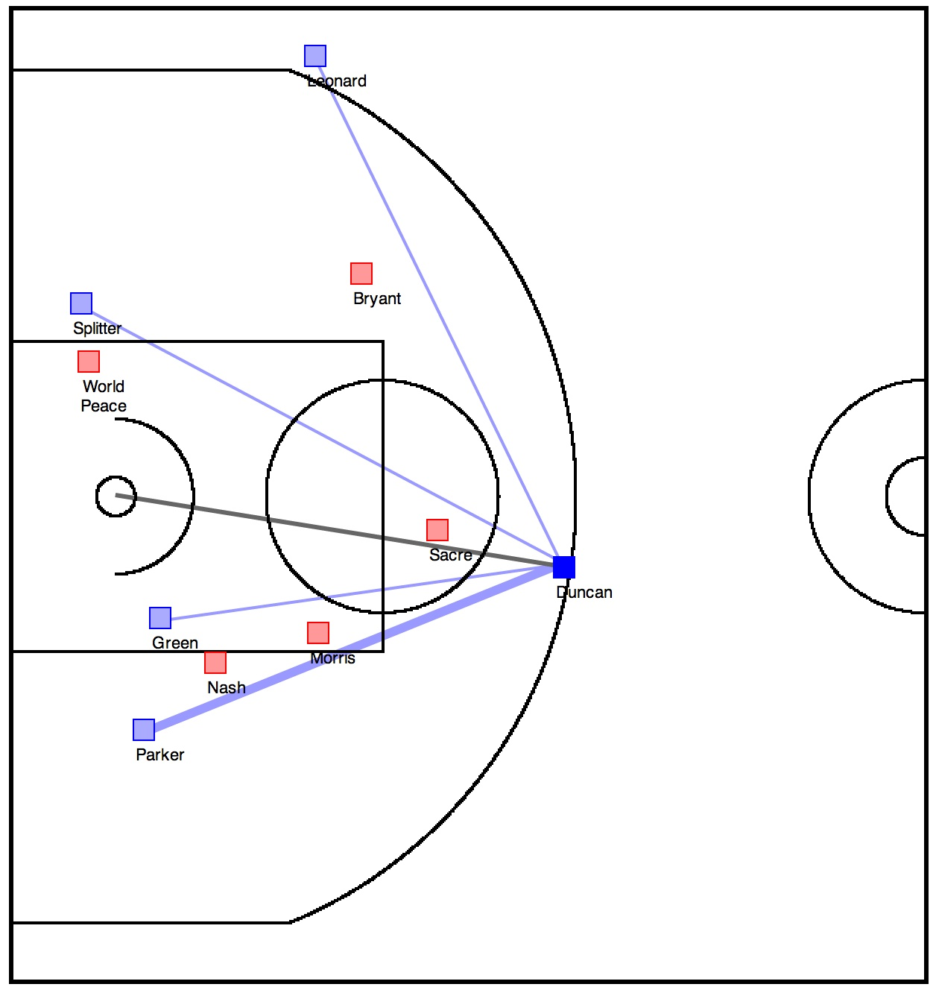
Teammates
Defenders
Defenders
Ball Handler
Teammates
Defenders

Slide 3
Demo
http://projects.yisongyue.com/bballpredict/

Slide 4
Outline
Model
  Inspection of learned model
Learning Problem
  How to train model

Slide 5
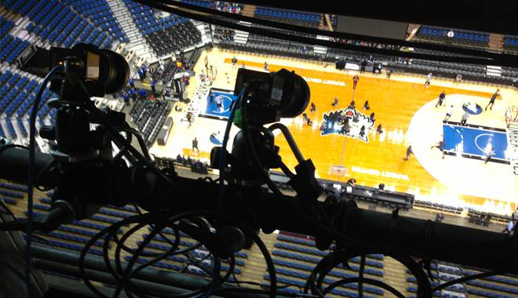
Training Data
STATS SportsVU
2012/2013 Season, 630 Games,
80K Possessions, 380 frames per possession

Slide 6
Prediction
Game state: x
  Coordinates of all players
  Who is the ball handler
Event: y
  Ball handler will shoot
  Ball handler will pass (to whom?)
  Ball handler will hold onto the ball
  6 possibilities
Goal: Learn P(y|x)
  Interpretable

Slide 7
Log-Linear Model
P(y|x)
F(y|x)
Encode spatial intuitions in F
Notes:
Recap of predictive model.
Remind people of how the spatial models we presented fit into the predictive model.

Slide 8
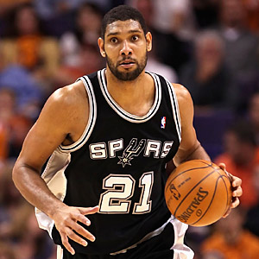
Fine-Grained
Spatial Models
Discretize court
  1x1 foot cells
  2000 cells
1 weight per cell
  2000 weights
50 feet
40 feet

Slide 9
Latent Factor Model (Shooting)
Discretize court into S cell locations
Shooting Score: F_{s}(x) = <B_{b}, L_{s}>
S Locations
K
S
F_{s}
B
L
K
=
N Players
N
Location Factors
Player Factors
Similar to [Miller et al., 2014]
Notes:
Can think of each F_s as a matrix of coefficients for shooting propensity
We can factorize F_s into player and location factors
Factorization also enables sharing of training data (we have more training data for some players than others)

Slide 10
Visualizing location factors L
Visualizing players B_{b}L
Similar to [Miller et al., 2014]
Notes:
Showing a visualization of the shooting component of our trained model. (Will discuss training later.)
Each shooting factor is a row of L
Each player is a linear combination of the 10 shooting factors

Slide 11
Recap: Log-Linear Models
P(y|x)
F(y|x)
Encode spatial intuitions in F
Notes:
Recap of predictive model.
Remind people of how the spatial models we presented fit into the predictive model.

Slide 12
Latent Factor Model (Passing) #1
Passing Score: F_{p}(x) = <P_{b}, M_{s}>
S Locations
K
S
F_{p}
P
M
K
=
N Players
N
Location Factors
Player Factors
Notes:
Model of where players tend to receive passes.
We can again factorize the coefficient matrix into player and location factors.
Again, this allows sharing of training data (some players have more training data than others)

Slide 13
Latent Factor Model (Passing) #2
Passing Score: F_{p}(x) = <P_{b}, M_{s}> + <Q_{1,s}, Q_{2,t}>
S Locations
K
S
F_{p}
Q₁
Q₂
K
=
S Locations
S
Target Location Factors
Source Location Factors
Notes:
Model of Passing tendencies around the court.

Slide 14
Where are Players Likely to Receive Passes?
M
Notes:
Showing a visualization of a passing component of our trained model. (Will discuss training later.)
Each passing factor is a row of M
Players are linear combinations of the 10 passing factors

Slide 15
How do passes tend to flow?
Passing From “X”
Passing To “X”
Notes:
Showing a visualization of a passing component of our trained model. (Will discuss training later.)
This shows the aggregated passing tendencies from recombining Q_1 * Q_2

Slide 16
Latent Factor Model
(Defending Shot)
Shooting Score: F_{s}(x) = <B_{b}, L_{s}> - <L_{s}, G_{d}>
Def. Location Factors
D Def. Locations
K
D
F_{sd}
L
G
K
=
S Locations
S
Location Factors

Slide 17
How is Shooting Likelihood Suppressed by Defenders?
G
L
Notes:
Don’t have time to talk about formulation, just show the visualization of defender model.
For upper row
-- “X” marks the location of the player
-- Up is towards the goal (either basket, or another player).
-- High intensity indicates strong score if defender is located in that region
For lower row
-- Intensity map of location of the player on the court

Slide 18
Other Defender Factors
Defending
Passing Lane
Defending
Receiver’s Shot
Notes:
Don’t have time to talk about formulation, just show the visualization of defender model.
For upper row
-- “X” marks the location of the player
-- Up is towards the goal (either basket, or another player).
-- High intensity indicates strong score if defender is located in that region
For lower row
-- Intensity map of location of the player on the court

Slide 19
Action Probabilities vs
Time-of-Possession

Slide 20
Recap: Log-Linear Models
P(y|x)
F(y|x)
Encode spatial intuitions in F
Notes:
Recap of predictive model.
Remind people of how the spatial models we presented fit into the predictive model.

Slide 21
STATS SportsVU
  2012/2013 NBA season
  Coordinates & identity of players (25 frames/sec)
  Annotated game events (passes, shots, etc)
Halfcourt sets
  At least 4 players across halfcourt for 4 seconds
  80K plays, ~380 frames per play
  Train on 80%, Test on 20%
Notes:
Baseline is just using distance-based features.

Slide 22
Visualizing Gains
Defending Shots
Relative Defender
Location
Ball Handler
Location
Ball Handler 50% less likely to shoot if defender present!

Slide 23
Aside: Higher Order Models
We only tried 2-way interactions
Can also model 3-way interactions
E.g., different players react differently to defenders at different locations
Def Location
Player
Location

Slide 24
Reminder: Training Data
STATS SportsVU
2012/2013 Season, 630 Games,
80K Possessions, 380 frames per possession

Slide 25
Training
Spatial Regularization:
(related to GP prior)
Train using gradient descent
Log likelihood of training data
Regularization
Notes:
Theta is a umbrella variable that encapsulates all the components of our model.
Our objective is to train an interpretable spatial model that has high predictive accuracy
Train using gradient descent.

Slide 26
Non-Convex!
(Need Initialization)
Gradient descent converges to local optimum!
  Can lead to non-interpretable latent factors
  Often similar predictive performance.
Good
Initialization
Random
Initialization

Slide 27
Non-Convex!
(Need Initialization)
Train un-factorized F_{s}
  Convex objective
  Gradient descent
Then factorize F_{s}
But un-factorized model
has many parameters!
Problem exacerbated
for higher-order models.

Slide 28
Coarse-to-Fine Training
Start with coarse resolution
Gradient descent
Make resolution more fine-grained
Repeat from Step 2
Factorize at
Some point.

Slide 29
Spatial Models for Basketball Gameplay
Predictive model of basketball actions
  E.g., shot, pass
  Captures spatial patterns
Model is interpretable
Requires careful training

Slide 30
Limitations
Temporal Blurring
  Mashes together player dynamics
Model full dynamics
  Currently only model snapshot
Model of team strategy
  Currently only 2 players at a time
Data Source: STATS LLC, copyright 2014

