Slide 1


Recent Applications of Latent Factor Models
Yisong Yue

Slide 2


Netflix Problem
(Collaborative Filtering)
Goals:
Predict Missing Values
Extract Reliable Patterns
User 1
User 2
User 3
User 4
User 5

Slide 3
Latent Factor Models
M Movies
K
M
Y
(missing values)
U^{T}
V
K
=
N Users
N
“Latent Factors”
Y_{ij} = rating user i gives to movie j:
“dot product”
“(un-normalized) cosine similarity”

Slide 4
User 1
User 2
User 3
User 4
User 5

Slide 5
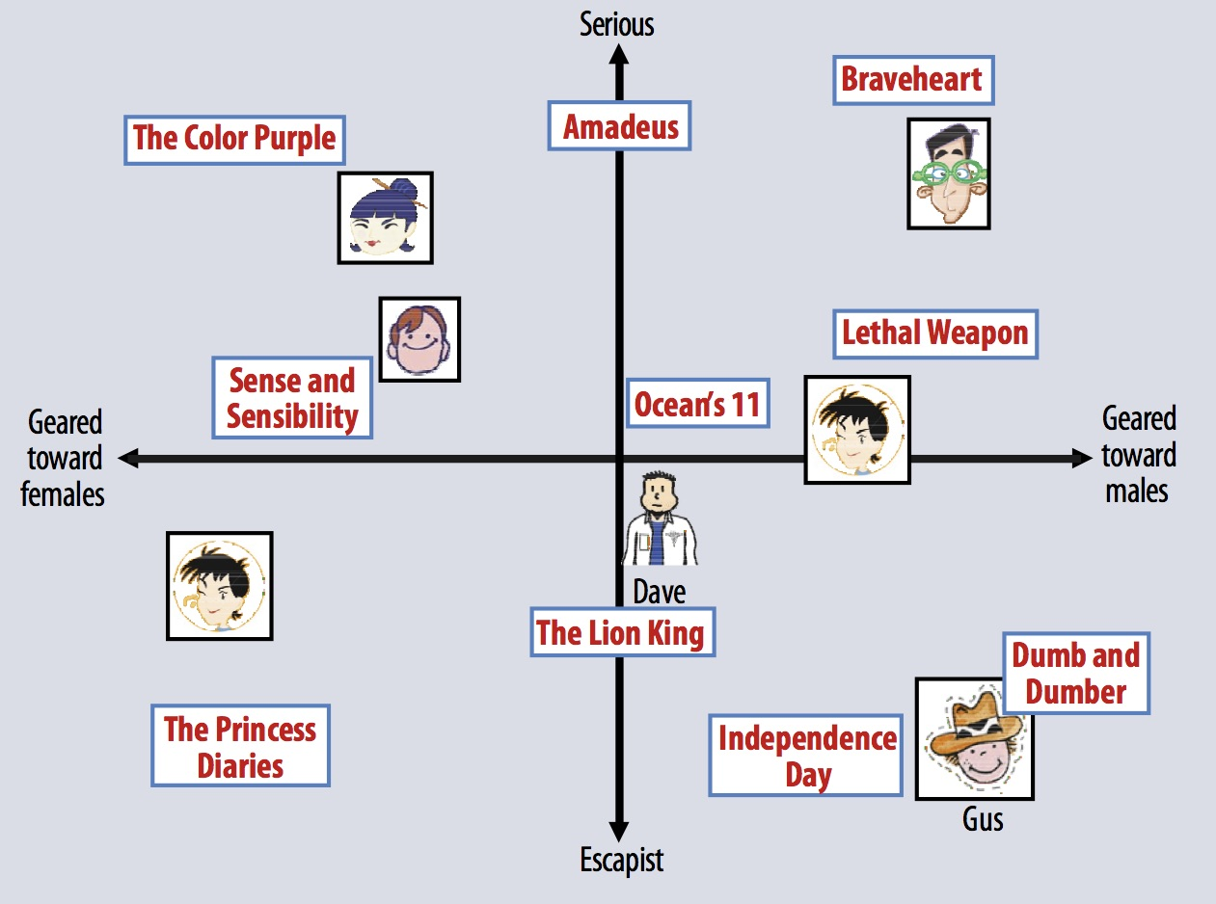
Example
Image Source: http://www2.research.att.com/~volinsky/papers/ieeecomputer.pdf

Slide 6
Basic Training Formulation
Only labels, no features
Learn a latent representation:
Training Set
Regularization
Training Error

Slide 7
Recap: Latent Factor Models
Automatically learns representation
  E.g., there is a “horror” genre
  Often not very clean
Exploits similarities in how people rate items
  Even if no one has rated all items
  Fills in missing values
State-of-the-art

Slide 8
This Talk
Latent Spatial Models
(for Basketball Play Prediction)
Latent Tensor Models
(for Collaborative Clustering)

Slide 9



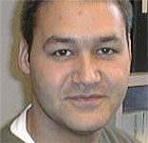
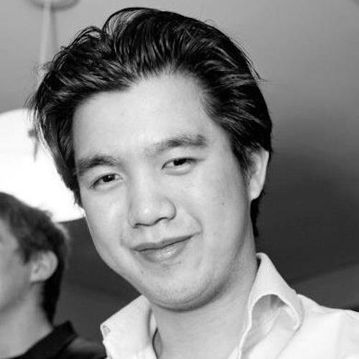
Learning Fine-Grained Spatial Models for Dynamic Sports Play Prediction
(ICDM 2014)
Joint work with:
Patrick
Lucey
Peter
Carr
Alina
Bialkowski
Iain
Matthews
Stephan
Zheng
http://www.yisongyue.com/publications/icdm2014_bball_predict.pdf

Slide 10
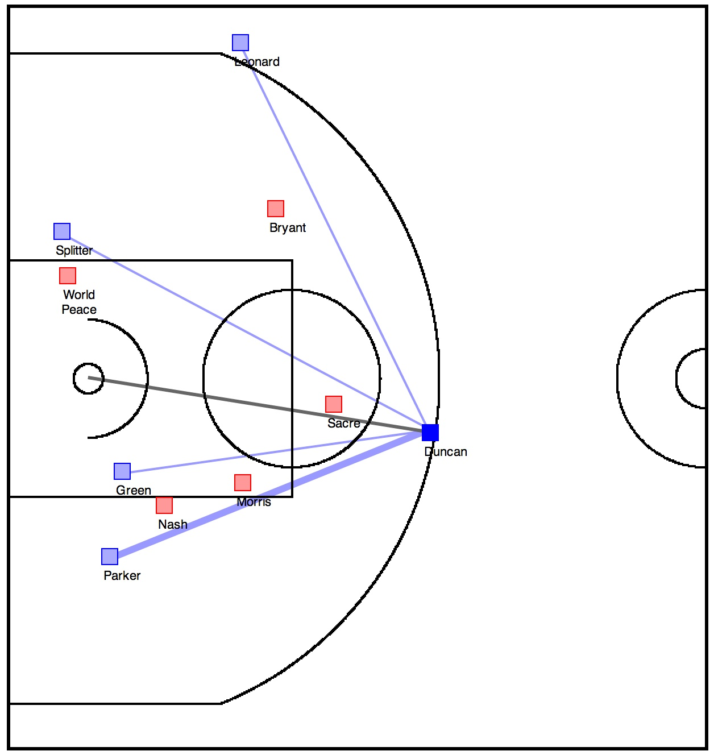
Teammates
Defenders
Goal:
Learn an Interpretable Predictive Model for Play Prediction
(E.g., Pass or Shot)
Defenders
Ball Handler
Teammates
Defenders

Slide 11
Demo
http://projects.yisongyue.com/bballpredict/

Slide 12
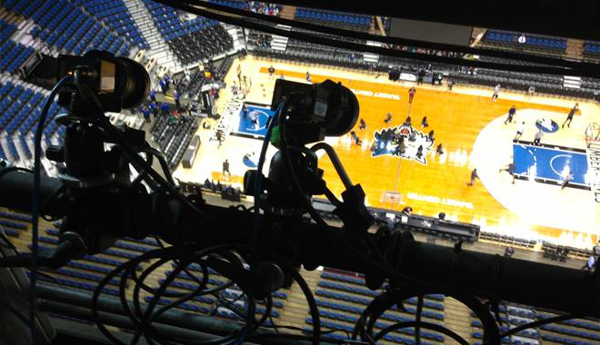
Training Data
STATS SportsVU
2012/2013 Season, 630 Games,
80K Possessions, 380 frames per possession

Slide 13
Prediction
Game state: x
  Coordinates of all players
  Who is the ball handler
Event: y
  Ball handler will shoot
  Ball handler will pass (to whom?)
  Ball handler will hold onto the ball
  6 possibilities
Goal: Learn P(y|x)
  Interpretable
http://www.yisongyue.com/publications/icdm2014_bball_predict.pdf

Slide 14
Log-Linear Spatial Model
P(y|x)
F(y|x)
Encode spatial intuitions in F
Notes:
Recap of predictive model.
Remind people of how the spatial models we presented fit into the predictive model.

Slide 15
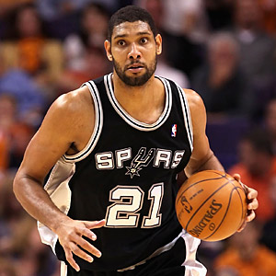
Fine-Grained
Spatial Models
Discretize court
  1x1 foot cells
  2000 cells
1 weight per cell
  2000 weights
50 feet
40 feet

Slide 16
Latent Factor Model (Shooting)
Discretize court into S cell locations
Shooting Score: F_{s}(x) = <B_{b}, L_{s}>
S
K
S
F_{s}
B
L
K
=
N
N
Location Factors
Player Factors
Similar to [Miller et al., 2014]
Notes:
Can think of each F_s as a matrix of coefficients for shooting propensity
We can factorize F_s into player and location factors
Factorization also enables sharing of training data (we have more training data for some players than others)

Slide 17
Visualizing location factors L
Visualizing players B_{b}L
Similar to [Miller et al., 2014]
Notes:
Showing a visualization of the shooting component of our trained model. (Will discuss training later.)
Each shooting factor is a row of L
Each player is a linear combination of the 10 shooting factors

Slide 18
Latent Factor Model (Passing) #1
Shooting Score: F_{p}(x) = <P_{b}, M_{s}>
S
K
S
F_{p}
P
M
K
=
N
N
Location Factors
Player Factors
Notes:
Model of where players tend to receive passes.
We can again factorize the coefficient matrix into player and location factors.
Again, this allows sharing of training data (some players have more training data than others)

Slide 19
Latent Factor Model (Passing) #2
Shooting Score: F_{p}(x) = <P_{b}, M_{s}> + <Q_{1,s}, Q_{2,t}>
S
K
S
F_{p}
Q₁
Q₂
K
=
S
S
Target Location Factors
Source Location Factors
Notes:
Model of Passing tendencies around the court.

Slide 20
Where are Players Likely to Receive Passes?
M
Notes:
Showing a visualization of a passing component of our trained model. (Will discuss training later.)
Each passing factor is a row of M
Players are linear combinations of the 10 passing factors

Slide 21
How do passes tend to flow?
Passing From “X”
Passing To “X”
Notes:
Showing a visualization of a passing component of our trained model. (Will discuss training later.)
This shows the aggregated passing tendencies from recombining Q_1 * Q_2

Slide 22
Recap: Log-Linear Spatial Model
P(y|x)
F(y|x)
Encode spatial intuitions in F
Notes:
Recap of predictive model.
Remind people of how the spatial models we presented fit into the predictive model.

Slide 23
Reminder: Training Data
STATS SportsVU
2012/2013 Season, 630 Games,
80K Possessions, 380 frames per possession

Slide 24
Training
Spatial Regularization:
(related to GP prior)
Log likelihood of training data
Regularization
Notes:
Theta is a umbrella variable that encapsulates all the components of our model.
Our objective is to train an interpretable spatial model that has high predictive accuracy
Train using gradient descent.

Slide 25
Non-Convex!
(Need Initialization)
Gradient descent converges to local optimum!
  Can lead to non-interpretable latent factors
  Often similar predictive performance.
Good
Initialization
Random
Initialization

Slide 26
Non-Convex!
(Need Initialization)
Train un-factorized F_{s}
  Convex objective
  Gradient descent
Then factorize F_{s}
But un-factorized model
has many parameters!
Problem exacerbated
for higher-order models.

Slide 27
Coarse-to-Fine Training
Start with coarse resolution
Gradient descent
Make resolution more fine-grained
Repeat from Step 2
Factorize at
Some point.

Slide 28
Spatial Models for Basketball Gameplay
Predictive model of basketball actions
  E.g., shot, pass
  Captures spatial patterns
Model is interpretable
Requires careful training

Slide 29
Limitations
Temporal Blurring
  Mashes together player dynamics
Model full dynamics
  Currently only model snapshot
Model of team strategy
  Currently only 2 players at a time
Data Source: STATS LLC, copyright 2014

Slide 30
Personalized Collaborative Clustering
(WWW 2014)
Joint work with:
Chong Wang
Khalid El-Arini
Carlos Guestrin
http://www.yisongyue.com/publications/www2014_collab_cluster.pdf

Slide 31
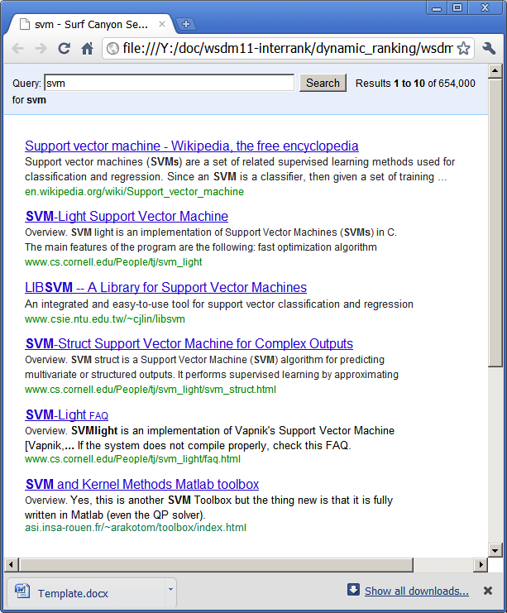


Motivation: Richer User Interfaces
?
Click
Information Bottleneck
We can only learn as much as interface permits
(We can only help user as much as interface permits)

Slide 32
“ReGroup: Interactive Machine Learning for On-Demand Group Creation in Social Networks”
[Ameershi et al., CHI 2012]

Slide 33
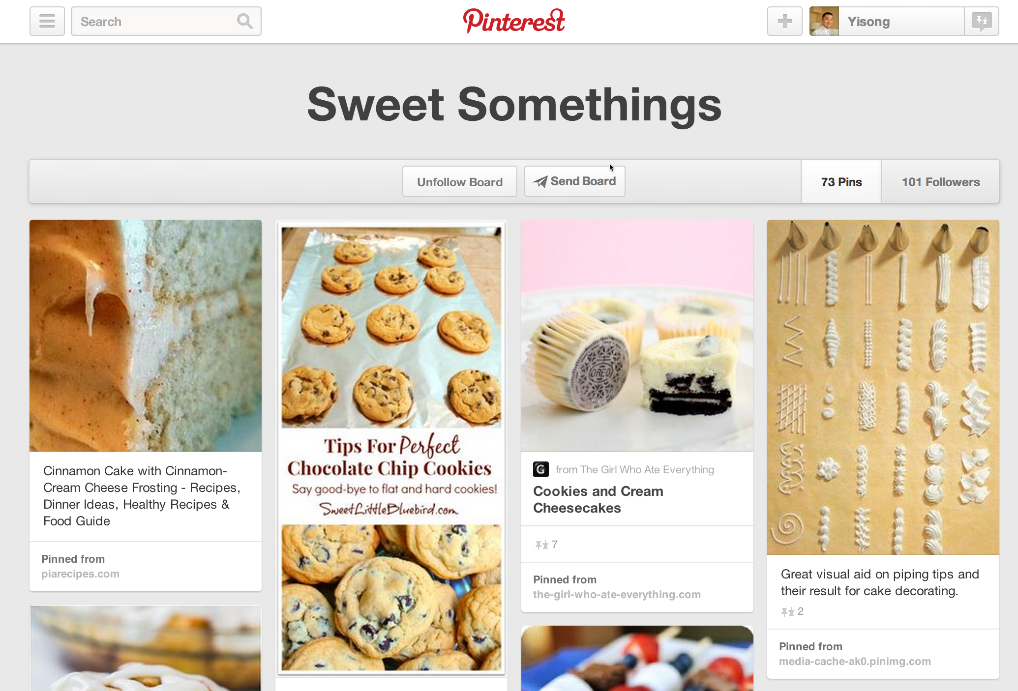
http://www.pinterest.com

Slide 34
“Apolo: Making Sense of Large Network Data by Combining Rich User Interaction and Machine Learning”
[Chau et al., CHI 2011]

Slide 35
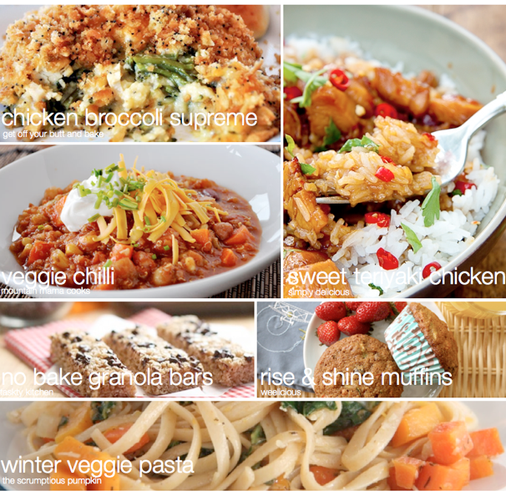
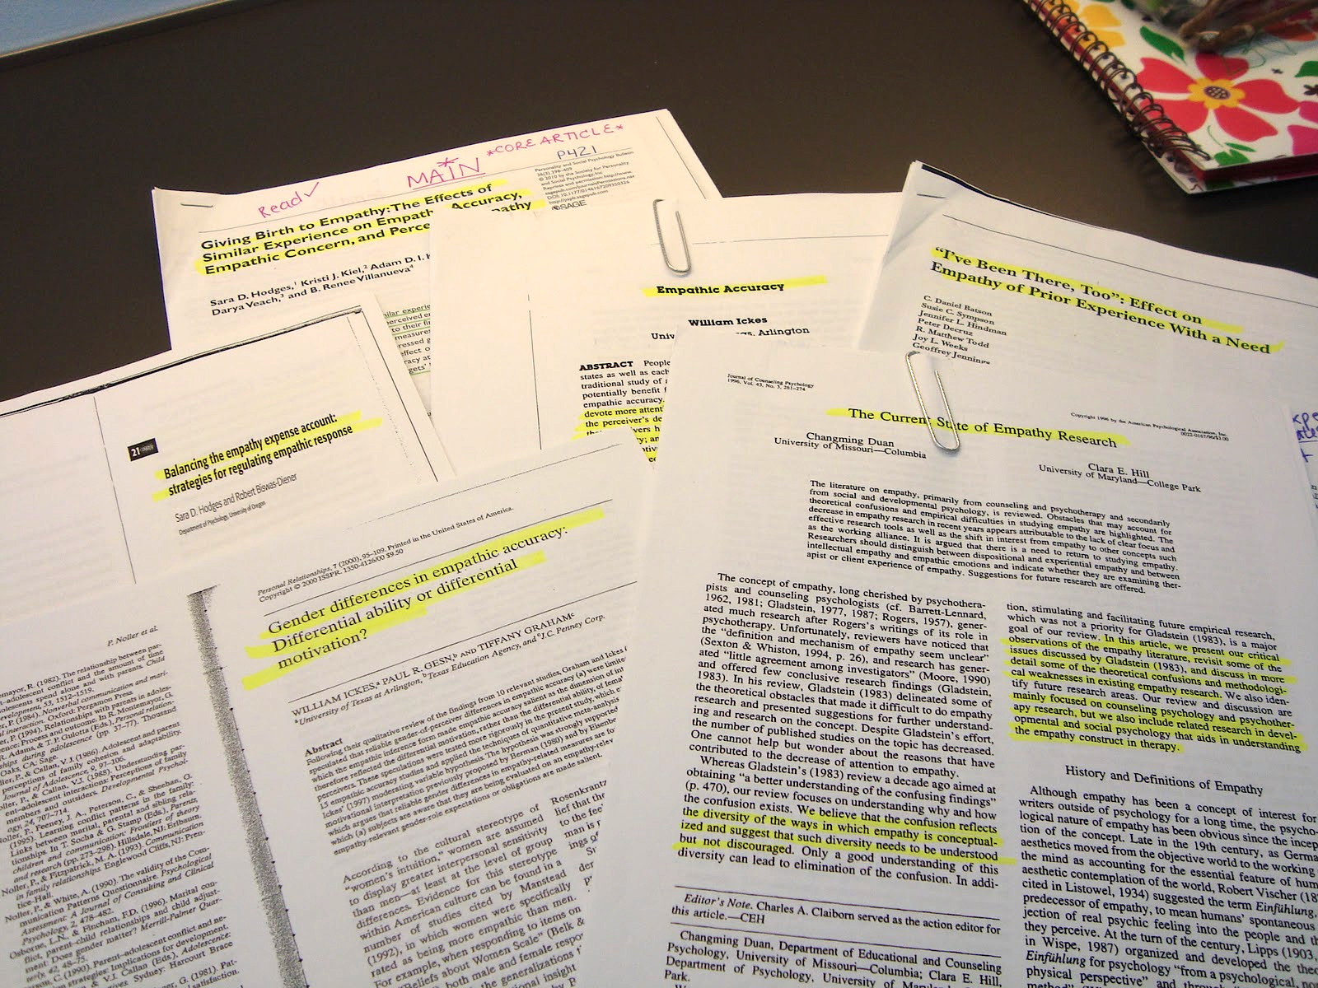
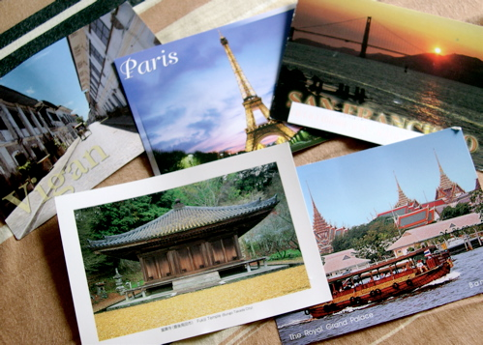
Demo
(Goal Oriented Data Browsing)
Planning a vacation
Planning meals for the week
Literature review for grant proposal

Slide 36
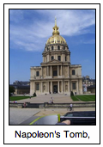

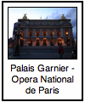


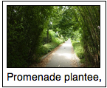


Recap: Collaborative Filtering
User 1
User 2
User 3
User 4
User 5

Slide 37
Recap: Collaborative Filtering
Training Data: M items, N users
Y = {Y₁ … Y_{N}}
Y_{n} =
Y_{k} =
( , ), ( , ),
( , ), …
Each user rates a
a subset of items
( , ), ( , ),
( , ), …

Slide 38
Recap: Collaborative Filtering
Learning Goal: F(n,i) ≈ y_{ni} (+1 or -1)
Y_{n} =
F(n, ) ≈ +1
F(n, ) ≈ -1
Prediction goal: F(n,i) for new items
( , ), ( , ),
( , ), …

Slide 39
Recap: Latent Factor Models
Can now predict
missing values
Also known as
matrix completion

Slide 40
Collaborative Clustering
Training Data: M items, N users
Y = {Y₁ … Y_{N}}
Y_{n} =
Y_{k} =
Each user clusters
a subset of items
(partial clustering)
http://www.yisongyue.com/publications/www2014_collab_cluster.pdf

Slide 41
Collaborative Clustering
Learning goal: F(n,i,j) ≈ y_{nij} (+1 or -1)
Y_{n} =
F(n, , ) ≈ +1
F(n, , ) ≈ -1
Prediction goal: F(n,i,j) for new items
Clustering analogue to
Collaborative Filtering
http://www.yisongyue.com/publications/www2014_collab_cluster.pdf

Slide 42
Latent Collaborative Clustering
K
M
X
M
Y
M
=
×
X
K
N
M
U^{T}
(Missing Values)
Users and items modeled
as K-dimensional factors.
(tensor factorization)
N
K
Hadamard Product
Prediction: F(n,i,j) = x_{i} u_{n} x_{j}
Actual model slightly
more complicated

Slide 43
Latent Collaborative Clustering
F(n,i,j) = x_{i} u_{n} x_{j}
F(n,i,j) =
Diag(u_{n}) = user-specific transform
  Metric learning (i.e., Mahanalobis)
Diag(u_{n})
Actual model slightly
more complicated
http://www.yisongyue.com/publications/www2014_collab_cluster.pdf

Slide 44
Learning
User Transform
Item Factor
Regularization
Reconstruction Error
Enforces Metric
Weight positive & negative
feedback differently
(optimization details in paper)
http://www.yisongyue.com/publications/www2014_collab_cluster.pdf

Slide 45
Input Clustering
Input Clustering
F(m, , ?)
F(m, , ?)
F(m, , ?)

Slide 46
Data Collection
New User Study: Hypothetical trip to Paris
Mechanical Turk
Cluster interesting attractions
250 attractions
(from TripAdvisor)
218 users
18.7 items per user
4.5 clusters per user
“Very interesting - I feel like I learned a bit about Paris!”
“I have never been to Paris but now I want to go even more.”
“We would just about sell our souls to get there! Thank you for letting me travel there vicariously through this HIT!!!”
(HIT refers to “Human Intelligence Task”)
“Great format. Have been to Paris several times but still learned about many great new places to visit”

Slide 47
Features for Attractions
2 sets of features
Wikipedia tf-idf
(~3.5K features)
Mechanical Turk
Tagging (right)
(~40 features)
Used for baselines

Slide 48
Evaluation
For each test user:
  Hold out some attractions
  Predict cluster membership (or new cluster)
Feature-based baselines:
  Diagonal metric (per user)
  [Wagstaff & Cardie, 2000] [Xing et al., 2002] [Schultz & Joachims, 2003]
  [Davis et al., 2007] [Parameswaran & Weinberger, 2010]
  Latent feature transform (significantly slower)
  [Blitzer & Weston, 2012]

Slide 49

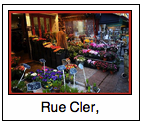
Prediction Tasks
Predict cluster membership
  Existing cluster:
  New cluster:
Cluster with highest average F(m,i,j).
(conventional classification)
All clusters have negative F(m,i,j).
(predicting novelty)

Slide 50
Conventional Prediction Setting
B E T T E R
Random
Largest
Cluster
Feature-Based
Transformed
Feature-Based
LCC
Hold 25% from each cluster (no empty clusters)
Predict cluster membership (conventional classification)

Slide 51
Predicting Novelty
Only method to
beat random!
B E T T E R
Random
Largest
Cluster
Feature-Based
Transformed
Feature-Based
LCC
Hold one entire cluster
Predict new cluster (predict novelty)

Slide 52
Overall
B E T T E R
Random
Largest
Cluster
Feature-Based
Transformed
Feature-Based
LCC
Hold 50% of attractions at random (some clusters empty)
Predict cluster membership (or new cluster)

Slide 53
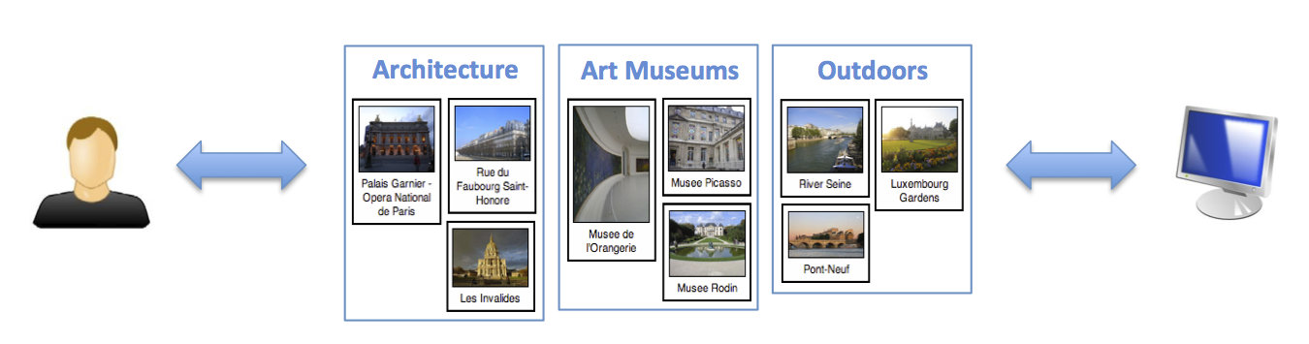
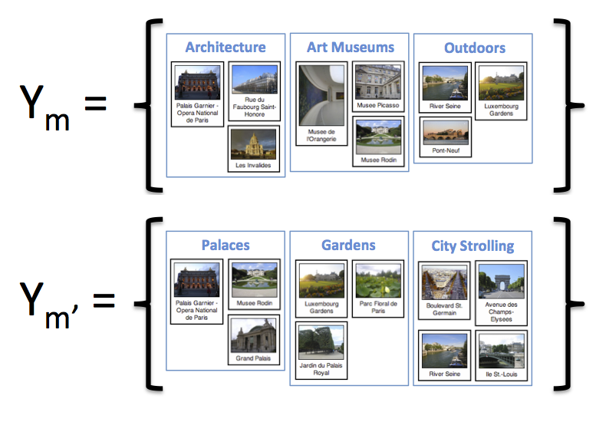
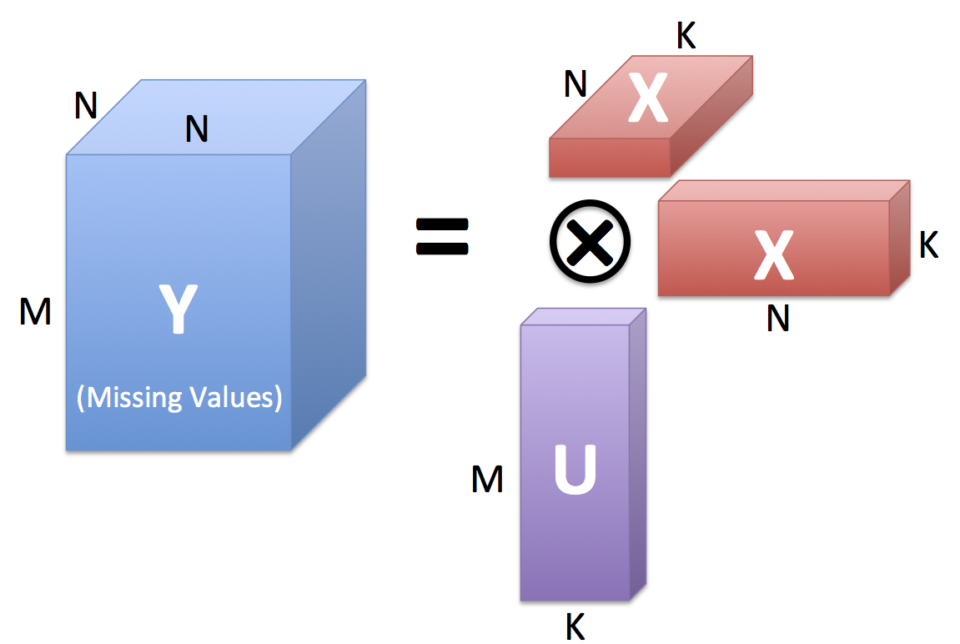
Collaborative Clustering
Rich User Feedback
Learning Problem
Latent Factor Model
User Study Data
Evaluation
http://projects.yisongyue.com/collab_cluster/

Slide 54
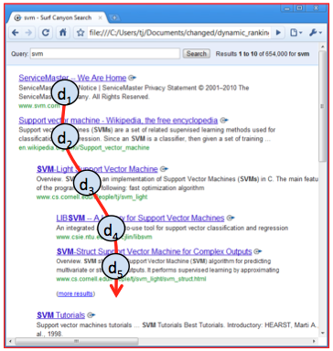
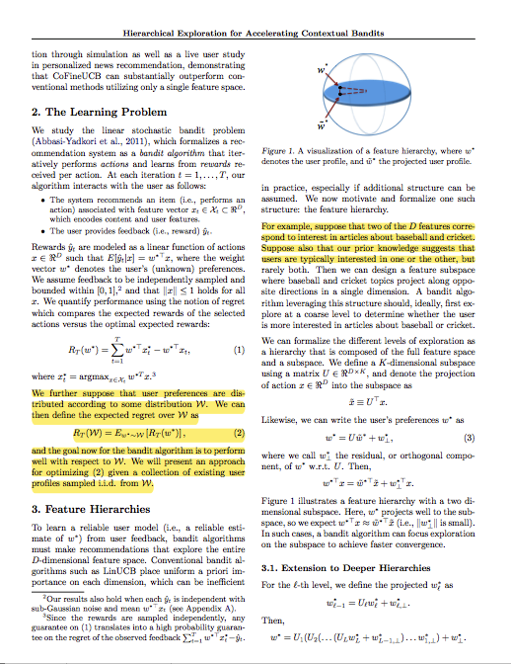
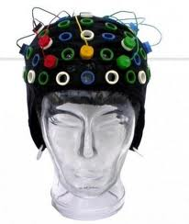
Future Work
Context, scalability, transfer learning, etc.
How to model interactive setting?
  Exploration vs Exploitation
  User goals?
How to model other rich interactions?
Dynamic Rankings
Zooming
Highlighting
Etc…
[Brandt et al., 2011]
[Shahaf et al., 2013]

Slide 55
Latent Factor Models
Explosion in different forms of raw data
Learn customized representations
  Improved accuracy
  Interpretability
  Requires some modeling assumptions

Slide 56
Extra Slides

Slide 57
ICDM 2014 Material

Slide 58
How is Shooting Likelihood Suppressed by Defenders?
G
L
Notes:
Don’t have time to talk about formulation, just show the visualization of defender model.
For upper row
-- “X” marks the location of the player
-- Up is towards the goal (either basket, or another player).
-- High intensity indicates strong score if defender is located in that region
For lower row
-- Intensity map of location of the player on the court

Slide 59
Other Defender Factors
Defending
Passing Lane
Defending
Receiver’s Shot
Notes:
Don’t have time to talk about formulation, just show the visualization of defender model.
For upper row
-- “X” marks the location of the player
-- Up is towards the goal (either basket, or another player).
-- High intensity indicates strong score if defender is located in that region
For lower row
-- Intensity map of location of the player on the court

Slide 60
Action Probabilities vs
Time-of-Possession

Slide 61
STATS SportsVU
  2012/2013 NBA season
  Coordinates & identity of players (25 frames/sec)
  Annotated game events (passes, shots, etc)
Halfcourt sets
  At least 4 players across halfcourt for 4 seconds
  80K plays, ~380 frames per play
  Train on 80%, Test on 20%
Notes:
Baseline is just using distance-based features.

Slide 62
Visualizing Gains
Defending Shots
Relative Defender
Location
Ball Handler
Location
Ball Handler 50% less likely to shoot if defender present!

Slide 63
Aside: Higher Order Models
We only tried 2-way interactions
Can also model 3-way interactions
E.g., different players react differently to defenders at different locations
Def Location
Player
Location

Slide 64
WWW 2014 Material

Slide 65
Learning
User Transform
Item Factor
Alternating least squares optimization
  (convex in U and each x, but not jointly)
Iterative closed form solutions
  (use ADMM to solve U≥0)
(optimization details in paper)
http://www.yisongyue.com/publications/www2014_collab_cluster.pdf

Slide 66
(Also efficient methods for
speeding up computation.)

