Slide 1

Machine Learning & Data Mining
CS/CNS/EE 155
Lecture 17:
The Multi-Armed Bandit Problem

Slide 2
Announcements
Lecture Tuesday will be Course Review
Final should only take a 4-5 hours to do
  We give you 48 hours for your flexibility
Homework 2 is graded
  We graded pretty leniently
  Approximate Grade Breakdown:
  64: A 61: A- 58: B+ 53: B 50: B- 47: C+ 42: C 39: C-
Homework 3 will be graded soon

Slide 3
Today
The Multi-Armed Bandits Problem
  And extensions
Advanced topics course on this next year

Slide 4
Recap: Supervised Learning
Training Data:
Model Class:
Loss Function:
Learning Objective:
E.g., Linear Models
E.g., Squared Loss
Optimization Problem

Slide 5
But Labels are Expensive!
“Crystal”
“Needle”
“Empty”
0 1 2 3…
“Sports”
“World News”
“Science”
Human Annotation
Running Experiment
x
y
Cheap and Abundant!
Expensive and Scarce!
Image Source: http://www.cs.cmu.edu/~aarti/Class/10701/slides/Lecture23.pdf

Slide 6
Solution?
Let’s grab some labels!
  Label images
  Annotate webpages
  Rate movies
  Run Experiments
  Etc…
How should we choose?

Slide 7
Interactive Machine Learning
Start with unlabeled data:
Loop:
  select x_{i}
  receive feedback/label y_{i}
How to measure cost?
How to define goal?

Slide 8


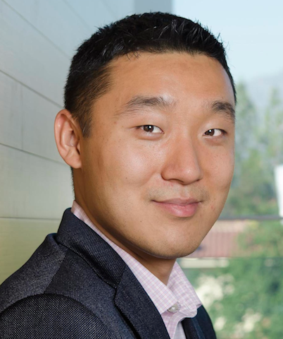

Crowdsourcing
Unlabeled
Repeat
Labeled
Initially Empty
“Mushroom”

Slide 9
Aside: Active Learning
Goal: Maximize Accuracy with Minimal Cost
Unlabeled
Choose
Repeat
Labeled
Initially Empty
“Mushroom”

Slide 10
Passive Learning
Unlabeled
Random
Repeat
Labeled
Initially Empty
“Mushroom”

Slide 11
Comparison with Passive Learning
Conventional Supervised Learning is considered “Passive” Learning
Unlabeled training set sampled according to test distribution
So we label it at random
  Very Expensive!

Slide 12
Aside: Active Learning
Cost: uniform
  E.g., each label costs $0.10
Goal: maximize accuracy of trained model
Control distribution of
labeled training data

Slide 13
Problems with Crowdsourcing
Assumes you can label by proxy
  E.g., have someone else label objects in images
But sometimes you can’t!
  Personalized recommender systems
    Need to ask the user whether content is interesting
  Personalized medicine
    Need to try treatment on patient
  Requires actual target domain

Slide 14
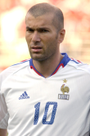


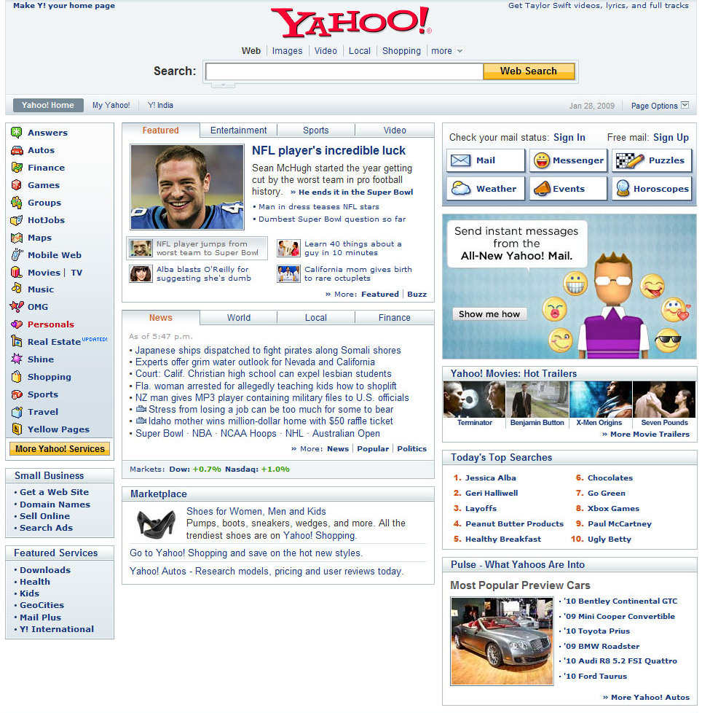



Personalized Labels
Unlabeled
Choose
Sports
Repeat
Labeled
Initially Empty
End User
What is Cost?
Real System

Slide 15
The Multi-Armed Bandit Problem

Slide 16
Formal Definition
K actions/classes
Each action has an average reward: μ_{k}
  Unknown to us
  Assume WLOG that u₁ is largest
For t = 1…T
  Algorithm chooses action a(t)
  Receives random reward y(t)
    Expectation μ_{a(t)}
    Goal: minimize Tu₁ – (μ_{a(1)} + μ_{a(2)} + … + μ_{a(T)})
Basic Setting
K classes
No features
Algorithm Simultaneously
Predicts & Receives Labels
If we had perfect information to start
Expected Reward of Algorithm

Slide 17
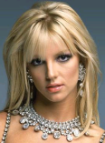
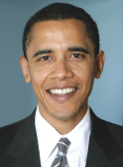
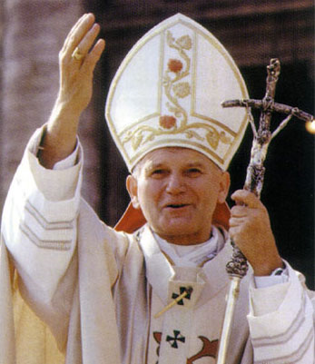

Interactive Personalization
(5 Classes, No features)
Sports
-- | -- | -- | -- | --
0 | 0 | 0 | 1 | 0
: 0
Average Likes
# Shown

Slide 18

Interactive Personalization
(5 Classes, No features)
Sports
-- | -- | -- | 0 | --
0 | 0 | 0 | 1 | 0
: 0
Average Likes
# Shown

Slide 19
Interactive Personalization
(5 Classes, No features)
Politics
-- | -- | -- | 0 | --
0 | 0 | 1 | 1 | 0
: 0
Average Likes
# Shown

Slide 20
Interactive Personalization
(5 Classes, No features)
Politics
-- | -- | 1 | 0 | --
0 | 0 | 1 | 1 | 0
: 1
Average Likes
# Shown

Slide 21
Interactive Personalization
(5 Classes, No features)
World
-- | -- | 1 | 0 | --
0 | 0 | 1 | 1 | 1
: 1
Average Likes
# Shown

Slide 22
Interactive Personalization
(5 Classes, No features)
World
-- | -- | 1 | 0 | 0
0 | 0 | 1 | 1 | 1
: 1
Average Likes
# Shown

Slide 23
Interactive Personalization
(5 Classes, No features)
Economy
-- | -- | 1 | 0 | 0
0 | 1 | 1 | 1 | 1
: 1
Average Likes
# Shown

Slide 24
Interactive Personalization
(5 Classes, No features)
Economy
…
-- | 1 | 1 | 0 | 0
0 | 1 | 1 | 1 | 1
: 2
Average Likes
# Shown

Slide 25
What should Algorithm Recommend?
Exploit:
Explore:
Best:
Economy
Celebrity
Politics
How to Optimally Balance Explore/Exploit Tradeoff?
Characterized by the Multi-Armed Bandit Problem
-- | 0.44 | 0.4 | 0.33 | 0.2
0 | 25 | 10 | 15 | 20
: 24
Average Likes
# Shown

Slide 26
( )
( )
( )
…
( )
( )
( )
…
Time Horizon
Regret:
Opportunity cost of not knowing preferences
“no-regret” if R(T)/T ➔ 0
  Efficiency measured by convergence rate

Slide 27
Recap: The Multi-Armed Bandit Problem
K actions/classes
Each action has an average reward: μ_{k}
  All unknown to us
  Assume WLOG that u₁ is largest
For t = 1…T
  Algorithm chooses action a(t)
  Receives random reward y(t)
    Expectation μ_{a(t)}
    Goal: minimize Tu₁ – (μ_{a(1)} + μ_{a(2)} + … + μ_{a(T)})
Basic Setting
K classes
No features
Algorithm Simultaneously
Predicts & Receives Labels
Regret

Slide 28
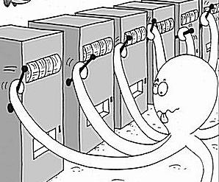
The Motivating Problem
Slot Machine = One-Armed Bandit
Goal: Minimize regret From pulling suboptimal arms
Each Arm Has
Different Payoff
http://en.wikipedia.org/wiki/Multi-armed_bandit

Slide 29
Implications of Regret
Regret:
If R(T) grows linearly w.r.t. T:
  Then R(T)/T ➔ constant > 0
  I.e., we converge to predicting something suboptimal
If R(T) is sub-linear w.r.t. T:
  Then R(T)/T ➔ 0
  I.e., we converge to predicting the optimal action

Slide 30



Experimental Design
How to split trials to collect information
Static Experimental Design
  Standard practice
  (pre-planned)
Treatment
Placebo
Treatment
Placebo
Treatment
…
http://en.wikipedia.org/wiki/Design_of_experiments

Slide 31
Sequential Experimental Design
Adapt experiments based on outcomes
Treatment
Placebo
Treatment
Treatment
Treatment
…

Slide 32
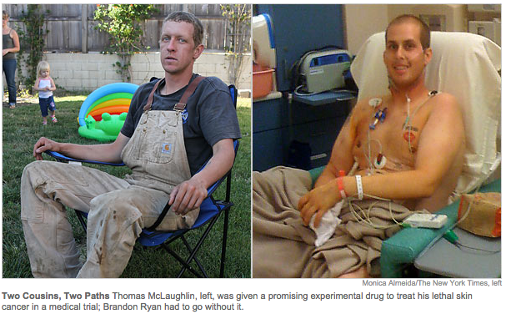
Sequential Experimental Design Matters
http://www.nytimes.com/2010/09/19/health/research/19trial.html

Slide 33
Sequential Experimental Design
MAB models sequential experimental design!
Each treatment has hidden expected value
  Need to run trials to gather information
  “Exploration”
In hindsight, should always have used treatment with highest expected value
Regret = opportunity cost of exploration
basic

Slide 34
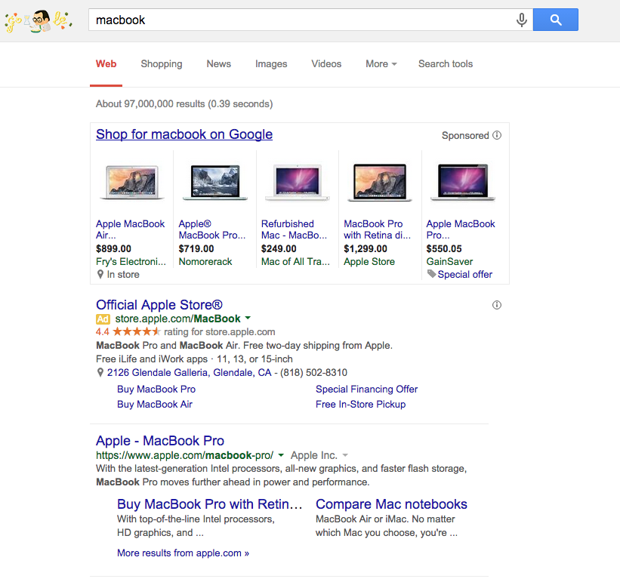
Online Advertising
Largest Use-Case
of Multi-Armed
Bandit Problems

Slide 35
The UCB1 Algorithm
http://homes.di.unimi.it/~cesabian/Pubblicazioni/ml-02.pdf

Slide 36
Confidence Intervals
Maintain Confidence Interval for Each Action
  Often derived using Chernoff-Hoeffding bounds (**)
= [0.1, 0.3]
= [0.25, 0.55]
Undefined
-- | 0.44 | 0.4 | 0.33 | 0.2
0 | 25 | 10 | 15 | 20
Average Likes
# Shown
** http://www.cs.utah.edu/~jeffp/papers/Chern-Hoeff.pdf
http://en.wikipedia.org/wiki/Hoeffding%27s_inequality

Slide 37
UCB1 Confidence Interval
Total Iterations so far
(70 in example below)
Expected Reward
Estimated from data
#times action k was chosen
-- | 0.44 | 0.4 | 0.33 | 0.2
0 | 25 | 10 | 15 | 20
Average Likes
# Shown
http://homes.di.unimi.it/~cesabian/Pubblicazioni/ml-02.pdf

Slide 38
The UCB1 Algorithm
At each iteration
  Play arm with highest Upper Confidence Bound:
-- | 0.44 | 0.4 | 0.33 | 0.2
0 | 25 | 10 | 15 | 20
Average Likes
# Shown
http://homes.di.unimi.it/~cesabian/Pubblicazioni/ml-02.pdf

Slide 39
Balancing Explore/Exploit
“Optimism in the Face of Uncertainty”
Exploitation Term
Exploration Term
-- | 0.44 | 0.4 | 0.33 | 0.2
0 | 25 | 10 | 15 | 20
Average Likes
# Shown
http://homes.di.unimi.it/~cesabian/Pubblicazioni/ml-02.pdf

Slide 40
Analysis (Intuition)
With high probability (**):
Upper Confidence Bound of Best Arm
Value of
Best Arm
The true value is greater than
the lower confidence bound.
Bound on regret at time t+1
** Proof of Theorem 1 in http://homes.di.unimi.it/~cesabian/Pubblicazioni/ml-02.pdf

Slide 41
500 Iterations
2000 Iterations
158 145 89 34 74
913 676 139 82 195
5000 Iterations
25000 Iterations
2442 1401 713 131 318
20094 2844 1418 181 468

Slide 42
How Often Sub-Optimal Arms Get Played
An arm never gets selected if:
The number of times selected:
  Prove using Hoeffding’s Inequality
Bound grows
slowly with time
Shrinks quickly
with #trials
Theorem 1 in http://homes.di.unimi.it/~cesabian/Pubblicazioni/ml-02.pdf

Slide 43
Regret Guarantee
With high probability:
  UCB1 accumulates regret at most:
#Actions
Time Horizon
Gap between best & 2nd best
ε = μ₁ – μ₂
Theorem 1 in http://homes.di.unimi.it/~cesabian/Pubblicazioni/ml-02.pdf

Slide 44
Recap: MAB & UCB1
Interactive setting
  Receives reward/label while making prediction
Must balance explore/exploit
Sub-linear regret is good
  Average regret converges to 0

Slide 45
Extensions
Contextual Bandits
  Features of environment
Dependent-Arms Bandits
  Features of actions/classes
Dueling Bandits
Combinatorial Bandits
General Reinforcement Learning

Slide 46
Contextual Bandits
K actions/classes
Rewards depends on context x: μ(x)
For t = 1…T
  Algorithm receives context x_{t}
  Algorithm chooses action a(t)
  Receives random reward y(t)
    Expectation μ(x_{t})
Goal: Minimize Regret
K classes
Best class depends
on features
Algorithm Simultaneously
Predicts & Receives Labels
Bandit multiclass prediction
http://arxiv.org/abs/1402.0555
http://www.research.rutgers.edu/~lihong/pub/Li10Contextual.pdf

Slide 47
Linear Bandits
K actions/classes
  Each action has features x_{k}
  Reward function: μ(x) = w^{T}x
For t = 1…T
  Algorithm chooses action a(t)
  Receives random reward y(t)
    Expectation μ_{a(t)}
Goal: regret scaling independent of K
K classes
Linear dependence
Between Arms
Algorithm Simultaneously
Predicts & Receives Labels
Labels can share information
to other actions
http://webdocs.cs.ualberta.ca/~abbasiya/linear-bandits-NIPS2011.pdf

Slide 48
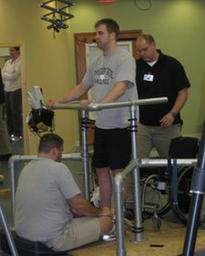
Example
Treatment of spinal cord injury patients
  Studied by Joel Burdick’s group @Caltech
Multi-armed bandit problem:
  Thousands of arms
Want regret bound that
scales independently of #arms
E.g., linearly in dimensionality
of features x describing arms
 | 5 |  |  |  | 5 |  |  |  | 5 |  |  |  | 5 |  |  |  | 5
0 |  | 11 |  | 0 |  | 11 |  | 0 |  | 11 |  | 0 |  | 11 |  | 0 |  | 11
 | 6 |  |  |  | 6 |  |  |  | 6 |  |  |  | 6 |  |  |  | 6
1 |  | 12 |  | 1 |  | 12 |  | 1 |  | 12 |  | 1 |  | 12 |  | 1 |  | 12
 | 7 |  |  |  | 7 |  |  |  | 7 |  |  |  | 7 |  |  |  | 7
2 |  | 13 |  | 2 |  | 13 |  | 2 |  | 13 |  | 2 |  | 13 |  | 2 |  | 13
 | 8 |  |  |  | 8 |  |  |  | 8 |  |  |  | 8 |  |  |  | 8
3 |  | 14 |  | 3 |  | 14 |  | 3 |  | 14 |  | 3 |  | 14 |  | 3 |  | 14
 | 9 |  |  |  | 9 |  |  |  | 9 |  |  |  | 9 |  |  |  | 9
4 |  | 15 |  | 4 |  | 15 |  | 4 |  | 15 |  | 4 |  | 15 |  | 4 |  | 15
 | 10 |  |  |  | 10 |  |  |  | 10 |  |  |  | 10 |  |  |  | 10
UCB1 Regret Bound:
Images from Yanan Sui

Slide 49
Dueling Bandits
K actions/classes
  Preference model P(a_{k} > a_{k’})
For t = 1…T
  Algorithm chooses actions a(t) & b(t)
  Receives random reward y(t)
    Expectation P(a(t) > b(t))
Goal: low regret despite only pairwise feedback
K classes
Can only measure
pairwise preferences
Algorithm Simultaneously
Predicts & Receives Labels
Only pairwise rewards
http://www.yisongyue.com/publications/jcss2012_dueling_bandit.pdf

Slide 50
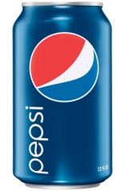
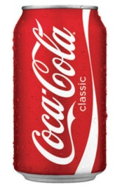
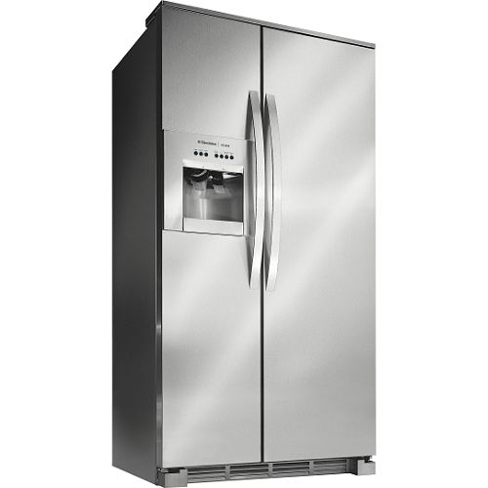
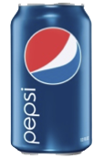
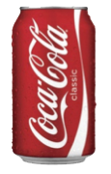
Example in Sensory Testing
(Hypothetical) taste experiment: vs
  Natural usage context
Experiment 1: Absolute Metrics
Very Thirsty!
3 cans
3 cans
2 cans
1 can
5 cans
3 cans
Total: 8 cans
Total: 9 cans

Slide 51
Example in Sensory Testing
(Hypothetical) taste experiment: vs
  Natural usage context
Experiment 1: Relative Metrics
2 - 1
3 - 0
2 - 0
1 - 0
4 - 1
2 - 1
All 6 prefer Pepsi

Slide 52
Example Revisited
Treatment of spinal cord injury patients
  Studied by Joel Burdick’s group @Caltech
Dueling Bandits Problem!
Patients cannot reliably
rate individual treatments
Patients can reliably
compare pairs of treatments
 | 5 |  |  |  | 5 |  |  |  | 5 |  |  |  | 5 |  |  |  | 5
0 |  | 11 |  | 0 |  | 11 |  | 0 |  | 11 |  | 0 |  | 11 |  | 0 |  | 11
 | 6 |  |  |  | 6 |  |  |  | 6 |  |  |  | 6 |  |  |  | 6
1 |  | 12 |  | 1 |  | 12 |  | 1 |  | 12 |  | 1 |  | 12 |  | 1 |  | 12
 | 7 |  |  |  | 7 |  |  |  | 7 |  |  |  | 7 |  |  |  | 7
2 |  | 13 |  | 2 |  | 13 |  | 2 |  | 13 |  | 2 |  | 13 |  | 2 |  | 13
 | 8 |  |  |  | 8 |  |  |  | 8 |  |  |  | 8 |  |  |  | 8
3 |  | 14 |  | 3 |  | 14 |  | 3 |  | 14 |  | 3 |  | 14 |  | 3 |  | 14
 | 9 |  |  |  | 9 |  |  |  | 9 |  |  |  | 9 |  |  |  | 9
4 |  | 15 |  | 4 |  | 15 |  | 4 |  | 15 |  | 4 |  | 15 |  | 4 |  | 15
 | 10 |  |  |  | 10 |  |  |  | 10 |  |  |  | 10 |  |  |  | 10
Images from Yanan Sui
http://dl.acm.org/citation.cfm?id=2645773

Slide 53
Combinatorial Bandits
Sometimes, actions must be selected from combinatorial action space:
  E.g., shortest path problems with unknown costs on edges
    aka: Routing under uncertainty
If you knew all the parameters of model:
  standard optimization problem
http://www.yisongyue.com/publications/nips2011_submod_bandit.pdf
http://www.cs.cornell.edu/~rdk/papers/OLSP.pdf
http://homes.di.unimi.it/cesa-bianchi/Pubblicazioni/comband.pdf

Slide 54
General Reinforcement Learning
Treatment
Placebo
Treatment
Placebo
Treatment
…
Bandit setting assumes actions do not affect the world
  E.g., sequence of experiments does not affect the distribution of future trials

Slide 55
Markov Decision Process
Example: Personalized Tutoring
M states
K actions
Reward: μ(s,a)
  Depends on state
For t = 1…T
  Algorithm (approximately) observes current state s_{t}
    Depends on previous state & action taken
  Algorithm chooses action a(t)
  Receives random reward y(t)
    Expectation μ(s_{t},a(t))
[Emma Brunskill et al.] (**)
** http://www.cs.cmu.edu/~ebrun/FasterTeachingPOMDP_planning.pdf

Slide 56
Summary
Interactive Machine Learning
  Multi-armed Bandit Problem
  Basic result: UCB1
  Surveyed Extensions
Advanced Topics in ML course next year
Next lecture: course review
  Bring your questions!

