Slide 1

Machine Learning & Data Mining
CS/CNS/EE 155
Lecture 16:
Deep Learning

Slide 2
Announcements
Last two lectures will not be covered on Final Exam
  Come for the love of (machine) learning
  Will release some practice questions for topics not covered in homeworks
Final Exam will be released on March 16th
Student have 48 hours from time of download
  Open book of everything on course website
  No collaboration

Slide 3
Recap: Linear Models
Linear scoring function in input features:
Sometimes non-linear transform at the end
  E.g., logistic Regression

Slide 4
Recap: Multiclass Logistic Regression
Binary LR:
“Log Linear” Property:
Keep a (w_{k},b_{k})
for each class
Extension to Multiclass:
Multiclass LR:
Train via Gradient Descent:

Slide 5


Example: Handwritten Digit Recognition
What is feature representation x?
  Each pixel is a feature
  Logistic regression yields ≈80% accuracy
    Can we do better?

Slide 6





Errors In Linear Logistic Regression
Often makes mistakes on 8’s:
Shares many pixels with 5’s and 3’s:
Linear model on pixels not powerful enough
  E.g., doesn’t capture interactions between pixels
http://cs.stanford.edu/people/karpathy/convnetjs/demo/mnist.html

Slide 7





Feature Engineering
Linear models require good features x
Directed edge detection:
  (With some blurring)
  “Oriented Gradients”
Logistic regression yields ≈90% accuracy
Left Edge
Top Left Edge
Top Right Edge
Bottom Left Edge
http://cs.stanford.edu/people/karpathy/convnetjs/demo/mnist.html

Slide 8





Comparing 8’s vs 3’s
New feature representation better distinguishes between 8’s and 3’s:
http://cs.stanford.edu/people/karpathy/convnetjs/demo/mnist.html

Slide 9
Learn Features Automatically?
Feature engineering is tedious
  Don’t know which ones are good
  Can we just learn them automatically?
Actually, we did!
  From convolutional net
    Learns features
    Learns logistic regression
    “Deep Learning”
http://cs.stanford.edu/people/karpathy/convnetjs/demo/mnist.html

Slide 10
Outline For Today
Introduction to Deep Learning
  Learning Features for Predictive Modeling
Deep Convolutional Networks
  Very popular in Computer Vision
Tips for Training Deep Networks
Brief Overview of other Deep Networks

Slide 11
Outline For Today
Introduction to Deep Learning
  Learning Features for Predictive Modeling
Deep Convolutional Networks
  Very popular in Computer Vision
Tips for Training Deep Networks
Brief Overview of other Deep Networks

Slide 12
Recap: 1 Layer Neural Network
1 Neuron
  Takes input x
  Outputs y
~Logistic Regression!
  Gradient Descent
x
Σ
y
“Neuron”
f(x|w,b) = w^{T}x – b
= w₁*x₁ + w₂*x₂ + w₃*x₃ – b
  y = τ( f(x) )
sigmoid
tanh
rectilinear

Slide 13
Recap: 2 Layer Neural Network
Σ
x
Σ
y
Σ
Hidden Layer
2 Layers of Neurons
  1st Layer takes input x
  2nd Layer takes output of 1st layer
Can approximate arbitrary functions
  Provided hidden layer is large enough
  “fat” 2-Layer Network
Non-Linear!

Slide 14
Deep Neural Networks
Why prefer Deep over a “Fat” 2-Layer?
  Compact Model
    (exponentially large “fat” model)
Image Source: http://blog.peltarion.com/2014/06/22/deep-learning-and-deep-neural-networks-in-synapse/

Slide 15
Expressive Power
Deeper networks are “exponentially more expressive” than shallower networks.
Related Example: Boolean Circuits
  Thought Experiment: How many gates required if only depth-2 circuits allowed?
x
y
http://en.wikipedia.org/wiki/Circuit_complexity

Slide 16
AND & OR as Transfer Functions
Deep networks can implement AND & OR transfer functions.
x
Σ
y
Used in practice

Slide 17
What Happens if No Transfer Function?
Just linear transforms?
Deep structure collapses to linear model!
  Linear operators are associative & commutative
  Applying a linear operator to a linear operator yields a linear operator
Σ
x
Σ
y
Σ
x
Σ
y

Slide 18
Recap: Training Neural Networks
Gradient Descent! **
  (Supervised Learning)
Parameters:
  (w₁₁,b₁₁,w₁₂,b₁₂,w₂,b₂)
Σ
x
Σ
y
Σ
f(x|w,b) = w^{T}x – b
  y = τ( f(x) )
Backpropagation = Gradient Descent
(lots of chain rules)
**additional details end of lecture

Slide 19
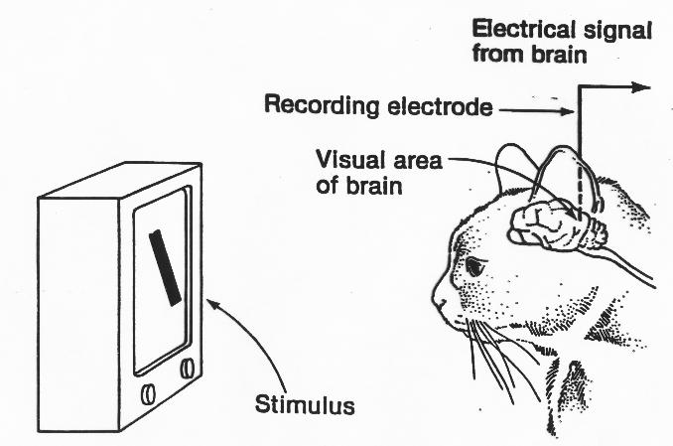
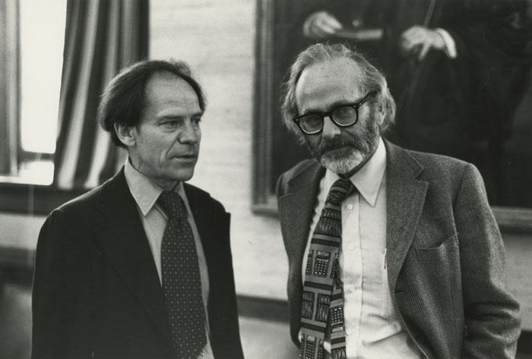
Original Biological Inspiration
David Hubel & Torsten Wiesel discovered “simple cells” and “complex cells” in the 1959
  Some cells activate for simple patterns
    E.g., lines at certain angles
  Some cells activate for more complex patterns
    Appear to take activations of simple cells as input
Image Source:
https://cms.www.countway.harvard.edu/wp/wp-content/uploads/2013/09/0002595_ref.jpg
https://cognitiveconsonance.files.wordpress.com/2013/05/c_fig5.jpg

Slide 20
The Brain is Hierarchical
Image Source: http://www.cs.nyu.edu/~yann/talks/lecun-ranzato-icml2013.pdf

Slide 21

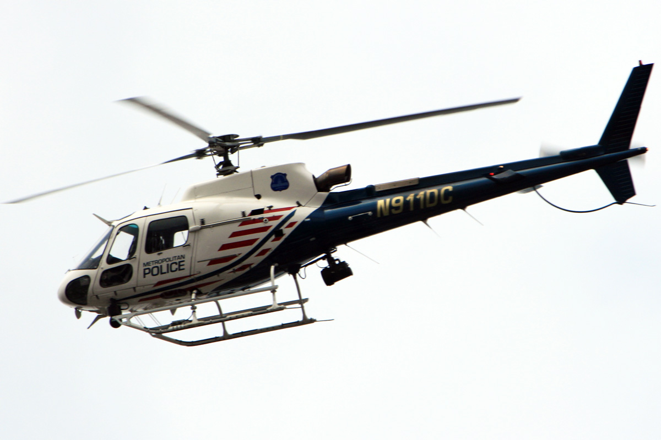
But Let’s Not Get Carried Away
We need some kind of wings to fly
  But no flapping
Do we even need wings?

Slide 22
No Longer Biologically Inspired
Original inspiration created the feed-forward network
Field is now called “Deep Learning”
  Most common name
Really just Automated Feature Learning
  Lots of optimization tricks
  And architecture tuning
E.g., Convolutional Network

Slide 23
Outline For Today
Introduction to Deep Learning
  Learning Features for Predictive Modeling
Deep Convolutional Networks
  Very popular in Computer Vision
Tips for Training Deep Networks
Brief Overview of other Deep Networks

Slide 24
Convolutions
Images typically have invariant patterns
  E.g., directional gradients are translational invariant:
Apply convolution to local sliding windows
http://cs.stanford.edu/people/karpathy/convnetjs/demo/mnist.html

Slide 25

Convolutional Filters
Applies to an image patch x
  Converts local window into single value
  Slide across image
Left-to-Right
Edge Detector
Local Image Patch
-1 | 0 | +1
-1 | 0 | +1
-1 | 0 | +1
W

Slide 26
Gabor Filters
Most common low-level convolutions for computer vision
    Grey = 0
    Light = positive
    Dark = negative
Example W:
-1 | 0 | +1
-1 | 0 | +1
-1 | 0 | +1
W
http://en.wikipedia.org/wiki/Gabor_filter

Slide 27
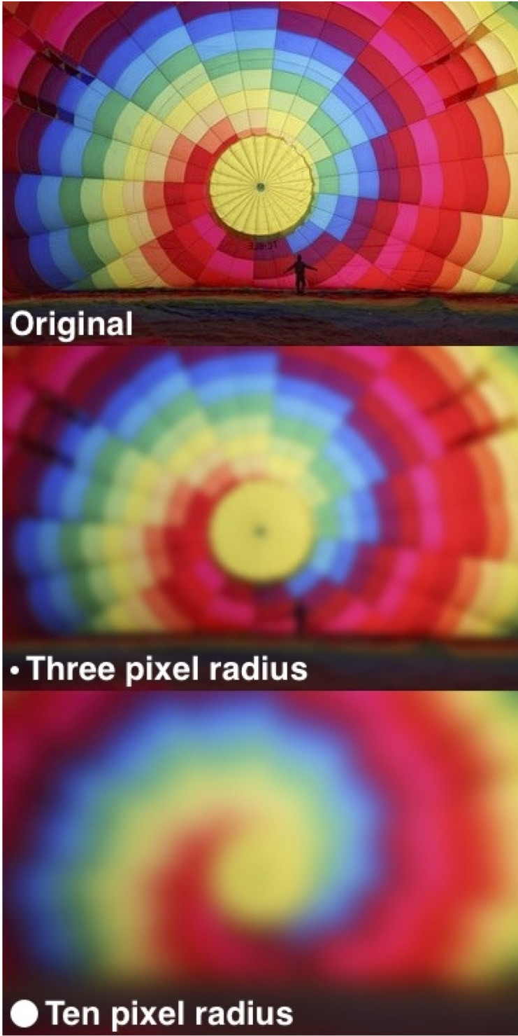
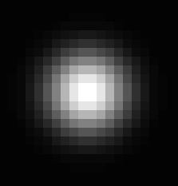
Gaussian Blur Filters
Weights decay according to
Gaussian Distribution
  Variance term controls radius
    Black = 0
    White = Positive
Example W:
Apply per RGB Channel
http://en.wikipedia.org/wiki/Gaussian_blur

Slide 28
Deep Convolutional Networks
Learn layers of convolutional filters W
  Apply convolution to outputs of previous layer
Note: convolutions are linear operators
  Need non-linear transform
  Otherwise all layers collapse to single convolution
E.g.:
Image Source: http://cs.nyu.edu/~fergus/presentations/nips2013_final.pdf

Slide 29
Convolutional Layer
Current Convolutional Layer consists of:
Main modeling concepts!
  Combine them to create convolutional layer
Convolution
Rectilinear Transform
Simplifies Backprop
Chain rule super easy
Also easier to train

Slide 30
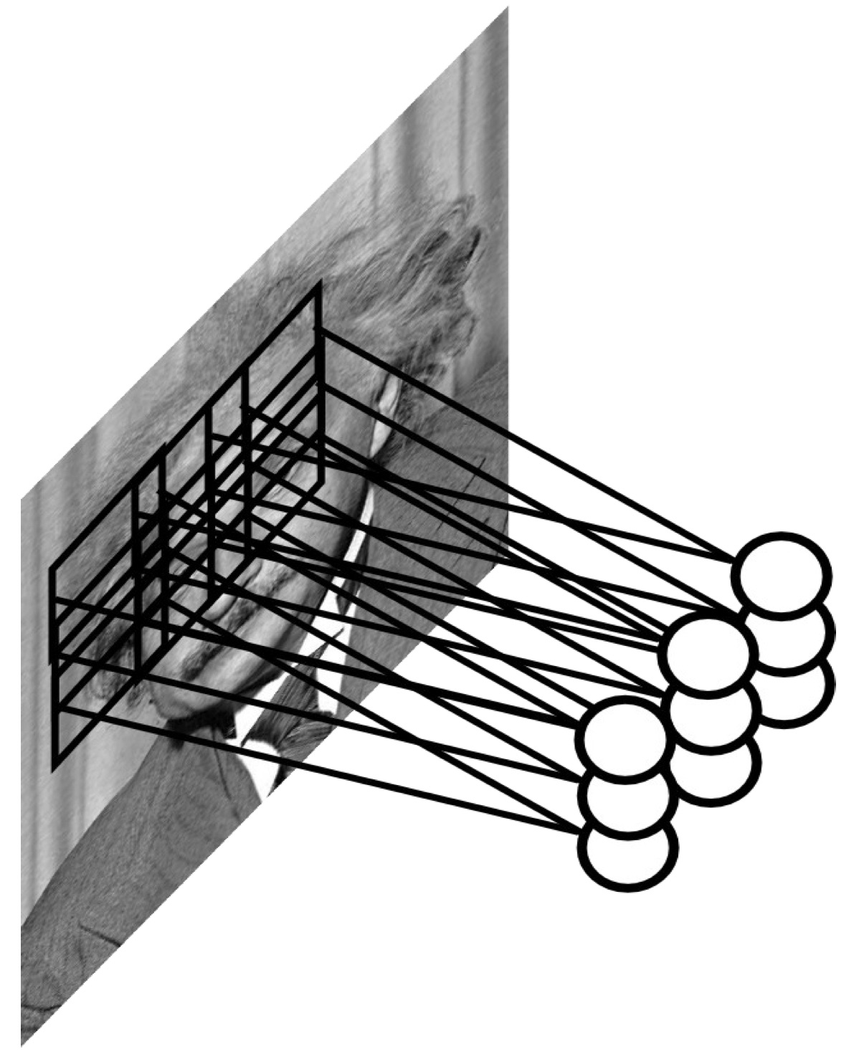
Max Pooling
Assume Convolution Layer is eye detector
How to make detector more robust to the exact location of the eye?
http://cs.nyu.edu/~fergus/tutorials/deep_learning_cvpr12/tutorial_p2_nnets_ranzato_short.pdf

Slide 31
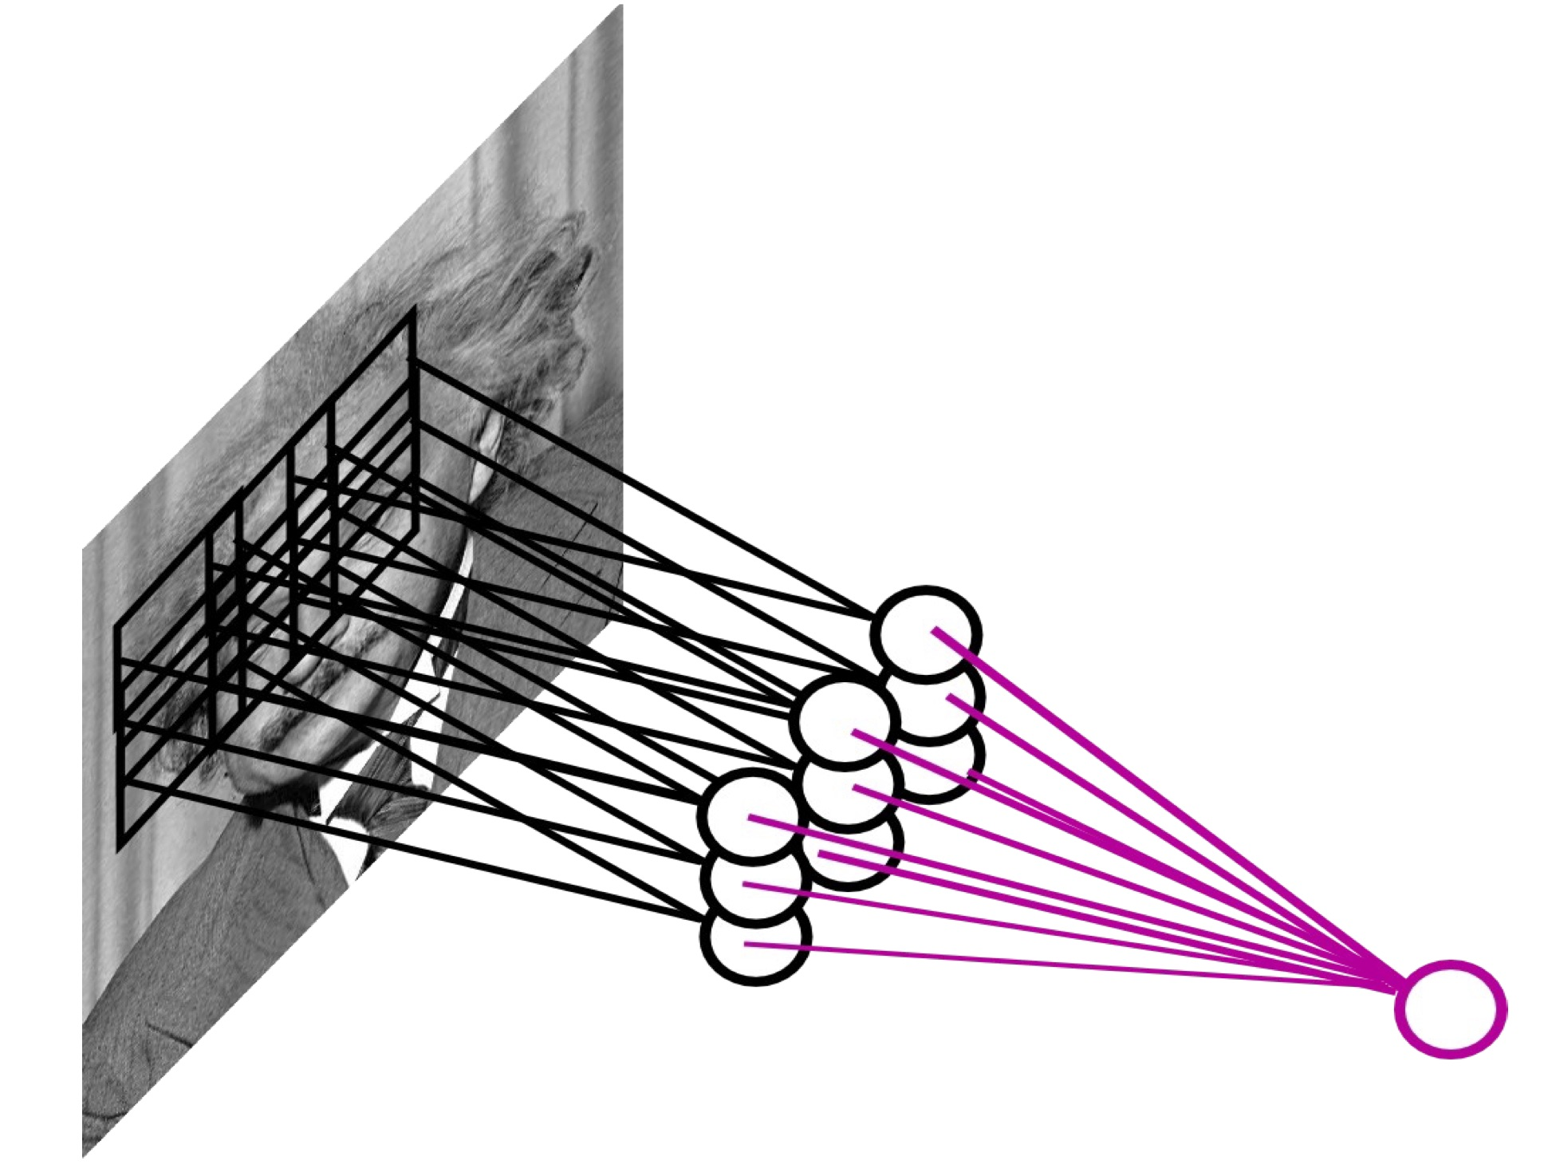
Max Pooling
Maximum response from a neighborhood of convolutional layer outputs
I.e., an OR gate!
http://cs.nyu.edu/~fergus/tutorials/deep_learning_cvpr12/tutorial_p2_nnets_ranzato_short.pdf

Slide 32
Alternative: L2 Pooling
L2 norm of a neighborhood of convolutional layer outputs
Softer version of max pooling
  Harder to differentiate

Slide 33
Local Contrast Normalization
Standardize output of convolutional layer using mean & variability estimated from neighboring outputs
Simple Example:
Other examples in references below:
f:
Biologically Inspired!
http://cs.nyu.edu/~fergus/tutorials/deep_learning_cvpr12/tutorial_p2_nnets_ranzato_short.pdf
http://www.cs.toronto.edu/~fritz/absps/imagenet.pdf

Slide 34








Input
8 Convolutional
Filters in 1st Layer
Rectilinear
Transform
Max Pooling
http://cs.stanford.edu/people/karpathy/convnetjs/demo/mnist.html

Slide 35
Deep Convolutional Networks
Input Image
Input Image
Input Image
10 filters
20 filters
RGB Input Image
100 x 100 x 3
7x7x3 Convolution
3x3 Max Pooling
Down Sample 4x
25 x 25 x 10
5x5x10 Convolution
3x3 Max Pooling
Down Sample 4x
6 x 6 x 20
Logistic
Regression
10 classes
Stack multiple layers together
Multiclass logistic regression at top
Train using gradient descent

Slide 36
Down Sampling
Adjacent Sliding Window Convolution
  Yields output of same dimensions as input
Good to compress into fewer pixels
  Skip a few pixels for each convolution
“Stride”
  How far away next convolution is
  No Down Sampling: Stride = 1
  Down Sampling 2x: Stride = 2
Also Max Pooling

Slide 37
Online Demo
http://cs.stanford.edu/people/karpathy/convnetjs/demo/mnist.html

Slide 38
ImageNET
Object recognition competition (2012)
  1.5 Million Labeled Training Examples
  ≈1000 classes
Leopard
Mushroom
Mite
http://www.image-net.org/

Slide 39
Deep Convolutional Net for ImageNET
7 Hidden Layers
  5 Convolutional
  2 Regular
Multiclass Logistic Regression at top
Trained using stochastic gradient descent
  And a lot of tricks
Won the 2012 ImageNET competition
http://www.cs.toronto.edu/~fritz/absps/imagenet.pdf
http://www.image-net.org/challenges/LSVRC/2012/results.html

Slide 40
Input Image
Input Image
Input Image
96 filters
256 filters
354 filters
7x7x3 Convolution
3x3 Max Pooling
Down Sample 4x
55 x 55 x 96
5x5x96 Convolution
3x3 Max Pooling
Down Sample 4x
13 x 13 x 256
3x3x256 Convolution
13 x 13 x 354
RGB Input Image
224 x 224 x 3
256 filters
354 filters
3x3x354 Convolution
3x3 Max Pooling
Down Sample 2x
6 x 6 x 256
3x3x354 Convolution
13 x 13 x 354
Logistic
Regression
≈1000 Classes
Standard
4096 Units
Standard
4096 Units
http://www.image-net.org/
http://www.cs.toronto.edu/~fritz/absps/imagenet.pdf
http://ftp.cs.nyu.edu/~fergus/papers/zeilerECCV2014.pdf

Slide 41
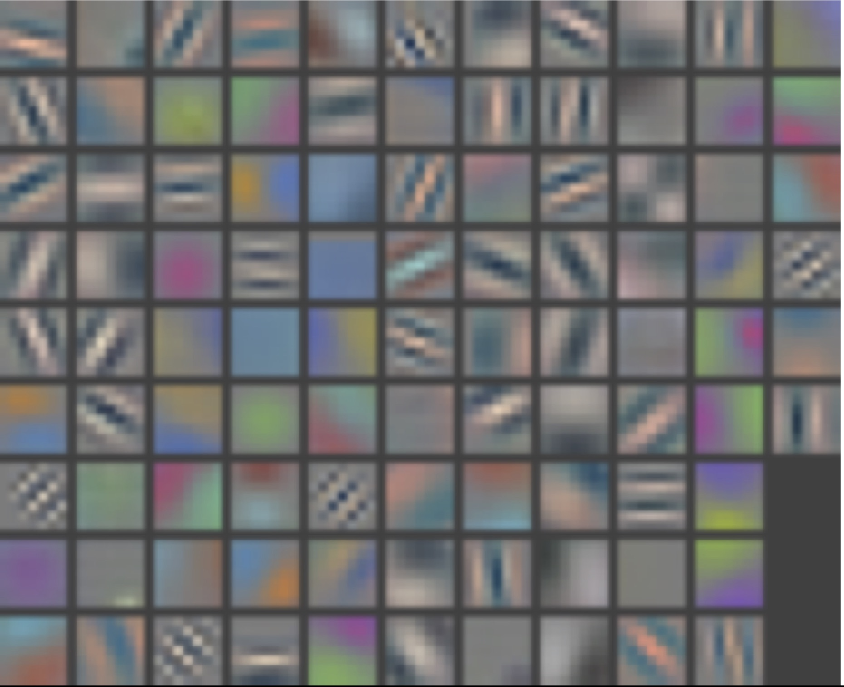
Visualizing CNN (Layer 1)
http://cs.nyu.edu/~fergus/papers/zeilerECCV2014.pdf
http://cs.nyu.edu/~fergus/presentations/nips2013_final.pdf

Slide 42
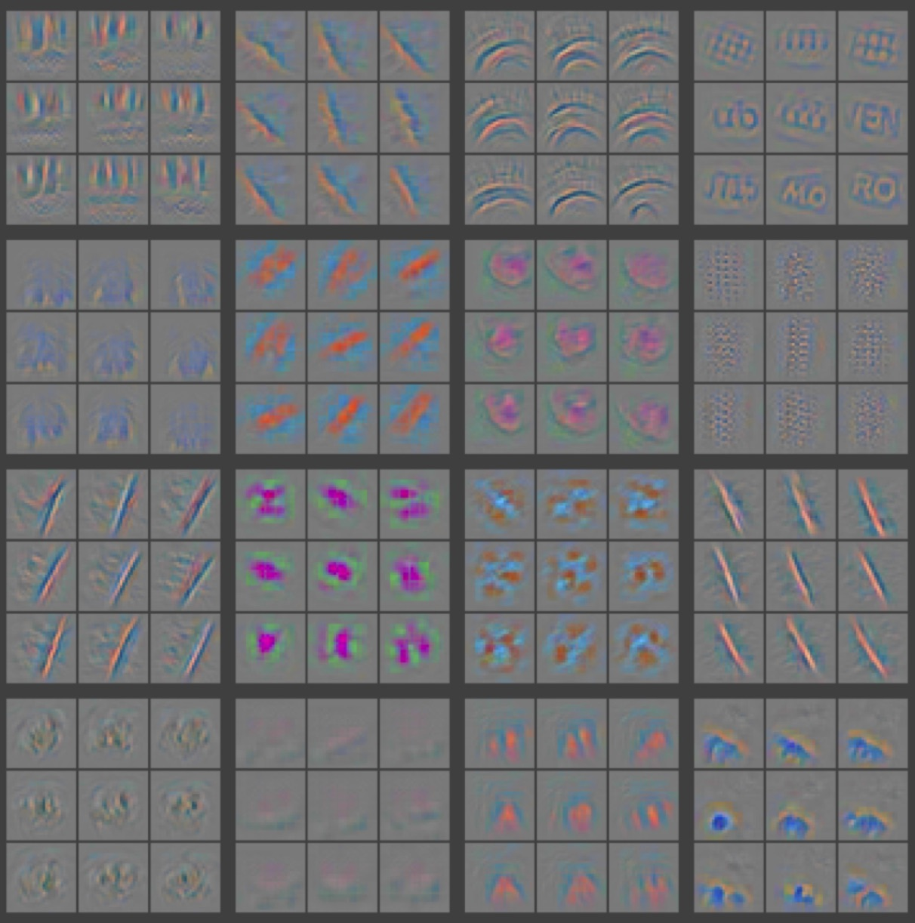
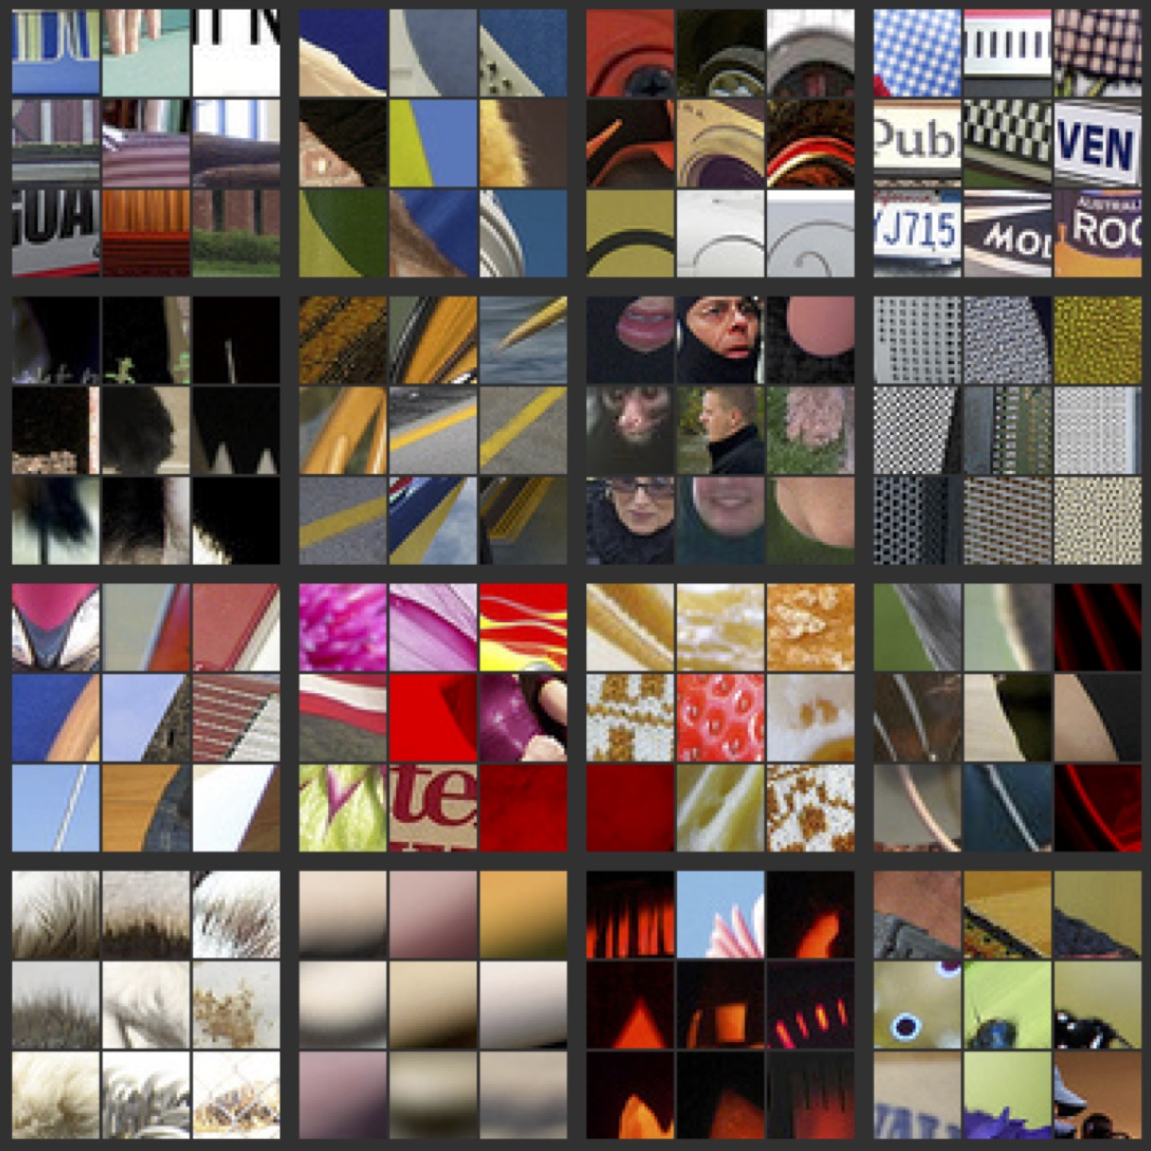
Visualizing CNN (Layer 2)
Part that Triggered Filter
Top Image Patches
http://cs.nyu.edu/~fergus/papers/zeilerECCV2014.pdf
http://cs.nyu.edu/~fergus/presentations/nips2013_final.pdf

Slide 43
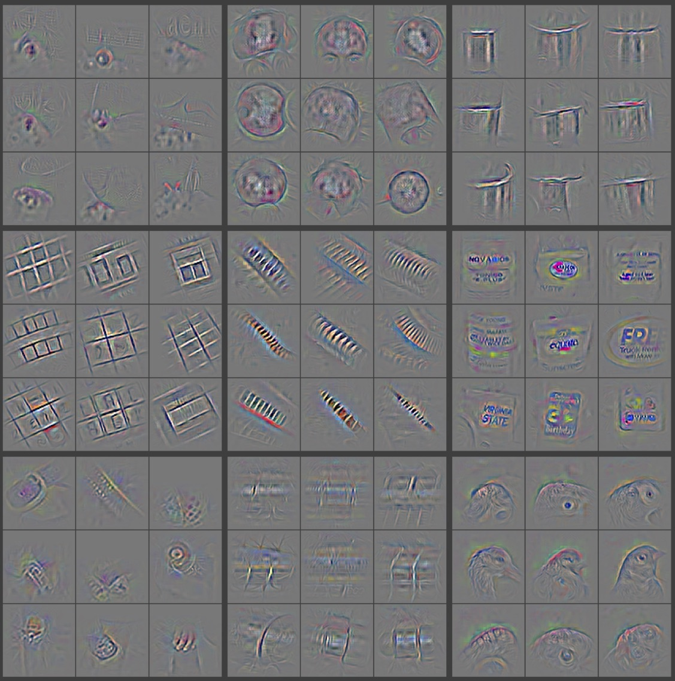
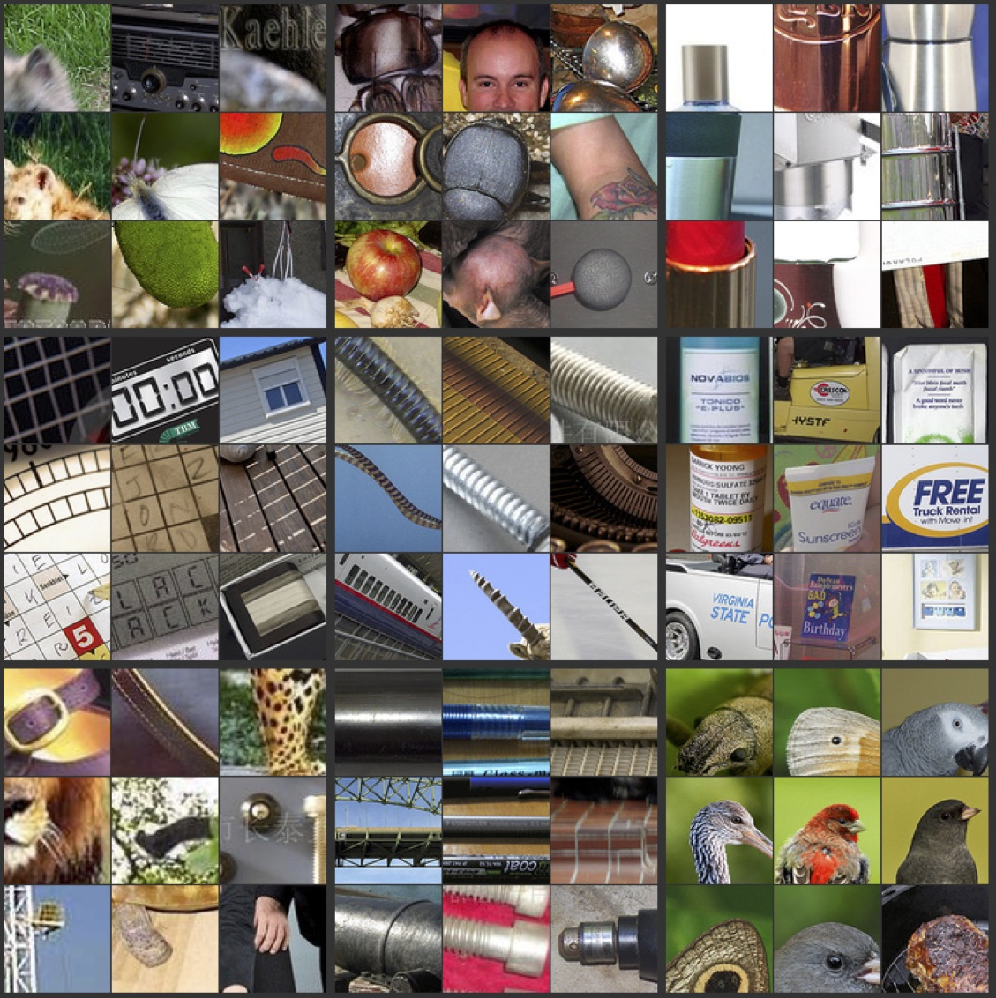
Visualizing CNN (Layer 3)
Part that Triggered Filter
Top Image Patches
http://cs.nyu.edu/~fergus/papers/zeilerECCV2014.pdf
http://cs.nyu.edu/~fergus/presentations/nips2013_final.pdf

Slide 44
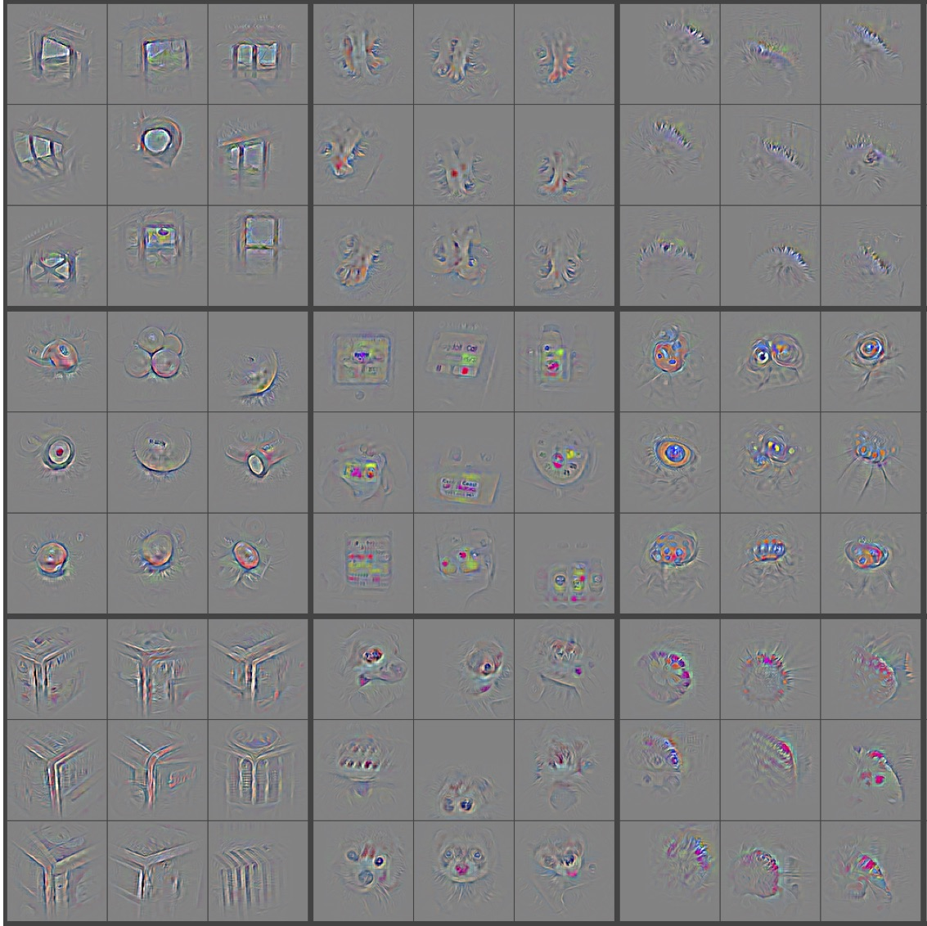
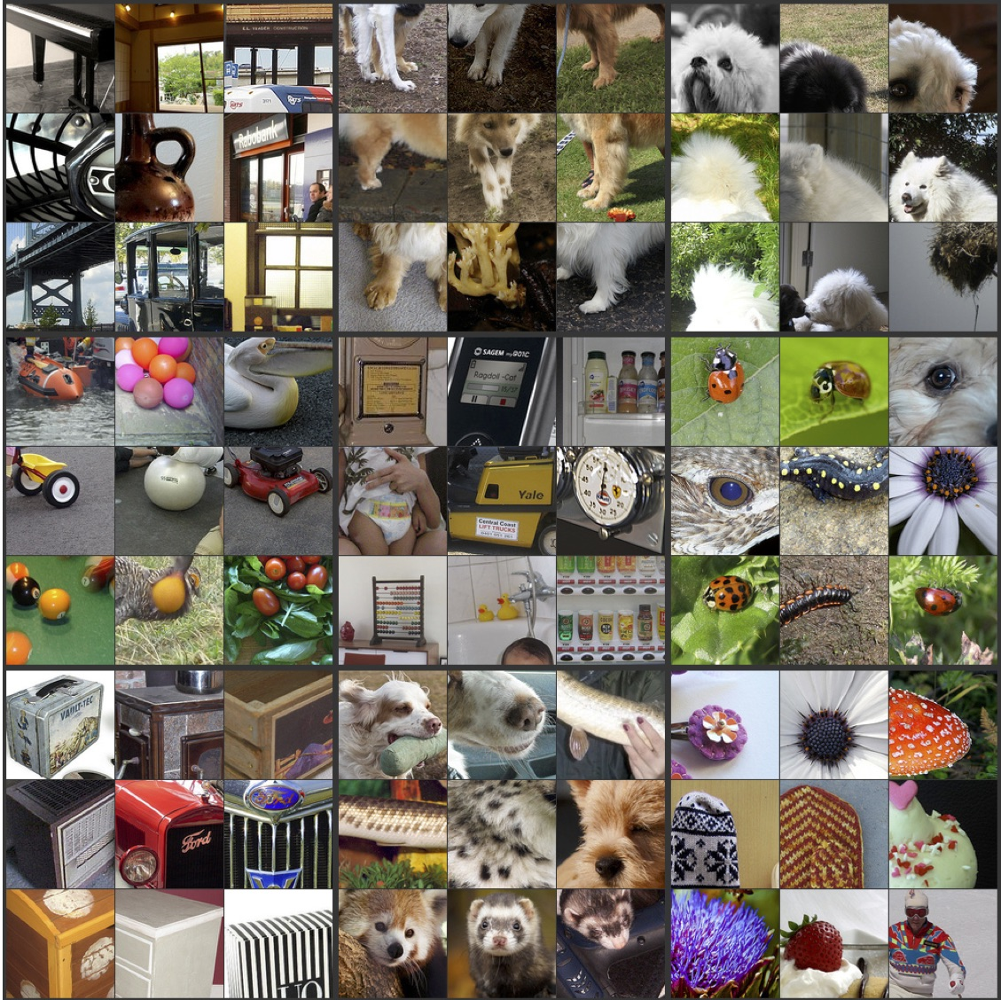
Visualizing CNN (Layer 4)
Part that Triggered Filter
Top Image Patches
http://cs.nyu.edu/~fergus/papers/zeilerECCV2014.pdf
http://cs.nyu.edu/~fergus/presentations/nips2013_final.pdf

Slide 45
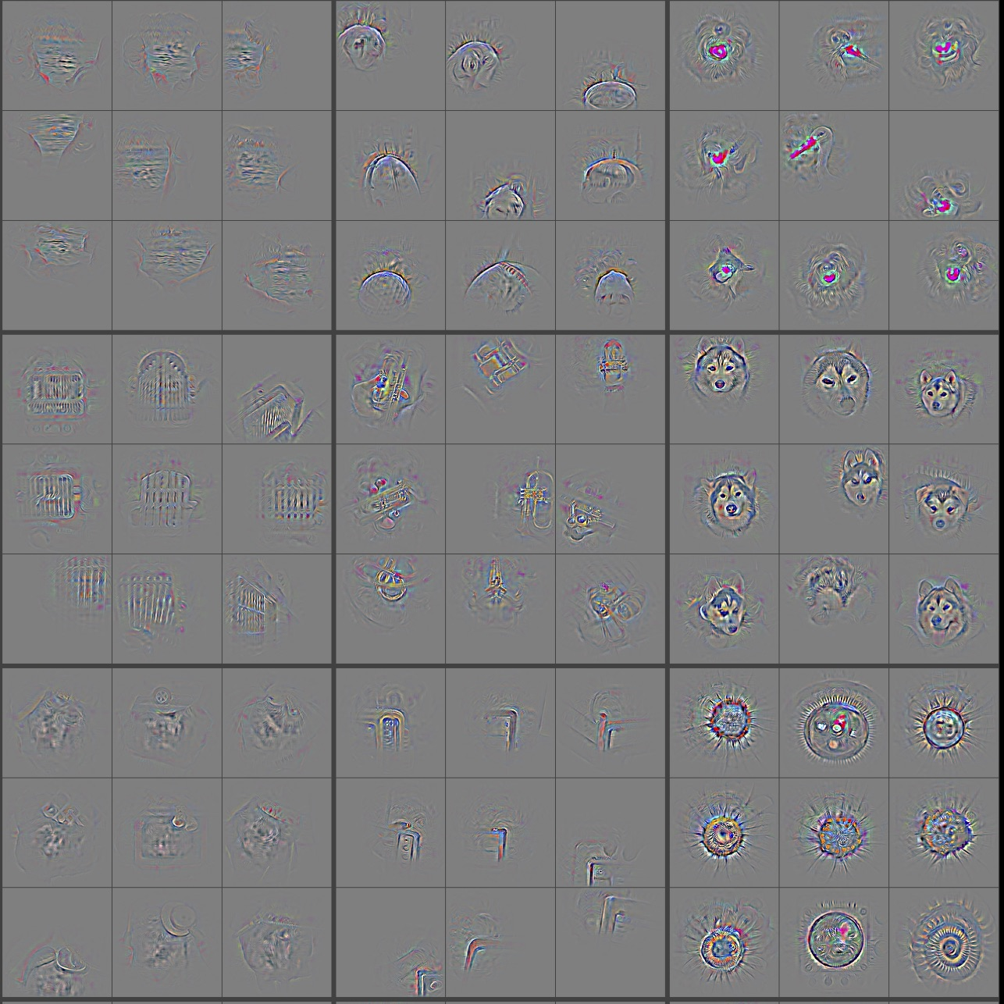
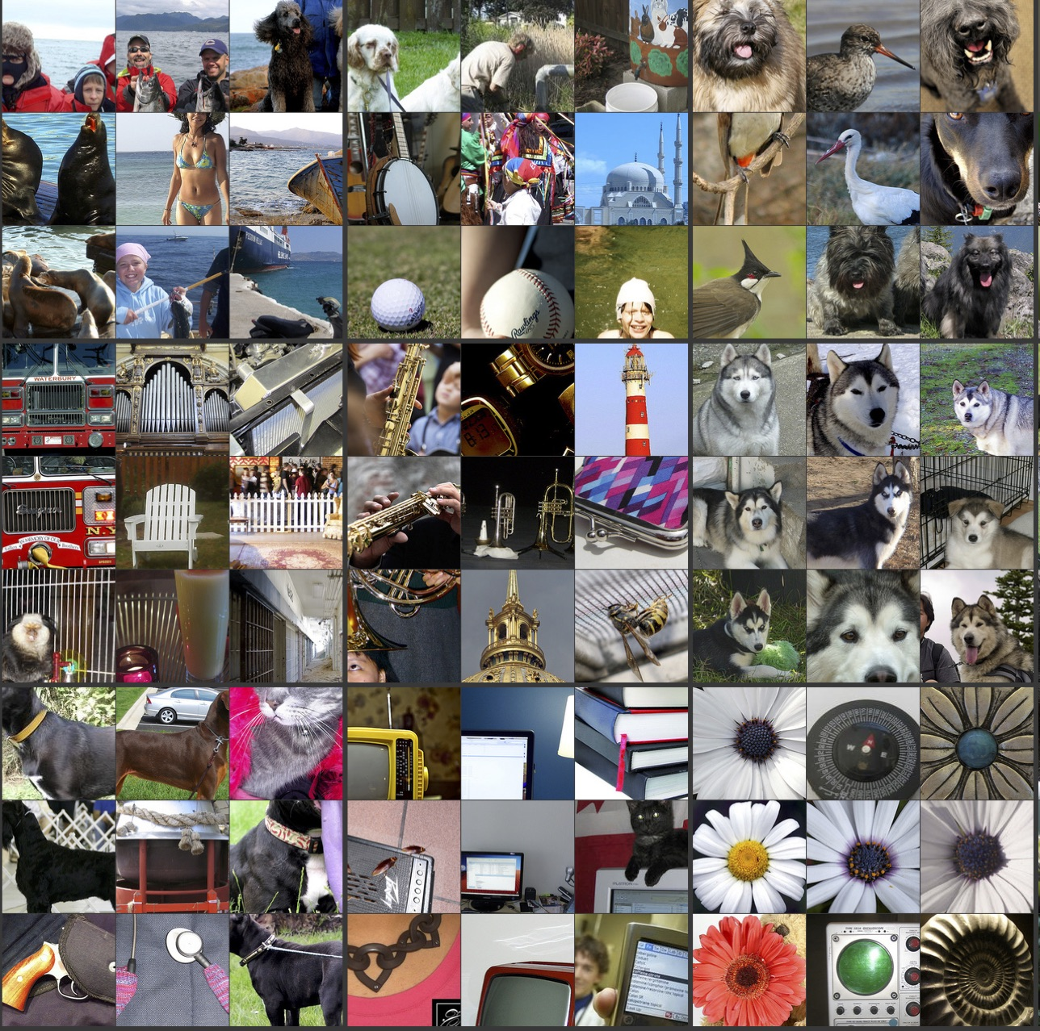
Visualizing CNN (Layer 5)
Part that Triggered Filter
Top Image Patches
http://cs.nyu.edu/~fergus/papers/zeilerECCV2014.pdf
http://cs.nyu.edu/~fergus/presentations/nips2013_final.pdf

Slide 46
Use Hidden Layers as Features
Stack hidden layer activations as new feature representation
Train an SVM =)
Generalize to other datasets

Slide 47
Failure Cases
Predicts
Correctly
Predicts
Incorrectly
Predicts
Correctly
Predicts
Incorrectly
http://arxiv.org/pdf/1312.6199v4.pdf

Slide 48
Outline For Today
Introduction to Deep Learning
  Learning Features for Predictive Modeling
Deep Convolutional Networks
  Very popular in Computer Vision
Tips for Training Deep Networks
Brief Overview of other Deep Networks

Slide 49
Training Deep Networks
Deep Networks are extremely non-convex
  Hard to train well
Deep Networks have extremely high capacity
  Many parameters, easy to overfit
Real success stories only in the last 10 years
  A lot of (annotated) data
  Increase in computational power
  Better bag of tricks

Slide 50
Stochastic Gradient Descent + Tricks!
Some related to choice of model/architecture
  Rectilinear over sigmoid transfer functions
  Local contrast normalization
  Sparse Connections that enable parallelism
  Ensemble of Deep Networks
Rest are optimization techniques
  Gradient Clamping
  Mini-batching
  Momentum
  Adaptive Learning Rates
  Random Initialization
  Dropout
http://yyue.blogspot.com/2015/01/a-brief-overview-of-deep-learning.html

Slide 51
Rectilinear vs Sigmoid
(The Vanishing Gradient Problem)
Sigmoid
Σ
x
Σ
y
Σ
τ(f)
w₁
f₁
τ₁
w₂
f₂
τ₂
f
Rectilinear
τ(f)
Large f ➔ linear gradient
No vanishing effect with more layers
Large f ➔ vanishing gradient
Compounded with more layers
f

Slide 52
Gradient Clamping
Rectilinear functions can grow unbounded:
  Gradients can get very large
  Compounding effect in lower layers
    Opposite of the vanishing gradient effect with sigmoids
Solution: clamp gradients
  E.g., clamp norm to 15
Rectilinear
τ(f)
f
http://yyue.blogspot.com/2015/01/a-brief-overview-of-deep-learning.html

Slide 53
Dense Convolutional Networks
Input Image
Input Image
Input Image
10 filters
20 filters
RGB Input Image
100 x 100 x 3
7x7x3 Convolution
3x3 Max Pooling
Down Sample 4x
25 x 25 x 10
5x5x10 Convolution
3x3 Max Pooling
Down Sample 4x
6 x 6 x 20
Logistic
Regression
10 classes
Every Convolutional Layer uses every output from previous layer

Slide 54
Sparse Convolutional Networks
5 filters
10 filters
Input Image
Input Image
Input Image
5 filters
10 filters
RGB Input Image
100 x 100 x 3
7x7x3 Convolution
3x3 Max Pooling
Down Sample 4x
25 x 25 x 10
Split Across 2 machines
5x5x5 Convolution
3x3 Max Pooling
Down Sample 4x
6 x 6 x 20
Split Across 2 Machines
Logistic
Regression
10 classes

Slide 55
Learning Rate & Momentum
Gradient Descent
If validation performance plateaus or gets worse
  Divide learning rate by 2
Momentum is a weighted combination of recent gradient updates
Momentum
http://www.cs.toronto.edu/~fritz/absps/momentum.pdf

Slide 56
Dropout
Randomly turn off nodes during training
Choose randomly for each SGD minibatch
  Decorrelates node in each layer
  Less overfitting
http://www.cs.toronto.edu/~rsalakhu/papers/srivastava14a.pdf

Slide 57
Outline For Today
Introduction to Deep Learning
  Learning Features for Predictive Modeling
Deep Convolutional Networks
  Very popular in Computer Vision
Tips for Training Deep Networks
Brief Overview of other Deep Networks

Slide 58
Unsupervised Deep Learning
Supervised = Learn Feature Encoding
  Uses supervised label as signal
Unsupervised = Also Learn Decoding
  Uses reconstruction error as signal
Input Image
Input Image
Input Image
Input Image
Input Image
Output
Image
50 filters
RGB Input Image
100 x 100 x 3
7x7x3 Convolution
3x3 Max Pooling
Down Sample 4x
25 x 25 x 50
Combine Activations
to Produce Image
Minimize Squared Error
Between Output & Input
http://research.google.com/archive/unsupervised_icml2012.html

Slide 59
Unsupervised Deep Learning
“Deep” dimensionality reduction
  Can think of matrix factorization as “shallow” linear dimensionality reduction
Encoding: convert image to features
  Matrix Factorization: z = Ux
Decoding: convert features to image
  Matrix Factorization: x = U^{T}z

Slide 60
Deep Belief Networks
Generative Model
Encodes image as distribution over hidden state activations
Can sample images given a setting of hidden states
http://www.cs.toronto.edu/~hinton/adi/

Slide 61
Deep Recurrent Networks
Sequence Prediction
  x & y are sequences
http://papers.nips.cc/paper/5346-sequence-to-sequence-learning-with-neural-networks.pdf
http://www1.icsi.berkeley.edu/~vinyals/Files/rnn_denoise_2012.pdf

Slide 62
Deep Recursive Networks
Input: parse tree
Output: sentiment
Recursively instantiate model on parse tree
  Each node takes the outputs of its children, and computes hidden layer activations as output
  Logistic regression at the top
http://nlp.stanford.edu/sentiment/

Slide 63
Recap: Deep Learning
Hierarchies (or layers) of non-linear transforms
  Often interpreted as feature learning
  Sometimes makes sense/visualizable
Supervised training at the top layer
  Unsupervised also possible (less successful)
Train using stochastic gradient descent
  But requires a lot of additional tricks
  Also requires sufficient training data
Nowhere close to general human cognition

Slide 64
Resources
http://caffe.berkeleyvision.org/
http://deeplearning.net/software/theano/
http://torch.ch/
https://code.google.com/p/cuda-convnet/
http://cs.nyu.edu/~fergus/tutorials/deep_learning_cvpr12/
http://deeplearning.net/tutorial/
http://deeplearning.stanford.edu/tutorial/
http://nlp.stanford.edu/sentiment/

Slide 65
Next Lecture
Semi-supervised Learning & Active Learning
  Probably…
Homework 4 due next Tuesday
Miniproject 2 due next Friday

