Slide 1

Machine Learning & Data Mining
CS/CNS/EE 155
Lecture 15:
Recent Applications of
Latent Factor Models

Slide 2
Today
Miniproject 1 Reports Due
Latent Spatial Models for Basketball Play Prediction
Latent Tensor Models for Collaborative Clustering
aka: Stuff Yisong Likes

Slide 3
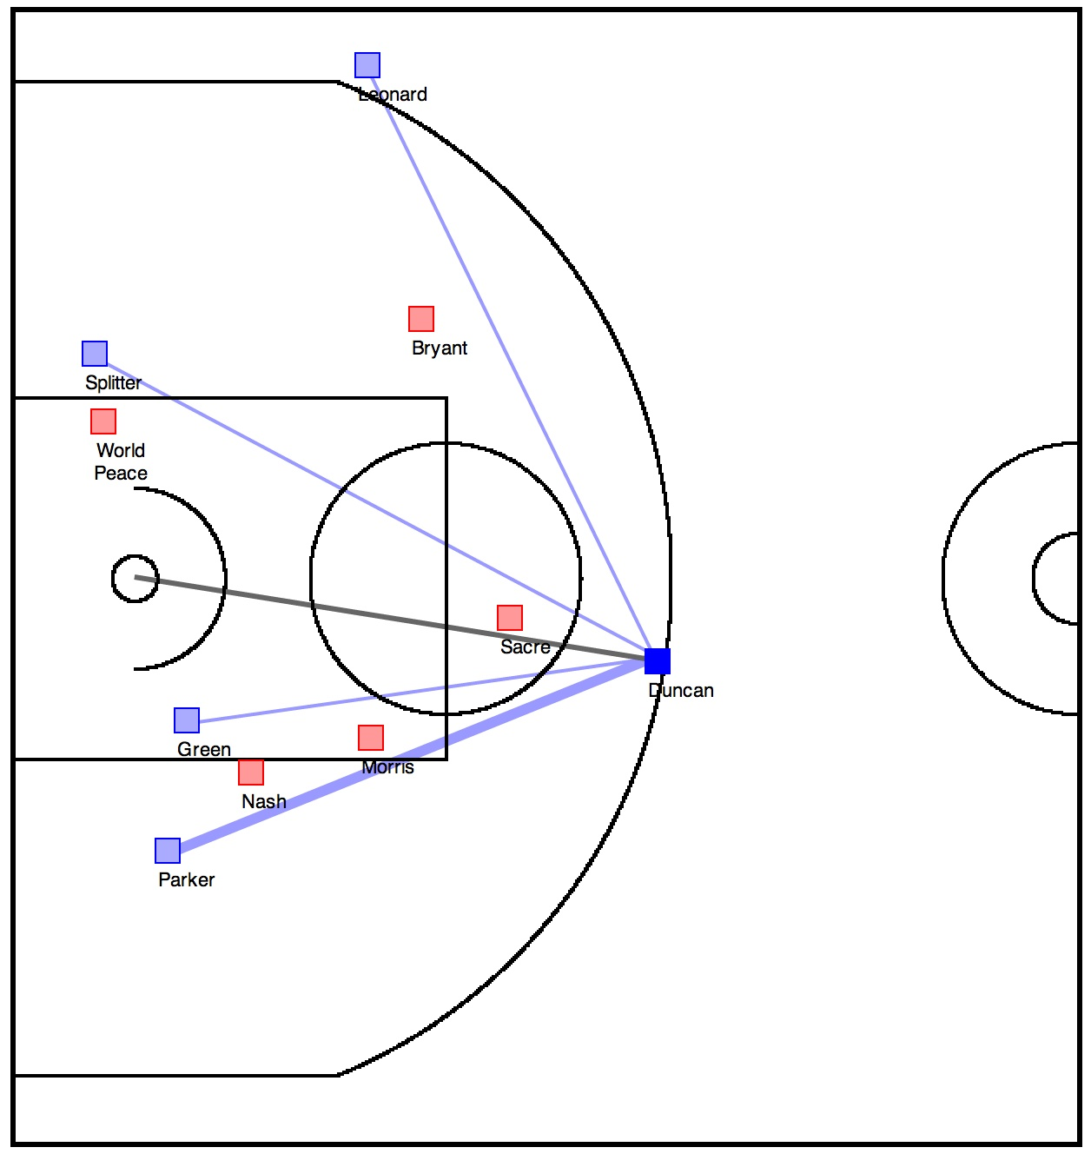
Teammates
Defenders
Goal:
Learn an Interpretable Predictive Model for Play Prediction
(E.g., Pass or Shot)
Defenders
Ball Handler
Teammates
Defenders

Slide 4
Demo
http://projects.yisongyue.com/bballpredict/

Slide 5
Prediction
Game state: x
  Coordinates of all players
  Who is the ball handler
Event: y
  Ball handler will shoot
  Ball handler will pass (to whom?)
  Ball handler will hold onto the ball
  6 possibilities
Goal: Learn P(y|x)
  Interpretable
http://www.yisongyue.com/publications/icdm2014_bball_predict.pdf

Slide 6
Logistic Regression
(Simple Version: Just for Shooting)
Shot
Hold on to ball
Offset or bias

Slide 7
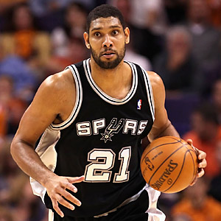
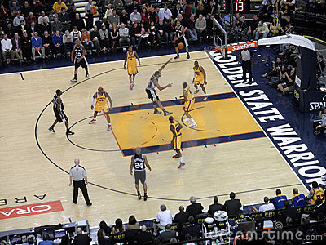
Example
Tim Duncan

Slide 8
Fine-Grained
Spatial Models
Discretize court
  1x1 foot cells
  2000 cells
50 feet
2000 dim coeff vector
Indicator feature vector
(1 in cell that ball handler is)
(0 in all other entries)
40 feet

Slide 9
Story so Far: Spatial Logistic Regression
Probability of shooting log-linear
  In spatial cell feature representation

Slide 10
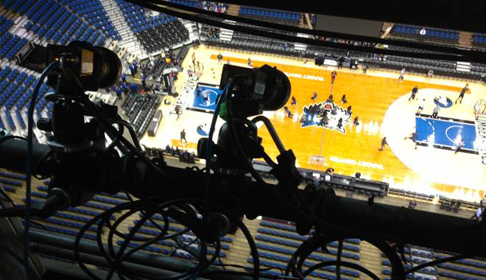
Training Data
STATS SportsVU
2012/2013 Season, 630 Games,
80K Possessions, 380 frames per possession

Slide 11
Learning the Model
Given training data:
Learn parameters of model:
Player
Configuration
What Happened
Next
Log Loss

Slide 12
Spatial Regularization
Self-defined feature vector
  Has spatial structure
Expect F_{s} to vary smoothly
  But not enough training data
  Spatial Regularization:

Slide 13
Combining Several Ideas
Multiclass prediction
  Predict different outcomes (e.g., shot, pass, etc)
Spatial Model
  Captures spatial structure
Multitask prediction
  One prediction task per player
Interpretable Model
  Low-dimensional representation
  Easy to visualize
We’ve only seen shots so far
Discretize into fine-grained cells
(regularize neighbors to be similar)
Talk about this next
Latent factor part
Related to multitask prediction

Slide 14
Multitask Prediction
One task per player
  F_{s} is actually a matrix of coefficients
  Each row is a player
Input data x contains id of
ball handler
  One task per ball handler
D=2000
F_{s}
M=450
Tim
Duncan
Dirk
Nowitski

Slide 15
Multitask Prediction
D=2000
F_{s}
M=450
Ballhander ID
Location
Learning Objective:

Slide 16
Not Enough Training Data!
Most players don’t shoot that often
  2000 weights per player
Cell discretization is very fine-grained
  Spatial regularization helps some
How to share data across players?
  Latent Factor Model!
D=2000
F_{s}
M=450

Slide 17
Latent Factor Model (Shooting)
Assume that players can be represented by K-dimensional vector
Learn a common K-dimensional latent feature representation
D
K
D
F_{s}
B^{T}
L
K
=
M
M
Location Factors
Player Factors
Shooting Score:
Notes:
Can think of each F_s as a matrix of coefficients for shooting propensity
We can factorize F_s into player and location factors
Factorization also enables sharing of training data (we have more training data for some players than others)

Slide 18
New Prediction Model
Ballhander ID
Location
http://www.yisongyue.com/publications/icdm2014_bball_predict.pdf

Slide 19
Enforce Non-Negativity
(Accuracy Worse)
(More Interpretable)
Visualizing location factors L (K=10)
Visualizing players
http://www.yisongyue.com/publications/icdm2014_bball_predict.pdf
Notes:
Showing a visualization of the shooting component of our trained model. (Will discuss training later.)
Each shooting factor is a row of L
Each player is a linear combination of the 10 shooting factors

Slide 20
Training Objective
Spatial Regularization
Log-Loss of Latent Factor Score
http://www.yisongyue.com/publications/icdm2014_bball_predict.pdf

Slide 21
Optimization via Gradient Descent
http://www.yisongyue.com/publications/icdm2014_bball_predict.pdf

Slide 22
Initialization
Need to initialize B & L before doing gradient descent
  Need to preserve spatial structure
  Random initialization often doesn’t work
Train F_{s} first w/o factorization
  Then factorize F into B*L
    Non-negative Matrix Factorization
  Use as initialization
http://www.yisongyue.com/publications/icdm2014_bball_predict.pdf

Slide 23
General Prediction Problem
(Multiclass Logistic Regression)
Multiclass
Classification
Scoring Function
Partition
Function
All possible y’s
Shot
Pass to teammate
Hold on to ball
http://www.yisongyue.com/publications/icdm2014_bball_predict.pdf

Slide 24
Latent Factor Model (Passing)
Passing Score:
D
K
D
F_{p}
P^{T}
M
K
₁
=
M
M
Location Factors
Player Factors
http://www.yisongyue.com/publications/icdm2014_bball_predict.pdf
Notes:
Model of where players tend to receive passes.
We can again factorize the coefficient matrix into player and location factors.
Again, this allows sharing of training data (some players have more training data than others)

Slide 25
Where are Players Likely to Receive Passes?
Enforce Non-Negativity
(Accuracy Worse)
(More Interpretable)
Visualizing Location Factors M
http://www.yisongyue.com/publications/icdm2014_bball_predict.pdf
Notes:
Showing a visualization of a passing component of our trained model. (Will discuss training later.)
Each passing factor is a row of M
Players are linear combinations of the 10 passing factors

Slide 26
Latent Factor Model (Passing) #2
Passing Score:
D
K
D
F_{p}
Q₁
Q₂
K
₂
=
_{T}
D
D
Target Location Factors
Source Location Factors
Additive Decomposition:
http://www.yisongyue.com/publications/icdm2014_bball_predict.pdf
Notes:
Model of Passing tendencies around the court.

Slide 27
How do passes tend to flow?
Q₁
Q₂
http://www.yisongyue.com/publications/icdm2014_bball_predict.pdf
Notes:
Showing a visualization of a passing component of our trained model. (Will discuss training later.)
12 source and target passing factors
The factors are vertically aligned (so someone standing in the first factor in Q_1 is likely to pass to someone standing in the first factor in Q_2)

Slide 28
How do passes tend to flow?
Passing From “X”
Passing To “X”
http://www.yisongyue.com/publications/icdm2014_bball_predict.pdf
Notes:
Showing a visualization of a passing component of our trained model. (Will discuss training later.)
This shows the aggregated passing tendencies from recombining Q_1 * Q_2

Slide 29
Visualizing Defender Factors
(Subtractive Decomposition)
Defending Shot
Defending
Passing Lane
Defending
Receiver’s Shot
http://www.yisongyue.com/publications/icdm2014_bball_predict.pdf
Notes:
Don’t have time to talk about formulation, just show the visualization of defender model.
For upper row
-- “X” marks the location of the player
-- Up is towards the goal (either basket, or another player).
-- High intensity indicates strong score if defender is located in that region
For lower row
-- Intensity map of location of the player on the court

Slide 30
Visualizing Time-of-Possession Factors
How long the ball handler has held on to the ball.
http://www.yisongyue.com/publications/icdm2014_bball_predict.pdf

Slide 31
Recap: Latent Factor Spatial Models
Multiclass prediction
Spatial Model
  Captures spatial structure
Multitask prediction
Interpretable Model
Gradient Descent
E.g., shot, pass, etc.
Discretize into fine-grained cells
(regularize neighbors to be similar)
(compose different spatial factors)
One task per player
Latent factor model
Shared representation across players
Non-negative coefficients
Requires good initialization
(NNMF of full model)

Slide 32
Latent Collaborative Clustering

Slide 33
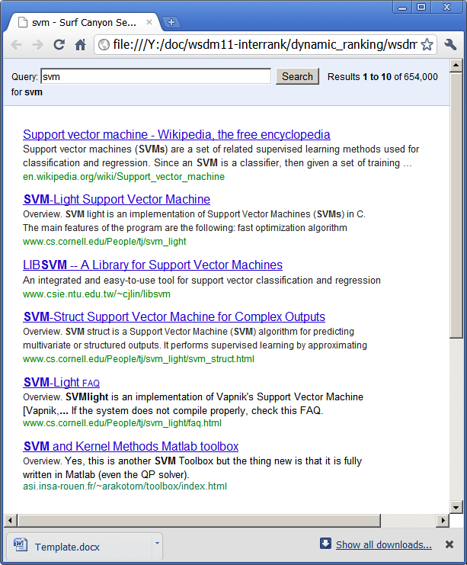


Motivation: Richer User Interfaces
?
Click
Information Bottleneck
We can only learn as much as interface permits
(We can only help user as much as interface permits)

Slide 34
“ReGroup: Interactive Machine Learning for On-Demand Group Creation in Social Networks”
[Ameershi et al., CHI 2012]

Slide 35
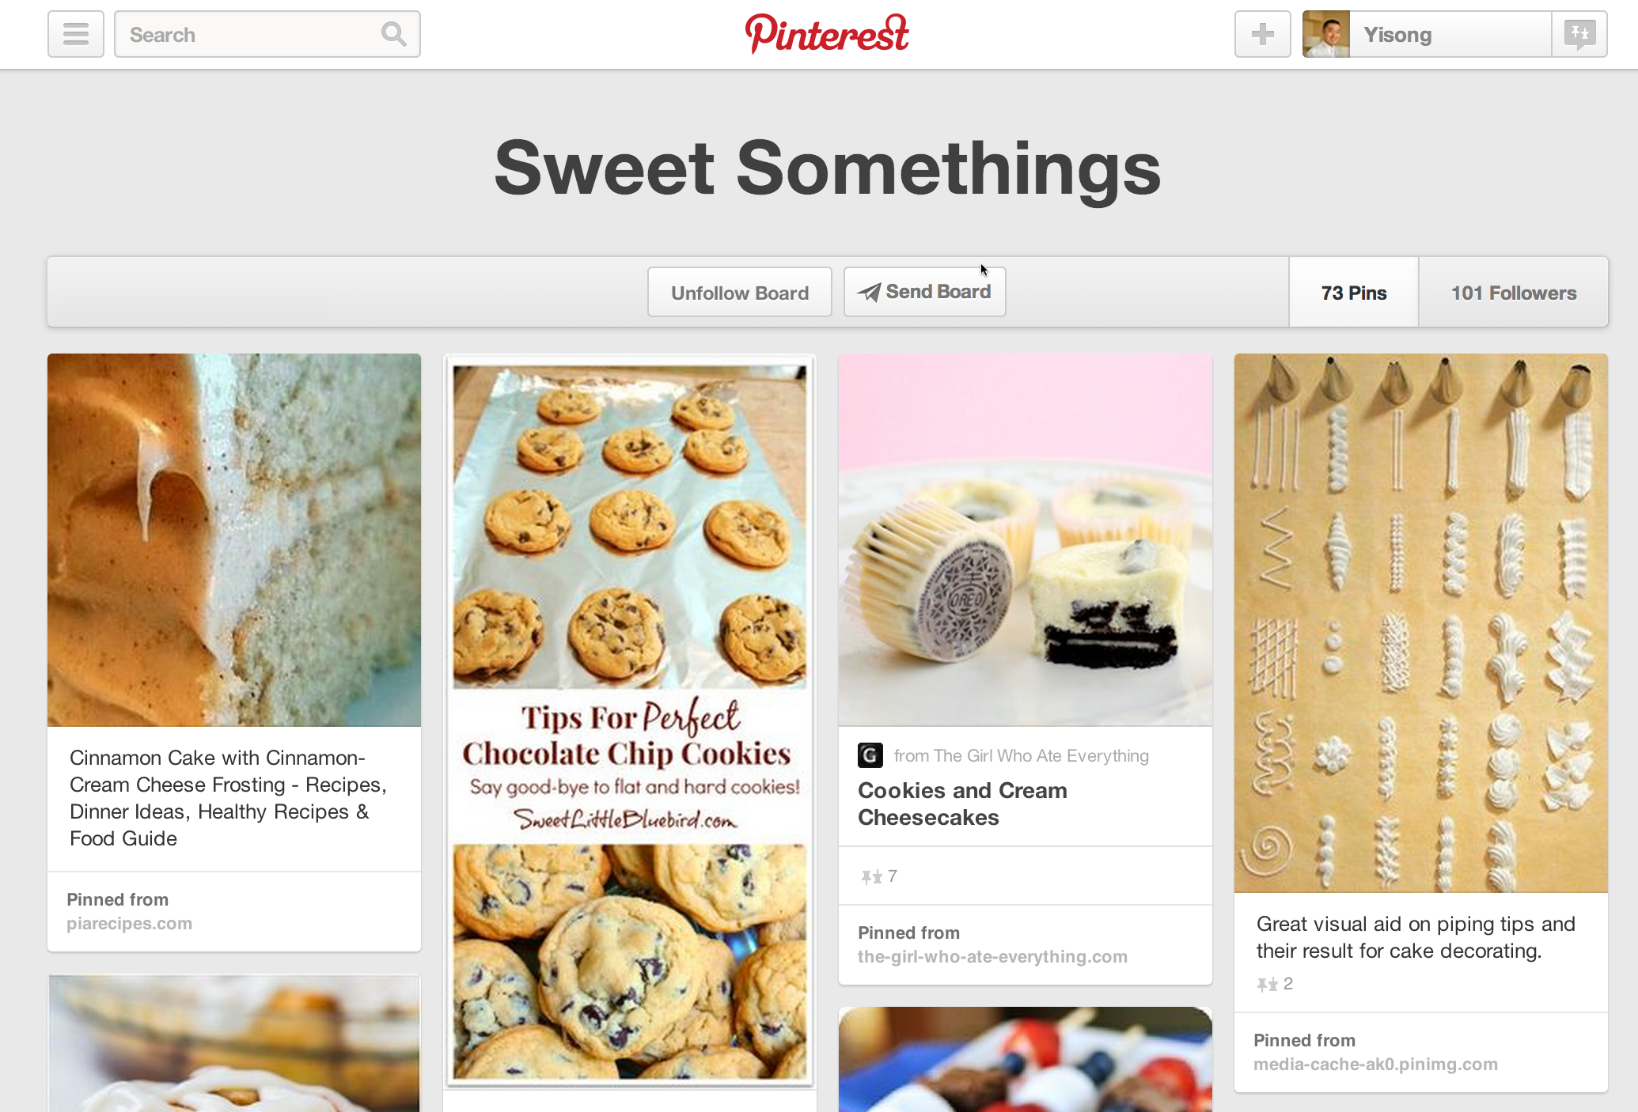
http://www.pinterest.com

Slide 36
“Apolo: Making Sense of Large Network Data by Combining Rich User Interaction and Machine Learning”
[Chau et al., CHI 2011]

Slide 37
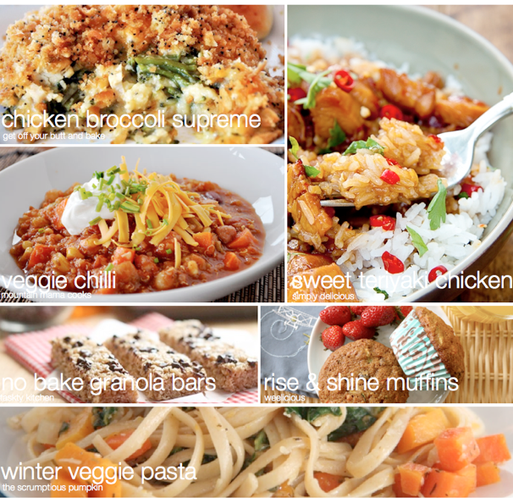
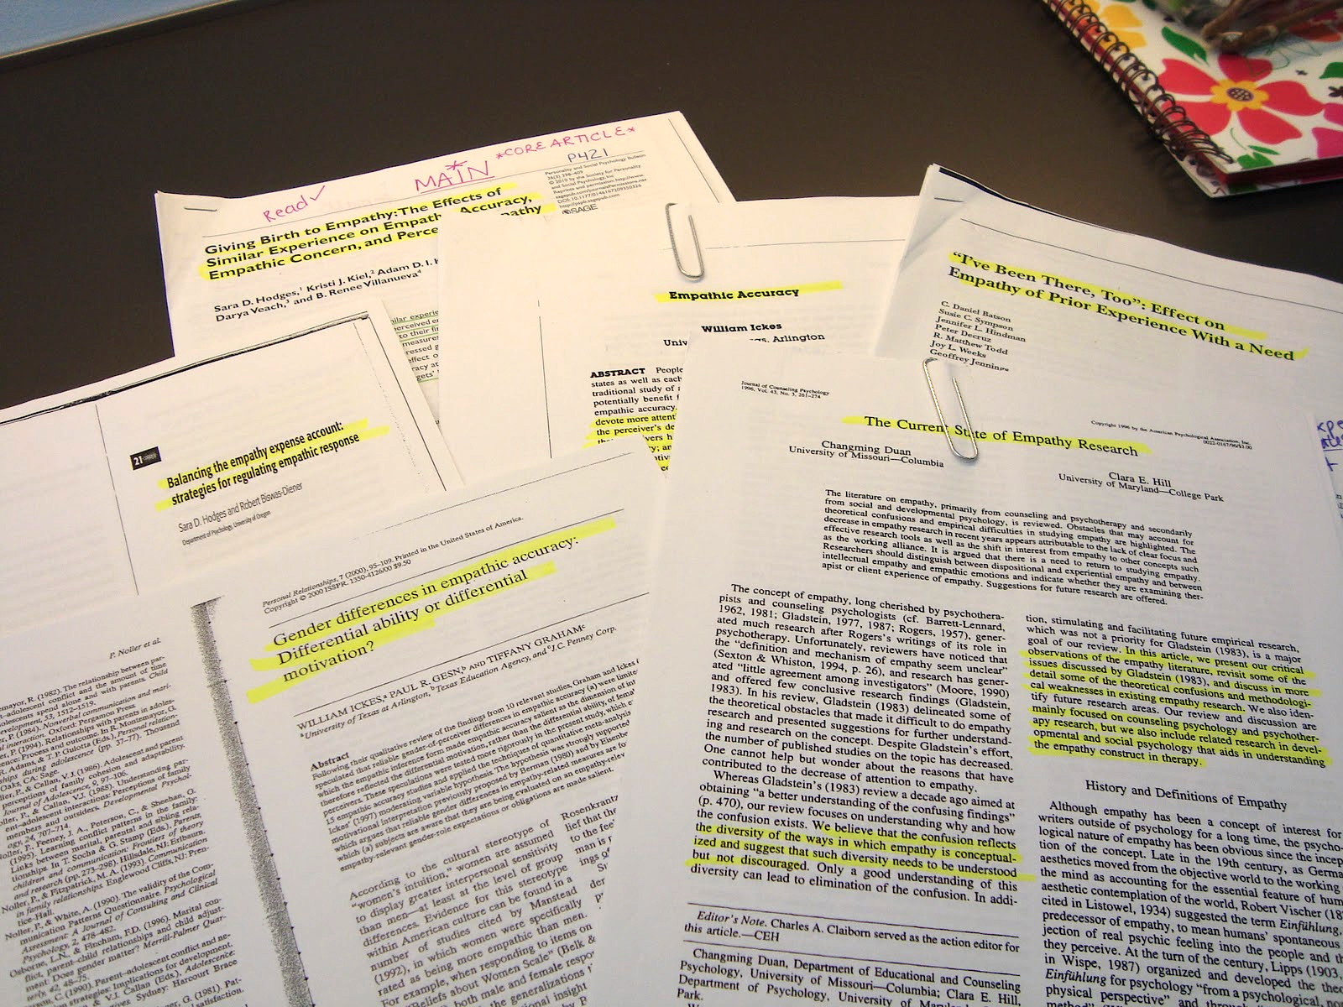
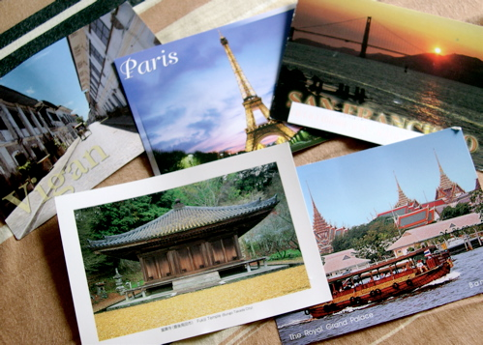
Demo
(Goal Oriented Data Browsing)
Planning a vacation
Planning meals for the week
Literature review for grant proposal

Slide 38
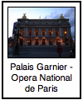


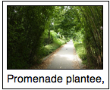


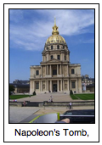
Recap: Collaborative Filtering
Training Data: N items, M users
Y = {Y₁ … Y_{M}}
Y_{m} =
Y_{k} =
( , ), ( , ),
( , ), …
Each user rates a
a subset of items
( , ), ( , ),
( , ), …

Slide 39
Recap: Collaborative Filtering
Learning Goal: F(m,i) ≈ y_{mi} (+1 or -1)
Y_{m} =
F(m, ) ≈ +1
F(m, ) ≈ -1
Prediction goal: F(m,i) for new items
( , ), ( , ),
( , ), …

Slide 40
Collaborative Clustering
Training Data: N items, M users
Y = {Y₁ … Y_{M}}
Y_{m} =
Y_{k} =
Each user clusters
a subset of items
(partial clustering)
http://www.yisongyue.com/publications/www2014_collab_cluster.pdf

Slide 41


Collaborative Clustering
Learning goal: F(m,i,j) ≈ y_{mij} (+1 or -1)
Y_{m} =
F(m, , ) ≈ +1
F(m, , ) ≈ -1
Prediction goal: F(m,i,j) for new items
Clustering analogue to
Collaborative Filtering
http://www.yisongyue.com/publications/www2014_collab_cluster.pdf

Slide 42
Recap: Latent Factor Models
Collaborative Filtering: N items, M users
Users rate items (y_{mi})
Prediction: F(m,i) = <u_{m}, x_{i}>
N
K
N
Y
U^{T}
X
K
=
M
M
Users and items modeled
as K-dimensional factors.
(matrix factorization)
(Missing Values)

Slide 43
Learning for Collaborative Filtering
User Model
Item Model
Regularization
Reconstruction Error

Slide 44
Recap: Collaborative Filtering
Can now predict
missing values
Also known as
matrix completion

Slide 45
Latent Collaborative Clustering
K
N
X
N
Y
N
=
×
X
K
M
N
U^{T}
(Missing Values)
Users and items modeled
as K-dimensional factors.
(tensor factorization)
M
K
Hadamard Product
Prediction: F(m,i,j) = x_{i} u_{m} x_{j}
Actual model slightly
more complicated

Slide 46
Latent Collaborative Clustering
F(m,i,j) = x_{i} u_{m} x_{j}
F(m,i,j) =
Diag(u_{m}) = user-specific transform
  Metric learning (i.e., Mahanalobis)
Diag(u_{m})
Actual model slightly
more complicated
http://www.yisongyue.com/publications/www2014_collab_cluster.pdf

Slide 47
Learning
User Transform
Item Factor
Regularization
Reconstruction Error
Enforces Metric
Weight positive & negative
feedback differently
(optimization details in paper)
http://www.yisongyue.com/publications/www2014_collab_cluster.pdf

Slide 48
Learning
User Transform
Item Factor
Alternating least squares optimization
  (convex in U and each x, but not jointly)
Iterative closed form solutions
  (use ADMM to solve U≥0)
(optimization details in paper)
http://www.yisongyue.com/publications/www2014_collab_cluster.pdf

Slide 49
Relationship to Metric Learning
Metric Learning Learns a Transformation U:
  Such that transforming features x by U minimizes loss:
Latent Collaborate Clustering Learns both U and Features x
  Useful if there many tasks, and few examples per task
  Or if don’t trust raw features x
Normal Metric Learning:
Transformed Inner Product:

Slide 50
Input Clustering
Input Clustering
F(m, , ?)
F(m, , ?)
F(m, , ?)

Slide 51
Data Collection
New User Study: Hypothetical trip to Paris
Mechanical Turk
Cluster interesting attractions
250 attractions
(from TripAdvisor)
218 users
18.7 items per user
4.5 clusters per user
“Very interesting - I feel like I learned a bit about Paris!”
“I have never been to Paris but now I want to go even more.”
“We would just about sell our souls to get there! Thank you for letting me travel there vicariously through this HIT!!!”
(HIT refers to “Human Intelligence Task”)
“Great format. Have been to Paris several times but still learned about many great new places to visit”

Slide 52
Features for Attractions
2 sets of features
Wikipedia tf-idf
(~3.5K features)
Mechanical Turk
Tagging (right)
(~40 features)
Used for baselines

Slide 53
Evaluation
For each test user:
  Hold out some attractions
  Predict cluster membership (or new cluster)
Feature-based baselines:
  Diagonal metric (per user)
  [Wagstaff & Cardie, 2000] [Xing et al., 2002] [Schultz & Joachims, 2003]
  [Davis et al., 2007] [Parameswaran & Weinberger, 2010]
  Latent feature transform (significantly slower)
  [Blitzer & Weston, 2012]

Slide 54

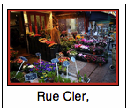
Prediction Tasks
Predict cluster membership
  Existing cluster:
  New cluster:
Cluster with highest average F(m,i,j).
(conventional classification)
All clusters have negative F(m,i,j).
(predicting novelty)

Slide 55
Conventional Prediction Setting
B E T T E R
Random
Largest
Cluster
Feature-Based
Transformed
Feature-Based
LCC
Hold 25% from each cluster (no empty clusters)
Predict cluster membership (conventional classification)

Slide 56
Predicting Novelty
Only method to
beat random!
B E T T E R
Random
Largest
Cluster
Feature-Based
Transformed
Feature-Based
LCC
Hold one entire cluster
Predict new cluster (predict novelty)

Slide 57
Overall
B E T T E R
Random
Largest
Cluster
Feature-Based
Transformed
Feature-Based
LCC
Hold 50% of attractions at random (some clusters empty)
Predict cluster membership (or new cluster)

Slide 58
Recap: Latent Collaborative Clustering
Multitask Metric Learning & Feature Learning
  Trained on partial clusterings created by individual users
Individual factors x hard to visualize
  Maybe easier if enforced non-negativity
Maybe better served as an embedding model:

Slide 59
Recap: Latent Factor Models
Great way to compactly represent data
  Share across many tasks
Can be very interpretable
  At least the simpler versions
  Tradeoff between interpretability and accuracy
Particularly useful if you don’t trust (or don’t have) raw features
Next Week: Deep Learning

