Slide 1

Machine Learning & Data Mining
CS/CNS/EE 155
Lecture 14:
Embeddings

Slide 2
Announcements
Kaggle Miniproject is closed
  Report due Thursday
Public Leaderboard
  How well you think you did
Private Leaderboard now viewable
  How well you actually did

Slide 3
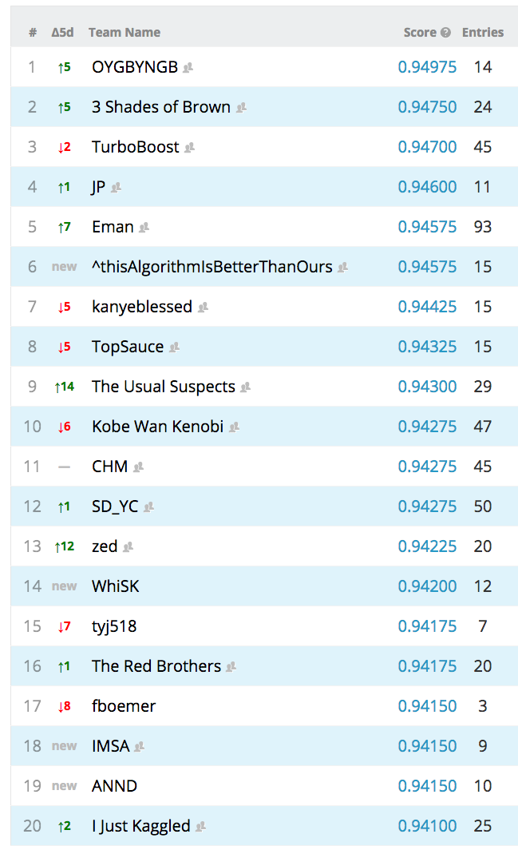
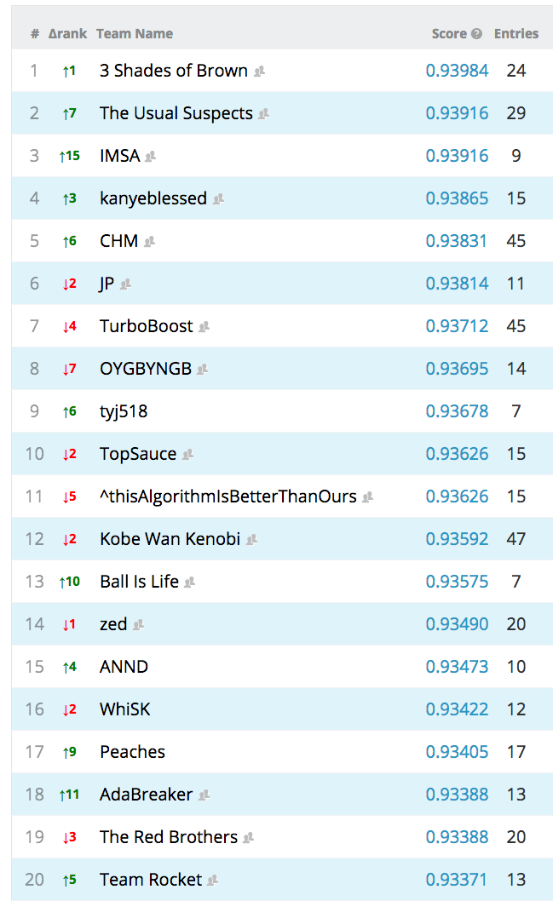

Slide 4
Last Week
Dimensionality Reduction
Clustering
Latent Factor Models
  Learn low-dimensional representation of data

Slide 5
This Lecture
Embeddings
  Alternative form of dimensionality reduction
Locally Linear Embeddings
Markov Embeddings

Slide 6
Embedding
Learn a representation U
  Each column u corresponds to data point
Semantics encoded via d(u,u’)
  Distance between points
http://www.sciencemag.org/content/290/5500/2323.full.pdf

Slide 7
Locally Linear Embedding
Given:
Learn U such that local linearity is preserved
  Lower dimensional than x
  “Manifold Learning”
Unsupervised Learning
x’s
u’s
Any neighborhood
looks like a linear plane
https://www.cs.nyu.edu/~roweis/lle/

Slide 8
Locally Linear Embedding
Create B(i)
  B nearest neighbors of x_{i}
  Assumption: B(i) is approximately linear
  x_{i} can be written as a convex combination of x_{j} in B(i)
B(i)
x_{i}
https://www.cs.nyu.edu/~roweis/lle/

Slide 9
Locally Linear Embedding
Given Neighbors B(i), solve local linear approximation W:
https://www.cs.nyu.edu/~roweis/lle/

Slide 10
Locally Linear Embedding
Given Neighbors B(i), solve local linear approximation W:
Every x_{i} is approximated as a convex combination of neighbors
  How to solve?

Slide 11
Lagrange Multipliers
Solutions tend to
be at corners!
http://en.wikipedia.org/wiki/Lagrange_multiplier

Slide 12
Solving Locally Linear Approximation
Lagrangian:

Slide 13
Locally Linear Approximation
Invariant to:
  Rotation
  Scaling
  Translation

Slide 14
Story So Far: Locally Linear Embeddings
Given Neighbors B(i), solve local linear approximation W:
Solution via Lagrange Multipliers:
Locally Linear Approximation
https://www.cs.nyu.edu/~roweis/lle/

Slide 15
Recall: Locally Linear Embedding
Given:
Learn U such that local linearity is preserved
  Lower dimensional than x
  “Manifold Learning”
x’s
u’s
https://www.cs.nyu.edu/~roweis/lle/

Slide 16
Dimensionality Reduction
Given local approximation W, learn lower dimensional representation:
Find low dimensional U
  Preserves approximate local linearity
x’s
u’s
Neighborhood
represented by W_{i,*}
https://www.cs.nyu.edu/~roweis/lle/

Slide 17
Given local approximation W, learn lower dimensional representation:
Rewrite as:
Symmetric positive semidefinite
https://www.cs.nyu.edu/~roweis/lle/

Slide 18
Given local approximation W, learn lower dimensional representation:
Suppose K=1
By min-max theorem
  u = principal eigenvector of M⁺
pseudoinverse
http://en.wikipedia.org/wiki/Min-max_theorem

Slide 19
Recap: Principal Component Analysis
Each column of V is an Eigenvector
Each λ is an Eigenvalue (λ₁ ≥ λ₂ ≥ …)

Slide 20
Given local approximation W, learn lower dimensional representation:
K=1:
  u = principal eigenvector of M⁺
  u = smallest non-trivial eigenvector of M
    Corresponds to smallest non-zero eigenvalue
General K
  U = top K principal eigenvectors of M⁺
  U = bottom K non-trivial eigenvectors of M
    Corresponds to bottom K non-zero eigenvalues
https://www.cs.nyu.edu/~roweis/lle/
http://en.wikipedia.org/wiki/Min-max_theorem

Slide 21
Recap: Locally Linear Embedding
Generate nearest neighbors of each x_{i}, B(i)
Compute Local Linear Approximation:
Compute low dimensional embedding

Slide 22
Results for Different Neighborhoods
True Distribution
2000 Samples
B=3
B=6
B=9
B=12
https://www.cs.nyu.edu/~roweis/lle/gallery.html

Slide 23
Embeddings vs Latent Factor Models
Both define low-dimensional representation
Embeddings preserve distance:
Latent Factor preserve inner product:
Relationship:

Slide 24
Visualization Semantics
Latent Factor Model
Similarity measured via dot product
Rotational semantics
Can interpret axes
Can only visualize 2 axes at a time
Embedding
Similarity measured via distance
Clustering/locality semantics
Cannot interpret axes
Can visualize many clusters simultaneously

Slide 25
Latent Markov Embeddings

Slide 26
Latent Markov Embeddings
Locally Linear Embedding is conventional unsupervised learning
  Given raw features x_{i}
  I.e., find low-dimensional U that preserves approximate local linearity
Latent Markov Embedding is a feature learning problem
  E.g., learn low-dimensional U that captures user-generated feedback

Slide 27




Playlist Embedding
Users generate song playlists
  Treat as training data
Can we learn a probabilistic model of playlists?

Slide 28
Probabilistic Markov Modeling
Training set:
Goal: Learn a probabilistic Markov model of playlists:
What is the form of P?
Songs
Playlists
Playlist Definition
http://www.cs.cornell.edu/People/tj/publications/chen_etal_12a.pdf

Slide 29
First Try: Probability Tables
P(s|s’) | s₁ | s₂ | s₃ | s₄ | s₅ | s₆ | s₇ | s_{start}
s₁ | 0.01 | 0.03 | 0.01 | 0.11 | 0.04 | 0.04 | 0.01 | 0.05
s₂ | 0.03 | 0.01 | 0.04 | 0.03 | 0.02 | 0.01 | 0.02 | 0.02
s₃ | 0.01 | 0.01 | 0.01 | 0.07 | 0.02 | 0.02 | 0.05 | 0.09
s₄ | 0.02 | 0.11 | 0.07 | 0.01 | 0.07 | 0.04 | 0.01 | 0.01
s₅ | 0.04 | 0.01 | 0.02 | 0.17 | 0.01 | 0.01 | 0.10 | 0.02
s₆ | 0.01 | 0.02 | 0.03 | 0.01 | 0.01 | 0.01 | 0.01 | 0.08
s₇ | 0.07 | 0.02 | 0.01 | 0.01 | 0.03 | 0.09 | 0.03 | 0.01
…
#Parameters = O(|S|²) !!!
…

Slide 30
Second Try: Hidden Markov Models
#Parameters = O(K²)
#Parameters = O(|S|K)
Total = O(K²) + O(|S|K)

Slide 31
Problem with Hidden Markov Models
Need to reliably estimate P(s|z)
Lots of “missing values” in this training set

Slide 32
Latent Markov Embedding
u_{s}: entry point of song s
v_{s}: exit point of song s
“Log-Radial” function
  (my own terminology)
http://www.cs.cornell.edu/People/tj/publications/chen_etal_12a.pdf

Slide 33
Log-Radial Functions
u_{s}
u_{s”}
v_{s’}
2K parameters per song
2|S|K parameters total
Each ring defines an equivalence class of transition probabilities

Slide 34
Learning Problem
Songs
Playlists
Playlist Definition
Learning Goal:
http://www.cs.cornell.edu/People/tj/publications/chen_etal_12a.pdf

Slide 35
Minimize Neg Log Likelihood
Solve using gradient descent
  Homework question: derive the gradient formula
  Random initialization
Normalization constant hard to compute:
  Approximation heuristics
    See paper
http://www.cs.cornell.edu/People/tj/publications/chen_etal_12a.pdf

Slide 36
Simpler Version
Dual point model:
Single point model:
  Transitions are symmetric
    (almost)
  Exact same form of training problem

Slide 37
Visualization in 2D
Simpler version:
Single Point Model
Single point model is
easier to visualize
http://www.cs.cornell.edu/People/tj/publications/chen_etal_12a.pdf

Slide 38
Sampling New Playlists
Given partial playlist:
Generate next song for playlist p^{j+1}
  Sample according to:
Dual Point Model
Single Point Model
http://www.cs.cornell.edu/People/tj/publications/chen_etal_12a.pdf

Slide 39
Demo
http://jimi.ithaca.edu/~dturnbull/research/lme/lmeDemo.html

Slide 40
What About New Songs?
Suppose we’ve trained U:
What if we add a new song s’?
  No playlists created by users yet…
  Only options: u_{s’} = 0 or u_{s’} = random
    Both are terrible!

Slide 41
Song & Tag Embedding
Songs are usually added with tags
  E.g., indie rock, country
  Treat as features or attributes of songs
How to leverage tags to generate a reasonable embedding of new songs?
  Learn an embedding of tags as well!
http://www.cs.cornell.edu/People/tj/publications/moore_etal_12a.pdf

Slide 42
Songs
Playlists
Playlist Definition
Learning Objective:
Tags for Each Song
Same term as before:
Song embedding ≈ average of tag embeddings:
Solve using gradient descent:
http://www.cs.cornell.edu/People/tj/publications/moore_etal_12a.pdf

Slide 43
Visualization in 2D
http://www.cs.cornell.edu/People/tj/publications/moore_etal_12a.pdf

Slide 44
Revisited: What About New Songs?
No user has yet s’ added to playlist
  So no evidence from playlist training data:
Assume new song has been tagged T_{s’}
  The u_{s’} = average of A_{t} for tags t in T_{s’}
  Implication from objective:
s’ does not appear in

Slide 45
Recap: Embeddings
Learn a low-dimensional representation of items U
Capture semantics using distance between items u, u’
Can be easier to visualize than latent factor models

Slide 46
Next Lecture
Recent Applications of Latent Factor Models
Low-rank Spatial Model for Basketball Play Prediction
Low-rank Tensor Model for Collaborative Clustering
Miniproject 1 report due Thursday.

