Slide 1

Machine Learning & Data Mining
CS/CNS/EE 155
Lecture 13:
Latent Factor Models &
Non-Negative Matrix Factorization

Slide 2
Recap: Orthogonal Matrix
A matrix U is orthogonal if UU^{T} = U^{T}U = I
  For any column u: u^{T}u = 1
  For any two columns u, u’: u^{T}u’ = 0
  U is a rotation matrix, and U^{T} is the inverse rotation
  If x’ = U^{T}x, then x = Ux’
x’
x

Slide 3
Recap: Orthogonal Matrix
Any subset of columns of U defines a subspace
Transform into new coordinates
Treat U_{1:K} as new axes
Project x onto U_{1:K} in original space
“Low Rank” Subspace

Slide 4
Recap: Singular Value Decomposition
SVD
Orthogonal
Orthogonal
Diagonal
U_{1:K} is the K-dim
subspace with
smallest residual
“Residual”

Slide 5
Recap: SVD & PCA
PCA
Orthogonal
Diagonal
SVD
Orthogonal
Orthogonal
Diagonal

Slide 6
Matrix Norms
Frobenius Norm
Trace Norm
Each σ_{d} is guaranteed to be non-negative
By convention: σ₁ ≥ σ₂ ≥ … ≥ σ_{D} ≥ 0

Slide 7
Properties of Matrix Norms
Each σ_{d} is guaranteed to be non-negative
By convention: σ₁ ≥ σ₂ ≥ … ≥ σ_{D} ≥ 0

Slide 8
Properties of Matrix Norms
Each σ_{d} is guaranteed to be non-negative
By convention: σ₁ ≥ σ₂ ≥ … ≥ σ_{D} ≥ 0

Slide 9
Other Useful Properties
Cauchy Schwarz:
AM-GM Inequality:
Orthogonal Transformation Invariance of Norms:
Trace Norm of Diagonals
True for any norm
If U is a full-rank orthogonal matrix
If A is a square diagonal matrix

Slide 10
Recap: SVD & PCA
SVD:
PCA:
The first K columns of U are the best rank-K subspace that minimizes the Frobenius norm residual:

Slide 11
Latent Factor Models

Slide 12
Netflix Problem
N Movies
K
N
Y
U
V^{T}
K
=
M Users
M
“Latent Factors”
Y_{ij} = rating user i gives to movie j
Solve using SVD!

Slide 13
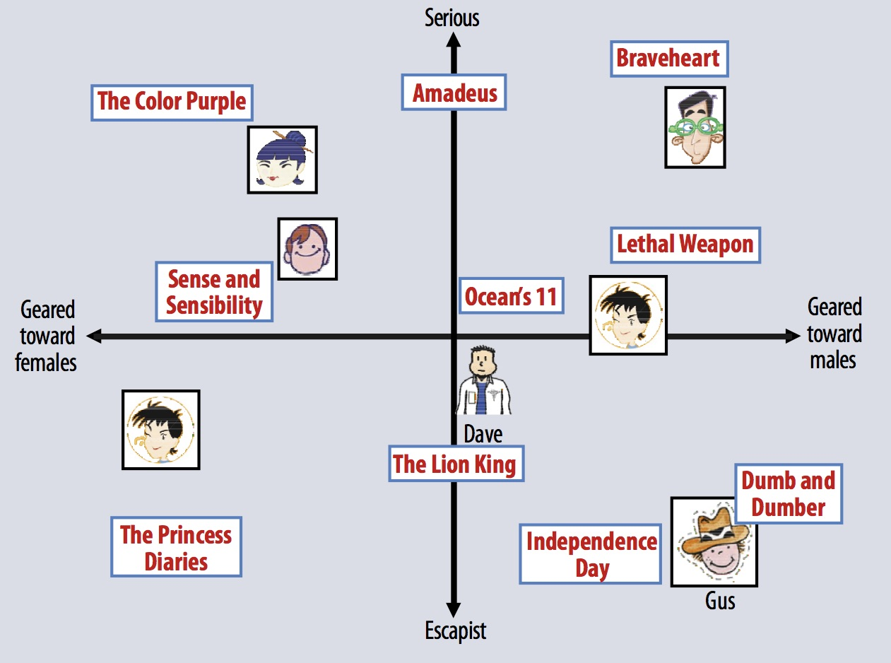
Example
Miniproject 2: create your own.
http://www2.research.att.com/~volinsky/papers/ieeecomputer.pdf

Slide 14
Actual Netflix Problem
N Movies
K
N
Y
(missing values)
U
V
K
=
M Users
M
“Latent Factors”
Many missing values!

Slide 15
Collaborative Filtering
M Users, N Items
Small subset of user/item pairs have ratings
Most are missing
Applicable to any user/item rating problem
  Amazon, Pandora, etc.
Goal: Predict the missing values.

Slide 16
Latent Factor Formulation
Only labels, no features
  Labels are “structured”
Learn a latent representation over users U and movies V such that:

Slide 17
Connection to Trace Norm
Suppose we consider all U,V that achieve perfect reconstruction: Y=UV^{T}
Find U,V with lowest complexity:
Complexity equivalent to trace norm:

Slide 18
Proof (One Direction)
We will prove:
SVD
Choose:
Then:

Slide 19
User/Movie Symmetry
If we knew V, then linear regression to learn U
  Treat V as features
If we knew U, then linear regression to learn V
  Treat U as features

Slide 20
Optimization
Only train over observed y_{ij}
Two ways to Optimize
  Gradient Descent
  Alternating optimization
    Closed Form (for each sub-problem)
  Homework question

Slide 21
Gradient Calculation
Closed Form Solution (assuming V fixed):

Slide 22
Coordinate Gradient Descent
Initialize U & V randomly
Loop
  Choose one u_{i}, v_{j} randomly
  Take gradient step:

Slide 23
Stochastic Gradient Descent
Initialize U & V randomly
Loop
  Choose one data point (i,j) randomly
  Compute gradient for all U & V of:
  Take a gradient step for all U & V
N = #observed entries

Slide 24
Alternating Optimization
Initialize U & V randomly
Loop
  Choose next u_{i} or v_{j}
  Solve optimally:
    (assuming all other variables fixed)

Slide 25
Tradeoffs
Alternating optimization much faster in terms of #iterations
  But requires inverting a matrix:
Gradient descent faster for high-dim problems
  Also allows for streaming data

Slide 26
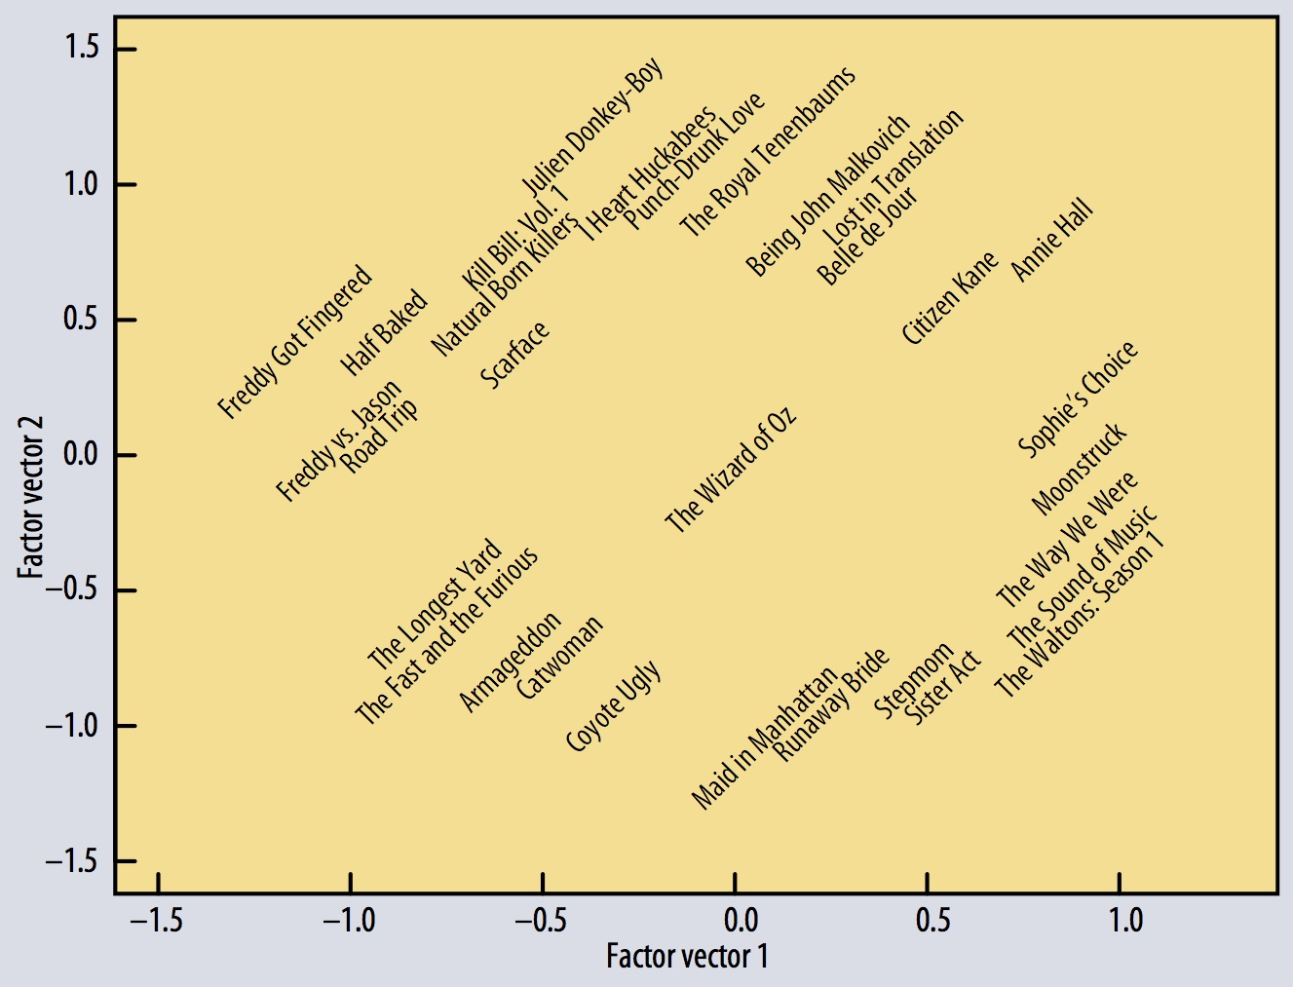
Miniproject 2: create your own.
http://www2.research.att.com/~volinsky/papers/ieeecomputer.pdf

Slide 27
Recap: Collaborative Filtering
Goal: predict every user/item rating
Challenge: only a small subset observed
Assumption: there exists a low-rank subspace that captures all the variability in describing different users and items

Slide 28




Multitask Learning
M Tasks:
Example: personalized recommender system
  One task per user:
Regularizer

Slide 29
How to Regularize?
Standard L2 Norm:
Decomposes to independent tasks
  For each task, learn D parameters

Slide 30
How to Regularize?
Trace Norm:
Induces W to have low rank across all task

Slide 31
Recall: Trace Norm & Latent Factor Models
Suppose we consider all U,V that achieve perfect reconstruction: W=UV^{T}
Find U,V with lowest complexity:
Claim: complexity equivalent to trace norm:

Slide 32
How to Regularize?
Latent Factor Approach
Learns a feature projection x’ = Vx
Learns a K dimensional model per task

Slide 33
Tradeoff
D*N parameters:
D*K + N*K parameters:
  Statistically more efficient
  Great if low-rank assumption is a good one

Slide 34
Multitask Learning
M Tasks:
Example: personalized recommender system
  One task per user:
  If x is topic feature representation
    V is subspace of correlated topics
    Projects multiple topics together

Slide 35
Reduction to Collaborative Filtering
Suppose each x_{i} is single indicator x_{i} = e_{i}
Then:
Exactly Collaborative Filtering!

Slide 36
Latent Factor Multitask Learning vs Collaborative Filtering
Projects x into low-dimensional subspace Vx
Learns low-dimensional model per task
Creates low dimensional feature for each movie
Learns low-dimensional model per user

Slide 37
General Bilinear Models
Users described by features z
Items described by features x
Learn a projection of z and x into common low-dimensional space
  Linear model in low dimensional space

Slide 38
Why are Bilinear Models Useful?
U: MxK
V: NxK
U: MxK
V: DxK
U: FxK
V: DxK

Slide 39
Story So Far: Latent Factor Models
Simplest Case: reduces to SVD of matrix Y
  No missing values
  (z,x) indicator features
General Case: projects high-dimensional feature representation into low-dimensional linear model

Slide 40
Non-Negative Matrix Factorization

Slide 41
Limitations of PCA & SVD
All features
non-negative
PCA/SVD
Solution
Better Solution?

Slide 42
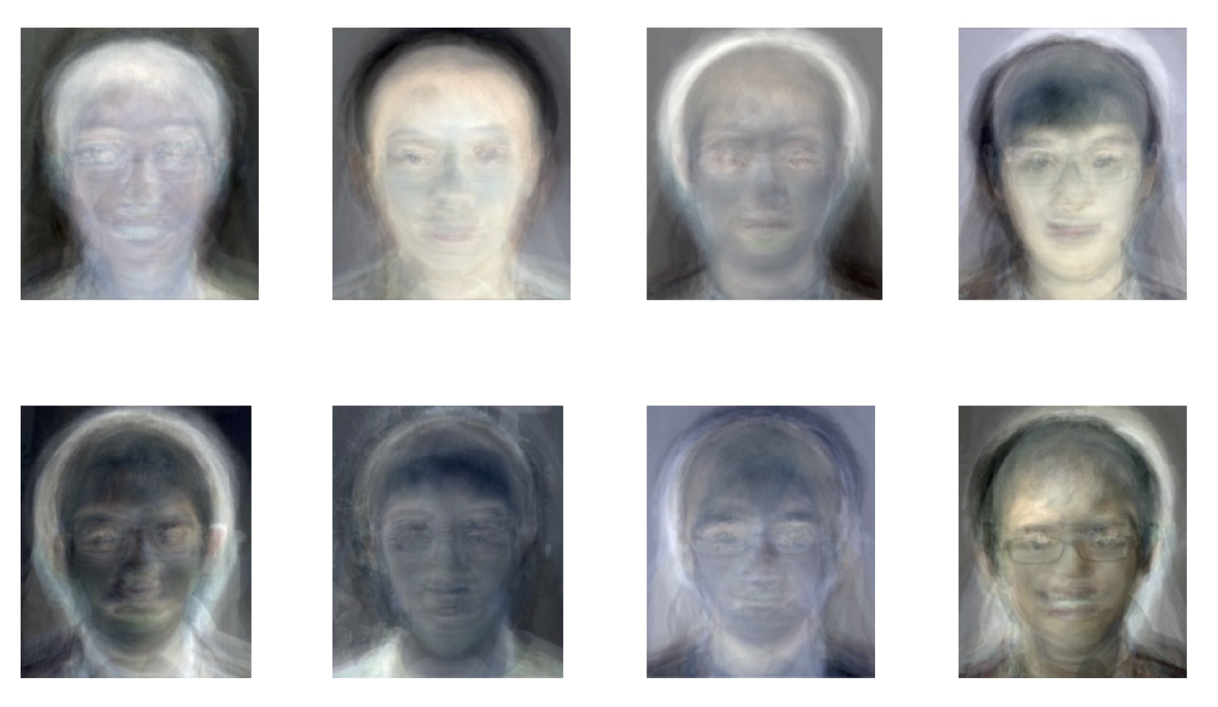
CS 155 Eigenface Basis
2.26
-0.56
0.46
0.70
0.93
1.58
0.06
1.46
0.30
-0.47
0.73
-0.40
-0.75
1.07
0.18
-0.98
http://hebb.mit.edu/people/seung/papers/nmfconverge.pdf
Avg Face

Slide 43
Non-Negative Matrix Factorization
N
K
N
Y
U
V^{T}
K
=
M
M
“Latent Factors”
Assume Y is non-negative
Find non-negative U & V

Slide 44
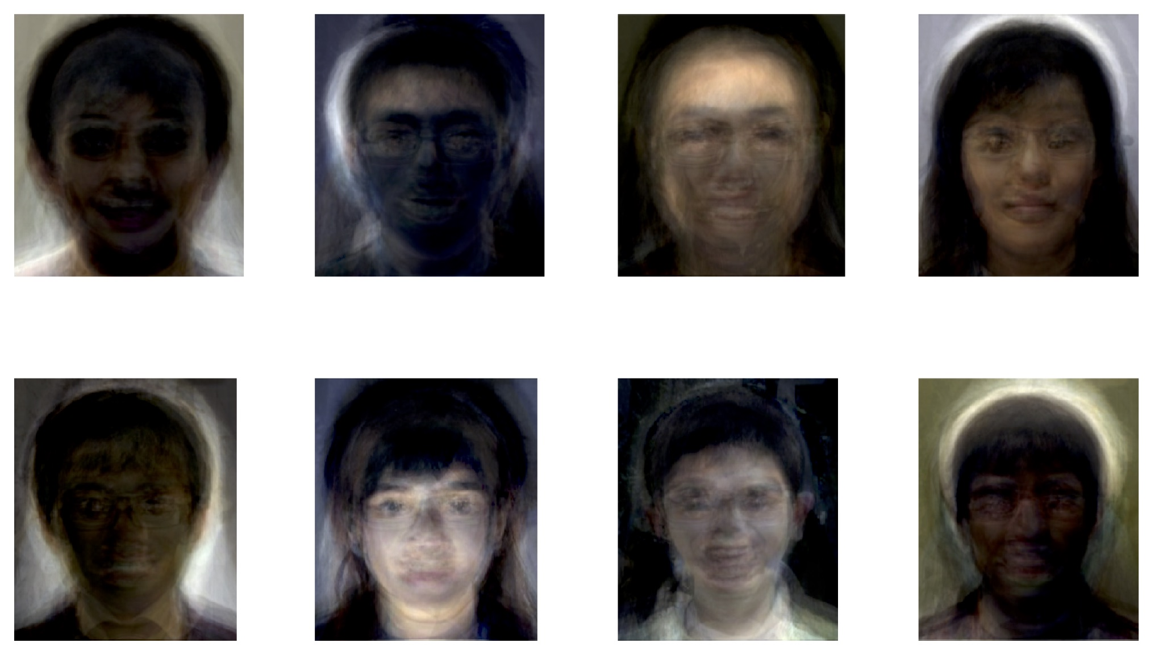
CS 155 Non-Negative Face Basis
0.21
0.11
0.08
0.70
0.55
0.06
0.43
1.28
0.00
0.09
0.09
1.47
1.20
0.04
0.77
0.74

Slide 45
Aside: Non-Orthogonal Projections
If columns of A are not orthogonal, A^{T}A≠I
  How to reverse transformation x’=A^{T}x?
  Solution: Pseudoinverse!
Intuition: use the rank-K orthogonal
basis that spans A.
SVD
Pseudoinverse

Slide 46
Objective Function
Squared Loss:
  Penalizes squared distance
Generalized Relative Entropy
  Aka, unnormalized KL divergence
  Penalizes ratio
Train using gradient descent
http://hebb.mit.edu/people/seung/papers/nmfconverge.pdf

Slide 47
SVD/PCA vs NNMF
SVD/PCA:
  Finds the best orthogonal basis faces
    Basis faces can be neg.
  Coeffs can be negative
  Often trickier to visualize
  Better reconstructions with fewer basis faces
    Basis faces capture the most variations
NNMF:
  Finds best set of non-negative basis faces
  Non-negative coeffs
    Often non-overlapping
  Easier to visualize
  Requires more basis faces for good reconstructions

Slide 48
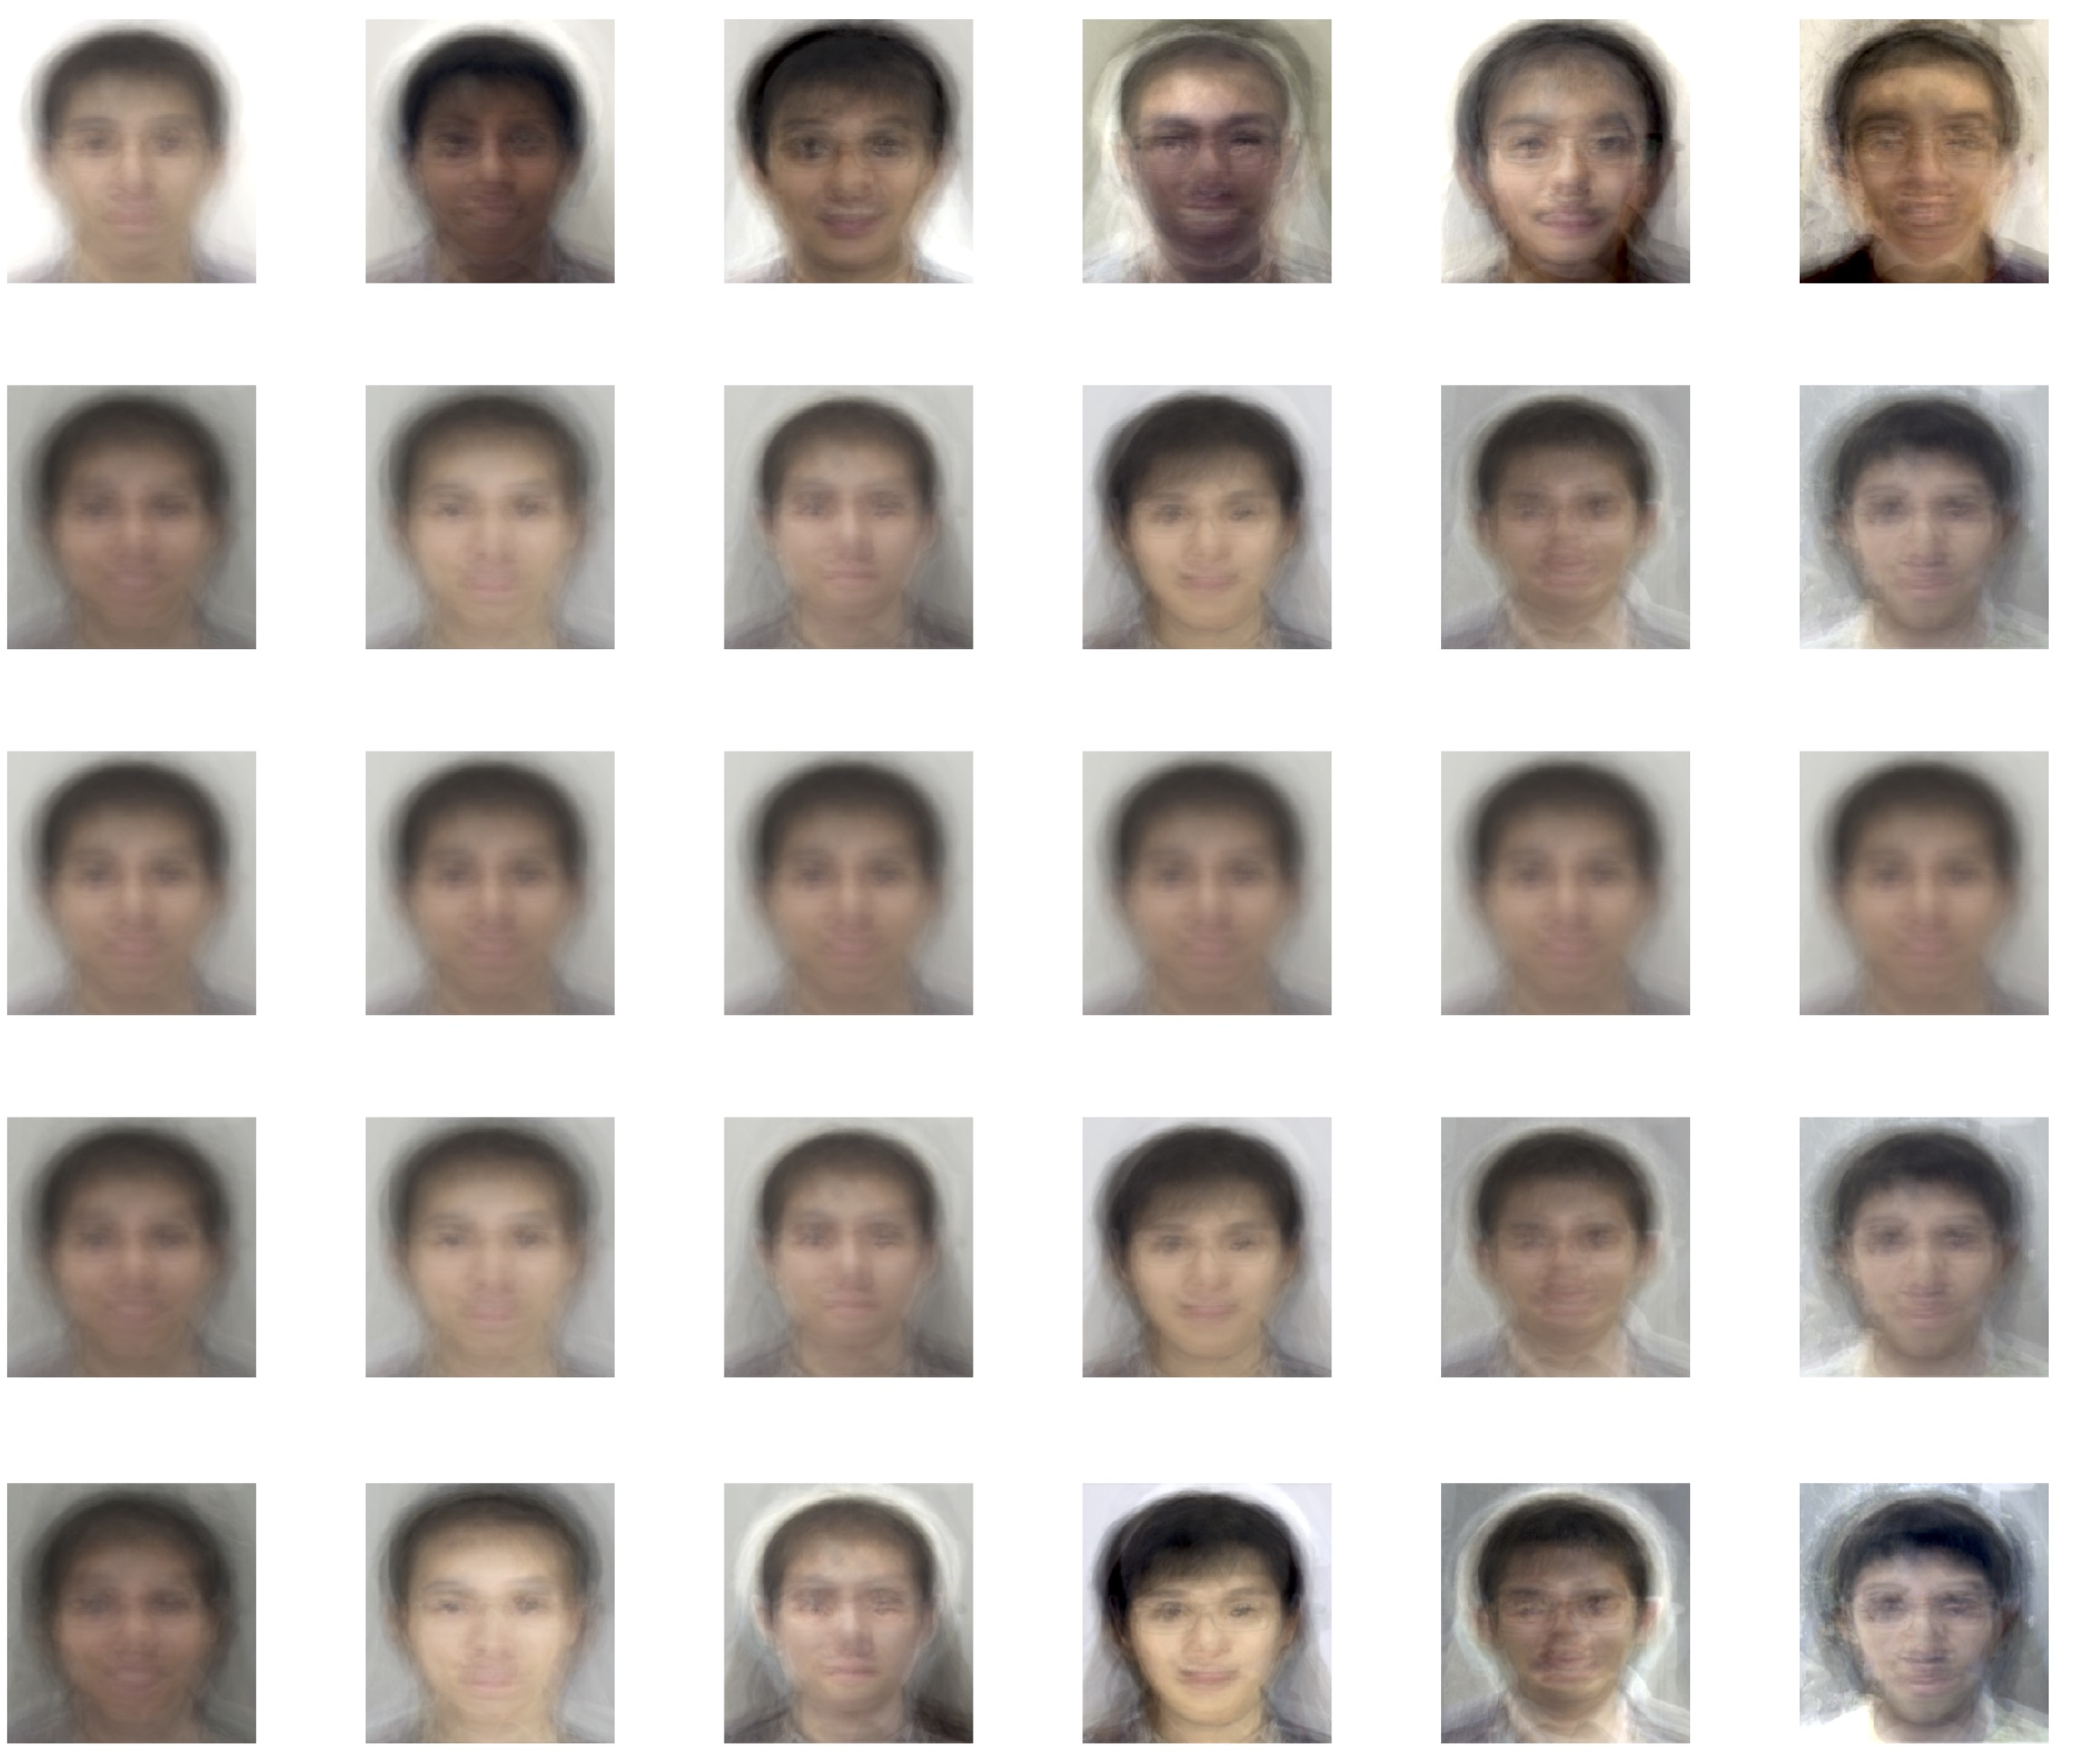
Varying top 6 Eigenfaces

Slide 49
Non-Negative Latent Factor Models
Simplest Case: reduces to NNMF of matrix Y
  No missing values
  (z,x) indicator features
General Case: projects high-dimensional non-negative features into low-dimensional non-negative linear model

Slide 50
Tensor Latent Factor Models

Slide 51
Tensor Factorization
K
N
V
N
Y
Q
=
×
W
K
M
Q
U
(Missing Values)
M

Slide 52
Tri-Linear Model
Prediction via 3-way dot product:
  Related to Hadamard Product
Example: online advertising
  User profile z
  Item description x
  Query q
Solve using
Gradient Descent

Slide 53
Next Week
Embeddings
Recent Applications of Latent Factor Models
  Example of non-negative latent factor model
  Example of tensor latent factor model
Kaggle Mini-project closes Next Tuesday
  Report due next Thursday

