Slide 1

Machine Learning & Data Mining
CS/CNS/EE 155
Lecture 12:
Clustering & Dimensionality Reduction

Slide 2
Announcements
Homework 4 will be released early next week
  Due in on March 10th
  Dimensionality reduction, latent factor models, embeddings
Miniproject 2 will be released early next week
  Due in 13th
  Visualization of machine learning models
Final Exam
  Take home final

Slide 3
Today
Clustering
Dimensionality Reduction

Slide 4
What is Clustering?
Clustering is the process of grouping data points into “clusters”.
High intra-cluster similarity
Low inter-cluster similarity

Slide 5
Example

Slide 6
Example

Slide 7
Unsupervised Learning
Given: unlabeled data:
  Only input features
  No labels
Goal: find hidden structure/patterns
  E.g., hidden structure is a clustering of data

Slide 8
Why is Clustering Useful?
Clustering is a “summary” of data
  Can just inspect cluster centers
  Or inspect a few data points per cluster

Slide 9
Images Related to “Pluto”
Each Row is a Cluster
Image Source: http://research.microsoft.com/en-us/people/jrwen/mm04.pdf

Slide 10
Why is Clustering Useful?
Clustering is a “summary” of data
  Can just inspect cluster centers
  Or inspect a few data points per cluster
Compact pre-processing of data before supervised training

Slide 11
Centroid Based Clustering
(K-Means)

Slide 12
Centroid Based Clustering
(K-Means)

Slide 13
Centroid Based Clustering
(K-Means)

Slide 14
Centroid Based Clustering
(K-Means)

Slide 15
Centroid Based Clustering
(K-Means)

Slide 16
Centroid Based Clustering
(K-Means)

Slide 17
Centroid Based Clustering
(K-Means)

Slide 18
Centroid Based Clustering
(K-Means)

Slide 19
Centroid Based Clustering
(K-Means)

Slide 20
Centroid Based Clustering
(K-Means)

Slide 21
Centroid Based Clustering
(K-Means)

Slide 22
Centroid Based Clustering
(K-Means)

Slide 23
Centroid Based Clustering
(K-Means)

Slide 24
Centroid Based Clustering
(K-Means)

Slide 25
Centroid Based Clustering
(K-Means)

Slide 26
K-Means Objective
Equivalent!
Clustering
Cluster Centers

Slide 27
EM Algorithm for K-Means
Clustering
Cluster Centers
E-Step
  Estimate C_{k}
  Estimate cluster membership
M-Step
  Estimate c_{k}
  Estimate model parameters

Slide 28
E-Step
For each x:
  Assign to cluster C_{k} with smallest distance to c_{k}

Slide 29
M-Step
For each c_{k}:
  Compute c_{k} = mean(C_{k})

Slide 30
Aside: Gaussian Mixture Models
Prob of cluster membership proportional to exp(-dist²/2σ²)
“Sharpness” of distribution increases as σ decreases
Converges to K-Means as σ goes to 0

Slide 31
Aside: Gaussian Mixture Models
E-Step: Estimate probabilities
M-Step: Maximize model parameters c₁,…,c_{k}

Slide 32
Recap: K-Means
Centroid-based Clustering
  Defines clusters using a notional of centrality
  E.g., all items in the cluster must be close to each other
Solve using EM algorithm
  Also probabilistic variant (Gaussian Mixture Models)
Useful when centrality assumption is good
  But bad when centrality assumption is bad…

Slide 33
Thought Experiment
What is good clustering?

Slide 34
Linkage Based Clustering
(Hierarchical Clustering)
K-Means used centroid clustering structure
  Clustered data points are “close” to cluster center
Sometimes a linkage structure is better…
  Employ hierarchical clustering
  E.g., agglomerative clustering

Slide 35
Agglomerative Clustering

Slide 36
Agglomerative Clustering
Equivalent to finding minimum spanning tree
  Kruskal’s Algorithm
  http://en.wikipedia.org/wiki/Kruskal%27s_algorithm
Order that edges are added defines the cluster hierarchy
Equivalent to finding a binary tree partitioning with progressively smaller partition distances

Slide 37
Recap: Clustering
Unsupervised learning
  Finds the clustering structure of input features
Centroid based
  Clusters should be clumped together
  K-Means
Linkage Based
  Clusters can be organized hierarchically
  Agglomerative Clustering
Works great when clustering assumption is good!

Slide 38
Limitations of Clustering

Slide 39
Principal Component Analysis

Slide 40
Summarizing Data
Summarize data using smaller #attributes
Clustering: summarize data via clusters
  K-Means: summarize via cluster membership
  Gaussian Mixture Model: Summarize via distribution over K clusters
PCA: summarize via orthogonal projections
  Define new feature representation
  Rotation + Projection

Slide 41
Principal Component Analysis

Slide 42
Principal Component Analysis
New Feature Representation!

Slide 43
Orthogonal Matrix
A matrix U is orthogonal if UU^{T} = U^{T}U = I
  For any column u: u^{T}u = 1
  For any two columns u, u’: u^{T}u’ = 0
  U is a rotation matrix, and U^{T} is the inverse rotation
  If x’ = U^{T}x, then x = Ux’
PCA finds a specific
orthogonal U
x’
x

Slide 44
Properties of Orthogonal Matrices
x’ = U^{T}x, x = Ux’
Norm preserving:
Preserves Total Variance:
Assuming zero mean

Slide 45
Principal Component Analysis
Summarize Using 1 Feature?

Slide 46
Principal Component Analysis
Summarize Using 1 Feature?

Slide 47
Principal Component Analysis
Summarize Using 1 Feature?
Works with arbitrary subsets of
columns of orthogonal U
E.g., U’ = [u₁,u₅,u₂₀]

Slide 48
PCA Formal Definition
Define M=matrix of all data:
Mean center:
PCA:
Symmetric
Orthogonal
Diagonal

Slide 49
Properties of PCA
Assuming zero mean
Each column of U is an Eigenvector
Each λ is an Eigenvalue
  λ₁ ≥ λ₂ ≥ … ≥ λ_{D}

Slide 50
Interpretation
Feature Covariance
Matrix:
Assuming zero mean
PCA Solution
Σ_{dd’} is the covariance of features d & d’ in training data.
The first column u₁ is the single direction of greatest variation
  λ₁ is the total variation along u₁:
u₂
u₁

Slide 51
Interpretation Continued
The first column u₁ is the single direction that minimizes the squared loss of reconstructing the original x’s
  I.e., minimizes the amount of residual variation
One can prove that:
(From definition in previous slide)
“Residual”

Slide 52
Definition: u₁ is the direction that captures the most variation
Step 1: for any x, its residual direction is orthogonal to u₁
Residual:
Step 2: establish relationship and complete proof

Slide 53
Interpretation Continued
Find the u₁ that minimizes the residual squared norm:
-

Slide 54
Solving PCA
(Iterative Algorithm)
Given:
Init:
For d=1,…,D
  Solve:
  Update:
Assuming zero mean

Slide 55
Property of PCA
The first K columns of U are guaranteed to be the K-dimensional subspace that captures the most variability of X
We just proved K=1 a few slides ago
Homework question: prove general case

Slide 56
Dimensionality Reduction
Solve PCA:
Use first K columns of U to create K-dim representation:
This creates a compact summary of original dataset
  E.g., K = 50, D = 1,000,000

Slide 57
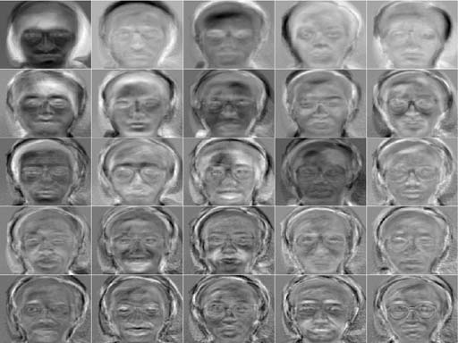
Example: Eigenfaces
PCA on a corpus of faces.
Every pixel is a “feature”
Visualizing the top Eigenvectors of U
http://www.cs.princeton.edu/~cdecoro/eigenfaces/

Slide 58
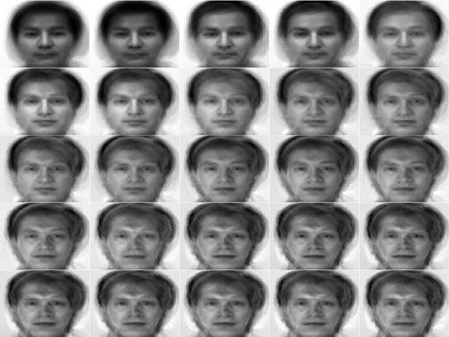
Example: Eigenfaces
Visualizing Projection
using top K Eigenvectors:
http://www.cs.princeton.edu/~cdecoro/eigenfaces/

Slide 59
CS 155 Eigenfaces
Avg Face

Slide 61
Singular Value Decomposition
Orthogonal
Orthogonal
Diagonal
SVD operates on X, as opposed to XX^{T}
Equivalence between SVD & PCA
V corresponds to new representation x’
Homework: prove this more rigorously

Slide 62
Summary
Clustering & PCA (and SVD) reduce the dimensionality of data representation.
For each data point
  Store K numbers
  Cluster membership probabilities
  Coefficients in K-dimensional projection
Nice visualization & interpretation?

Slide 63
Next Lecture
Latent Factor Models
Matrix Factorization with Missing Values
  E.g., the “Netflix Problem”

